Slide 1
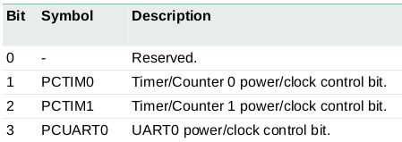
Power Up Timers
(1) Power up timer
1. Power: In the PCONP register (Table 46), set bits PCTIM0/1/2/3. On reset, Timer0/1 are enabled (PCTIM0/1 = 1), and Timer2/3 are disabled (PCTIM2/3 = 0). Chapter 21, pp 499;
2. Table 46. Power Control for Peripherals register (PCONP - address 0x400F C0C4)
Example: based on table 46, power up Timer 1, write a C-code to realize this task
int main(void)
{
/* Power up timer0 */
LPC_SC->PCONP |= BIT(1);
/* Clear all interrupts */
LPC_TIM0->IR = 0x3F;
/* Set prescaler based on sysclk to get 1000us minimum interval */
switch (PCLKSEL_TIMER0(LPC_SC->PCLKSEL0)) {
case 0x00:
LPC_TIM0->PR = SystemCoreClock / 4000;
break;
}
/* Power up timer1 */
LPC_SC->PCONP |= BIT(2);
Or
LPC_SC->PCONP |= 0x4;
Fig. 1
How would you power up both Timer 0 and 1?
(c) Harry Li, Ph.D. SJSU, CMPE127

Slide 2
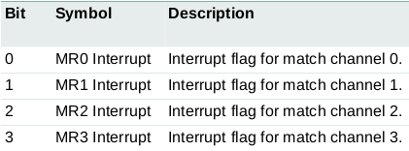
Clear All Timer INTs
(2) LPC_TIM0->IR Interrupt Register; (3) Set Prescaler
Table 427. Interrupt Register - addresses 0x4000 4000, IR consists of 4 bits for the match interrupts, if interrupt generated then its corresponding bit will set high. chapter 21, pp. 502; you will need to clear it for the next interrupt.
Example: based on table 427, clear TIM3->IR, write a C-code to realize this task
int main(void)
{
/* Power up timer0 */
LPC_SC->PCONP |= BIT(1);
/* Clear all interrupts */
LPC_TIM0->IR = 0x3F;
/* Set prescaler based on sysclk to get 1000us minimum interval */
switch (PCLKSEL_TIMER0(LPC_SC->PCLKSEL0)) {
case 0x00:
LPC_TIM0->PR = SystemCoreClock / 4000;
break;
}
LPC_TIM0->IR |= 0x4;
How to clear both Timer 3 and 4?
Can you change the above c code to the following for the same clear function?
LPC_TIM0->IR = 0x4;
Fig. 1
(c) Harry Li, Ph.D. SJSU, CMPE127

Slide 3
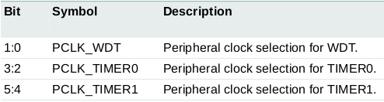
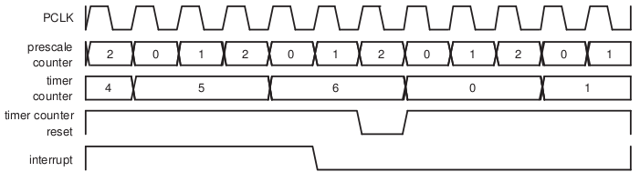
Timing Waveforms and Prescaler PR
(3) Set Prescaler
Note: 4 important registers, PR, PC, TC, and MR
Two steps: first, PCLKSEL register, Peripheral Clock Selection register, selects Timer0 clock; Section 4.7.3, pp. 57;
2nd, LPC_TIM0->PR Prescaler register, When the
Prescale Counter (PC) is equal to PR,
Timer Counter (TC) is incremented by 1;
e.g,
TC is incremented every PR+1 cycles of PCLK.
CLK
PC
int main(void)
{
/* Power up timer0 */
LPC_SC->PCONP |= BIT(1);
/* Clear all interrupts */
LPC_TIM0->IR = 0x3F;
/* Set prescaler based on sysclk to get 1000us minimum interval */
switch (PCLKSEL_TIMER0(LPC_SC->PCLKSEL0)) {
case 0x00:
LPC_TIM0->PR = SystemCoreClock / 4000;
break;
}
TC
Example:
Given PR = 2, MR = 6; An interrupt generated on match.
(1) at every clock, PC -> PC+1;
(2) when PC = PR, TC -> TC+1 ;
(3) when TC = MR, INT generated.
Fig. 1
(c) Harry Li, Ph.D. SJSU, CMPE127

Slide 4
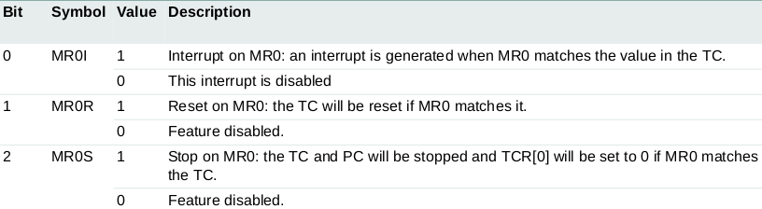
Set MR, MCR and TCR
(4) set match register MR and match control register MCR
/* Set the interval at Match Control 0 */
LPC_TIM0->MR0 = TIMER_INTERVAL;
/* Enable Match Control 0 */
LPC_TIM0->MCR = BIT(0) | BIT(1);
/* Disable Timer as default */
LPC_TIM0->TCR = 0;
/* Enable Timer IRQ */
NVIC_EnableIRQ(TIMER0_IRQn);
/* Set P2.10 as EINT0 function */
LPC_PINCON->PINSEL4 &= ~GEN_MASK(2, 20);
LPC_PINCON->PINSEL4 |= BIT(20);
/* Enable falling edge trigger for P2.10 */
LPC_GPIOINT->IO2IntEnF |= BIT(10);
/* Edge trigger for EINT0 */
LPC_SC->EXTMODE |= BIT(0);
/* Enable EINT IRQ */
NVIC_EnableIRQ(EINT0_IRQn);
printf("Main Function: Waiting for interrupt\n");
while(1);
return 0;
}
MR values are continuously compared to the Timer Counter value. When matched, action takes place as one of the following three: an interrupt, reset the Timer Counter, or stop the timer. Actions controlled by the settings in the MCR register.
Table 430 (pp. 505). Match Control Register (T[0/1/2/3]MCR - addresses 0x4000 4014
Timer Counter registers (T0TC – T3TC) is incremented when the prescale counter reaches its terminal count. Chapter 21, pp. 504.
(c) Harry Li, Ph.D. SJSU, CMPE127

