Slide 1
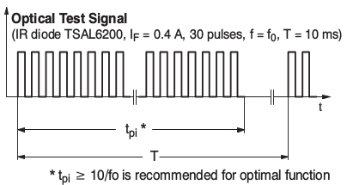
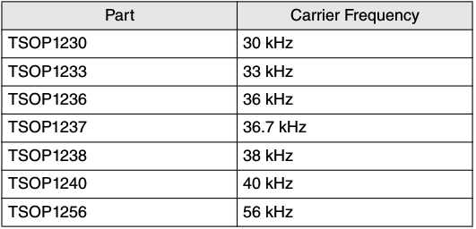
Background on TSOP12xx Modulation
Base band Signal
Carrier signal ' s Frequency
Time Domain
1 for -T/2 <= t <= T/2
g(t)
g(t) =
X
0 otherwise
Base band signal
A g(t) cos(2*pi*f_c*t + phi)
… (1)
Modulated output
T Sin (pi* f_c * T)
FT [g(t)] =
Acos(2*pi*f_c*t + phi)
pi* f _c* T
… (2)
Carrier signal
Harry Li, Ph.D. SJSU, CMPE 127

Slide 2
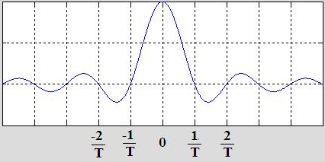
Frequency Characteristics
Fourier Transform of the Base band Signal
T Sin (pi* f * T)
f
FT [g(t)] =
pi* f * T
Fourier Transform of the carrier
FT [Acos(2*pi*f_c*t)] = A/2 [delta(f-f_c) + delta(f+f_c)]
… (3)
g(t)
A/2 * delta(f+f_c)
A/2 * delta(f-f_c)
X
A g(t) cos(2*pi*f_c*t + phi)
f
Modulated signal output
-f_c
f_c
Acos(2*pi*f_c*t + phi)
Time Domain
Harry Li, Ph.D., SJSU, CMPE 127

Slide 3
Frequency Characteristics of the Output
T Sin (pi* f * T)
FT [g(t)] =
pi* f * T
FT [Acos(2*pi*f_c*t)] = A/2 [delta(f-f_c) + delta(f+f_c)]
A/2 * delta(f-f_c)
A/2 * delta(f+f_c)
f
Convolution
-f_c
f_c
FT [ A g(t) cos(2*pi*f_c*t + phi) ] = FT(g(t) ∗ FT [Acos(2*pi*f_c*t)]
… (4)
T Sin (pi*( f-f_c) * T)
T Sin (pi*( f+f_c) * T)
… (4-1)
A/2
+
pi* (f-f_c) * T
pi* (f+f_c) * T
f
Harry Li, Ph.D., SJSU, CMPE 127
-f_c
f_c

