Slide 1
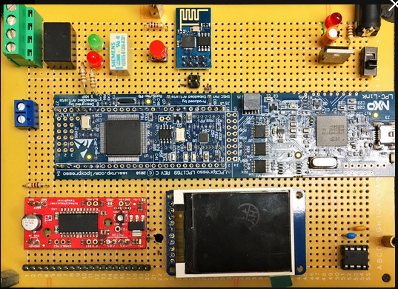
J2/(or 6 for rev. B) Connector with CPU GPIO Pins
J1: PWR Connector
J2 (Rev. D) or J6 (Rev.B) connector with CPU GPIO Pin
LPC1769
SPI I/F Flash
Dimension: 16 x 11 mm or 6.25 x 4.50 inch
Harry Li, Ph.D. SJSU CMPE 127

Slide 2
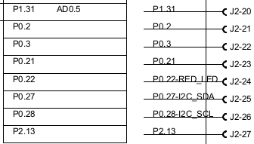
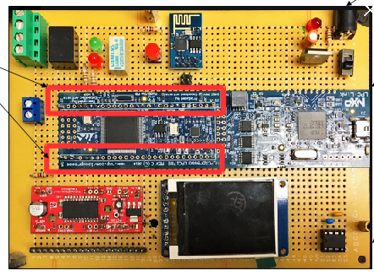

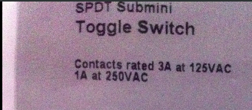
J2 (Rev. D) or J6 (Rev. B) Connector with CPU GPIO Pins
Table 1. J2 Pin Assignment
J2 connector with CPU GPIO Pin
Reference: SCH design
Rev D.
Table 2. J2 Connectivity
Board: 16 x 11 mm or 6.25 x 4.50 inch
SPDT switch for GPIO input testing
CPU
J2
Description
P0.2 J2-21 GPIO output
P0.3 J2-22 GPIO input
A Single Pole Double Throw (SPDT) switch is a switch that only has a single input and can connect to and switch between 2 outputs.
Harry Li, Ph.D. SJSU CMPE 127

Slide 3
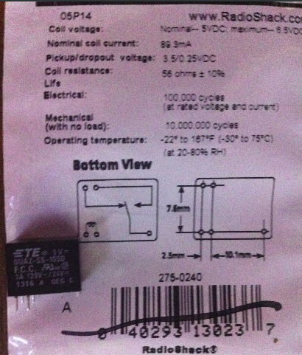
GPIO (GPP) Output with SSR
SSR: Solid State Relay
SSR: Solid State Relay
Harry Li, Ph.D. SJSU CMPE 127

Slide 4
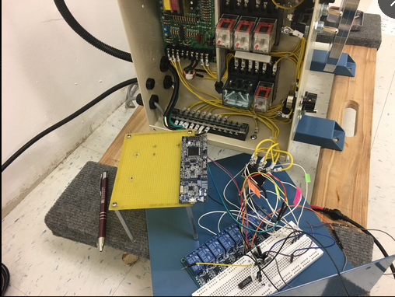
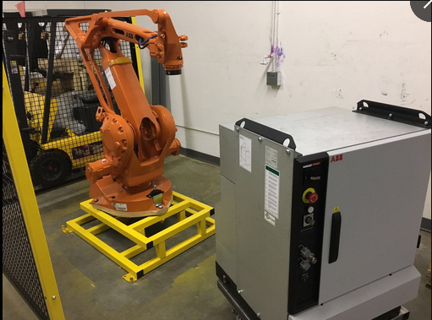
GPIO (GPP) Output SSR Application
SSR: Solid State Relay
SMT-POS Positioner
Harry Li, Ph.D. SJSU CMPE 127

Slide 5
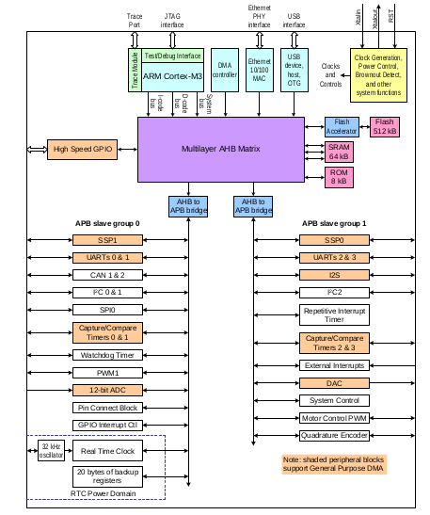
GPIO (GPP) Controller and SPRs
1. Definition of SPRs:
Special purpose registers are those to perform init and config functions.
2. 32 bit each with unique address.
3. In IDE (software, e.g., eXpresso in this class), *.h file with something looks like the following
#define SPR 0x2000_0000
map the CPU architecture to the arm gcc compiler
Memory Map
LPC_GPIO0->FIODIR
LPC_GPIO0->FIOSET
LPC_GPIO0->FIOCLR
CPU
Ref: pp. 9 datasheet
Pwr up address
0x0000_0000
Harry Li, Ph.D. SJSU CMPE 127

Slide 6
GPIO (GPP) SPRs
GPIO SPRs
Reference: Chapter 9: LPC176x/5x General Purpose Input/Output (GPIO) Rev. 3.1 — 2 April 2014 User manual
LPC_GPIO0->FIODIR
#include "../../../tools/redlib/include/stdint.h"
#include "../../../tools/redlib/include/stdio.h"
#ifdef __USE_CMSIS //board init & config stuff
/* CMSIS: the Cortex Microcontroller Software Interface Standard
*/
#include "LPC17xx.h"
LPC_GPIO0->FIOSET
LPC_GPIO0->FIOCLR
Background:
From CPU datasheet, GPIOs are configured using the following registers:
1. Power: always enabled.
2. Pins: See Section 8.3 for GPIO pins and their modes.
3. Wake-up: GPIO ports 0 and 2 can be used for wake-up if needed, see (Section 4.8.8).
4. Interrupts: Enable GPIO interrupts in IO0/2IntEnR (Table 115) or IO0/2IntEnF
(Table 117). Interrupts are enabled in the NVIC using the appropriate Interrupt Set
Enable register.
9.4 Pin description
P0[30:0] [1] ; Type: Input/Output; Description: General purpose in/output.
From SCH pdf doc make connection from this GPP pin to physical connector pin out, e.g., J2-21, J2-22 etc.
Harry Li, Ph.D. SJSU CMPE 127

Slide 7
GPIO SPRs Description
Table 102. GPIO register map, from CPU data sheet pp133
LPC_GPIO0->FIODIR
FIODIR Fast GPIO Port Direction control register, controls the direction of each port pin
LPC_GPIO0->FIOSET
LPC_GPIO0->FIOCLR
FIOSET Fast Port Output Set register using FIOMASK. This register
R/W
controls the state of output pins. Writing 1s produces highs at the corresponding port pins. Writing 0s has no effect. Reading this register returns the current contents of the port output register. Only bits enabled by 0 in FIOMASK can be altered.
FIOCLR Fast Port Output Clear register using FIOMASK. This register WO
controls the state of output pins. Writing 1s produces lows at
the corresponding port pins. Writing 0s has no effect. Only bits
enabled by 0 in FIOMASK can be altered.
Harry Li, Ph.D. SJSU CMPE 127

Slide 8
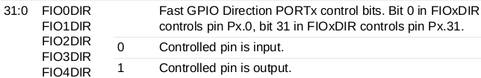
FIOxDIR Description
LPC_GPIO0->FIODIR
Reference: CPU Datasheet, 9.5.1 GPIO port Direction register FIOxDIR (FIO0DIR to FIO4DIR- 0x2009
C000 to 0x2009 C080)
LPC_GPIO0->FIOSET
Table 104. Fast GPIO port Direction register FIO0DIR to FIO4DIR - addresses 0x2009 C000 to 0x2009 C080) bit description
LPC_GPIO0->FIOCLR
FIO0DIR
(Compiler: LPC_GPIO0->FIODIR)
Example: FIO0DIR Init & Config,
Set P0.2 output, “1”
P0.3 input, “0”
0x4
Bit 3 for pin 3
Bit 2 for pin 2
0
1
Harry Li, Ph.D. SJSU CMPE 127
LPC_GPIO0->FIODIR = 0x4;

Slide 9
*.h Mapping the CPU Architecture
LPC_GPIO0->FIODIR
/*--General Purpose Input/Output (GPIO) --*/
typedef struct
{
union {
__IO uint32_t FIODIR;
struct {
__IO uint16_t FIODIRL;
__IO uint16_t FIODIRH;
};
struct {
__IO uint8_t FIODIR0;
__IO uint8_t FIODIR1;
__IO uint8_t FIODIR2;
__IO uint8_t FIODIR3;
};
};
//…
//…
} LPC_GPIO_TypeDef;
LPC_GPIO0->FIOSET
LPC_GPIO0->FIOCLR
Example: LPC1769.h
Maps compiler to architecture
Harry Li, Ph.D. SJSU CMPE 127

Slide 10
*.h Mapping the Memory Map
Peripheral Memory Map
LPC_GPIO0->FIODIR
1
/**************************************************/
/* Peripheral memory map */
/**************************************************/
/* Base addresses */
#define LPC_FLASH_BASE (0x00000000UL)
#define LPC_RAM_BASE (0x10000000UL)
#define LPC_GPIO_BASE (0x2009C000UL)
#define LPC_APB0_BASE (0x40000000UL)
#define LPC_APB1_BASE (0x40080000UL)
#define LPC_AHB_BASE (0x50000000UL)
#define LPC_CM3_BASE (0xE0000000UL)
LPC_GPIO0->FIOSET
LPC_GPIO0->FIOCLR
Example: LPC1769.h
Maps compiler to memory map
2
/* GPIOs */
#define LPC_GPIO0_BASE (LPC_GPIO_BASE + 0x00000)
#define LPC_GPIO1_BASE (LPC_GPIO_BASE + 0x00020)
#define LPC_GPIO2_BASE (LPC_GPIO_BASE + 0x00040)
#define LPC_GPIO3_BASE (LPC_GPIO_BASE + 0x00060)
#define LPC_GPIO4_BASE (LPC_GPIO_BASE + 0x00080)
/************ Peripheral declaration ***************/
#define LPC_SC ((LPC_SC_TypeDef *) LPC_SC_BASE )
#define LPC_GPIO0 ((LPC_GPIO_TypeDef *) LPC_GPIO0_BASE )
#define LPC_GPIO1 ((LPC_GPIO_TypeDef *) LPC_GPIO1_BASE )
#define LPC_GPIO2 ((LPC_GPIO_TypeDef *) LPC_GPIO2_BASE )
#define LPC_GPIO3 ((LPC_GPIO_TypeDef *) LPC_GPIO3_BASE )
#define LPC_GPIO4 ((LPC_GPIO_TypeDef *) LPC_GPIO4_BASE )
3
Harry Li, Ph.D. SJSU CMPE 127

Slide 11
GPIO Init and Config
int main(void)
{
// Force the counter to be placed into memory
volatile static int i = 0 ;
//Set pin 0.2 as output
GPIOinitOut(0,2); //port number, pin number
//Set pin 0.3 as output
GPIOinitOut(0,3);
setGPIO(0, 3);
clearGPIO(0, 2); //port number, pin number
void GPIOinitOut(uint8_t portNum, uint32_t pinNum)
{
if (portNum == 0)
{
LPC_GPIO0->FIODIR |= (1 << pinNum);
}
else if (portNum == 1)
{
LPC_GPIO1->FIODIR |= (1 << pinNum);
void setGPIO(uint8_t portNum, uint32_t pinNum)
{
if (portNum == 0)
{
LPC_GPIO0->FIOSET = (1 << pinNum); //1 as output
printf("Pin 0.%d has been set.\n",pinNum);
}
void clearGPIO(uint8_t portNum, uint32_t pinNum)
{
if (portNum == 0)
{
LPC_GPIO0->FIOCLR = (1 << pinNum);
printf("Pin 0.%d has been cleared.\n", pinNum);
}

