Slide 1
Special Purpose Registers for Init and Config
//Power up SPI
LPC_SC->PCONP
//set PCLK
LPC_SC->PCLKSEL0
1
5
//init CR0 and CR1 registers
LPC_SSP1->CR0
LPC_SSP1->CR1
2
6
3
// set ssp clock rate
LPC_SSP1->CPSR = 8;
// Enable Slave SPI nCS
LPC_GPIO0->FIODIR
LPC_GPIO0->FIOSET
4
// Perform init
LPC_PINCON->PINSEL0
Harry Li, Ph.D. SJSU

Slide 2

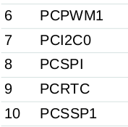
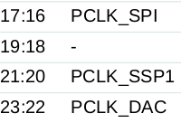


SSP Init and Config
PCONP Power Control for Peripherals Register
//Power up SPI
LPC_SC->PCONP
//set PCLK
LPC_SC->PCLKSEL0
Table 14. System control registers, pp 31; Table 46, PCONP contains control bits to turn on/off individual peripheral controller for power saving purpose, pp. 64
1
2
Table 40. PCKSEL0 Peripheral Clock Selection register 0, pp, Table 42, pp. 58 bit selection table
Table 46, PCONP
3
// Enable Slave SPI nCS
LPC_GPIO0->FIODIR
LPC_GPIO0->FIOSET
4
Bit = 10
8.5.1 Pin Function Select register 0, PINSEL0 register selects the multiplexed functions of the lower half of Port 0. pp 117
// Perform init
LPC_PINCON->PINSEL0
Harry Li, Ph.D. SJSU

Slide 3
C-Code for SSP Init and Config
void initSSP1(void){
//power up spi1
LPC_SC->PCONP |= (1<<10);
//01 PCLK_peripheral = CCLK.. 01, since it's CCLK/1
LPC_SC->PCLKSEL0 &= ~(3<<20);
LPC_SC->PCLKSEL0 |= (1<<20);
//P0.6 is used as a GPIO output and acts as a Slave select
LPC_GPIO0->FIODIR |= (1<<6);
LPC_GPIO0->FIOSET = (1<<6);
//P0.7:9 init
LPC_PINCON->PINSEL0 &= ~((3<<18)|(3<<16)|(3<<14));
LPC_PINCON->PINSEL0 |= ((2<<18)|(2<<16)|(2<<14));
//data size set to 8 bits
LPC_SSP1->CR0 = 0x07;
//For AT45 flash SI pin latched on the rising edge of SCK, while output data
//on the SO pin is always clocked out on the falling edge of SCK.
//MS=0 (Master), SSE =1
LPC_SSP1->CR1 = 0x2;
LPC_SSP1->CPSR = 8; //SCK Frequency for Continuous Read(Low Freq) is 33Mhx max. here we are setting it below it.
}
1
2
3
4
5
6
Harry Li, Ph.D. SJSU

Slide 4
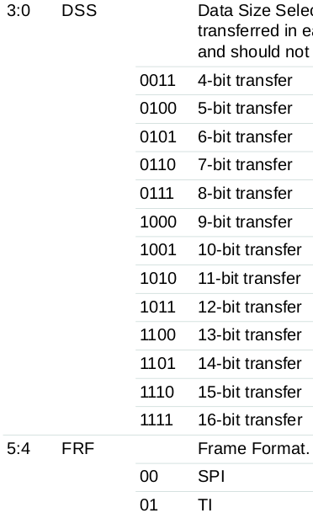
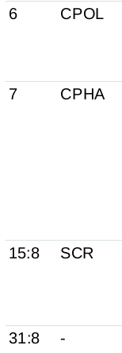
CR0 for SSP Init and Config
Table 371: SSPn Control Register 0 (SSP0CR0 - address 0x4008 8000, SSP1CR0 -
0x4003 0000) bit description, pp 431
Clock Out Polarity
Clock Out Phase
Serial Clock Rate
Harry Li, Ph.D. SJSU

