Slide 1
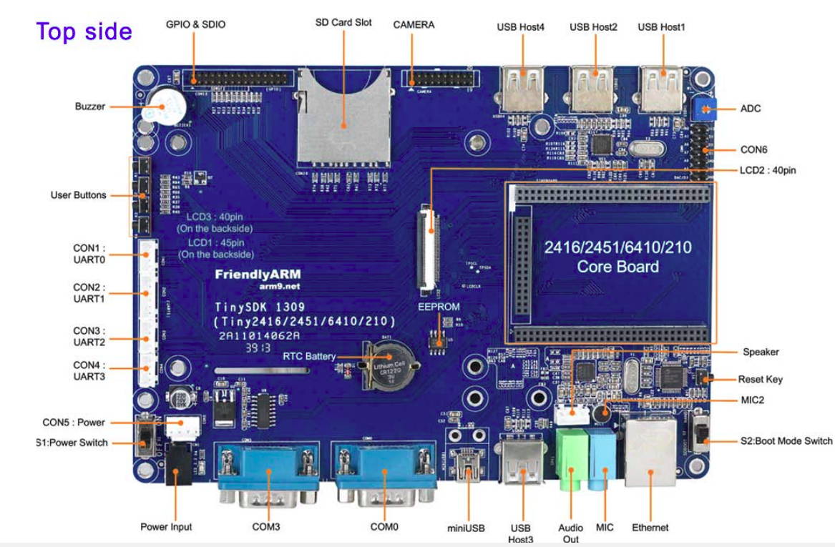
Connector with CPU GPIO Pins
Identify the connectors for GPIO testing
Note: Check your board revision number, you may have different type of board and different connectors, check the vendor document
Harry Li, Ph.D. SJSU CMPE 242

Slide 2
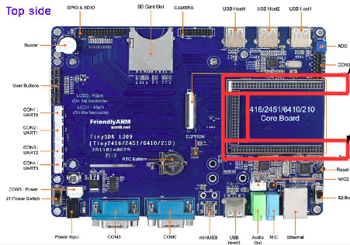



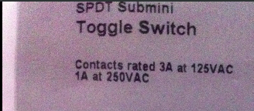
CON1 Connector with GPIO Pins
Table 1. CON1 Pin Assignment
Reference: Vendor Document, or my class handout, see
github.com/hualili
Table 2. GPIO I/O testing
1. SPDT switch for GPIO input testing;
2. Build circuit for input testing and output testing. Output testing will have to allow GPP port to drive LED
On/Off.
CPU
CON1
Description
GPE1 1.3 output
GPE2 1.4 input
A Single Pole Double Throw (SPDT) switch is a switch that only has a single input and can connect to and switch between 2 outputs.
Harry Li, Ph.D. SJSU CMPE 242

Slide 3
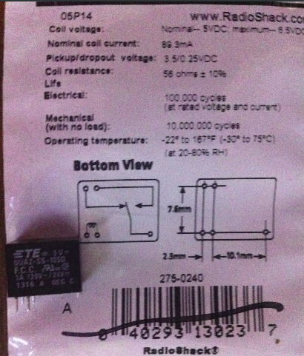
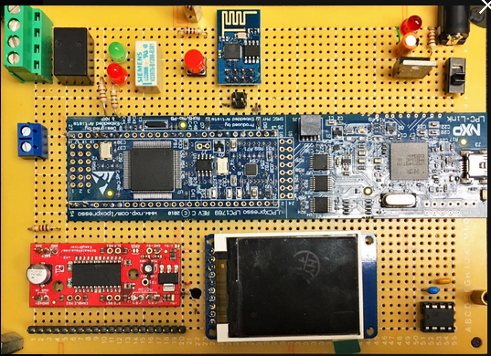
GPIO (GPP) Output with SSR
SSR: Solid State Relay
SSR: Solid State Relay
Harry Li, Ph.D. SJSU CMPE 244

Slide 4
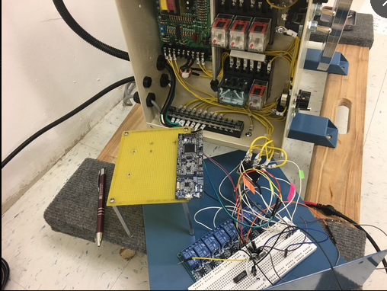
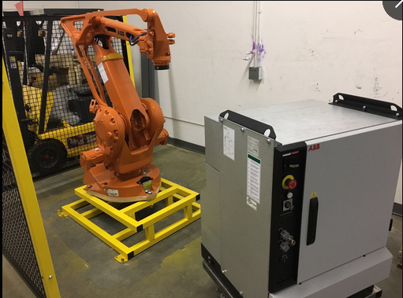
GPIO (GPP) Output SSR Applications
SSR: Solid State Relay
SMT-POS Positioner
Harry Li, Ph.D. SJSU CMPE 242

Slide 5
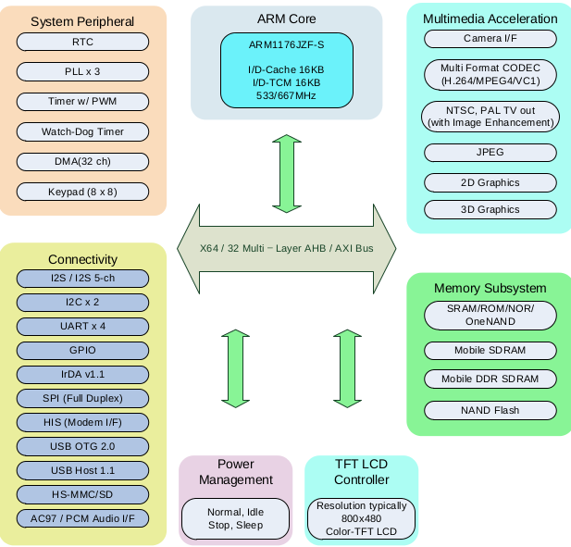
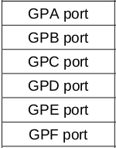

ARM GPIO (GPP) Controller and SPRs
1. Definition of SPRs:
Special purpose registers are those to perform init and config functions.
2. 32 bit each with unique address.
3. In IDE (software, e.g., linux-arm-gcc in this case), *.h file with something looks like the following
#define SPR 0x2000_0000
map the CPU architecture to the arm gcc compiler
Memory Map
To conector
CPU datasheet Chapter1
Ref: pp. 61 datasheet
Pwr up address
0x0000_0000
Ref: pp. 306 datasheet
Harry Li, Ph.D. SJSU CMPE 242

Slide 6

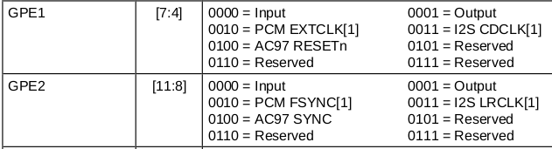
SPR: GPECON Description
Reference: CPU Datasheet, 10.4 REGISTER DESCRIPTION
Configuration Register
GPECON
(Compiler used name:
GPECON)
Data Register
Pull up/down Register
Example: GPE Init & Config,
Set GPE1 output, “1”
GPE2 input, “0”
So the binary pattern is 0x10
Bit 8 - 11 for GPE2: 0000
Bit 4-7 for GPE1: 0001
GPECON
0000
0001
Harry Li, Ph.D. SJSU CMPE 242

