Slide 1
RS232 Electric Characteristics
CMOS Electric Characteristic:
logic 0: 0 VDC
logic 1: 3.3 VDC
TTL Electric Characteristic:
logic 0: 0 VDC
logic 1: 5.0 VDC
RS232
logic 0: [+2.5, +18 VDC]
logic 1: [-18, -2.5 VDC]
Note: if using devices like MAX232, the range will be [+2.5, +5.0] and [-5.0, -2.5].
Logic 0
2.5
Undefined
-2.5
Logic 1
© Harry Li, Ph.D. SJSU

Slide 2
RS232 Waveforms
Example: Suppose hex number 0xaf is to be transmitted via RS232 link, as 8N1 at 9600 bps bit rate. Draw its waveform. (MSB out first) Note: 0xaf in binary 1010 1111 with stop and start bit fields
0 1010 1111 1
Logic 0
5.0
Start Bit
Stop Bit
-5.0
Logic 1
© Harry Li, Ph.D. SJSU

Slide 3


Build RS232 Interface for LPC1769 Platform
Prototype Board
Note This is cable side
LPC1769
Level Shifter
TX
TX_in
TX_out
2 Rx
2 Tx
RX
3 Tx
3 Rx
RX_out
RX_in
5
GND
GND
DB (Male)
USB-to-RS232
Cable Connector (Female)
© Harry Li, Ph.D. SJSU

Slide 4
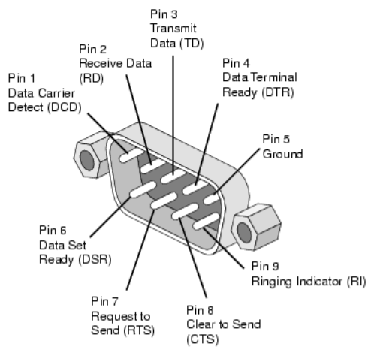
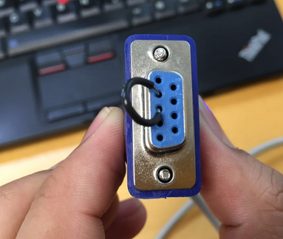
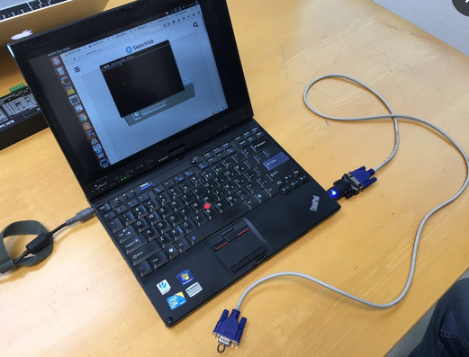
DB9 Connectors Both Genders
Note This DB-9 connector (male) is on board side
Note This DB-9 connector is on cable side
https://www.google.com/search?q=DB9+connector&biw=1025&bih=493&source=lnms&tbm=isch&sa=X&ved=0ahUKEwiNxpj0g7bQAhVoAcAKHYkFA5UQ_AUIBygC#imgrc=oLXSmrvj4tMqHM%3A

Slide 5
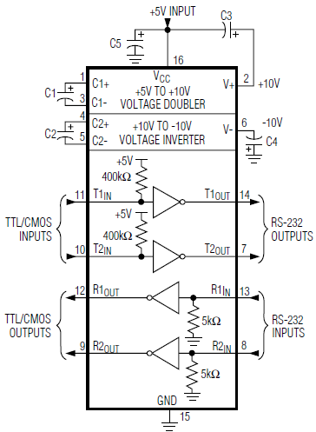
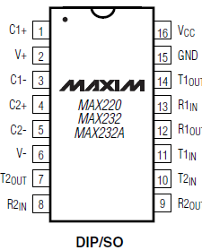

MAX 232 Level Shifter
Reference : from MAX232 Datasheet
Note: (1) external caps are used to form low pass filter to remove noise; (2) pay attention to the caps polarity.
Design: use MAX232 to finish LPC1769 RS232 interface circuit design
© Harry Li, Ph.D. SJSU

Slide 6
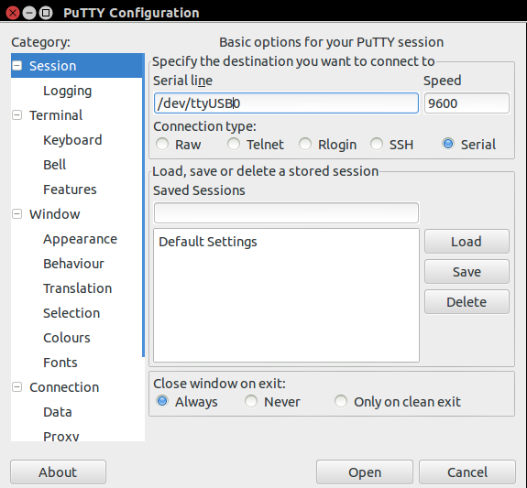
USB-RS232 Loop Back Test Using Putty
Use linux OS, at the console input, type putty to start the putty program (if you do not have putty, then google it and install one.
Then, you will see the GUI as shown on the left, (1) choose Serial connection button, (2) define driver as /dev/ttyUSB0 (3) try baud rate 9600
(4) Use USB-to-Serial cable, plug into your laptop usb, and connect TX and RX pins as shown here (connect pin 2 and 3, where 2 is Tx for this cable), then click on open, you will be prompted with the console, now you can start type in the strings for loop back test
© Harry Li, Ph.D. SJSU

