Slide 1
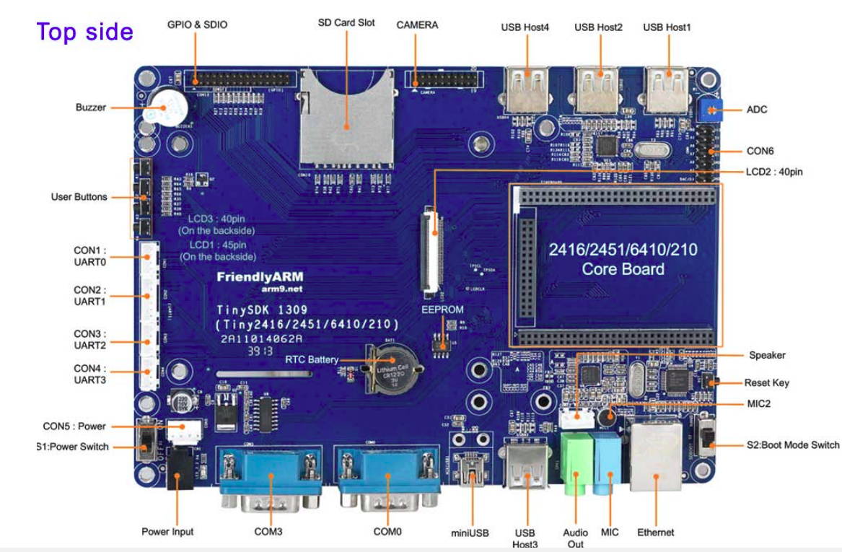
Connector with CPU PWM Pins
Identify the connectors for GPIO testing
P1 connector
for PWM
Note: Check your board revision number, you may have different type of board and different connectors, check the vendor document
Harry Li, Ph.D. SJSU CMPE 242

Slide 2
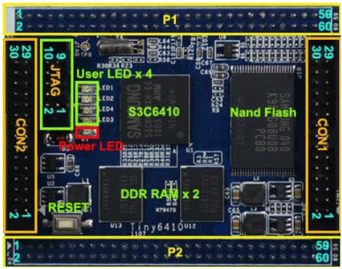
P1 Connector with PWM Pin
Table 6 . P1 Pin Assignment, see class handout
P1 connector
for PWM
Reference: Vendor Document, or my class handout, see github.com/hualili, Handout On Hardware of the ARM11 Development Board, HL, S12
CPU data sheet, chapter 32, PWM TIMER describes PWM TIMER in S3C6410X RISC microprocessor. pp 1106
PWM has 2 operation modes:
• Auto-Reload Mode
Continuous PWM pulses
• One-Shot Pulse Mode
Only one PWM pulse generated
Harry Li, Ph.D. SJSU CMPE 242

Slide 3
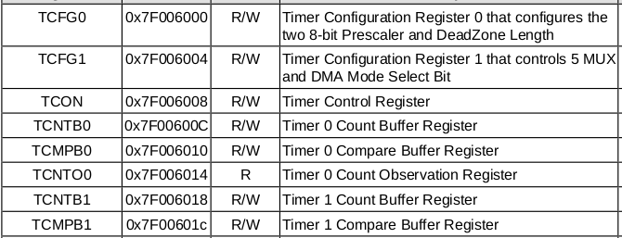
PWM Special Purpose Registers
4 special purpose registers
CPU data sheet pp 1117, Partial list here
Harry Li, Ph.D. SJSU CMPE 242

Slide 4
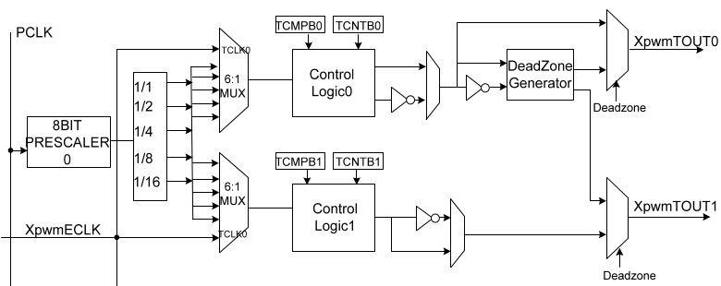
PWM Architecture
２
４
Timer 0
３
１
Timer 1
private clock-divider
1. Timers 0 and 1 share a programmable 8-bit prescaler
Harry Li, Ph.D. SJSU CMPE 242

Slide 5
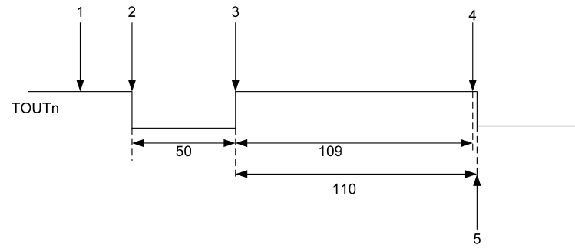
PWM Special Purpose Registers
1. TCLKn: Eexternal clock TCLK0.
2. TCNTBn Timer Count Buffer register (TCNTBn). When the down-counter reaches 0, the timer interrupt request is generated to inform CPU, and the value of corresponding TCNTBn can be automatically reloaded into the down-counter to start the next cycle.
3. TCONn timer control register;
4.TCMPB0: Timer 0 Compare Buffer Register
pp 1108
1. Initialize the TCNTBn with 159(50+109) and the TCMPBn with 109.
2. Start Timer by setting the start bit and manual update bit off.
The TCNTBn value of 159 is loaded into the down-counter, the output is driven low.
3.When down-counter counts down to the value in the TCMPBn register 109,
the output is changed from low to high
4. When the down-counter reaches 0, the interrupt request is generated.
5. The down-counter is automatically reloaded with TCNTBn, which restarts the cycle.
Harry Li, Ph.D. SJSU CMPE 242

Slide 6
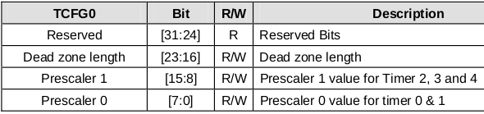
SPRs Description
Reference: TCFG0, CPU Datasheet, pp 1117
Example: PWM Init & Config,
Set PWM frequency
32.4.1.3 TCON (Timer Control Register) pp 1119
32.4.1.4 TCNTB0 (Timer0 Counter Register)
32.4.1.5 TCMPB0 (Timer0 Compare Register)
Harry Li, Ph.D. SJSU CMPE 242

Slide 7
PWM Driver Program Sample (1)
static void PWM_Set_Freq( unsigned long freq )
{
… …
tmp = readl(S3C64XX_GPFCON);
tmp &= ~(0x3U << 28);
tmp |= (0x2U << 28);
writel(tmp, S3C64XX_GPFCON);
tcon = __raw_readl(S3C_TCON);
tcfg1 = __raw_readl(S3C_TCFG1);
tcfg0 = __raw_readl(S3C_TCFG0);
//prescaler = 50
tcfg0 &= ~S3C_TCFG_PRESCALER0_MASK;
tcfg0 |= (50 - 1);
Harry Li, Ph.D. SJSU CMPE 242

Slide 8
PWM Driver Program Sample (2)
//mux = 1/16
tcfg1 &= ~S3C_TCFG1_MUX0_MASK;
tcfg1 |= S3C_TCFG1_MUX0_DIV16;
__raw_writel(tcfg1, S3C_TCFG1);
__raw_writel(tcfg0, S3C_TCFG0);
clk_p = clk_get(NULL, "pclk");
pclk = clk_get_rate(clk_p);
tcnt = (pclk/50/16)/freq;
__raw_writel(tcnt, S3C_TCNTB(0));
__raw_writel(tcnt/2, S3C_TCMPB(0));
tcon &= ~0x1f;
tcon |= 0xb; //disable deadzone, auto-reload, inv-off, update TCNTB0&TCMPB0,
// start timer 0
__raw_writel(tcon, S3C_TCON);
tcon &= ~2; //clear manual update bit
__raw_writel(tcon, S3C_TCON);
}
Harry Li, Ph.D. SJSU CMPE 242

