Slide 1
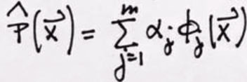








Generalized Fourier Transform (1)
Prepare for Function Approximation
Choose Hermit polynomials as orthogonal basis, we have
… (7)
...(9)
where
For k => 1, and x from negative infinity to positive infinity
… (8)
So, for k = 3
Xi are feature vectors from group w_i
And is orthogonal basis
function
...(10)
… (8-1)
Harry Li, Ph.D. SJSU CMPE297

Slide 2
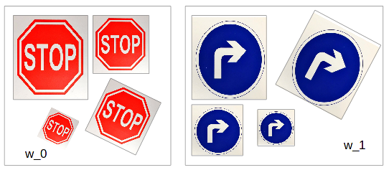
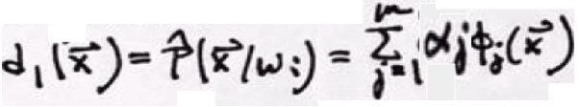
Hermit Polynomials As Decision Function as orthogonal basis function
Feature vectors from groups w_i, w_k etc
are higher dimensional, where i=1, k=2, so
w_1
w_2
… (7)
There are j feature vectors in w_1
denoted as X_ij, i=1, and j = 1, 2,
3, 4, e.g.,
{X_1j | j = 1, … N_0}
Where N_1 = 4
So rewrite Eqn(7) as for decision function
There are j feature vectors in
w_2, j = 0, 1, 2, 3, e.g., N_1 = 3 e.g.,
{X_2j | j = 0, 1, … N_2}
Where N_2 = 4
… (7-1)
where
… (8)
Harry Li, Ph.D. SJSU CMPE297

Slide 3
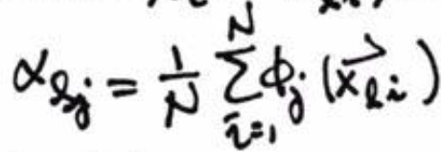
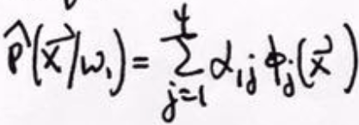
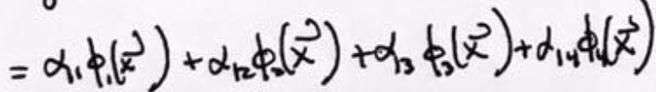
Hermit As Generalized FT Coefficient as orthogonal basis function
Rewrite the notation above as feature vector from group w_l, X_lj
… (8)
...(8-1)
Example: for w_1 group, and J up to 4 feature vectors,
Harry Li, Ph.D. SJSU CMPE297

Slide 4
Hermit Polynomials in 1D Space as orthogonal basis function
Note: Hermit polynomials whose independent variable is a scalar, just x one dimensional as in equation (9) and (10) below,
However, in video analytics applications, we will have feature vector space up to dimension N. For example, in the following we have M group of traffic signs, w_i, i=1, 2, …, M, and each group w_i will have J feature vectors, and each feature vector can have N dimensions, such as x_bar, y_bar, orientation angle, moments, etc.
...(9)
For k => 1, and x from negative infinity to positive infinity
So, for k = 3
w_1
w_2
Feature vectors from groups w_i, w_k etc
are higher dimensional.
...(10)
Harry Li, Ph.D. SJSU CMPE297

Slide 5
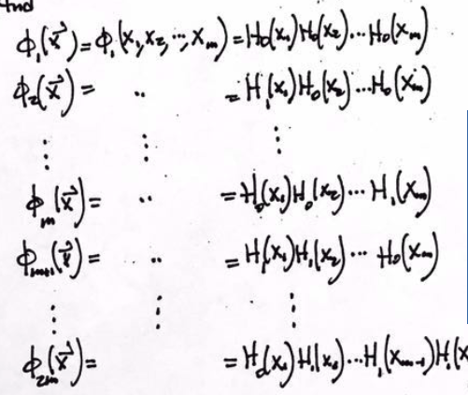
Hermit in Higher Dimension as orthogonal basis function
Note: Hermit polynomials in 1D as follows
The Product of
2 H(x) Hermit becomes 2D space;
3 H(x) … … 3D space;
N H(x) … … ND space;
As shown in the right.
Number of feature vectors within that group, e.g., 2m
Product of N Hermit, Dim(N)
Harry Li, Ph.D. SJSU CMPE297

Slide 6
Computation of Coefficients as orthogonal basis function
...(8-1)
See example in the handout.
Harry Li, Ph.D. SJSU CMPE297

