Slide 1
Dimension Reduction of Feature Vectors
Dominant feature vector
Dimension reduction
Video Capture
Identification of ROI
Computing Features
Decision making
Cluster finding
Entropy minimization based technique

Slide 2





Entropy Minimization (1)
Feature Vector Dimension Reduction
Suppose we have traffic signs from group w_1
… (1)
Each feature vector Y follows normal distribution
w_1
… (1*)
There are j feature vectors in w_1 denoted as Y_ij, i=1, and j = 1, 2, 3, 4, e.g.,
{Y_1j | j = 1,2, … N}
Where N_1 = 4
… (2)
Note; m < n for dimension reduction
Harry Li, Ph.D. SJSU CMPE297

Slide 3



Entropy Minimization (2)
Feature Vector Dimension Reduction
Entropy of the feature vector Y
2
… (3)
The feature vectors in w_i group, denoted as Y_ij, with Prob(Y_ij), the higher the probability the more likely this feature vector to occur, hence the small entropy.
… (3*)
Entropy minimization is then equivalent to find the more likely feature vectors. Hence, this leads to reduction of less likely feature vectors.
1
Why entropy minimization? From the definition of a entropy, the higher the probability of an event Y, the smaller the entropy, as in the following equation:
Harry Li, Ph.D. SJSU CMPE297

Slide 4


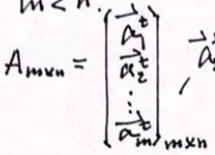
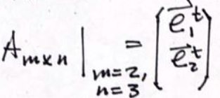

Entropy Minimization (3)
Feature Vector Dimension Reduction
Minimize entropy by linear transformations as follows
Find characteristic equation
… (4)
… (2)
Find eigen vector
Where matrix A is
… (5)
Form matrix A
and
… (6)
Harry Li, Ph.D. SJSU CMPE297

