Slide 1


Software Tools for Video Analytics
Software tools:
1. OpenCV http://opencv.org/
2. Caffe Deep learning framework developed by the Berkeley Vision and Learning Center (BVLC), support GPU architecture.
Free for both academic and commercial use, with C++, C, Python and Java interfaces, originally developed at Intel designed for multi-core processing. Enabled with OpenCL, has more than 47K user community and exceeding 9 million downloads, latest version 3.2.
caffe.berkeleyvision.org
caffe.berkeleyvision.org
https://docs.google.com/presentation/d/1UeKXVgRvvxg9OUdh_UiC5G71UMscNPlvArsWER41PsU/edit#slide=id.gc2fcdcce7_216_0
Harry Li, Ph.D. SJSU, CMPE 297, F2016

Slide 2
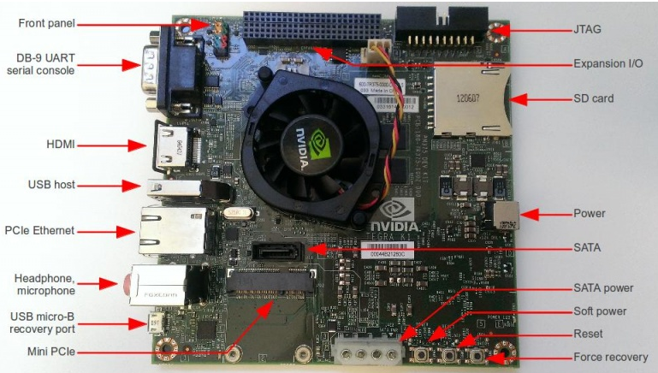
Hardware Platform for Video Analytics
Jetson tk1 GPU Embedded Platform: cross over like platform, either as an embedded platform or desktop machine
1. http://elinux.org/Jetson_TK1
Use putty on my ubuntu laptop to run Jetson
Harry Li, Ph.D. SJSU, CMPE 297, F2016

Slide 3
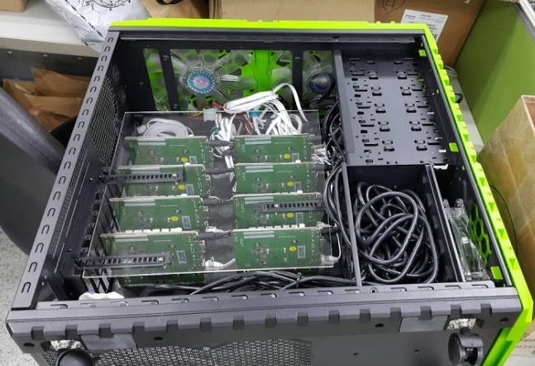
Jetson Cluster
http://elinux.org/File:SparkleSOM.jpg

Slide 4
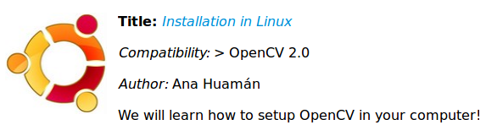
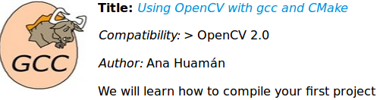

Introduction to OpenCV
http://docs.opencv.org/2.4/doc/tutorials/introduction/table_of_content_introduction/table_of_content_introduction.html
How to set up openCV
http://docs.opencv.org/2.4/doc/tutorials/introduction/linux_install/linux_install.html#linux-installation
How to compile and build
http://docs.opencv.org/2.4/doc/tutorials/introduction/linux_gcc_cmake/linux_gcc_cmake.html#linux-gcc-usage
Using Eclipse
http://docs.opencv.org/2.4/doc/tutorials/introduction/linux_eclipse/linux_eclipse.html#linux-eclipse-usage
Optional but better
Harry Li, Ph.D. SJSU, CMPE 297, F2016

Slide 5
Start with A Simple Image Display Code
#include <stdio.h>
#include <opencv2/opencv.hpp>
using namespace cv;
int main(int argc, char** argv )
{
if ( argc != 2 )
{
printf("usage: DisplayImage.out <Image_Path>\n");
return -1;
}
Mat image;
image = imread( argv[1], 1 );
if ( !image.data )
{
printf("No image data \n");
return -1;
}
namedWindow("Display Image OpenGL", WINDOW_OPENGL );
imshow("Display Image", image);
waitKey(0);
return 0;
}
cv::Mat Class Reference Basic image container
http://docs.opencv.org/3.1.0/d3/d63/classcv_1_1Mat.html
Mat cv::imread ( const String & filename, int flags = IMREAD_COLOR )

Slide 6
Background on Computer Vision and Intelligent Control
Software tools developed:
PC-DIP (PC based Digital Image Processing Software Package) at Texas Tech University, originated from teaching material and C code, from CS5386 Machine Perception and Recognition, CS5395 Computer Graphics, Computer Science Department,
College of Engineering, Texas Tech University, 1990-94
Courses:
EE263/264 Digital Image Processing
Lockheed Martin, KLA Tencor, 2009, 2011, 2013 and 2016;
CS5386 Machine Perception and Recognition;
CS5395 Computer Graphics;
Computer Science Department, College of Engineering, Texas Tech University, 1990-94
Harry Li, Ph.D. SJSU, CMPE 297, F2016

Slide 7
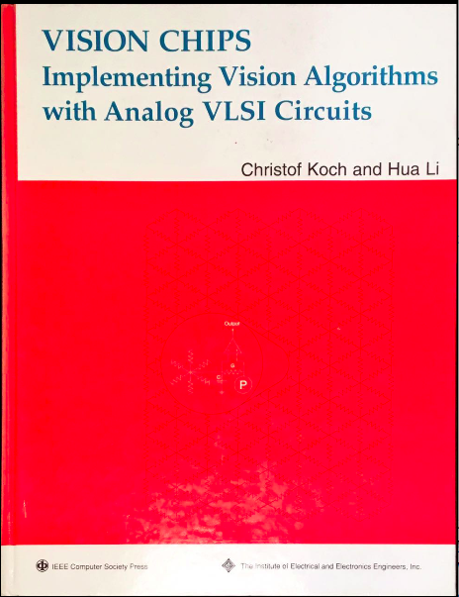
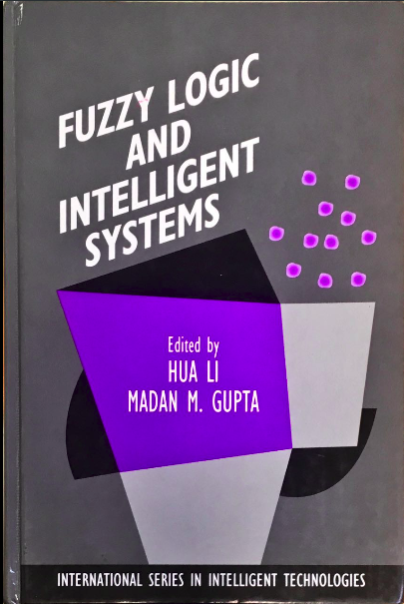
Background (1)
Harry Li, Ph.D. SJSU, CMPE 297, F2016

Slide 8
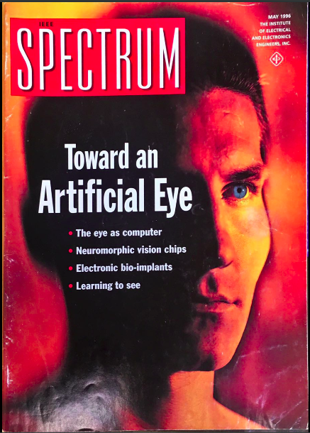
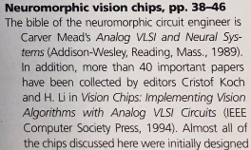
Background (2)
To Prob further
Harry Li, Ph.D. SJSU, CMPE 297, F2016

Slide 9
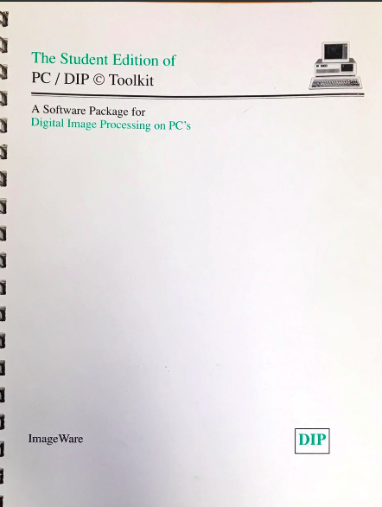
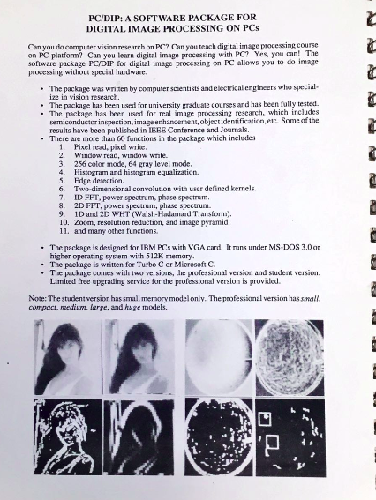
Background (3)
Developed Image Processing Tool Kit
Harry Li, Ph.D. SJSU, CMPE 297, F2016

Slide 10
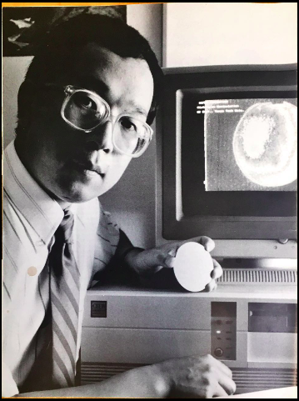
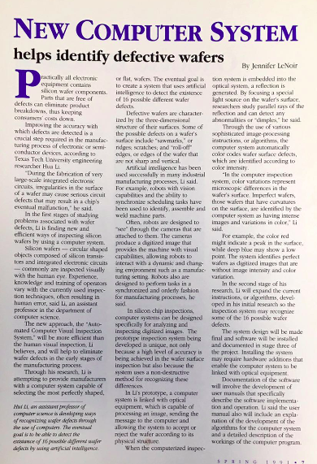
Background (4)
Applications to Semiconductor Equipment
Harry Li, Ph.D. SJSU, CMPE 297, F2016

Slide 11
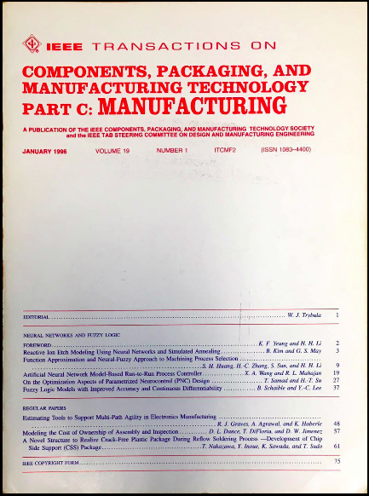
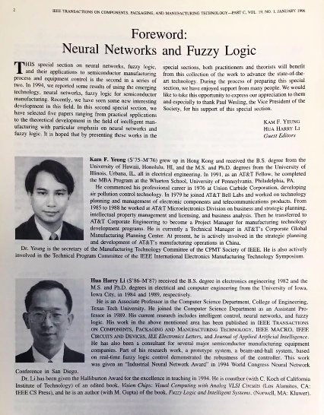
Background (5)
Applications to Semiconductor Equipment
Harry Li, Ph.D. SJSU, CMPE 297, F2016

