Slide 1
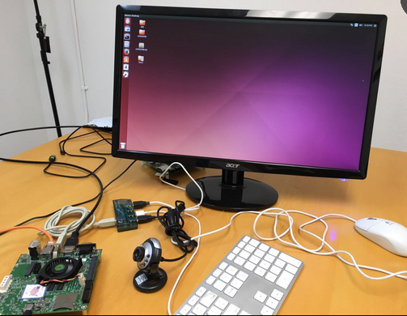
Getting Started with Jetson tk1
Note:
1. Set up NVDA jetson tk1, with
(1) USB hub to allow mouse, keyboard, camera, and/or usb wifi connected to the board;
(2) default password from NVDA is ubuntu, please keep that way so we can check/verify your homework and code;
2. Although the tk1 can work as a stand-alone system, it is needed to trouble shut the system, so use putty (on your linux laptop) to establish USB-to-Serial connection, use 115200, 8n1 connection. See demo.
3. Use putty to set SSH connection to establish remote desktop sharing capability can be helpful, so you may want to try to establish this in the future as well.
4. Down load and install openCV, and run you first openCV demo program. See demo.
Harry Li, Ph.D. SJSU CMPE297 S2017

