Slide 1


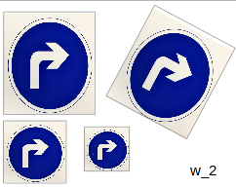
Function Approximation and Decision Making
Dominant feature vector
Dimension reduction
Video Capture
Identification of ROI
Computing Features
Group w_i
Decision making
Cluster finding
Group w_k
Group w_j
Function Approximation + decision
Clusters for each group w_i , not the cluster previously defined as mean for example
Group w_k
Group w_i

Slide 2
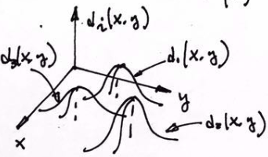
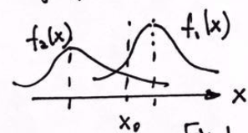
Background on Pattern Classification Based On Bayesian Statistical Decision
Formulation of the problem
Group w_i
1
Group w_j
Group w_k
Without losing generality, conceptually reduce the dimension of the feature vector to 2D space for simplicity
2
Conceptually further simplify the decision making by simply further reducing the dimension of the feature vectors to 1D space and 2 groups w1 and w2
Harry Li, Ph.D. SJSU CMPE297
Harry Li, Ph.D. SJSU CMPE297

Slide 3




Bayesian Statistical Decision for 2 Groups
… (1)
… (2)
Then the decision making is as follows
If
Where f1(x) is the pdf of group w1, and f2(x) is the pdf of group w2.
And Prob(w1) and Prob(w2) are the probability of group w1 and w2 respectively.
Assume Prob(w1) = Prob(w2) = 0.5, e.g., equally likely,
so we have
d1(x) = f1(x) and d2(x) = f2(x)
… (3)
If
… (4)
Harry Li, Ph.D. SJSU CMPE297
Harry Li, Ph.D. SJSU CMPE297

Slide 4


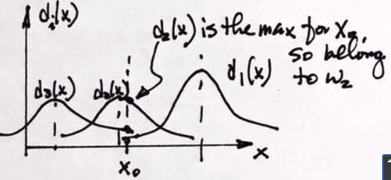
Bayesian Statistical Decision
Now, generalize the decision making function from 2 groups case, we have
Example: The decision making for 3 groups is illustrated in the figure below
If
j
… (5)
Then
d (x) belong to group w_j
j
Summary: the key is to find pdf function f_i(X) for each group w_i
Lead to function approximation
Harry Li, Ph.D. SJSU CMPE297
Harry Li, Ph.D. SJSU CMPE297

Slide 5
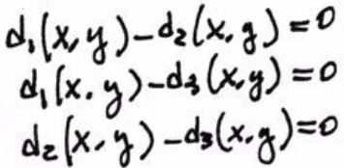
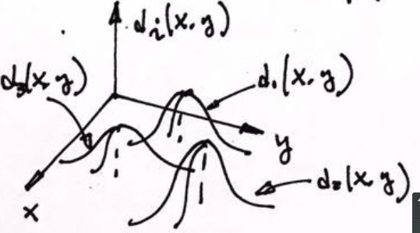
Visualize Decision Boundary
Example: For 3 groups, illustrated below, we can visualize the decision boundary by equations in (6)
… (6)
Note even still 3 groups here but each group feature vector dimension is 2, increased 1 dimension from the previous slide for the purpose of generalization
Harry Li, Ph.D. SJSU CMPE297
Harry Li, Ph.D. SJSU CMPE297

Slide 6
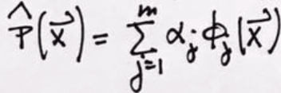








Generalized Fourier Transform (1)
Prepare for Function Approximation
Choose Hermit polynomials as orthogonal basis, we have
… (7)
...(9)
where
For k => 1, and x from negative infinity to positive infinity
… (8)
So, for k = 3
Xi are feature vectors from group w_i
And is orthogonal basis
function
...(10)
… (8-1)
Harry Li, Ph.D. SJSU CMPE297

Slide 7

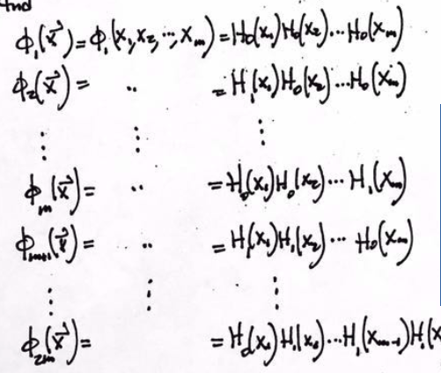
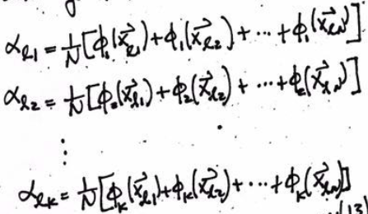
Generalized Fourier Transform (2)
Prepare for Function Approximation
Feature vectors from group l, rewrite X_i as X_li we have
Where
… (8-2)
Where j = 1, 2, ...
… (9)
… (8-3)
Harry Li, Ph.D. SJSU CMPE297

