Slide 1

2019S-2-lec3-8-3-1-part2-v3-behavior-2019-4-5
(Part 2)
Project Lead: Harry Li, Ph.D.
Version 1.0 Dec. 2018
CTI One Corporation
3679 Enochs Street
Santa Clara, CA 95051
Team members: Prashanth, Ryan, Dester, Yan Liu

Slide 2
April-5-2019 Execution of the Model
https://github.com/hualili/opencv/tree/master/IP120-AI-DL/2018F
history = model.fit_generator(
train_generator,
steps_per_epoch=100,
epochs=30,
validation_data=validation_generator,
validation_steps=50)
model.save('cats_and_dogs_small_1.h5') #save model after training
#plot loss function
import matplotlib.pyplot as plt
acc = history.history['acc']
val_acc = history.history['val_acc']
loss = history.history['loss']
val_loss = history.history['val_loss']
Harry Li, Ph.D.

Slide 3
April-5-2019 Generator for Preprocessing
https://github.com/hualili/opencv/tree/master/IP120-AI-DL/2018F
from keras.preprocessing.image import ImageDataGenerator
# All images will be rescaled by 1./255
train_datagen = ImageDataGenerator(rescale=1./255)
test_datagen = ImageDataGenerator(rescale=1./255)
train_generator = train_datagen.flow_from_directory(
# This is the target directory
train_dir,
# All images will be resized to 150x150
target_size=(150, 150),
batch_size=20,
# Since we use binary_crossentropy loss, we need binary labels
class_mode='binary')
validation_generator = test_datagen.flow_from_directory(
validation_dir,
target_size=(150, 150),
batch_size=20,
class_mode='binary')
Harry Li, Ph.D.

Slide 4

April-5-2019 Compile CNN
https://github.com/hualili/opencv/tree/master/IP120-AI-DL/2018F
#-------------compilation---------------*
from keras import optimizers
model.compile(loss='binary_crossentropy',
optimizer=optimizers.RMSprop(lr=1e-4),
metrics=['acc'])
(1) loss function
https://machinelearningmastery.com/how-to-choose-loss-functions-when-training-deep-learning-neural-networks/
(2) optimizer
(3) metrics
Harry Li, Ph.D.

Slide 5
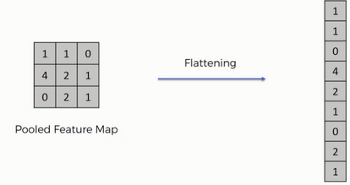
April-5-2019 CNN Basic Building Blocks
https://github.com/hualili/opencv/tree/master/IP120-AI-DL/2018F
C1/M1 + C2/M2 + C3/M3 + C4/M4 + F + D1 + D2
https://www.google.com/search?q=flatten+layer&client=ubuntu&hs=Usa&channel=fs&source=lnms&tbm=isch&sa=X&ved=0ahUKEwijkZGEh7rhAhWQvZ4KHeD_C_EQ_AUIDigB&biw=917&bih=431#imgrc=Rmtg_AgwhISrIM:
Harry Li, Ph.D.

Slide 6
April-5-2019 Step 1 Building CNN
https://github.com/hualili/opencv/tree/master/IP120-AI-DL/2018F
On github/hualili
harry@harry-Latitude-E5470:~/Documents/SJSU/CMPE297/CMPE297VideoAnalytics/lec/lec5-MNIST-LetterDetection-TF/lec5-1-TF_Digits-Dete/lec5-1-1-DigitsTF/final-SourceNumerals$
8convnets-SmallData-cats-dogs-ch05.py
from keras import layers
from keras import models
model = models.Sequential()
model.add(layers.Conv2D(32, (3, 3), activation='relu',
input_shape=(150, 150, 3)))
model.add(layers.MaxPooling2D((2, 2)))
model.add(layers.Conv2D(64, (3, 3), activation='relu'))
model.add(layers.MaxPooling2D((2, 2)))
model.add(layers.Conv2D(128, (3, 3), activation='relu'))
model.add(layers.MaxPooling2D((2, 2)))
model.add(layers.Conv2D(128, (3, 3), activation='relu'))
model.add(layers.MaxPooling2D((2, 2)))
model.add(layers.Flatten())
model.add(layers.Dense(512, activation='relu'))
model.add(layers.Dense(1, activation='sigmoid'))
model.summary()
C1/M1 + C2/M2 + C3/M3 + C4/M4 + F + D1 + D2
Harry Li, Ph.D.

Slide 7
April-5-2019 Building CNN
https://github.com/hualili/opencv/tree/master/IP120-AI-DL/2018F
_________________________________________________________________
Layer (type) Output Shape Param #
=================================================================
conv2d_1 (Conv2D) (None, 148, 148, 32) 896
_________________________________________________________________
max_pooling2d_1 (MaxPooling2 (None, 74, 74, 32) 0
_________________________________________________________________
conv2d_2 (Conv2D) (None, 72, 72, 64) 18496
_________________________________________________________________
max_pooling2d_2 (MaxPooling2 (None, 36, 36, 64) 0
_________________________________________________________________
conv2d_3 (Conv2D) (None, 34, 34, 128) 73856
_________________________________________________________________
max_pooling2d_3 (MaxPooling2 (None, 17, 17, 128) 0
_________________________________________________________________
conv2d_4 (Conv2D) (None, 15, 15, 128) 147584
_________________________________________________________________
max_pooling2d_4 (MaxPooling2 (None, 7, 7, 128) 0
_________________________________________________________________
flatten_1 (Flatten) (None, 6272) 0
_________________________________________________________________
dense_1 (Dense) (None, 512) 3211776
_________________________________________________________________
dense_2 (Dense) (None, 1) 513
=================================================================
Total params: 3,453,121
Trainable params: 3,453,121
Non-trainable params: 0
Harry Li, Ph.D.

Slide 8
April-5-2019 Training the Model
https://github.com/hualili/opencv/tree/master/IP120-AI-DL/2018F
On github/hualili
8convnets-SmallData-cats-dogs-ch05.py
harry@harry-Latitude-E5470:~/Documents/SJSU/CMPE297/CMPE297VideoAnalytics/lec/lec5-MNIST-LetterDetection-TF/lec5-1-TF_Digits-Dete/lec5-1-1-DigitsTF/final-SourceNumerals$
# The path to the directory where the original
# dataset was uncompressed
# original_dataset_dir = '/Users/fchollet/Downloads/kaggle_original_data'
original_dataset_dir = 'kaggle-cats-dogs'
# The directory to store smaller dataset
base_dir = 'kaggle-cats-dogs-small'
os.mkdir(base_dir)
Harry Li, Ph.D.

Slide 9
April-5-2019 Convnets-smallData
https://github.com/hualili/opencv/tree/master/IP120-AI-DL/2018F
On github/hualili
4.7. To be able to select/define different loss functions
4.8. To be able to identify the architecture of the Convnet
5. To able to integrate or optimize form one architecture to the other architecture
1. To be able to train the model
2. To be able to save the model
3. To be able to load the model
4. To be able to modify the model
4.1. To be able to change the input data set
4.2. To be able to update the classifiers, e.g., from K classifiers to M classifiers, (from 10 to 4);
4.3. To be able to add layers or remove layers;
4.4. To be able to train the selected layers;
4.5. To be able to visualize each layer by displaying the image
4.6. To be able to select different activation functions
Harry Li, Ph.D.

Slide 10
April-5-2019 The Code for Training
https://github.com/hualili/opencv/tree/master/IP120-AI-DL/2018F
On github/hualili
On laptop 1
harry@harry-Latitude-E5470:~/Documents/CTI0/3项目/3-5-SV-Institute/3-5-4-courses
/3-5-4-2-IP520-DeepLearning/3-5-4-2-lec4-TF-keras/source$
On laptop 2 for testing and development, and it is a working code
Document/harry/tf/1keras
Harry Li, Ph.D.

Slide 11
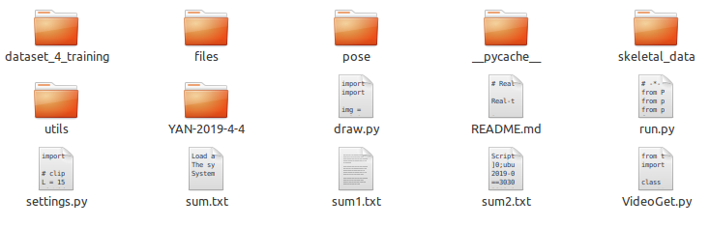
April-5-2019 Skeleton Extraction
3-8-3-1-3-UI-Real-Time-Action-Recognition-master
Bug: to be fixed
Harry Li, Ph.D.

Slide 12
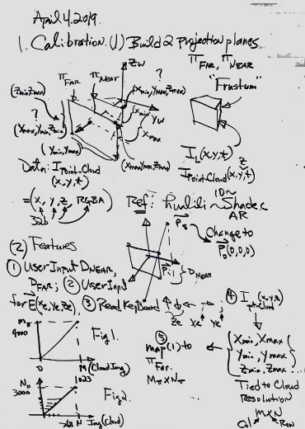
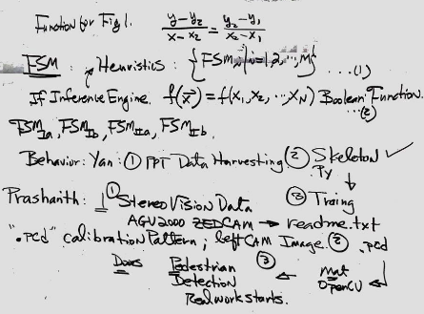
April-5-2019 Process for Behav Improvement
1. PPT for data harvesting, see github on line lec3-8-3-1-2-OnLineHarvesting-Images.ppt https://github.com/hualili/opencv/tree/master/IP120-AI-DL/2018F
Harry Li, Ph.D.

Slide 13
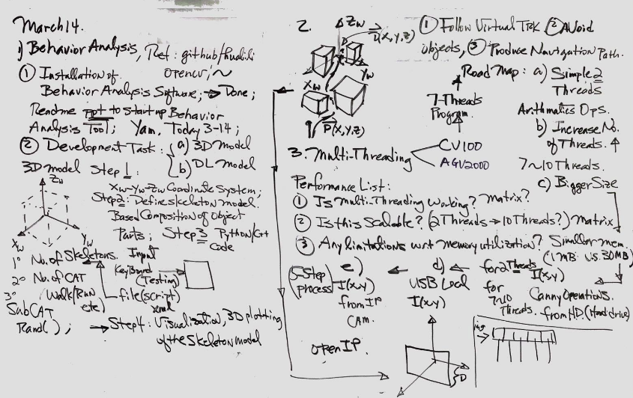
3-13-2019 Denis Net
Harry Li, Ph.D.

Slide 14

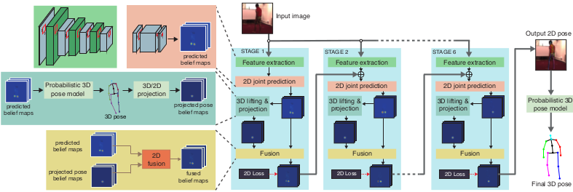
2-22-2019 Denis Net
Harry Li, Ph.D.

Slide 15
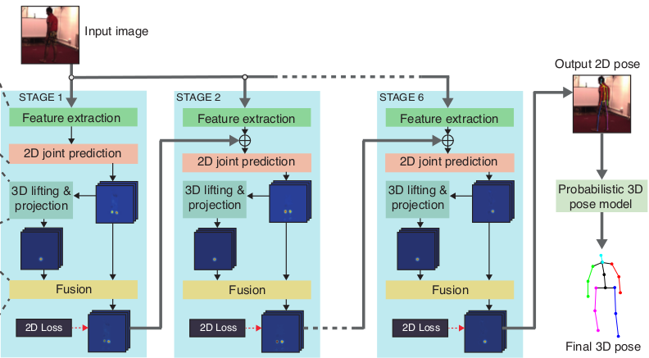
2-22-2019 Denis Net Architecture (1/3)
Harry Li, Ph.D.

Slide 16
2-22-2019 Denis Net Architecture (2/3)
x
I(x,y)
Input Image
y
Stage I
Stage 2
Stage 3
Stage 4
Stage 5
Stage 6
Probabilistic 3D Pose Model
Output Image
Harry Li, Ph.D.

Slide 17
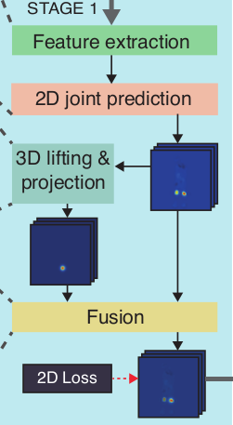
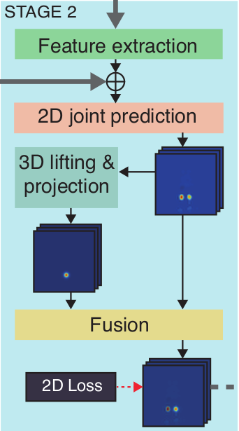
2-22-2019 Denis Net Subsystems
Harry Li, Ph.D.

Slide 18
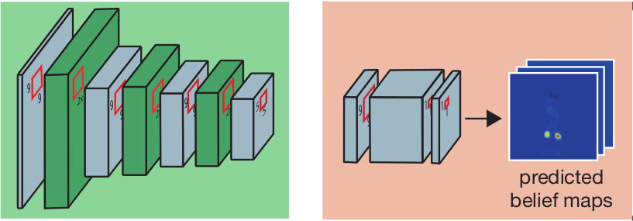
2-22-2019 Feature Extraction & 2D Join Prediction
Feature Extraction
2D Joint Prediction
Harry Li, Ph.D.

Slide 19
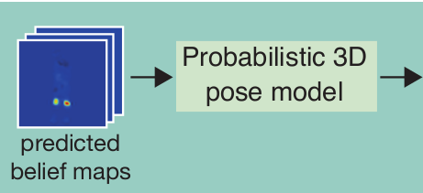
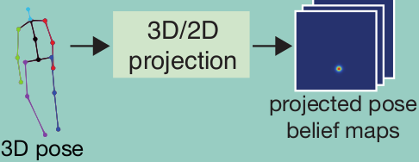
2-22-2019 3D Lifting & Prediction
Harry Li, Ph.D.

Slide 20
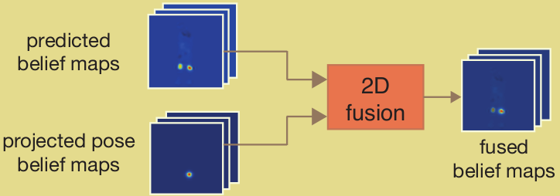
2-22-2019 2D and 3D Fusion
Harry Li, Ph.D.

Slide 21
12-27-2018 3D CNN in Keras - Action Recognition
http://learnandshare645.blogspot.com/2016/06/3d-cnn-in-keras-action-recognition.html
#Reading boxing action class
#Reading hand clapping action class
#Reading hand waving action class
#Reading jogging action class
#Reading running action class
#Reading walking action class
https://www.youtube.com/watch?v=ecbeIRVqD7g&feature=youtu.be
Anuj shah
Published on Jun 19, 2016
This video explains the implementation of 3D CNN for action recognition. It explains little theory about 2D and 3D Convolution. The implementation of the 3D CNN in Keras continues in the next part. The codes are available at - http://learnandshare645.blogspot.in/2.... The links in the videos are given below : -
1. Install Keras from https://github.com/MinhazPalasara
https://github.com/MinhazPalasara/ker...
2. Download KTH action dataset http://www.nada.kth.se/cvap/actions/
3.Configure opencv for video processing – install ffmeg and set up the path
http://kronoskoders.logdown.com/
Harry Li, Ph.D.

Slide 22
12-26-2018 Behavior Analysis
Konstantinos Makantasis 1
Anastasios Doulamis 2
Nikolaos Doulamis 2
Konstantinos Psychas 3
1, 2: Technical University of Crete, School of Production Engineering and Management, Chania, Greece; National Technical University of Athens, School of Electrical and Computer Engineering, Athens, Greece
3: Columbia University, Electrical Engineering Department, New York, USA
Rely in tutor to fusing spatio-temporal information of human activities into 2D maps before feding to a CNN, which, in turn, automatically constructs high-level features to capture the human activities.
Computational complexity is O(KLM log KLM ) [15], with 2D convolution,O(KL log KL). Variables K and L stand for video’s height and width, while M stands for the number of subsequent frames
The fully automated behavior understanding in industrial environments. we exploit a Convolutional Neural Network (CNN), which automate the process of feature construction. Although such models are limited to handle still 2D inputs, we transform video input to incorporate temporal information into each frame. Our model hierarchically constructs features from both spatial and temporal dimensions. Data taken from Nissan factory, and it achieves superior performance without relying on handcrafted features.
Harry Li, Ph.D.

Slide 23
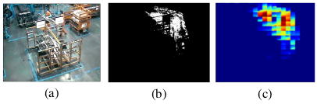
12-26-2018 DCT Feature Reduction
Motion History Image (MHI)
Non overlapping windows
(a) Original frame,(b) MHI for the captured frame and (c) dimension reduction using DCT transform.
ConvolutionalCNN
DCT
Incorporate temporal information into constructed features, we model the visual content of each frame using its Motion History Image (MHI) over a predefined number frames [17]. It has been shown in [16] that a small number of subsequent frames are enough to achieve an activity recognition performance.
To achieve a computational efficient, we split MHI input into non overlapping windows and keep the most dominant Discrete Cosine Transform (DCT) coefficients.
Harry Li, Ph.D.

Slide 24
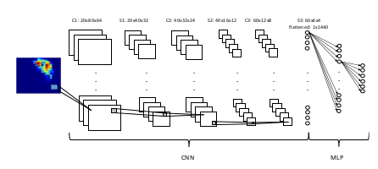
12-26-2018 CNN Architecture
C1 S1 C2 S2 C3 S3
Harry Li, Ph.D.

Slide 25
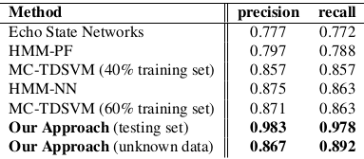
12-26-2018 Experimental Setup
Deep learning tools
Data set library
Theano [19, 20] library.
The SCOVIS dataset consists of 20 scenarios.
Table 1. Other approaches
(i) Echo State Networks (ESN) [4], with handcrafted local motion grid features
(ii) Hidden Markov Model exploiting Particle Filters (HMM-PF)
and Hidden Markov Model using a Neural Network rectifica-
tion scheme (HMM-NN) [5], with handcrafted features using Zernike moments of pixel changing history [21]
(iii) MultiClass Tapped Delay Support Vector Machines (MC-TDSVM) [6] with handcrafted features [5] along with a user feedback strategy.
Harry Li, Ph.D.

Slide 26
12-27-2018 SCOVIS
Self-Configurable Cognitive Video Supervision
http://archive.li/Ec6qf
SCOVIS supports the automatic detection of
a) behaviours
b) workflow violation and
c) localization of salient moving or static objects in scenes, monitoring by multiple cameras (static or active).
Project Coordinator, Institute of Communication and Computer Systems/National Technical University of Athens (ICCS/NTUA)
Harry Li, Ph.D.

Slide 27

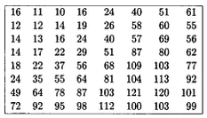
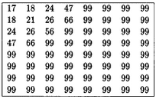

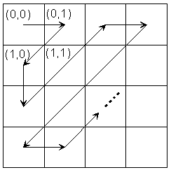
12-27-2018 DCT Technique
http://www.johnloomis.org/ece563/notes/compression/jpeg/tutorial/jpegtut1.html
Quantization table for Luminance
Quantization table for Luminance
Quantization table for chrominance
Quantization Matrix
Then use quantization table cofficient to divide each dct value to finish quantization
The quantization matrix is the 8 by 8 matrix of step sizes (sometimes called quantums) - one element for each DCT coefficient. It is usually symmetric. Step sizes will be small in the upper left (low frequencies), and large in the upper right (high frequencies); a step size of 1 is the most precise. The quantizer divides the DCT coefficient by its corresponding quantum, then rounds to the nearest integer. Large quantums drive small coefficients down to zero. The result: many high frequency coefficients become zero, and therefore easier to code. The low frequency coefficients undergo only minor adjustment.
https://www.sciencedirect.com/topics/computer-science/quantization-matrix
Harry Li, Ph.D.

Slide 28
12-27-2018 DCT For 64 Times Image Reduction
Preprocessing: convert 704×576 color to gray scale image, then
1. Split each frame into 32 × 32 non-overlapping blocks to compute its DCT transform;
2. Keep the 16 most dominant DCT coefficients; (so the reduction is from 32x32 to 4x4)
3. Then perform inverse DCT to recover 4x4 image block.
32 × 32 non-overlapping blocks with quantization matrix from (1) luminance, and (2) size extended to 32 x 32 by adding big number 99 as below
16 most dominant DCT coefficients kept in the following manner
32
4 x 4
32
Harry Li, Ph.D.

Slide 29
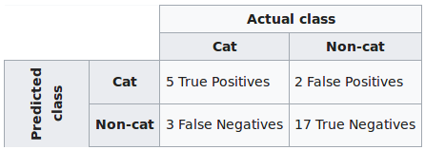
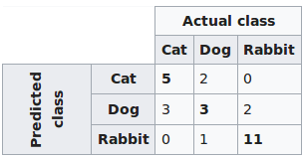
12-27-2018 Confusion Matrix
https://en.wikipedia.org/wiki/Confusion_matrix
A confusion matrix, e.g., an error matrix, is a table for visualization of the performance of an algorithm, typically a supervised learning in machine learning and statistical classification.
Example: If a classification system has been trained to distinguish between cats, dogs and rabbits, a confusion matrix will summarize the results of testing the algorithm. Assuming a sample of 27 animals — 8 cats, 6 dogs, and 13 rabbits, the resulting confusion matrix could look like the table below:
Table 2
Predictive analytics
Sub total
7 27
8
12
Table 1
Sub-total 8 6 13
Total 27 (=8+6+13)
Classification system
Harry Li, Ph.D.

Slide 30
12-26-2018 Pyrdown to Replace DCT for Feature Reduction
Pyramid down stage?
Motion History Image (MHI)
Non overlapping windows
ConvolutionalCNN
DCT
Harry Li, Ph.D.

