Slide 1
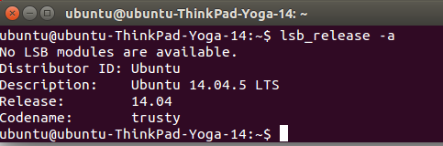
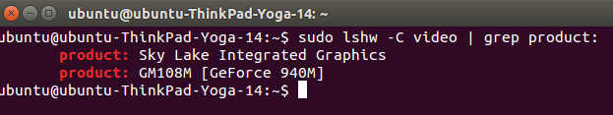
CUDA as the Prerequisite for Tensor Flow
https://www.tensorflow.org/tutorials/
1. Find the version of your ubuntu
or
lsb_release -a
2. find the graphics card your machine support
sudo lshw -C video | grep product:
Run lshw to find out your CPU feature
uname -m && cat /etc/*release
Ubuntu 14.04 support CUDA tool kit 8.0 :
X86_64 Ubuntu 14.04 kernel: 3.13; gcc: 4.8.2; glibc: 2.19
For ARMv8 CPU (aarch64) is the same version requirements.
GPU GeForce 940M is CUDA capable (compute capability 5.0, see NVDA website
https://developer.nvidia.com/cuda-gpus
If needs GPU driver down load:
http://www.nvidia.com/Download/index.aspx?lang=en-us
Since I have GPU (GeForce 940M), to install CUDA tool kit 8.0, will have to check if the GPU is CUDA capable.
http://docs.nvidia.com/cuda/cuda-installation-guide-linux/#axzz4VZnqTJ2A

Slide 2
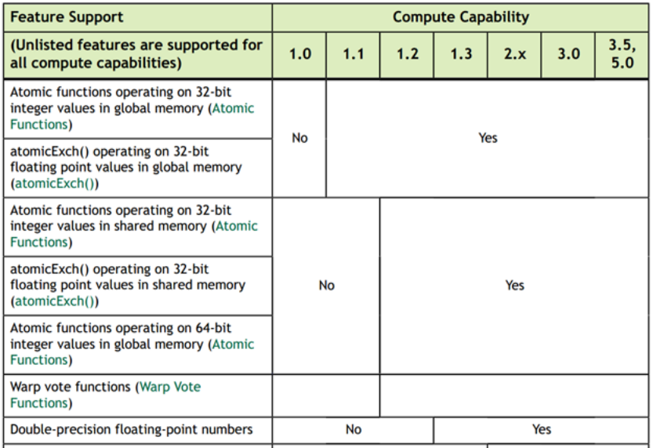
Cuda Compute Capability Explained (1)
https://stackoverflow.com/questions/10961476/what-are-the-differences-between-cuda-compute-capabilities
Note: my laptop GeForce 940M, supports 5.0

Slide 3
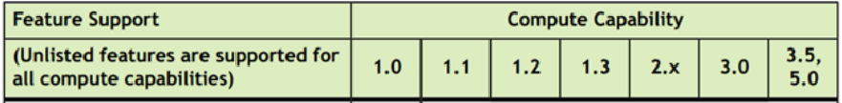
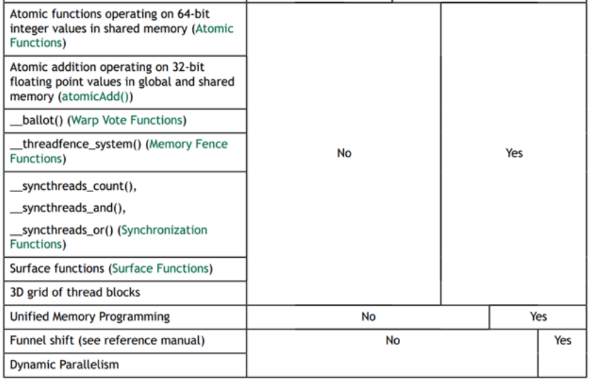
Cuda Compute Capability Explained (2)
https://stackoverflow.com/questions/10961476/what-are-the-differences-between-cuda-compute-capabilities

Slide 4
CUDA Installation Guide
http://docs.nvidia.com/cuda/cuda-installation-guide-linux/index.html#axzz4oHtT15GP
Find ubuntu gcc compiler version:
gcc -v
Note: the guideline for installation
Verify the system has a CUDA-capable GPU.
Verify the system is running a supported version of Linux.
Verify the system has gcc installed.
Verify the system has the correct kernel headers and development packages installed.
Download the NVIDIA CUDA Toolkit.
Handle conflicting installation methods.
Read more at: http://docs.nvidia.com/cuda/cuda-installation-guide-linux/index.html#ixzz4oCNBURHX
Follow us: @GPUComputing on Twitter | NVIDIA on Facebook

Slide 5

Verify Correct Kernel Header CUDA
http://docs.nvidia.com/cuda/cuda-installation-guide-linux/index.html#axzz4oHtT15GP
The kernel headers and development packages has to be installed.
The NVIDIA CUDA Toolkit is available at .
1. the Runfile is not good, Runfile installation performs no package validation; 2. the RPM and Deb installations of the driver will make an attempt to install the kernel header;
Installation Instructions:
`sudo dpkg -i cuda-repo-ubuntu1404-8-0-local-ga2_8.0.61-1_amd64.deb`
`sudo apt-get update`
`sudo apt-get install cuda`
2. Find the version of your linux kernel
uname -r
Make sure do download verification: ？？？
add CUDA to the PATH
This is the version of the kernel headers and development packages that must be installed prior to installing the CUDA Drivers.
To install the header and the package:
export PATH=/usr/local/cuda-8.0/bin${PATH:+:${PATH}}
sudo apt-get install linux-headers-$(uname -r)

Slide 6
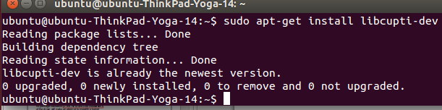
Export PATH and Profiler Installation
export PATH=/usr/local/cuda-8.0/bin${PATH:+:${PATH}}
PATH is a global OS variable contains names of files to be executed without specyfing the whole path. For example You can just write startx to start graphic environemnt instead of /bin/some other folders/startx
The libcupti-dev library, which is the NVIDIA CUDA Profile Tools Interface. This library provides advanced profiling support. To install this library, issue the following command
Run . ~/.profile for changes to take immediate effect
To add a directory to your $PATH, follow any one of the below. (example, to add '/usr/hitech/picc/9.82/bin/picc'
simply edit ~/.profile
gedit ~/.profile
find the following line:
PATH="$HOME/bin:$PATH"
and change it to:
PATH="$HOME/bin:$PATH:/usr/hitech/picc/9.82/bin"
Or run the below command in terminal
export PATH=$PATH:/usr/hitech/picc/9.82/bin
https://www.tensorflow.org/install/install_linux
Note: when I did the above for libcupti-dev, I have got a some kind symbolic link error messsage, after searching google, I did:
sudo apt-get update
sudo apt-get upgrade
Then retry install libcupti-dev, the error is gone.

Slide 7



cuDNN v5.1 Installation
Deep Neural Network library (cuDNN)
cuDNN accelerates widely used deep learning frameworks, including , , , , , and . See for more details.
https://developer.nvidia.com/rdp/form/cudnn-download-survey

Slide 8

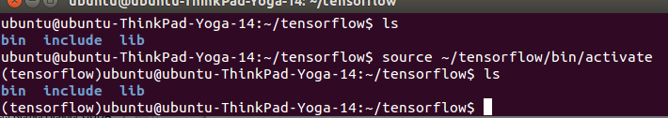
Tensor Flow Installation on Ubuntu 14.04
https://www.tensorflow.org/tutorials/
After all the prerequisite, now follow the tensor flow installation recommendation, go with virtualenv installation for isolated python environment.5 Steps from the tensor flow tutorial:
Step 1: sudo apt-get install python3-pip python3-dev python-virtualenv
Step 2: virtualenv --system-site-packages -p python3 ~/tensorflow
Step 3: $source ~/tensorflow/bin/activate # bash, sh, ksh, or zsh (note, you can use the following for your choice:
$ source ~/tensorflow/bin/activate.csh # csh or tcsh) if it is successful, then The preceding source command should change your prompt to the following:
(tensorflow)$
Note: check your python version
$python --version
Step 4: pip3 install --upgrade tensorflow-gpu
But had error message of no download was found, so upgrade pip and tensorflow as follows, then install again, the error was gone.
pip install --upgrade pip
pip install --upgrade tensorflow

Slide 9
Activate and Deactivate Tensor Flow
To activate:
$ source ~/tensorflow/bin/activate # bash, sh, ksh, or zsh
$ source ~/tensorflow/bin/activate.csh # csh or tcsh
To deactivate:
$deactivate
Your prompt will become the following to indicate that your tensorflow environment is active:
(tensorflow)$

Slide 10
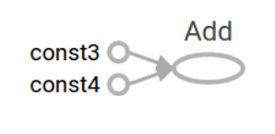
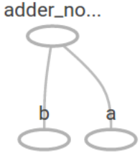
Tensor Flow Lecture Notes 1
https://www.tensorflow.org/get_started/get_started
Two rows and 3 columns
Define Tensor:
3 # a rank 0 tensor; this is a scalar with shape []
[1. ,2., 3.] # a rank 1 tensor; this is a vector with shape [3]
[[1., 2., 3.], [4., 5., 6.]] # a rank 2 tensor; a matrix with shape [2, 3]
[[[1., 2., 3.]], [[7., 8., 9.]]] # a rank 3 tensor with shape [2, 1, 3]
Import Tensorflow
The canonical import statement for TensorFlow programs:
import tensorflow as tf
This gives Python access to all of TensorFlow's classes, methods, and symbols.
A computational graph is a series of TensorFlow operations arranged into a graph of nodes.
Create 2 floating point Tensors node1 and node2 as follows:
node1 = tf.constant(3.0, dtype=tf.float32)
node2 = tf.constant(4.0) # also tf.float32 implicitly
print(node1, node2)
The final print statement produces
Tensor("Const:0", shape=(), dtype=float32) Tensor("Const_1:0", shape=(), dtype=float32)
Notice that printing the nodes does not output the values 3.0 and 4.0 as you might expect. Instead, they are nodes that, when evaluated, would produce 3.0 and 4.0, respectively.

Slide 11
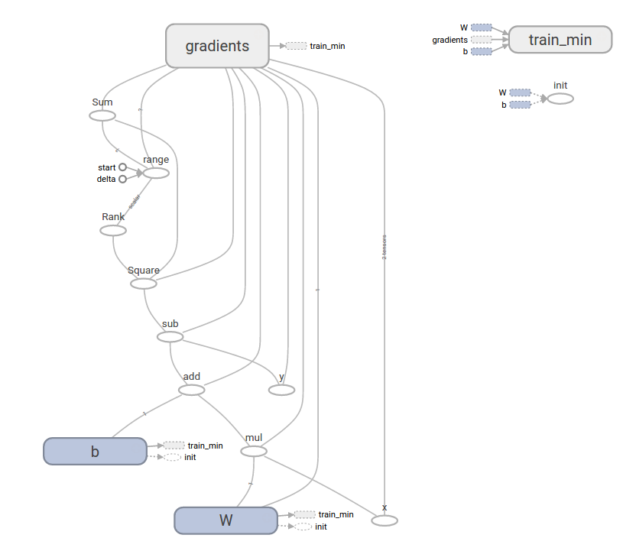
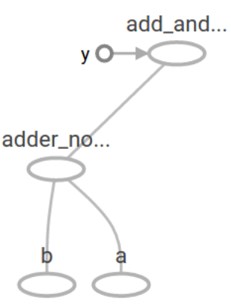
Tensor Flow Lecture Notes 1

Slide 12

Your First Python Program
The program first.py
print(“Harry, hello”)
To run it:
$python first.py

