Slide 1

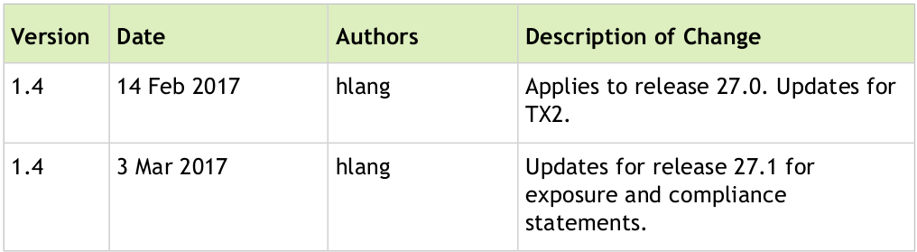
lec11-1-Webinstallation-2017-12-29
lec8-2-Install-TF-Tx2-2017-12-16
Company confidential
CTI One Corporation
Version: x0.1
Date: Dec.29, 2017
Project Lead: Harry Li, Ph.D.
Group Leaders: Team members:
Document Change History; Document number:

Slide 2
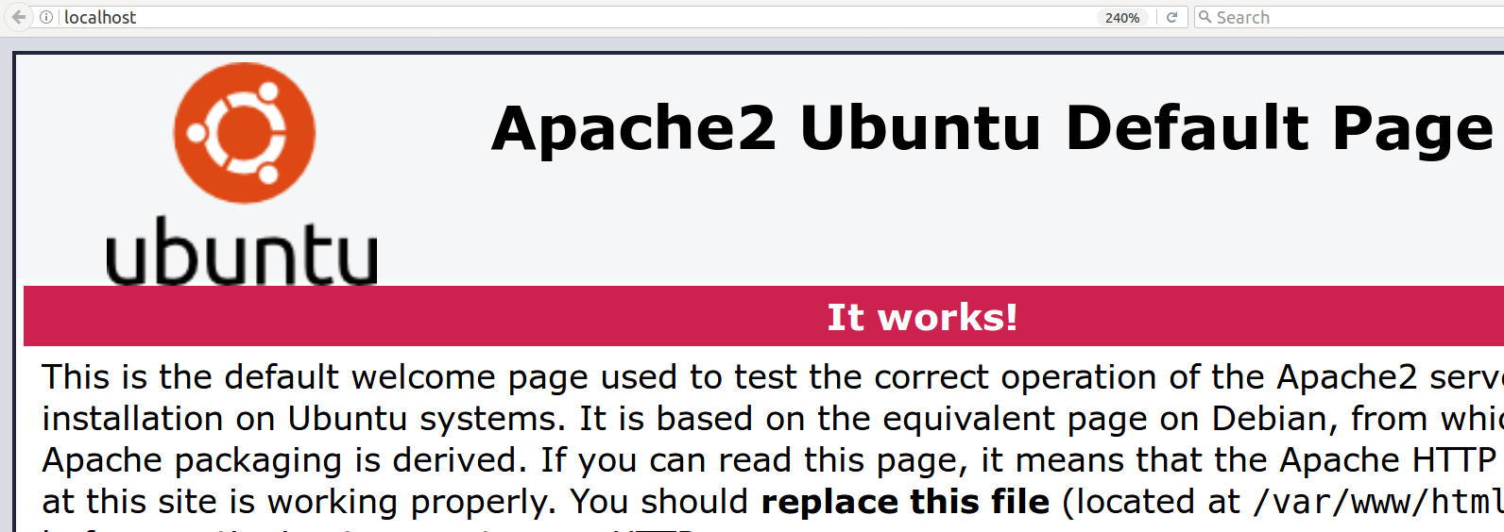
Procedures to Install Web Server
https://www.digitalocean.com/community/tutorials/how-to-install-linux-apache-mysql-php-lamp-stack-on-ubuntu-14-04
1. Have a separate, non-root user account set up on your server. (note I am using Ubuntu 14.04., and created a directory ~/Desktop/harry )
2. Install Apache using Ubuntu's package manager, apt from a repository maintained by Ubuntu.
sudo apt-get update
sudo apt-get install apache2
Once it is done, check it by using your browser and pointing it to http://localhost your web server will respond as follows:
If you can read this page, it means that the Apache HTTP server is working properly. You can replace this file (located at /var/www/html/index.html) before continuing to operate your HTTP server.
/etc/apache2/
|-- apache2.conf
| `-- ports.conf
|-- mods-enabled
| |-- *.load
| `-- *.conf
|-- conf-enabled
| `-- *.conf
|-- sites-enabled
| `-- *.conf
The configuration layout is as follows
1
CTI One Corporation, Santa Clara, CA 95051

Slide 3
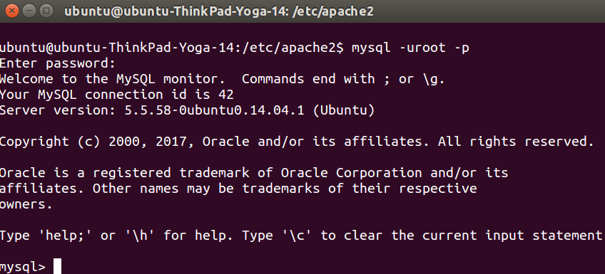
Install mySQL
http://www.linuxandubuntu.com/home/how-to-setup-a-web-server-and-host-website-on-your-own-linux-computer
Install mySQL database to store and retrieve data in tables. Since we shall be using php, we will also need to install php5-mysql component.
$sudo apt-get install mysql-server php5-mysql
If you set the password during installation open with -p parameter:
$mysql -uroot -p
To check if mySQL is installed properly:
$mysql -uroot
Note: I set password as ubuntu
1
CTI One Corporation, Santa Clara, CA 95051

Slide 4
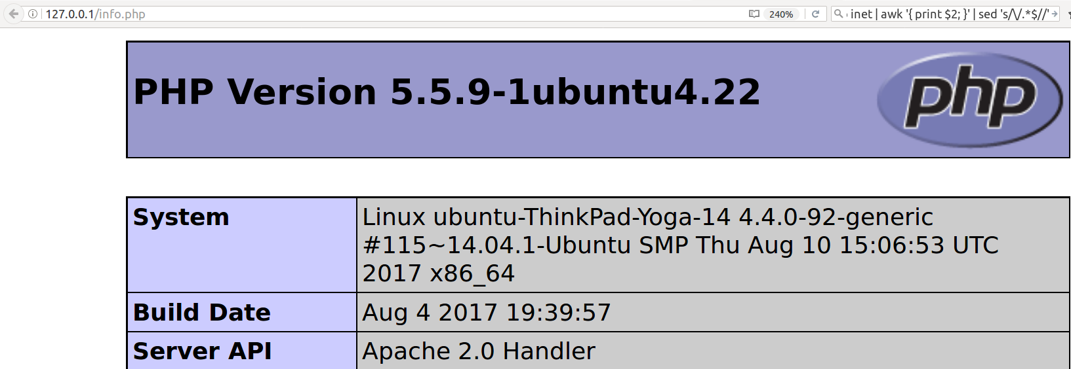
Install php
http://www.linuxandubuntu.com/home/how-to-setup-a-web-server-and-host-website-on-your-own-linux-computer
PHP is open source web server scripting language that will interact with the mySQL database. For example, if you want to show the tabular employee list stored in your mySQL database in your website, with the help of PHP you can interact with mySQL, retrieve the employee list and render in html page. Php5-mysql library helps you with multiple libraries.
​
To search the libraries that are available.
$apt-cache search php5-
To install PHP and php5-mysql
$sudo apt-get install php5 libapache2-mod-php5 php5-mcrypt
$sudo apt-get install php5-sqlite
Browser html page
website
mySQL
To check if php is installed correctly, make file /var/www/html/info.php and add the following content to this file -
​<?php
phpinfo();
?>
Once it is done, check it by using your browser and pointing it to http://localhost your web server will respond as follows:
You will see this as php installation is successful.
1
CTI One Corporation, Santa Clara, CA 95051

Slide 5
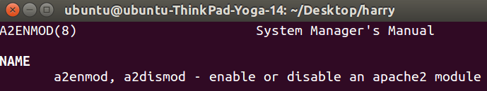
Apache2 Configuration
https://www.digitalocean.com/community/tutorials/how-to-install-linux-apache-mysql-php-lamp-stack-on-ubuntu-14-04
/etc/apache2/
|-- apache2.conf
| `-- ports.conf
|-- mods-enabled
| |-- *.load
| `-- *.conf
|-- conf-enabled
| `-- *.conf
|-- sites-enabled
| `-- *.conf
the main configuration file, includes all remaining configuration files when starting up the web server. Read and browse this file.
1
ports.conf is always included from the main configuration file. It defines the listening ports for incoming connections, and this file can be customized anytime.
2
Configuration files in these 3 directories: mods-enabled/, conf-enabled/ and sites-enabled/ contain configuration snippets to manage modules, global configuration fragments, or virtual host configurations, respectively.
3
Configuration files are activated by symlinking available configuration files from their respective *-available/ counterparts. These should be managed by using helpers (See the man pages)
a2enmod,
a2dismod,
a2ensite,
a2dissite, and
a2enconf,
a2disconf .
2
CTI One Corporation, Santa Clara, CA 95051

Slide 6

Apache2 Document Root
https://www.digitalocean.com/community/tutorials/how-to-install-linux-apache-mysql-php-lamp-stack-on-ubuntu-14-04
Due to the use of environment variables, in the default configuration, apache2 needs to be started/stopped with /etc/init.d/apache2 or apache2ctl. Calling /usr/bin/apache2 directly will not work with the default configuration.
By default, Ubuntu does not allow access through the web browser to any file apart of those located in /var/www, public_html directories (when enabled) and /usr/share (for web applications). If your site is using a web document root located elsewhere (such as in /srv) you may need to whitelist your document root directory in /etc/apache2/apache2.conf.
The default Ubuntu document root is /var/www/html. You can make your own virtual hosts under /var/www. This is different to previous releases which provides better security out of the box.
3
CTI One Corporation, Santa Clara, CA 95051

Slide 7
Start/Stop Apache2
https://www.digitalocean.com/community/tutorials/how-to-install-linux-apache-mysql-php-lamp-stack-on-ubuntu-14-04
3
CTI One Corporation, Santa Clara, CA 95051

Slide 8

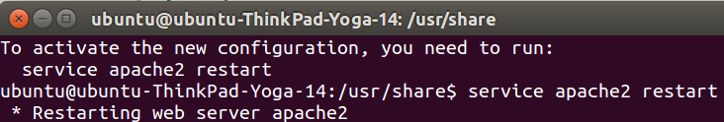
Find Apache2 Public IP Address
https://www.digitalocean.com/community/tutorials/how-to-install-linux-apache-mysql-php-lamp-stack-on-ubuntu-14-04
Your server's public IP address is usually the address to connect to your server through SSH. Use the iproute2 tools to get your address as:
ip addr show eth0 | grep inet | awk '{ print $2; }' | sed 's/\/.*$//'
This will give you one or two lines back. They are both correct addresses, but your computer may only be able to use one of them, try each one.
An alternative method is:
curl http://icanhazip.com
Use $service apache2 restart
to restart your apache2 server
3
CTI One Corporation, Santa Clara, CA 95051

Slide 9
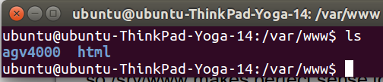
Create Web Content at /srv/www/html
https://www.linux.com/blog/configuring-apache2-run-python-scripts
As sudo make the following directory for my cgi
/srv/www/agv4000/public_html/cgi-bin
1. Put your web files based on filesystem hierarchy standard (FHS) in the "/srv" directory, also a lot of people put web files in "/var/www". Note the "/var" directory is full of logs and print spoolers etc.
2. Put network files in /srv/files as well.
3. Put the web root in /var/www, Arch, for example uses /srv/http by default. Its not difficult to change it to serve the files from any directory in the file system. All the contents of your server, including mysql databases, a bunch of SVN repositories and a few virtual websites are stored in various subdirectories of /srv
4. /srv is relatively new. According to the FHS, "/srv contains data served by this system" so /srv/www makes perfect sense for a webserver. /var is an older convention. It was meant for data that changes over time ("variable data") such as caches, spool, logs, all sorts of housekeeping and administration files, while "user data" would be in home directories
3
CTI One Corporation, Santa Clara, CA 95051

Slide 10
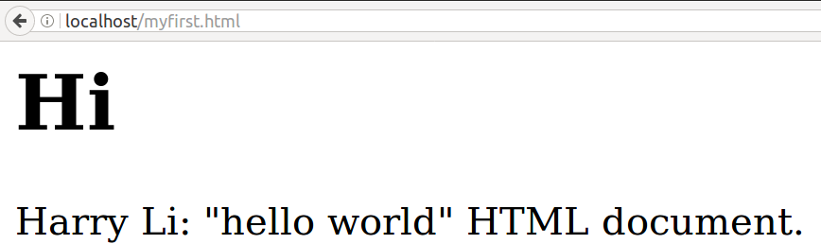
Visit Your Local Web Content at /srv/www/html
1. place your html web page in /srv/www/html directory, for example, /svr/www/html/myfirst.html
2. use browser point to http:/localhost/myfirst.html or http://127.0.0.1/myfirst.html
To change port address, you need to edit the configuration file at /etc/apache2/ports.conf and change the Listen 80 to your desired port number. After edit you need to restart the apache2 server.
3
CTI One Corporation, Santa Clara, CA 95051

