Slide 1

105-1-Camsvr2-testing-hl-2020-2-26.odp
CTI One Corporation
Version: x0.1 (Alpha)
Date: Feb 25, 2020
Project Lead: Harry Li, Ph.D.
Team members:
Minh Duc Ong
https://github.com/hualili/robotics-open_abb/tree/master/ai-embedded
/media/harry/easystore/backup-2020-2-15/CTI0/3proejcts/3-8-smart-tech/3-8-4-huaYuan/3-8-4-6-products/CAMSVR-3-8-4-6-1/manufacturing-camsvr3-8-4-6-1/camsvr-pack/105-testing$
Company confidential

Slide 2
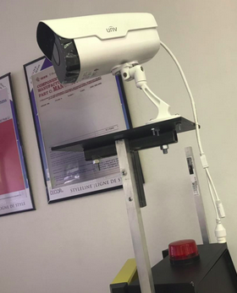
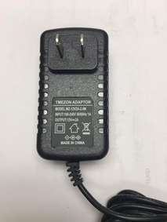
CAMSVR2 From the Packaging Box
华源智能
Power unit: 12V, 2 A
CAMSVR2

Slide 3
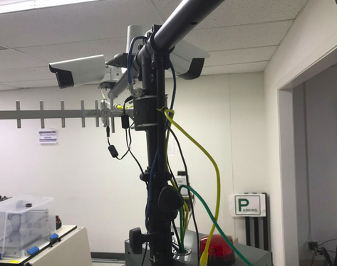
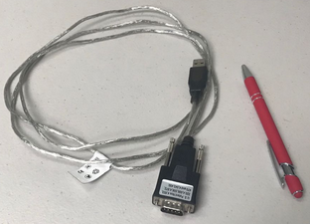

CAMSVR2 Testing Set Up
华源智能
1
Set up CAMSVR2 and have its power cable and URAT/RS232 cable which is in CAT5 cable (ethernet cable) with RJ45 connector , we call this cable 1, this cable installed on CAMSVR2. CAMSVR2 now in the test is set as UART/RS232 client
2
Set up laptop computer (1) with putty or minicom for linux OS, hyperterminal for windows. (2) then have USB-to-serial cable, we call this cable2, and make this cable plug into laptop, which is then set as UART/RS232 host. (3) then perform loop back test of the UART/RS232 host as described in the following slides.
UAR
USB-to-serial cable
USB-to-serial cable

Slide 4
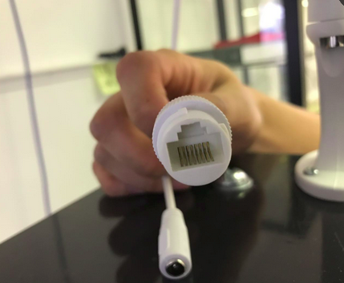
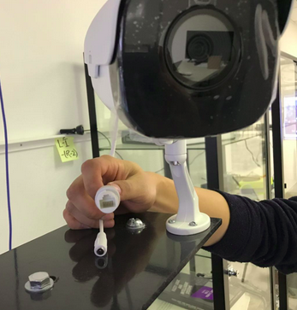
Cable 1 and 2
华源智能
cable 1
1
Set up CAMSVR2 URAT/RS232 cable is in CAT5 cable (ethernet cable) with RJ45 connector.
2
CAMSVR2 cable 2 is power cable see the figure to the right.
cable 2

Slide 5



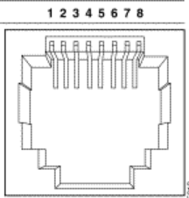
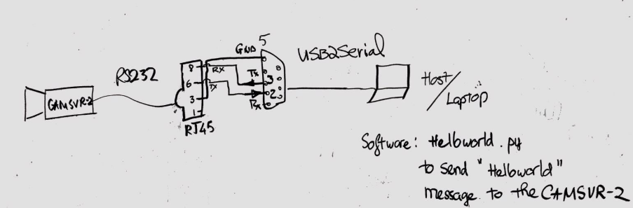
Pin Assignment
DB9 Male Connector from USB-to-Serial Cable for Laptop connection
RJ45 Female Pin Connectivity
PIN
1
2
3 GND
4
5
6 TX (to Laptop Rx)
7
8 RX (from Laptop Tx)
PIN
1
2 RX
3 TX
4
5 GND
6
7
8
9

Slide 6
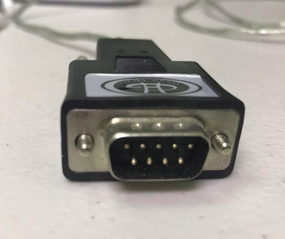
Pin Connectivity for Communication Test
RJ45-CAMSVR2 DB9-Laptop
PIN PIN 1
2
3 GND 5
4
5
6 TX (to Laptop Rx) 2
7
8 RX (from Laptop Tx) 3

Slide 7

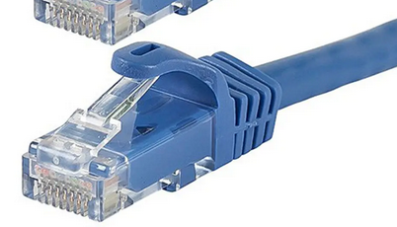
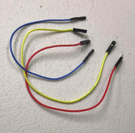
UART/RS232 Testing Set Up
Laptop
CAMSVR-1
RS232 Setting: (1) Start putty on the linux laptop, and set baud rate 115200, 8N1, no parity checking;
(2) then run the program on linux laptop,

Slide 8

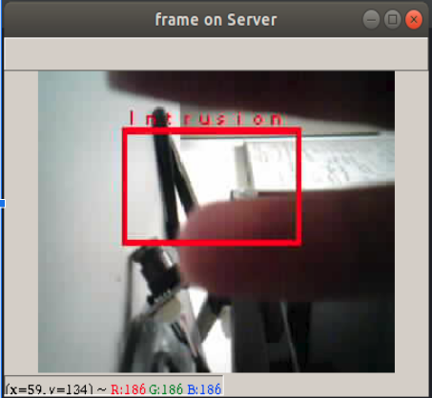
CAMSVR Intrusion Detection
Step 1: Connect the hardware as shown in the previous slide.
Step 2: Plug Power adapter to CAMSVR-2.
Step 3: Run the program “Illegal_Intrusion.py” on the laptop.
Step 4: Verify if the UART connection is set up. By those message shown on Figure 1 below.
Step 5: The “Illegal_Intrusion.py” program will send back a Image received from CAMSVR-2.
Step 6: Users use mouse click to click 2 points to select a Region of Interest.
Step 7: After the Region of Interest is set, whenever there is an illegal intrusion action occur inside that region, an Illegal Intrusion Image is sent from CAMSVR-2 to host/laptop to inform users about the intrusion (as shown in Figures 3)
Fig1. UART Handshake Message
Fig2. image_received.jpg Illegal Intrusion

Slide 9
END

