Slide 1

3-14-2-Cabling-2019-3-8.odp
CTI One Corporation
Version: x0.1
Date: March 8, 2019
Project Lead: Harry Li, Ph.D.
Team members: Barry Jia
CTI One Confidential, HL

Slide 2
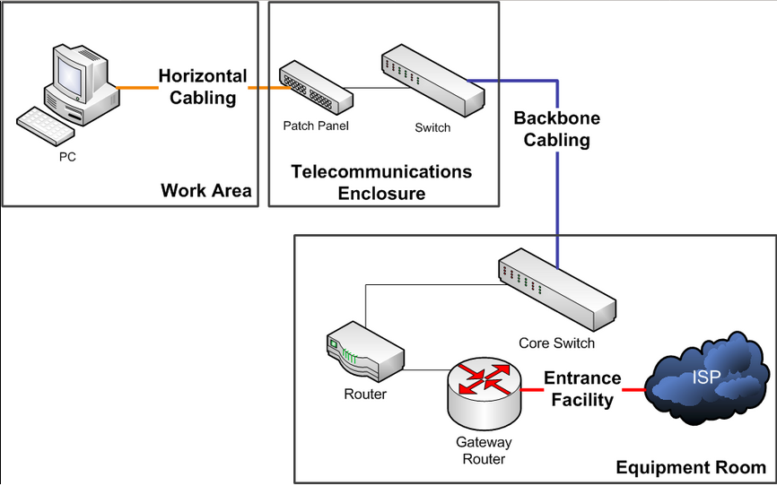
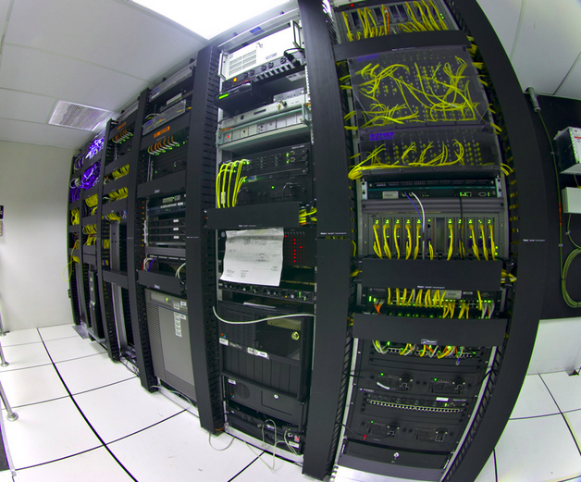
Structured Cabling IT Cabling Standards
https://en.wikipedia.org/wiki/Structured_cabling
Harry Li, Ph.D.
CTI One Confidential

Slide 3
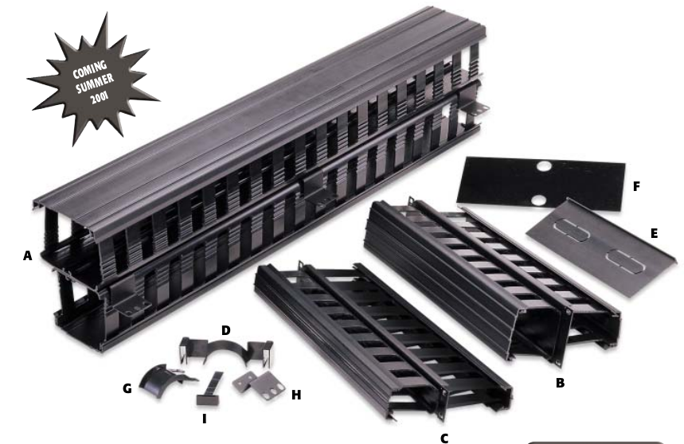
Cable Management
Harry Li, Ph.D.
CTI One Confidential

Slide 4
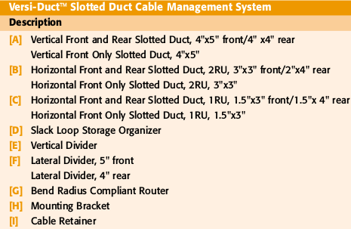
Cable Management Parts List
Harry Li, Ph.D.
CTI One Confidential

Slide 5
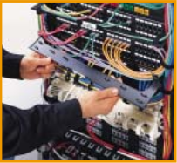

Cable Management Parts List
Harry Li, Ph.D.
CTI One Confidential

Slide 6
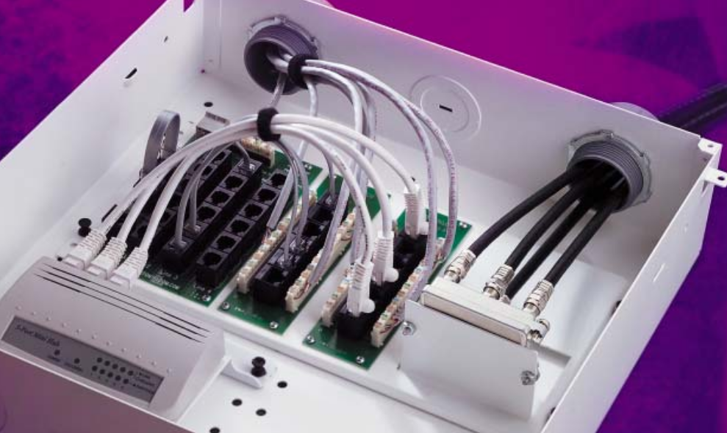
Structured Cabling Example
Harry Li, Ph.D.
CTI One Confidential

Slide 7
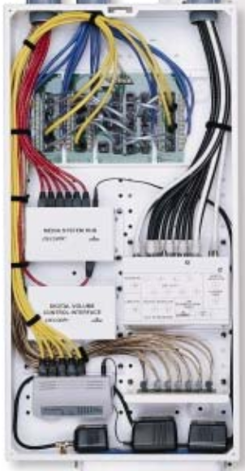
Structured Cabling Example 2
Harry Li, Ph.D.
CTI One Confidential

Slide 8
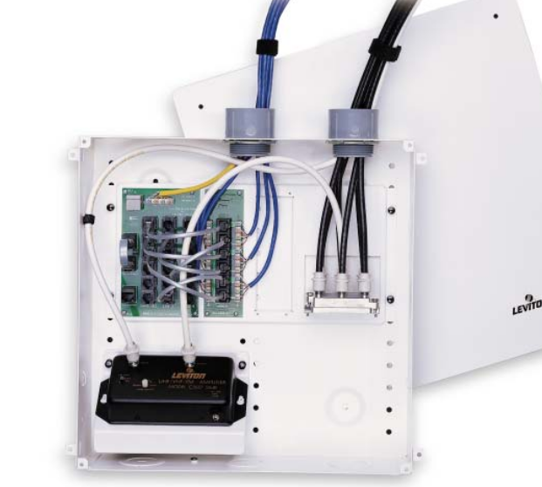
Structured Cabling Example 3
Harry Li, Ph.D.
CTI One Confidential

Slide 9
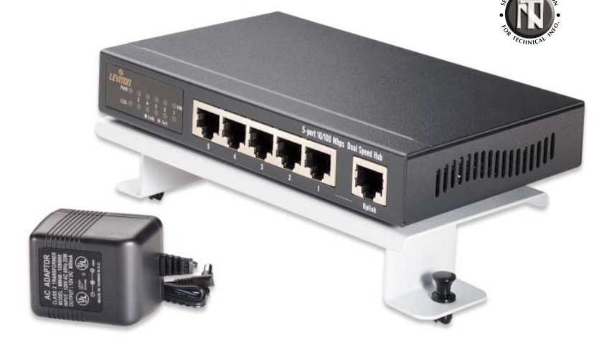
Structured Cabling Example 4
Mounting platform
Harry Li, Ph.D.
CTI One Confidential

Slide 10
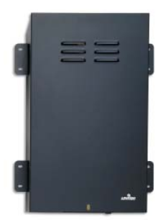
Structured Cabling Example 5
Harry Li, Ph.D.
CTI One Confidential

Slide 11
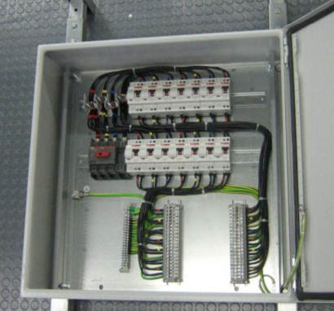
Instrumentation Cabling Example 1
Harry Li, Ph.D.
CTI One Confidential

Slide 12
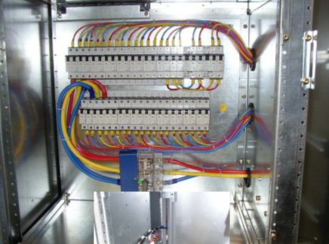
Instrumentation Cabling Example 2
Harry Li, Ph.D.
CTI One Confidential

Slide 13
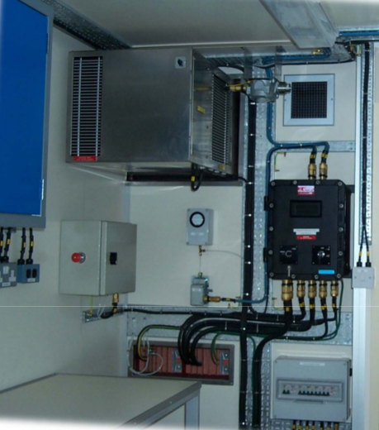
Instrumentation Cabling Example 2-1
Harry Li, Ph.D.
CTI One Confidential

Slide 14
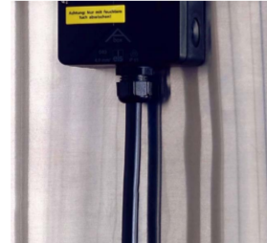
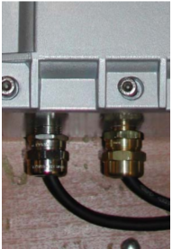
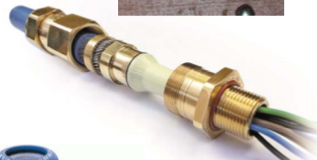
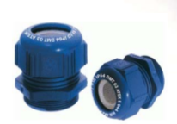
Instrumentation Cabling Example 3
Harry Li, Ph.D.
CTI One Confidential

Slide 15
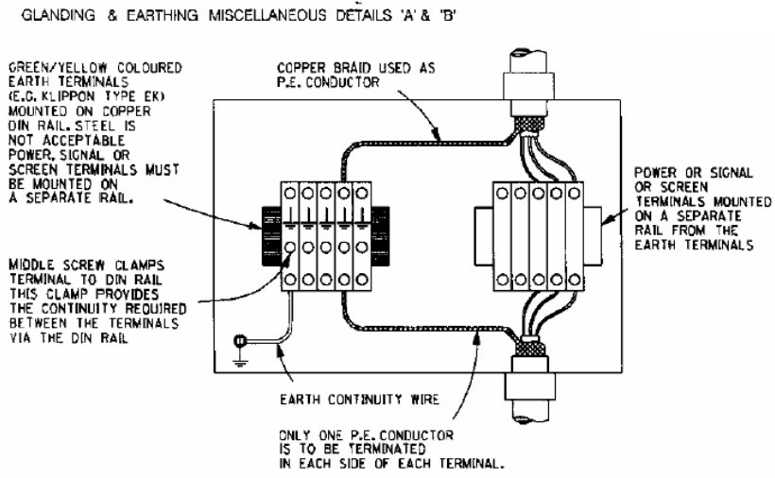
Instrumentation Cabling Example 4
Harry Li, Ph.D.
CTI One Confidential

Slide 16
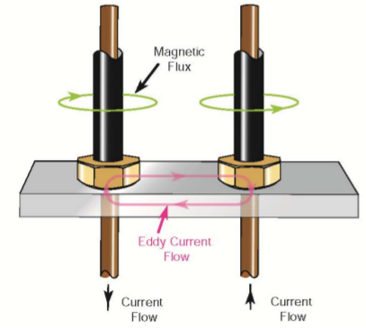
Instrumentation Cabling Eddy Current
Eddy currents can overheat iron or steel cabinets, locknuts or bushings or any
ferrous metal that completely encircles the single conductor cables. This
presents no problem in multi‐conductor cables, where the magnetic fields tend
to cancel each other out. For single core cables, it is recommended that these
cables enter metal enclosures through a non‐ferrous plate such as aluminum
Harry Li, Ph.D.
CTI One Confidential

Slide 17
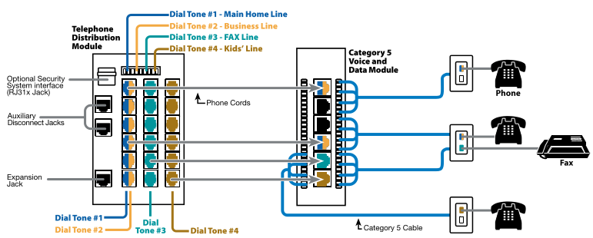
Configuration Example
1. color coded cables; 2. module based cable connectors integration;
Harry Li, Ph.D.
CTI One Confidential

Slide 18
Cabling Design Example for AGV2000
Power
Adapter1
Color Monitor
ether
Tx2 GPUSVR
Power
Adapter2
5 ports
Router
Key
board
Power
Adapter3
ether
ether
Mouse
Power
Adapter4
LPCARM
PIEARM
D-Signal distribution Module
A-Signal distribution Module
D-Signal distribution Module
Digital SENSOR
Module
Digital
Motor Drive
Module
Digital SENSOR
Module
Analog
SENSOR
Module
Digital SENSOR
Module
RF0NOD
Module
Harry Li, Ph.D.
CTI One Confidential

