Slide 1

Aiv100-2019-5-21
CTI One Corporation
Version: x0.4
Date: Sep 7, 2018
Project Lead: Harry Li, Ph.D.
Team members:
Company confidential

Slide 2


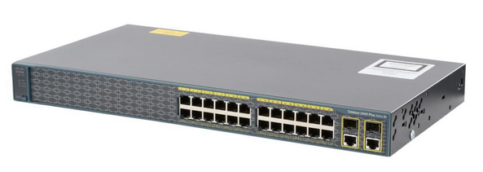
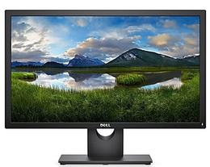
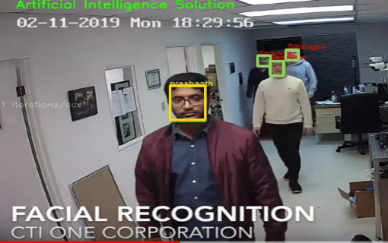
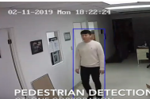
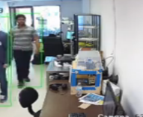


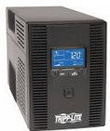
AIV-100 System Setup I
IP CAM
CTI-CAMSVR
IP Cloud
IP Router
CTI-GPUSVR
Optional Remote Management Office
Management Office

Slide 3
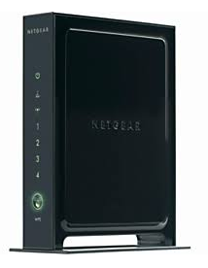

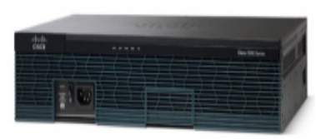

CTI One Network Setup
IP
Router_i
Router_j
2911
2900/11
CALL: (718) 766 5269
SW_i1
SW_i2
SW_j1
CISCO Catalyst 2960 2960-24TC-S(WS-C2960+24TC-S) Managed Plus 24 + 2 T/SFP LAN LiteSwitch

Slide 4
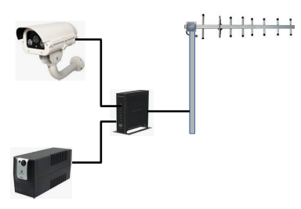


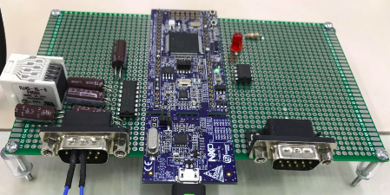
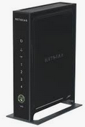
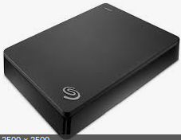

AIV-100 System Setup II
Camera 1
Office
Camera N
smartphone
Checking

Slide 5
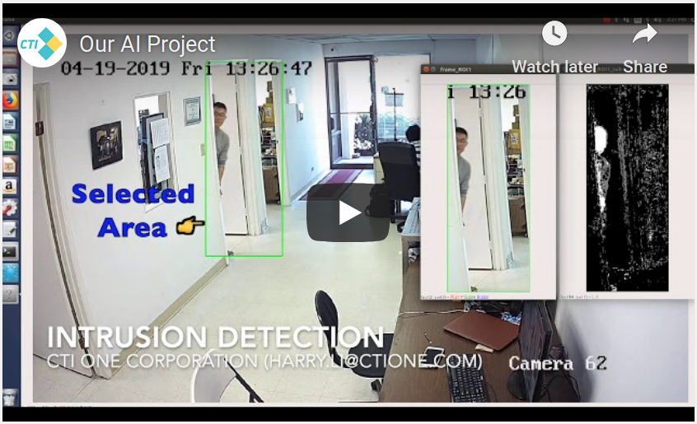
AIV-100 Intrusion Detection
Visit us on Youtube
https://www.youtube.com/watch?v=41BT45oxFTM

Slide 6
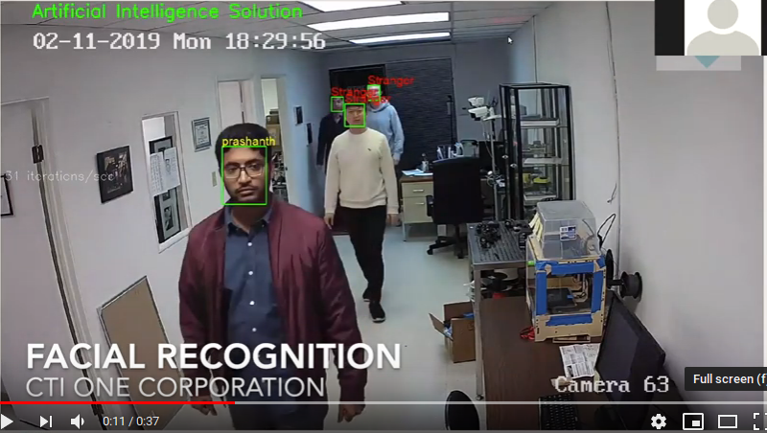
AIV-100 Facial Detection
Visit us on Youtube
https://www.youtube.com/watch?v=41BT45oxFTM
www.ctione.com

Slide 7
AIV-100 Facial Detection
Visit us on Youtube
https://www.youtube.com/watch?v=41BT45oxFTM
www.ctione.com

Slide 8
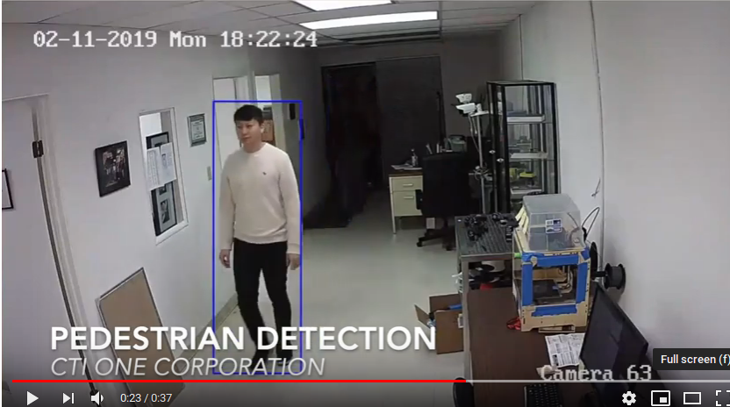
AIV-100 Behavior Analysis
Visit us on Youtube
https://www.youtube.com/watch?v=41BT45oxFTM

Slide 9
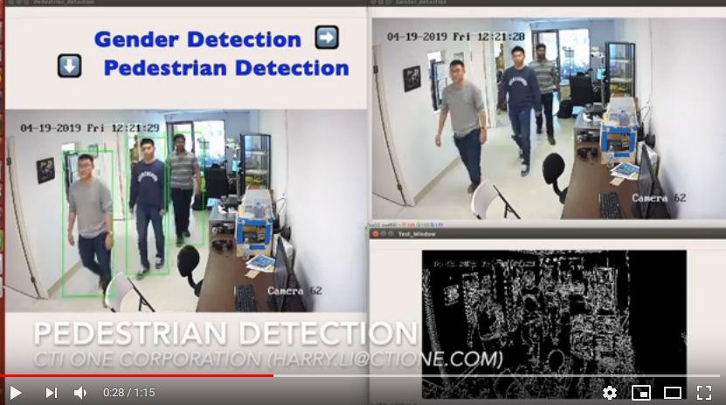
AIV-100 Behavior Analysis
Visit us on Youtube
https://www.youtube.com/watch?v=41BT45oxFTM

