Slide 1

OPTICAL ENCODERS FOR AGV4000
???
V2 Sept 23, 2019
Rama Jayaraman
CTI ONE
12/6/17 v1

Slide 2
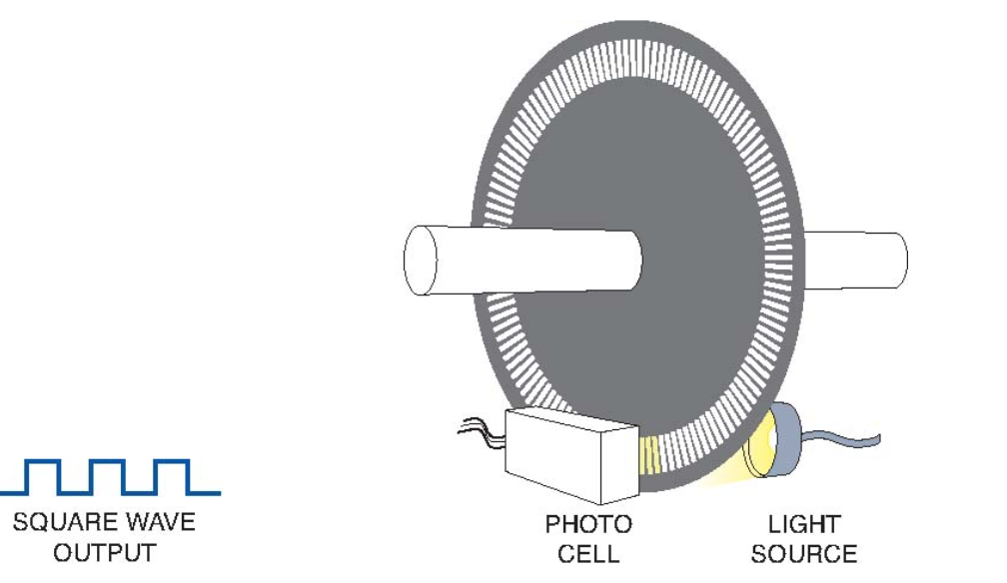
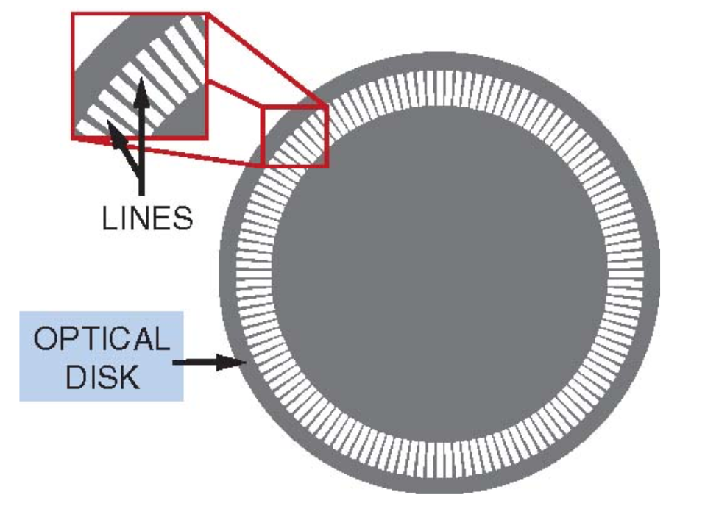
OPTICAL ENCODER – WORKING PRINCIPLE
An infrared light beam is passed through an encoder disk with multiple slots
The slots interrupt continuous beam from light source falling onto a photo detector
These slots/lines produce transitions from light to dark and dark to light which is captured by the photocell
Encoder’s current position and direction can be deduced by counting transitions and state of the previous transitions
Ref: http://blog.nidec-avtron.com/encoders/how-optical-encoders-work

Slide 3
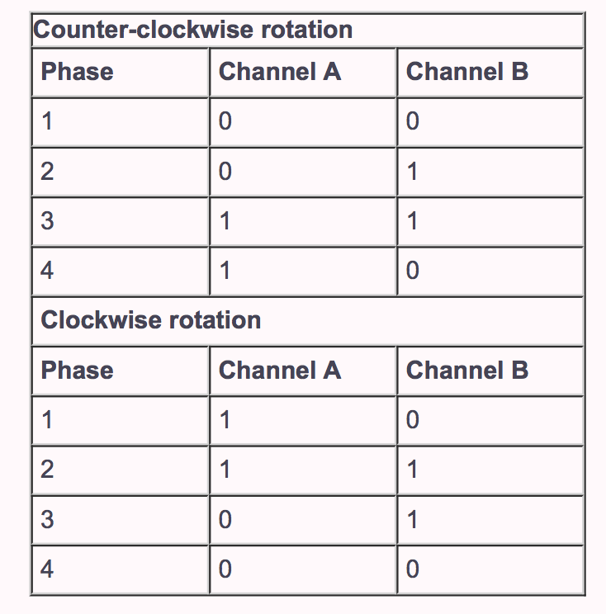
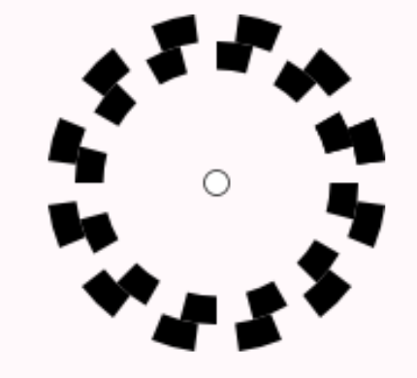
OPTICAL ENCODER – QUADRATURE MODE
A two track encoder with channels A and B can be in four possible states
The direction of rotation can be determined by the order at which state transitions happen
Encoder’s position is derived by counting each state transitions
The optical encoders used in AGV4000 has 600 slots on each channel
Each slot on channels A and B together can produce 4 states. So, maximum count for each encoder rotation is 600x4 = 2400
Encoder maximum count per rotation = 2400 steps
Channel A
Channel B
Ref: http://www.robotoid.com/appnotes/circuits-quad-encoding.html

Slide 4
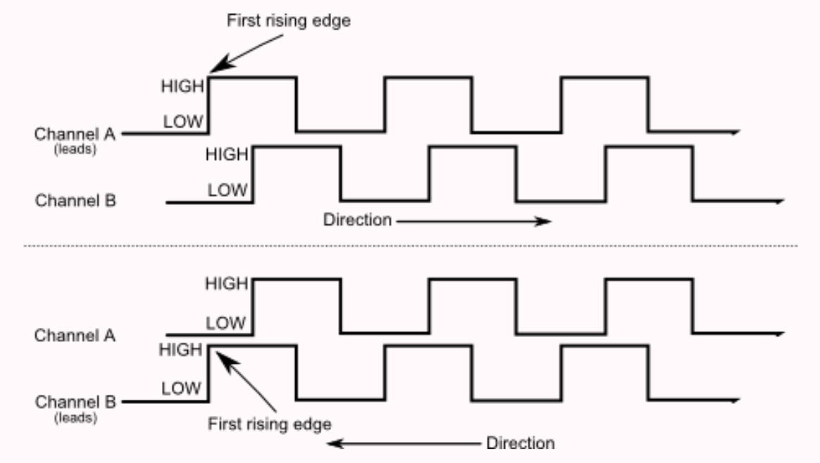
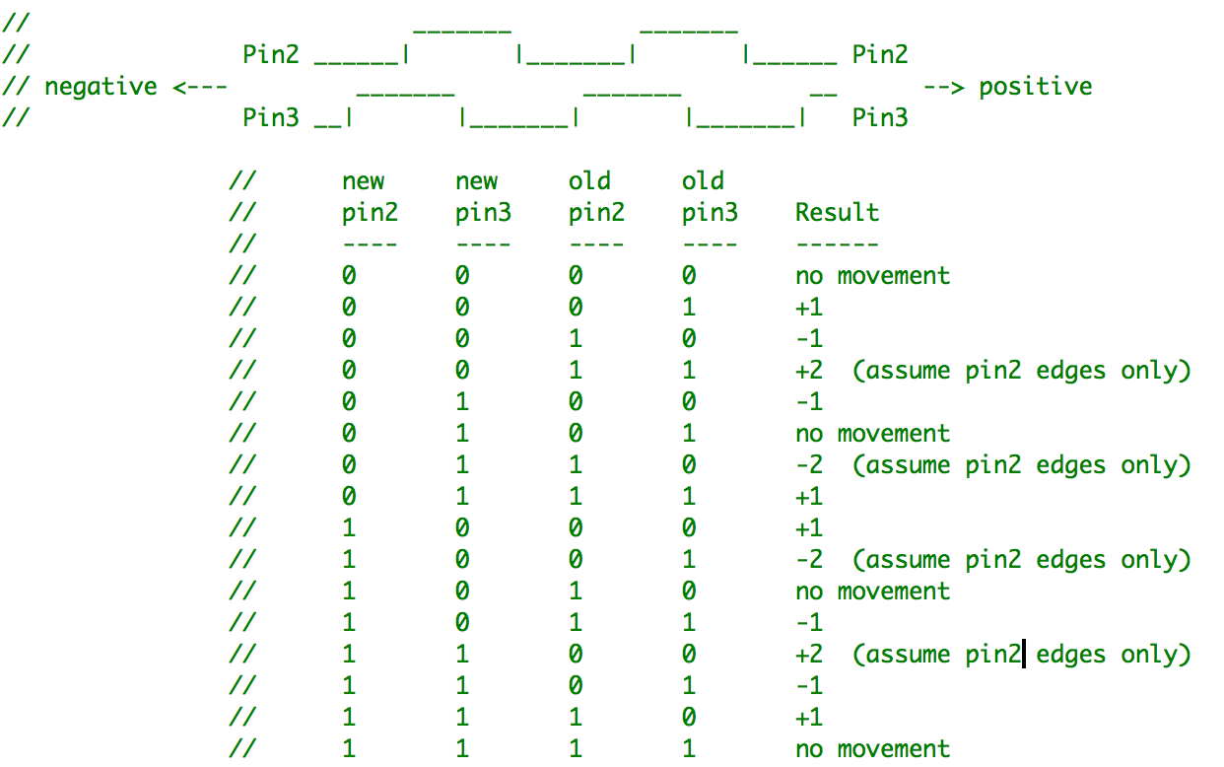
OPTICAL ENCODER – QUADRATURE MODE
The two channels are out of phase by 90 degrees
The order in which the signal changes from low to high indicates direction of rotation
Pins 2 and 3 of ARNOD1 and ARNOD2 are connected to channel A and channel B of encoders on each wheel of AGV4000
The changes in signal can be accurately captured by attaching interrupts to pins 2 and 3 of the Arduinos
So, every time there is an interrupt from the pins 2 and 3, a counter is incremented or decremented depending on the direction of rotation
Ref: http://www.robotoid.com/appnotes/circuits-quad-encoding.html

Slide 5
ENCODER – WHEEL CALIBRATION
To calibrate the encoder revolutions to match wheel revolution, a number of test data was collected by rotating AGV 4000’s wheel different number of times at different speeds.
Based on the data collected, 28 encoder rotation = 1 wheel rotation

Slide 6
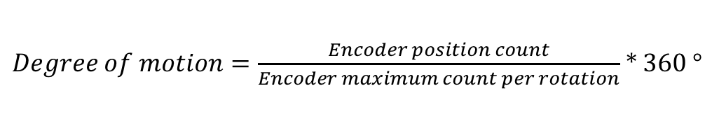
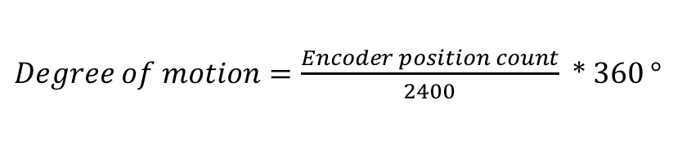
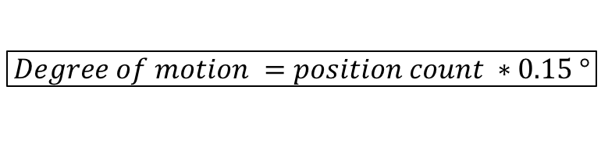
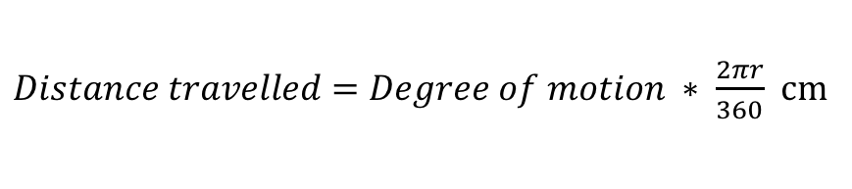

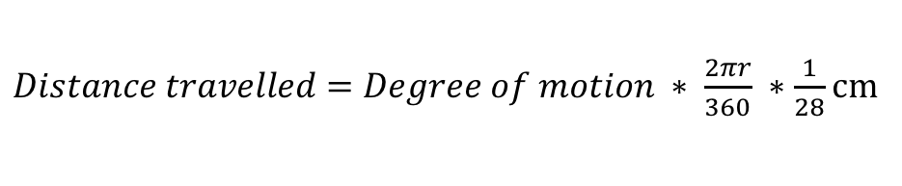
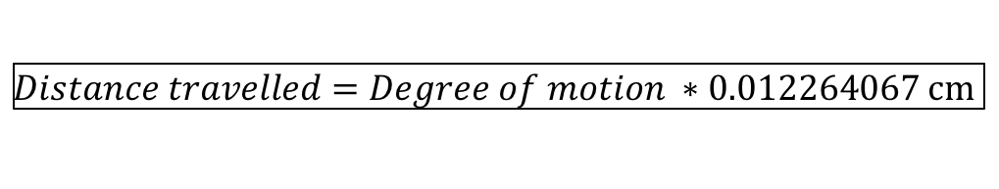
ENCODER – CALCULATE DISTANCE
* 360
* 360
cm
Considering,
cm
2r = 39.37 cm,
cm

Slide 7
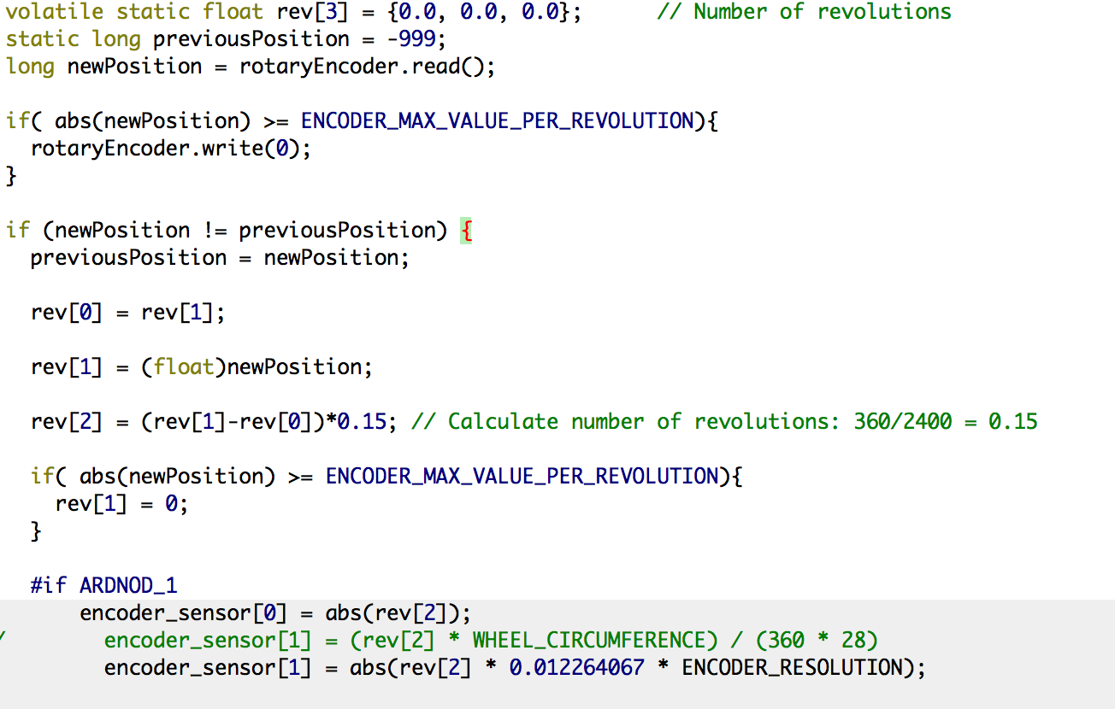
ENCODER FUNCTION: readEncoder()
readEncoder() is called from ARNODModbusSlave sketch in the loop function where all sensor data are obtained and sent to TX1 through Modbus
Read Optical encoder’s current position. Position determined by interrupts on pin 2 and 3 in ARNOD 1
If position is greater than maximum encoder steps per revolution i.e. 2400, reset it to zero
Check if encoder has changed position before entering loop
Calculate how much encoder has moved compared to previous function call and find degree of motion
Calculate linear distance using distance travelled formula in previous slide

Slide 8
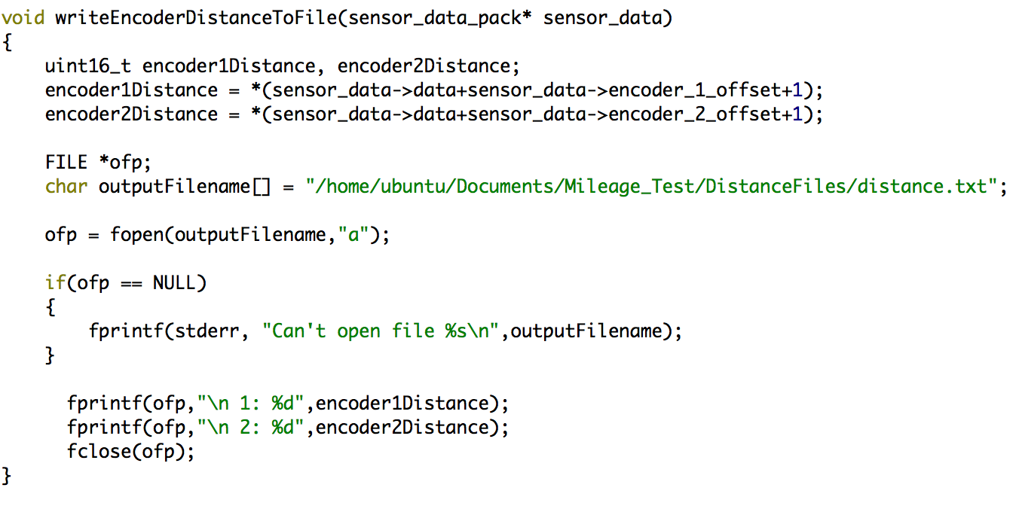
ODOMETER USING ENCODER DISTANCES
writeEncoderDistanceToFile() is called every time data is received on the Modbus from ARNOD 1 and ARNOD 2
Extract encoder linear distances (one for each wheel of the AGV4000) from data packet sent from ARNOD1 and ARNOD2 to TX1 through Modbus
Create and open file distance.txt to write distance data of both encoders
Write distances to file

Slide 9
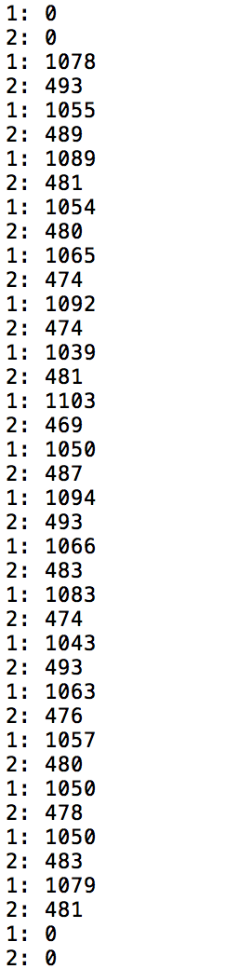
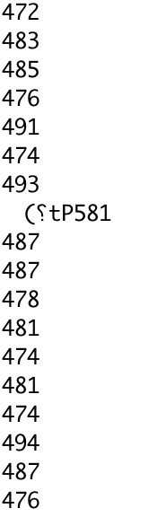
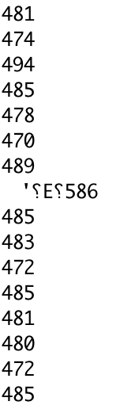
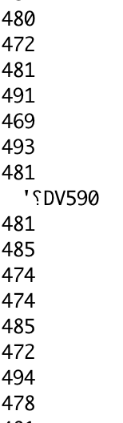
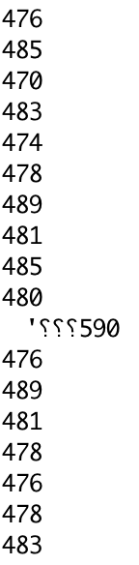
DISTANCE COLLECTED AT ARDUINO SIDE Vs DISTANCE RECEIVED BY TX1
TX1 misses a majority of data points generated by the Arduino for Encoder revolutions.
Number of data points on the Arduino side for 5 wheel revolutions: 1441
Number of data points on TX1 side: 18
It is clear where the TX1 is reading data from Arduino since TX1 sends a garbage data to the memory address after it reads the data.
TX1 DATA
ARDUINO DATA
Notes:
<number>

Slide 10
Mechanical Drawing and Coupling
Mechanical engineers

