Slide 1

nnn-nn-Unity-Python-CAPP-1-v1-YY-2022-3-3
CTI One Corporation
Version: 1.0
Date: March 3, 2022
Project Lead: Harry Li, Ph.D.
Members: Yusuke Yakuwa,
Company confidential

Slide 2
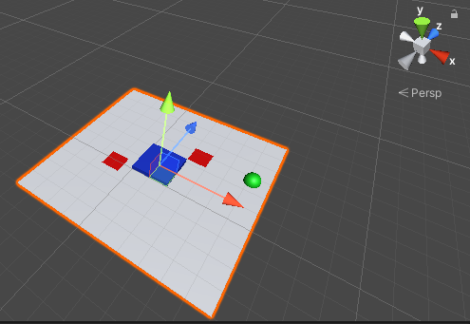
Left-Handed Coordinate System
The coordinate system in Unity is Left-Handed Coordinate system.
x: Right side direction
y: Height
z: Forward direction
Fig 1. Unity Coordinate System

Slide 3
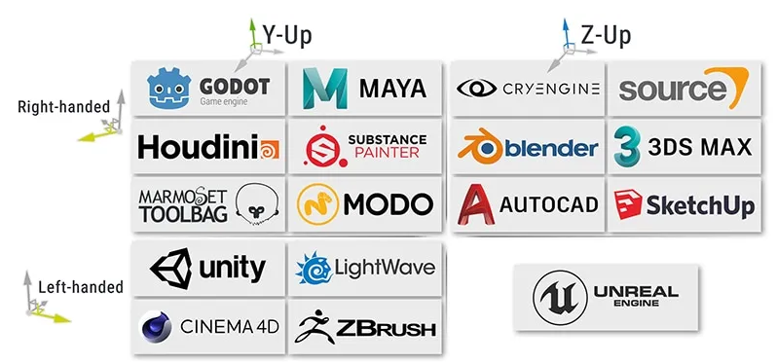
Right-Handed VS Left-Handed Coordinate System
CTIOne AGV2000 and AGV4000
CTIOne BBD Robot
https://www.techarthub.com/a-guide-to-unitys-coordinate-system-with-practical-examples/#:~:text=Unity%20uses%20a%20left%2Dhanded,unexpected%20results%20for%20the%20uninitiated.

Slide 4
World vs Local Coordinate System In Unity
World Coordinate System: Coordinate based on Unity world. Point (0, 0, 0) is the center of the Unity world.
Local Coordinate System: Coordinate based on the parent object. Point (0, 0, 0) is the center of the parent object. If the objects do not have its parent object, the objects belong to the world, in this case, world coordinator and local coordinator are same.
World coordinate system (left hand)
Mapping phi_1
Local
Mapping phi_2
Local coordinate system (
Vehicle coordinate system (for Ego motion, e.g., robot/vehicle)

Slide 5
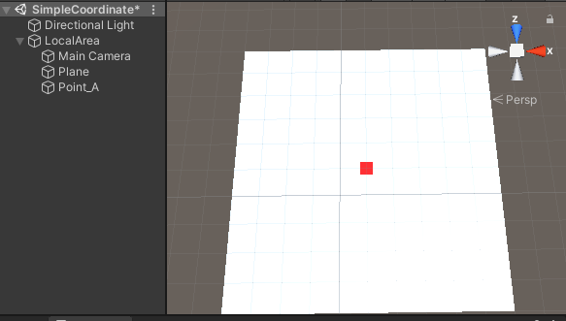
Object Position
“LocalArea” object (“Floor” whose center is):
1. No parent object
2. In world coordinate system: (X=10,Y= 0, Z=10)
3. In local coordinate system: (X=10,Y= 0, Z=10)
“Point_A” object (Red Cube in Fig 1.):
1. Parent object is “LocalArea” object
2. In world coordinate system: (X=10,Y= 0, Z=10)
3. In local coordinate system: (X=0,Y= 0, Z=0)
Fig 2. Object Position
In world coordinate system: (X=10,Y= 0, Z=10)
In local coordinate system: (X=0,Y= 0, Z=0)

Slide 6
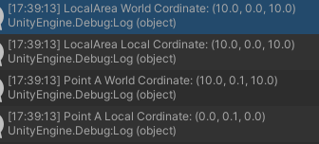
C# Code For Displaying The Coordinator
using System.Collections;
using System.Collections.Generic;
using UnityEngine;
public class SimpleCoordinate : MonoBehaviour
{
GameObject localArea;
GameObject point_a;
void Start()
{
localArea = GameObject.Find("LocalArea");
point_a = GameObject.Find("Point_A");
Debug.Log("LocalArea World Cordinate: " + localArea.transform.position.ToString());
Debug.Log("LocalArea Local Cordinate: " + localArea.transform.localPosition.ToString());
Debug.Log("Point A World Cordinate: " + point_a.transform.position.ToString());
Debug.Log("Point A Local Cordinate: " + point_a.transform.localPosition.ToString());
}
}
Fig 3. Result of displaing the coodinator

Slide 7
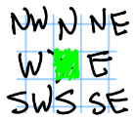
C# Code For Moving Object In Local Coodinate System
machine = GameObject.Find("Machine");
// To North
machine.transform.localPosition += new Vector3(0, 0, 1);
// To South
machine.transform.localPosition += new Vector3(0, 0, -1);
// To East
machine.transform.localPosition += new Vector3(1, 0, 0);
// To West
machine.transform.localPosition += new Vector3(-1, 0, 0);
(0,0,0)
Z
x

Slide 8
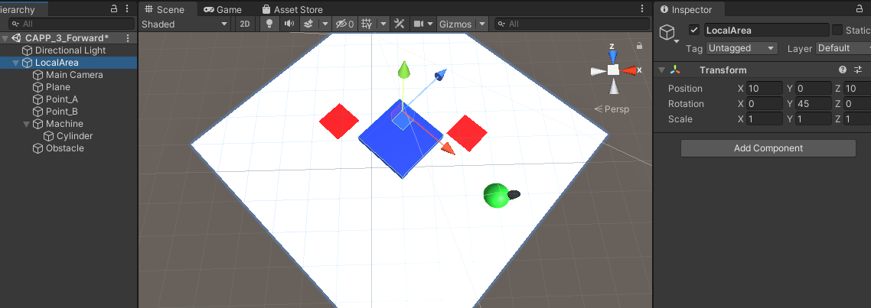
Local VS World Coordinate System For Moving Object
“LocalArea” : Parent object, Rotaion(X:0, Y:45, Z:0)
“Machine” : Child object of “Local Area”
Below Code A and Code B are same meaning
Code A (Local):
machine.transform.localPosition += new Vector3(0, 0, 1);
Code B (World):
machine.transform.position += new Vector3(0.7, 0, 0.7);
This is a translation, but please add rotation code sample. ???
Fig 4. Axes of coordinate system
Axes of World Coordinate System
Axes of Local Coordinate System
1. w.r.t. positive x; and 2. clock wise direction

Slide 9
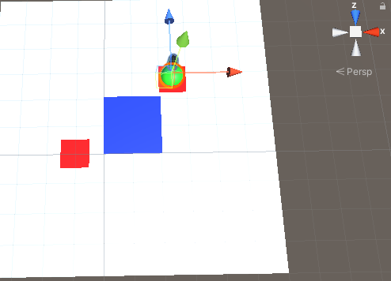
Normalized Vector (1)
https://docs.unity3d.com/ScriptReference/Transform.html
GameObject.Transform has properties normalized vectors: forward, right, up
forward: Z axis
right: X axis
up: Y axis
The normalized vectors are in world coordinate system.
If the object orientation is the same as axes of world coordinate system; forward returns (x: 0, y: 0, z: 1)
right returns (x: 1, y: 0, z: 0)
up returns (x: 0, y: 1, z: 0)
If the object orientation rotates 45 degree from axes of world coordinate system;
forward returns (x: 0.7, y: 0, z: 0.7)
right returns (x: 0.7, y: 0, z: -0.7)
up returns (x: 0, y: 1, z: 0)
Fig 5. Object’s Orientaion
Object’s Axes
Axes of World Coordinate System

Slide 10
C# Code For Displaying Normalized Vector
Debug.Log("Machine Forward Coordinator: " + machine.transform.forward.ToString());
Debug.Log("Machine Right Coordinator: " + machine.transform.right.ToString());
Debug.Log("Machine Up Coordinator: " + machine.transform.up.ToString());

Slide 11
END

