Slide 1

Send SMS Message Via Twilio
-2020-03-02
Company confidential
CTI One Corporation
Version: 1.0
Date: Mar.2, 2020
Project Lead: Harry Li, Ph.D.
Team members:
M.O., Y.Y.

Slide 2

Block Diagram For Sending SMS Via Twilio
https://www.twilio.com/
REST API
SMS (Short Message Service)
1. Twilio is a cloud communications platform company based in San Francisco
2. Twilio produces web service APIs which allows software developers to make programs to receive and send text messages to cell phones
3. The library which allows developers to access to Twilio’s services is prepared in Python.

Slide 3
Example Code In Python To Send SMS
from twilio.rest import Client
client = Client("ACa1015fc09a813a15e611111111111111", "1e557258c0fa1bdd9f11111111111111")
client.messages.create(to="+19876543210",
from_="+11234567890",
body="Hello World from Python!")
Account SID, AUTH Token, and Source Phone Number are obtained from Twilio’s web site.
Source: https://www.twilio.com/docs/sms/tutorials/how-to-send-sms-messages-python
Source: https://www.fullstackpython.com/blog/send-sms-text-messages-python.html
Account SID
AUTH Token
Destination Phone Number
Destination Phone Number
Source Phone Number
Message

Slide 4
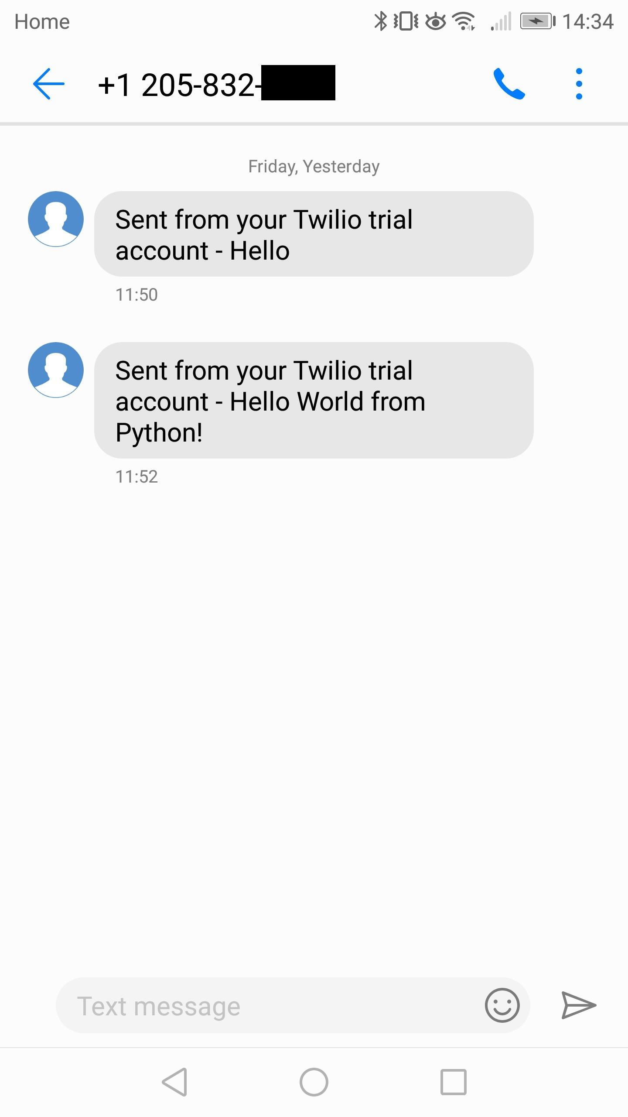
Send Message
1. The source phone number must be purchased from Twilio
2. The destination phone number must be verified by phone owner if messages are sent from trial account

Slide 5
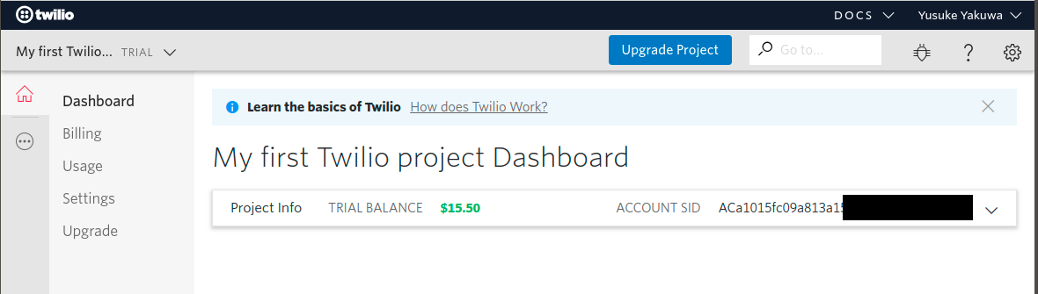
Setup Trial Account (1)
1. Sign up on Twilio
https://www.twilio.com/try-twilio
2. Free trial account will give you $15.50 trial balance
3. Purchase a phone number from Twilio
https://www.twilio.com/console/phone-numbers/search
4. Obtain account SID and Auth Tocken
Click to show Auth Token

Slide 6
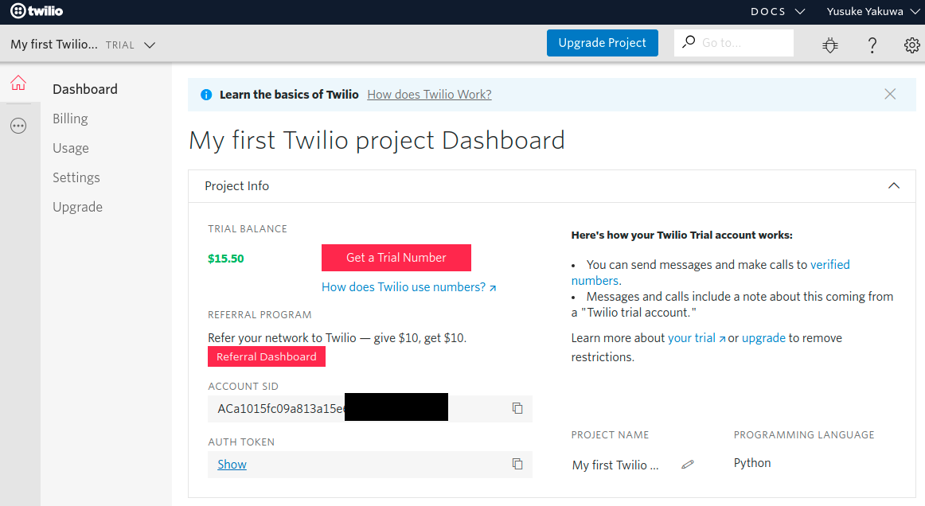
Setup Trial Account (2)
Click to copy account SID
Click to copy Auth Token

Slide 7
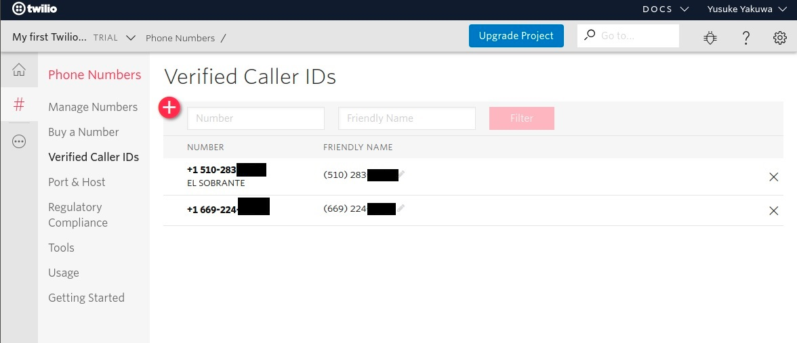
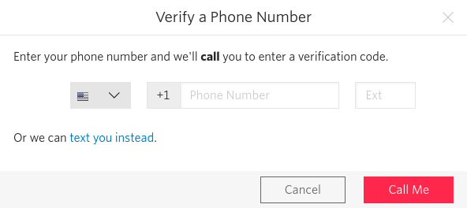
Verify Phone Number
1. Verify other phone numbers
https://www.twilio.com/console/phone-numbers/verified
(1) Click to start verification, will open subwindow
(2) Click to text verification number

Slide 8
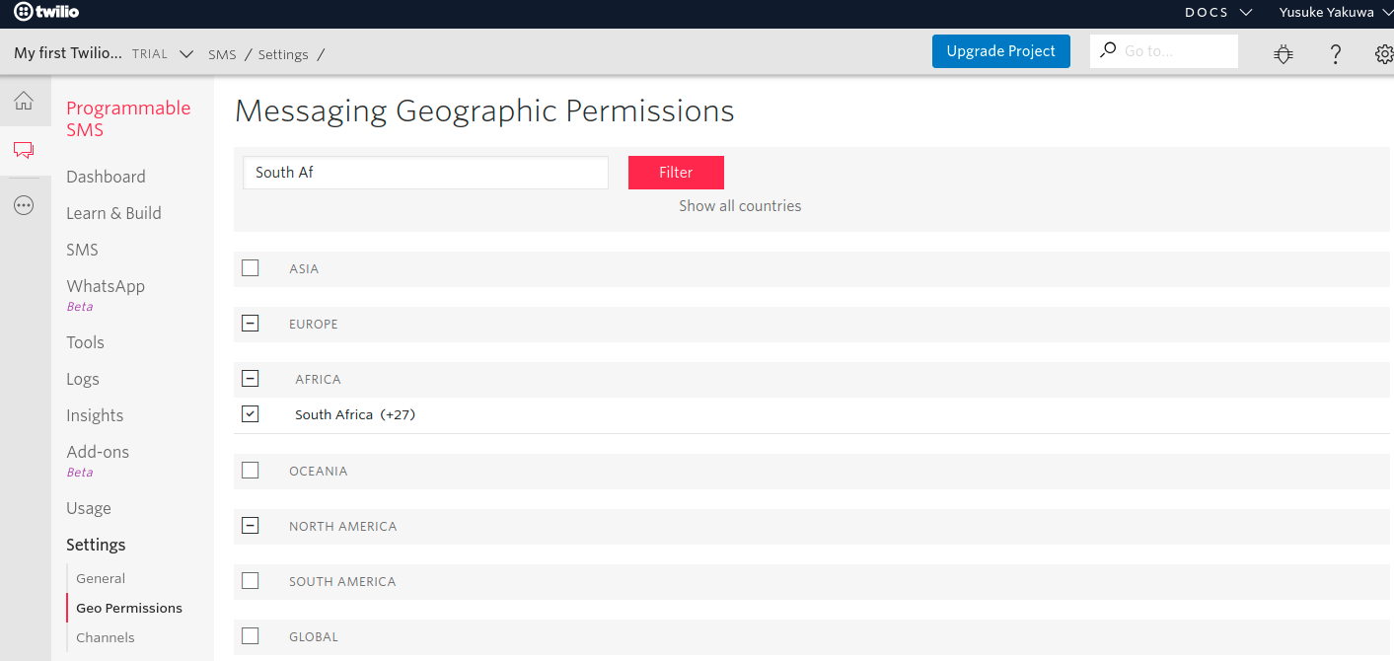
Messaging Geographic Permissions
1. Give messaging geographic permissions
https://www.twilio.com/console/sms/settings/geo-permissions
Check the box to give a permission

Slide 9
Installing Twilio’s Python library
1. Perform below command in a terminal
pip3 install twilio

Slide 10
Phone Number Price / Month
Country | Phone Number Type | Phone Number Price / month | Inbound SMS Price / msg
Nigeria | Local | 35 | N/A
United States | Local | 1 | 0.0075
South Africa | Local | 1.5 | N/A
South Africa | Mobile | 4 | 0.0075
South Africa | National | 1.5 | N/A

Slide 11
Outbound Messaging Pricing
Country | Description | Price / msg
Nigeria | NIGERIA Outbound SMS - Airtel | 0.0995
Nigeria | NIGERIA Outbound SMS - Capcom | 0.0995
Nigeria | NIGERIA Outbound SMS - Etisalat | 0.0995
Nigeria | NIGERIA Outbound SMS - Glo Mobile | 0.0995
Nigeria | NIGERIA Outbound SMS - MTN | 0.0995
Nigeria | NIGERIA Outbound SMS - Nitel | 0.0995
Nigeria | NIGERIA Outbound SMS - Other | 0.0995
Nigeria | NIGERIA Outbound SMS - Reliance | 0.022
Nigeria | NIGERIA Outbound SMS - Starcomms | 0.10833
Nigeria | NIGERIA Outbound SMS - Visafone | 0.0995
United States | UNITED STATES Outbound SMS - Other | 0.0075
South Africa | SOUTH AFRICA Outbound SMS - 8ta | 0.027
South Africa | SOUTH AFRICA Outbound SMS - Cell C | 0.027
South Africa | SOUTH AFRICA Outbound SMS - MTN | 0.027
South Africa | SOUTH AFRICA Outbound SMS - Other | 0.027
South Africa | SOUTH AFRICA Outbound SMS - Vodacom | 0.027

Slide 12
Consideration
1. Suppose the system needs to send 1,000 messages per day. It will require 4 phone numbers to handle it. Because carriers generally have limit which allows to send 250 messages per day.
2. A message size is 160 characters (80 for unicode). If a message is greater than 160 characters, it will be separated.
3. Volume discounts automatically kick-in.
4. Twilio also provides WhatsApp API. It’s in beta version now (Feb. 28 2020). Its cost is higher than SMS.
Source: https://www.twilio.com/console/sms/overview

Slide 13
Reference
1. Twilio
https://www.twilio.com/
2. Matt Makai (2020, April 28). How to Send SMS Text Messages with Python.
Full Stack Python. Retrieved from https://www.fullstackpython.com/blog/send-sms-text-messages-python.html

