Slide 1

MaixPy Turtorial
CTI One Corporation
Version: x0.1 (Alpha)
Date: Feb 25, 2020
Project Lead: Harry Li, Ph.D.
Team members:
Minh Duc Ong
Company confidential

Slide 2
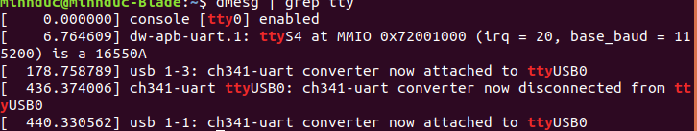
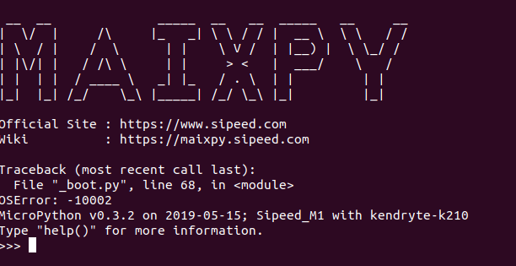
MaixPy Set Up
source: https://www.youtube.com/watch?v=KResVuAIMb4
https://maixpy.sipeed.com/en/
http://blog.sipeed.com/p/category/maix-software/maixpy
Step 1: Check the Sipeed board Serial connection, open the Terminal and run this command:
dmesg | grep tty
In this case, it is ttyUSB0
Step 2: Install Screen application:
sudo apt-get install screen
Step 3: After Screen is installed, we do access to the Sipeed board:
sudo screen /dev/ttyUSB0 115200
Press Ctrl +C, then Ctrl + D to reboot the board

Slide 3
MaixPY example program
Step 4:
Type this program to MaixPy:
import sensor
import image
import lcd
lcd.init()
sensor.reset()
sensor.set_pixformat(sensor.RGB565)
sensor.set_framesize(sensor.QVGA)
sensor.run(1)
while True:
img=sensor.snapshot()
lcd.display(img)
Then press Enter 3 times, and we can see the Videos Streaming from the Camera.

Slide 4
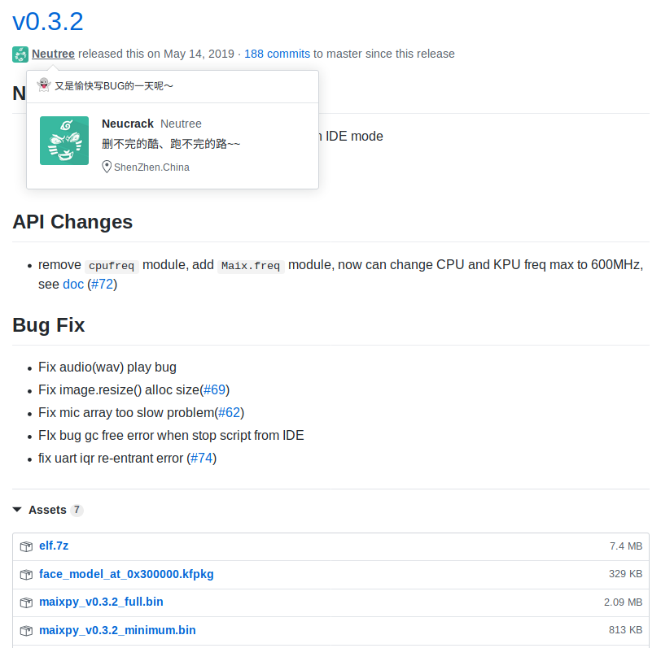
MaixPY Firmware Download
Step 5: Go to https://github.com/sipeed/MaixPY/releases, scroll down to 0.3.2 and download 3 files:
1.face_model_at_0x300000.kfpkg
2.maixpy_v0.3.2_full.bin
3.maixpy_v0.3.2_minimum.bin

Slide 5
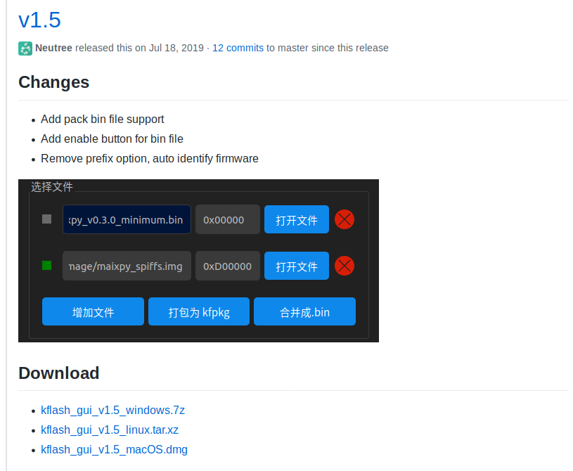
KFlash program to flash binary files
Step 6: Go to https://github.com/sipeed/kflash_gui/releases, download kflash v1.5 for Linux:
Download this for Linux

Slide 6
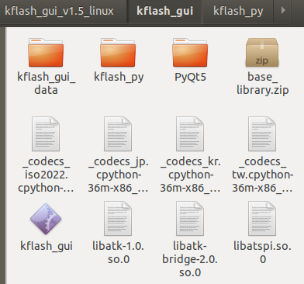
KFlash program to flash binary files
Step 6.1: Decompress the “kflash_gui_v1.5_linux”, and go to kflash_gui.
Step 6.2: Then open a Terminal Window in this folder and run the klash_gui with sudo mode:
sudo ./kflash_gui

Slide 7
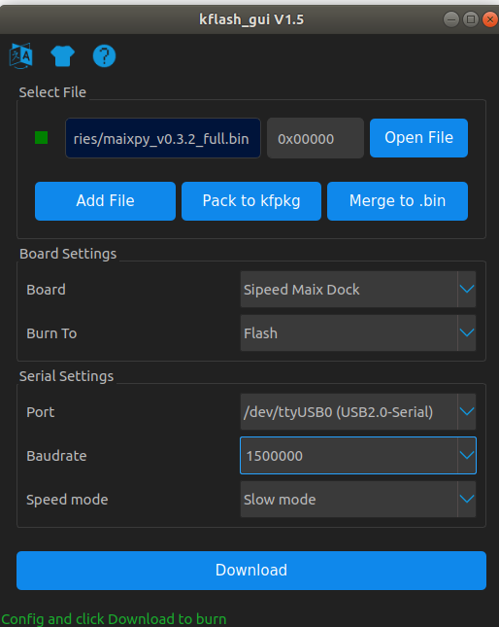
MaixPY Firmware Flashing
Step 7: Then open the kflash_gui application and choose options as below
Step 7.1: On “Open File” and select:
maixpy_v0.3.2_full.bin
Step 7.2: On “Board” select:
Sipeed Maix Dock
Step 7.3: On “Burn To” select:
Flash
Step 7.4: On “Port” select:
/dev/ttyUSB0
Step 7.5: On “Baud Rate” select:
150000
Step 7.6: On “Speed Mode” select:
Slow Mode
Step 7.7: Click Download to flash the firmware to the board.

Slide 8
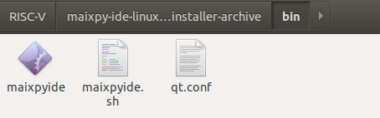
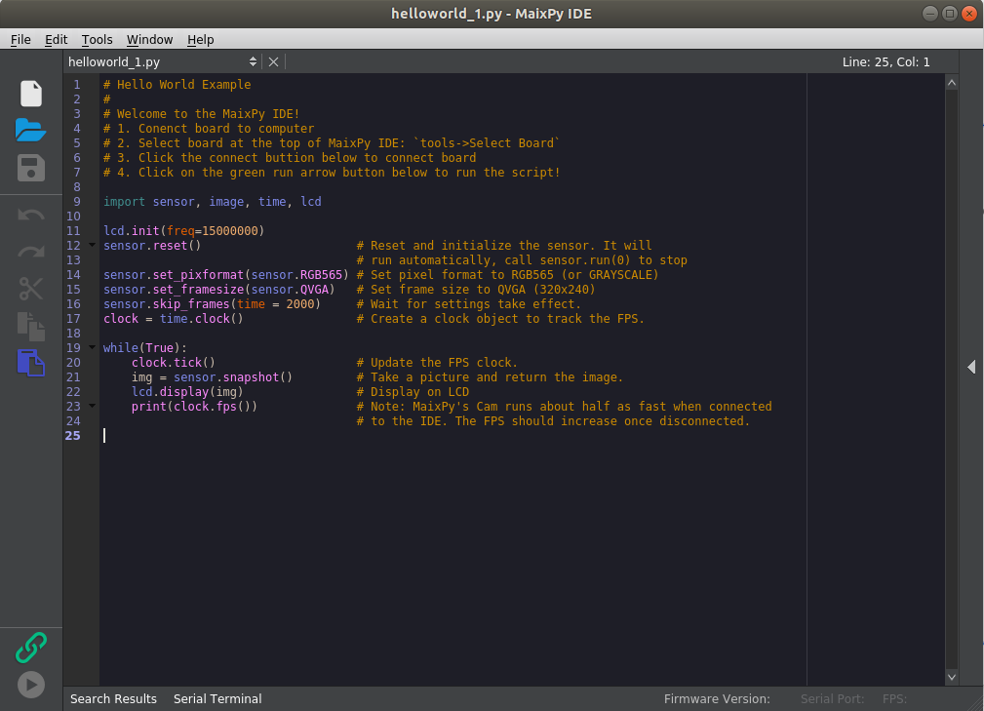
MaixPY IDE program
Step 8: Go to http://dl.sipeed.com/MAIX/MaixPy/ide/v0.2.2 and download
maixpy-ide-linux-x86_64-0.2.2-installer-archive.7z
Step 8.1: The decompress, go to
./maixpy-ide-linux-x86_64-0.2.2-installer-archive/bin:
Open Terminal Window and run: sudo ./maixpyide
Click this to link to the board
Click this to run the program

Slide 9
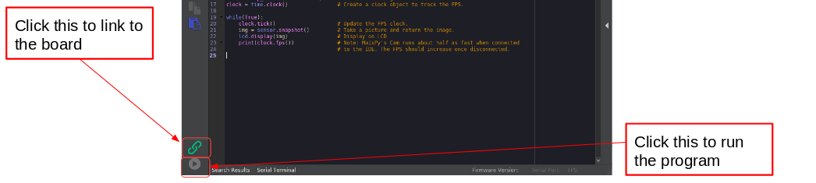
MaixPY Face Detection
Step 9: Go to https://github.com/sipeed/MaixPY/releases and clone whole folder by these following steps:
9.1 Open Terminal Window
9.2 cd $HOME/Documents
9.3 mkdir MaixPy
9.4 cd MaixPy
9.3 git clone https://github.com/sipeed/MaixPy_scripts.git
Step 10: Then from the MaixPy IDE, on the top left corner, select
File > Document Folder > MaixPy > MaixPy_scripts > machine_vision > demo_find_face
Step 11: Repeat step 7 to flash face_model_at_0x30000.kfpkg to the board
Step 12: On the MaixPy IDE, when the demo_find_face program is opened, click button to link to the board (12.1) and run the program (12.2)
(12.1)
(12.2)

Slide 10
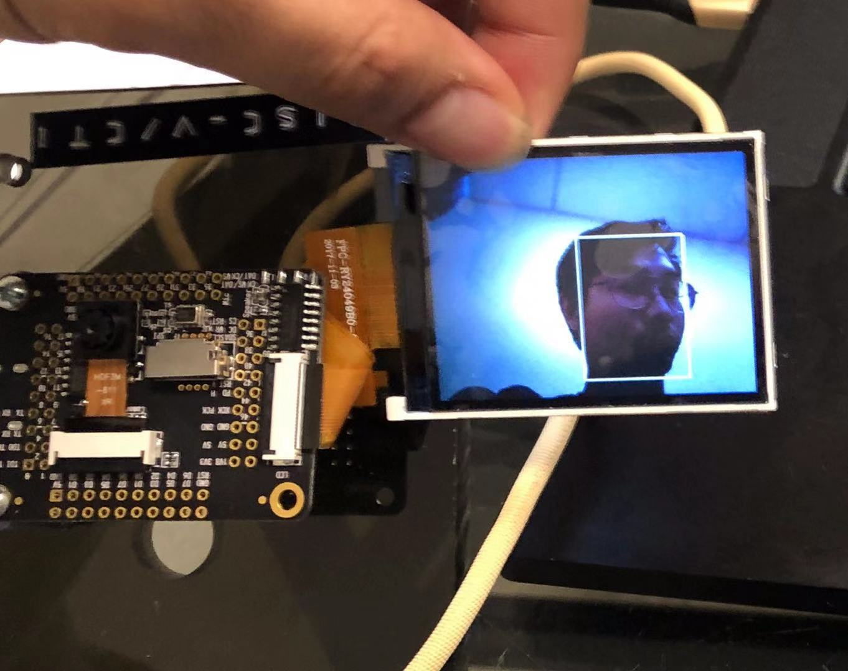
MaixPY Face Detection Result
After flashing the face_model_at_0x30000.kfpkg by the kflash v1.5 program, and run the face detection program , we have the result as shown:

Slide 11
Little VGL
https://blog.littlevgl.com/2019-02-20/micropython-bindings

Slide 12
Manage File
https://maixpy.sipeed.com/en/get_started/edit_file.html
http://docs.micropython.org/en/v1.7/esp8266/library/os.html

Slide 13
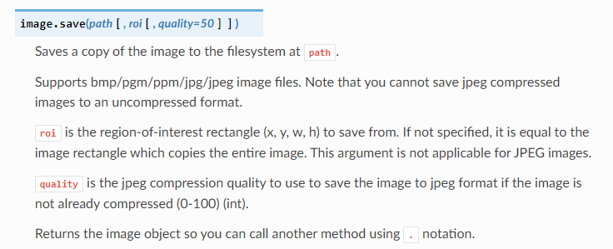
Image Class
https://docs.openmv.io/library/omv.image.html
sensor.snapshot().save("test01.jpg") #save image

Slide 14
OpenMV Example
https://github.com/openmv/openmv/tree/master/scripts/examples

Slide 15
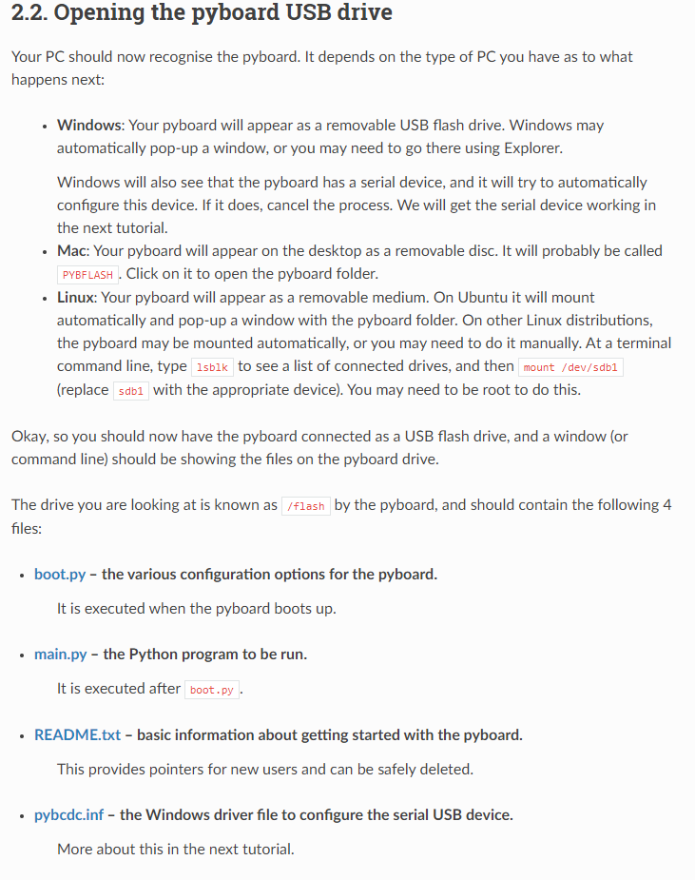
Boot Script
http://docs.micropython.org/en/latest/pyboard/tutorial/script.html

Slide 16
BOOT Default Program
1.We need to import os function of maixpy and check which program is stored from MaixPY:
import os
os.listdir()
2.Use pye editor to create a Hello World Program
pye(“HelloWorld.py”)
print(“Hello World First Bootable program”)
Click Ctrl+S to save and Ctrl+Q to exit the file
3.Use pye editor to modify boot.py
pye(“boot.py”)
Then add these lines to boot.py
with open("HelloWorld.py") as f:
exec(f.read())
4. Click Ctrl+S to save and Ctrl+Q to exit the file
5. Reboot the MaixPY board by Ctrl+D

Slide 17
Object Training
https://www.youtube.com/watch?v=6sLOZK-DOEc
http://acoptex.com/project/11708/basics-project-083e-sipeed-maixduino-board-uploading-maixpy-at-acoptexcom/#sthash.HOLgblUO.dpbs

Slide 18
Establish, client, server communication

Slide 19
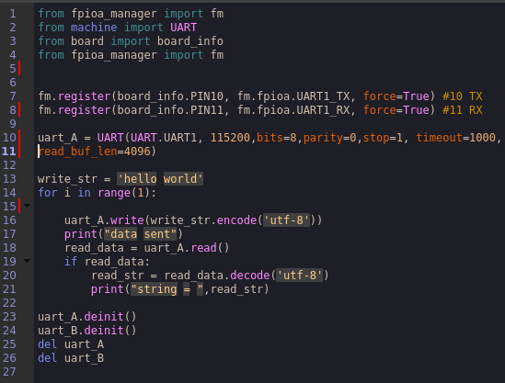
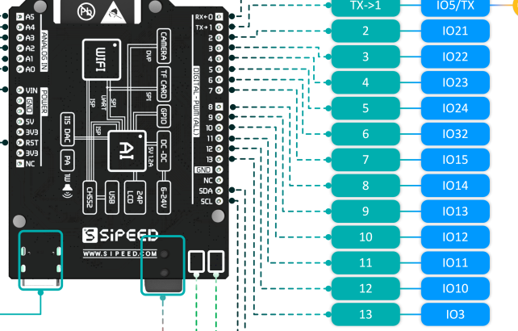
Image via UART (Step1)
https://www.codrey.com/embedded-systems/uart-serial-communication-rs232/
https://pyserial.readthedocs.io/en/latest/pyserial_api.html#serial.STOPBITS_ONE
https://docs.micropython.org/en/latest/library/machine.UART.html
Steps:
1. Perform UART loopback test on the MaxNod. (Connect RX and TX together)
2. Perform UART loopback test on laptop
2.1 Create a "hello world" file, and save file.
2.2 Perform loopback test on the laptop.
3. Level Shifter with Max232, send “Hello Message” from MaixNod to the laptop.
4. Transmit Image via UART communication from MaxNod to Laptop
4.1 Put Real time RTOS.
4.2 Scheduler
Step 1: Loopback Test
Perform UART Loopback Test on the MaixNod.
1.1 Set up:
Pin IO10 is TX port.
Pin IO11 is RX port.
1.2 Connect IO10 to IO11
1.3 Run “hello world” Program
RX
Figure 5.
TX

Slide 20
Describe loopback test

Slide 21
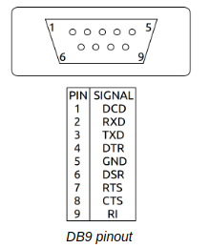
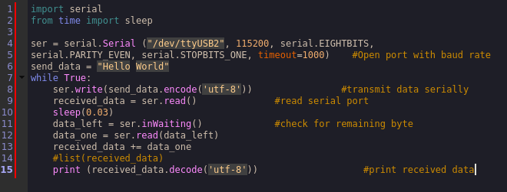
Image via UART: Loopback test, (Step2)
https://www.codrey.com/embedded-systems/uart-serial-communication-rs232/
https://pyserial.readthedocs.io/en/latest/pyserial_api.html#serial.STOPBITS_ONE
https://www.codrey.com/embedded-systems/uart-serial-communication-rs232/
Step 2: Perform UART Loopback Test on the laptop.
2.1 Connect DP9-USB Cable to the laptop
2.2 Set up, :
Use the Jumper Cable to connect Pin2 RX port to Pin 3 TX port of
DP9
2.3 Run Hello the World Program
RX
TX
Figure 6.

Slide 22
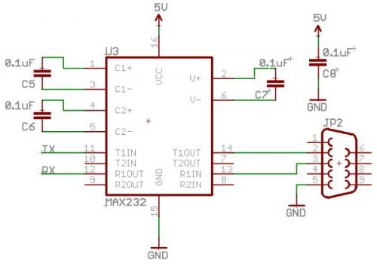
UART/TTl to RS232
source: https://gzalo.com/rs232ttl_en/

Slide 23
GPP Port mapping to UART
MaxNod | Max232
Pin IO10 is TX port. | Pin 11
Pin IO11 is RX port | Pin 12
Max232 | DP9
Pin 13 | Pin 3 is TXD
Pin 14 | Pin 2 is RXD
MicroPython Source Code on Maxnod:
from fpioa_manager import fm
from machine import UART
from board import board_info
from fpioa_manager import fm
fm.register(board_info.PIN10, fm.fpioa.UART1_TX, force=True) #10 TX
fm.register(board_info.PIN11, fm.fpioa.UART1_RX, force=True) #11 RX
uart_A = UART(UART.UART1, 115200,bits=8)
write_str = 'hello N10001 is here'
initial_flag=False
while (1):
if initial_flag==False:
uart_A.write(write_str)
initial_flag=True
read_data = uart_A.read()
#print("string = ",read_str)
if read_data:
read_str = read_data.decode('utf-8')
if read_str == 'H001 copied N10001':
print("Received: ",read_str)
write_str = 'N10001 copied, now sending image N10001-2020-02-20.jpg'
print("Sent: ",write_str)
uart_A.write(write_str)
if read_str == 'H001 copied N10001-2020-02-20.jpg':
print("Received: ",read_str)
break
Python Source Code on Host/Laptop:
import serial
from time import sleep
ser = serial.Serial ("/dev/ttyUSB2", 115200, serial.EIGHTBITS) #Open port with baud rate
send_data = "H001 copied N10001"
data_num=20
while (1):
#transmit data serially
received_data = ser.read(data_num) #read serial port
#sleep(0.03)
data_left = ser.inWaiting() #check for remaining byte
data_one = ser.read(data_left)
received_data += data_one
#list(received_data)
#print (received_data.decode('utf-8')) #print received data
if received_data.decode('utf-8') == 'hello N10001 is here':
print ("Received: " + received_data.decode('utf-8'))
print ("Sent: " + send_data)
ser.write(send_data.encode('utf-8'))
data_num =54
if received_data.decode('utf-8') == 'N10001 copied, now sending image N10001-2020-02-20.jpg':
print ("Received: " + received_data.decode('utf-8'))
send_data = "H001 copied N10001-2020-02-20.jpg"
print ("Sent: " + send_data)
ser.write(send_data.encode('utf-8'))
break

Slide 24
Some candidates for file transfer
XMODEM protocol:
https://pythonhosted.org/xmodem/xmodem.html
This is a literal implementation of XMODEM.TXT, XMODEM1K.TXT and XMODMCRC.TXT, support for YMODEM and ZMODEM is pending. YMODEM should be fairly easy to implement as it is a hack on top of the XMODEM protocol using sequence bytes 0x00 for sending file names (and some meta data).
Ampy with Micropython:
https://www.digikey.com/en/maker/projects/micropython-basics-load-files-run-code/fb1fcedaf11e4547943abfdd8ad825ce
https://garrettgoss.com/blog/2019/07/getting-started-with-the-sipeed-maixduino-kit.html
https://lekum.org/post/ampy/

Slide 25
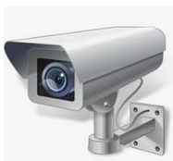

UART Communication Testing 1
# Hello World Example
#
# Welcome to the MaixPy IDE!
# 1. Conenct board to computer
# 2. Select board at the top of MaixPy IDE: `tools->Select Board`
# 3. Click the connect buttion below to connect board
# 4. Click on the green run arrow button below to run the script!
import sensor, image, time, lcd
lcd.init(freq=15000000)
sensor.reset() # Reset and initialize the sensor. It will
# run automatically, call sensor.run(0) to stop
sensor.set_pixformat(sensor.RGB565) # Set pixel format to RGB565 (or GRAYSCALE)
sensor.set_framesize(sensor.QVGA) # Set frame size to QVGA (320x240)
sensor.skip_frames(time = 2000) # Wait for settings take effect.
clock = time.clock() # Create a clock object to track the FPS.
once_flag = False
while(True):
clock.tick() # Update the FPS clock.
img = sensor.snapshot() # Take a picture and return the image.
if once_flag == False:
sensor.snapshot().save("test02.png") #save image
once_flag=True
lcd.display(img) # Display on LCD
print(clock.fps()) # Note: MaixPy's Cam runs about half as fast when connected
# to the IDE. The FPS should increase once disconnected.
USB2Serial

Slide 26
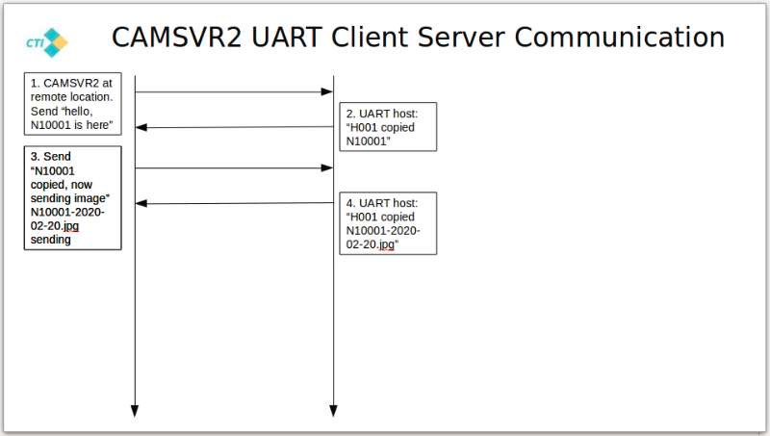
Handshake message
Communication protocol:
Host naming convention H+XXX, example: H001 as host 1
Client nameing convention N+XXXXX, example: 10001
Delimiter: uuu place at the end of each communication of master and clients.

Slide 27
UART Communication Testing 1
# Hello World Example
#
# Welcome to the MaixPy IDE!
# 1. Conenct board to computer
# 2. Select board at the top of MaixPy IDE: `tools->Select Board`
# 3. Click the connect buttion below to connect board
# 4. Click on the green run arrow button below to run the script!
import sensor, image, time, lcd
lcd.init(freq=15000000)
sensor.reset() # Reset and initialize the sensor. It will
# run automatically, call sensor.run(0) to stop
sensor.set_pixformat(sensor.RGB565) # Set pixel format to RGB565 (or GRAYSCALE)
sensor.set_framesize(sensor.QVGA) # Set frame size to QVGA (320x240)
sensor.skip_frames(time = 2000) # Wait for settings take effect.
clock = time.clock() # Create a clock object to track the FPS.
once_flag = False
while(True):
clock.tick() # Update the FPS clock.
img = sensor.snapshot() # Take a picture and return the image.
if once_flag == False:
sensor.snapshot().save("test02.png") #save image
once_flag=True
lcd.display(img) # Display on LCD
print(clock.fps()) # Note: MaixPy's Cam runs about half as fast when connected
# to the IDE. The FPS should increase once disconnected.
USB2Serial

Slide 28
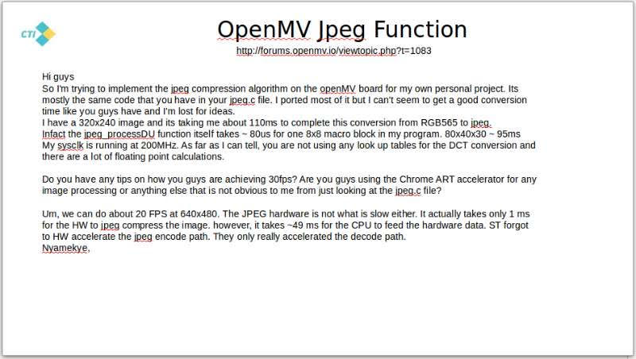
Sending Image

Slide 29
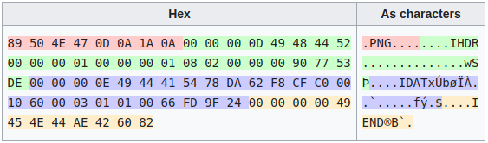
PNG format
https://en.wikipedia.org/wiki/Portable_Network_Graphics

Slide 30

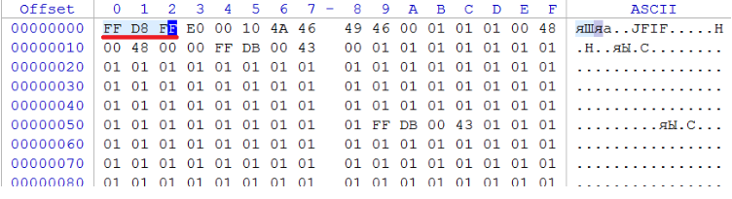
JPG captured from Maxnod
Source Code:
import sensor, image, time, lcd
import os
lcd.init(freq=15000000)
sensor.reset() # Reset and initialize the sensor. It will
# run automatically, call sensor.run(0) to stop
sensor.set_pixformat(sensor.RGB565) # Set pixel format to RGB565 (or GRAYSCALE)
sensor.set_framesize(sensor.QVGA) # Set frame size to QVGA (320x240)
sensor.skip_frames(time = 2000) # Wait for settings take effect.
clock = time.clock() # Create a clock object to track the FPS.
once_flag = False
while(True):
clock.tick() # Update the FPS clock.
img = sensor.snapshot() # Take a picture and return the image.
if once_flag == False:
print("capturing the picture")
sensor.snapshot().save("testImage.jpg") #save image
print("current files in flash ", os.listdir())
once_flag=True
Fig. testImage.jpg
Resolution: 320x240
Size: 6.4kB
JPEG Format
t_trans = 1 * 1024 * 1024 * 8 [bits] / 9600 [bits/sec] = 873.81 sec = 14.56 min
Of course you can, but as stated in the comments and in the other answer JPEG use a complex algorithm to compress the images, and most computers have a dedicated hardware to perform the cosens discrete transform. Anyway the answer to your question is yes, and it's not hard.
You just have to split the image into bytes, send them through the serial port and make Arduino read and save them into an array. To avoid errors create a protocol that can decode what are you doing.
For example: 0b1111000 for 3 times = Start sending 0b00011000 = new line and so on..
The first thing that come in my mind is to use the pySerial library, that can automate the process. Python is perfect for prototyping: open the image (maybe using the numpy library instead of using lists) and with a for loop send every byte over the serial port in according to the protocol you created.
On the Arduino just code the protocol to understand every bite and save the image in an array.

Slide 31
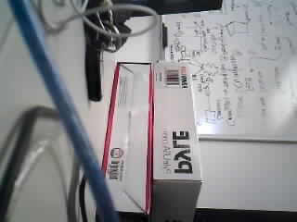
Client Sending JPG from File
Source Code on Maxnod (client/sender):
from fpioa_manager import fm
from machine import UART
from board import board_info
from fpioa_manager import fm
fm.register(board_info.PIN10, fm.fpioa.UART1_TX, force=True) #10 TX
fm.register(board_info.PIN11, fm.fpioa.UART1_RX, force=True) #11 RX
uart_A = UART(UART.UART1, 115200,bits=8)
for i in range (1):
uart_A.write(open("testImage.jpg","rb").read())
uart_A.deinit()
del uart_A
Source Code on laptop (host/receiver):
import serial
from time import sleep
ser = serial.Serial ("/dev/ttyUSB2", 115200, serial.EIGHTBITS) #Open port with baud rate
data_num=20
f = open('image_received.jpg','wb')
while 1:
f.write(ser.read())
Fig. image_received.jpg
Resolution: 320x240
Size: 7.4kB

Slide 32
Client Sending JPG from buffer
Source Code on Maxnod (client/sender):
from fpioa_manager import fm
from machine import UART
from board import board_info
from fpioa_manager import fm
import sensor, image, time, lcd
fm.register(board_info.PIN10, fm.fpioa.UART1_TX, force=True) #10 TX
fm.register(board_info.PIN11, fm.fpioa.UART1_RX, force=True) #11 RX
uart_A = UART(UART.UART1, 115200,bits=8)
#Image captured
lcd.init(freq=15000000)
sensor.reset() # Reset and initialize the sensor. It will
# run automatically, call sensor.run(0) to stop
sensor.set_pixformat(sensor.RGB565) # Set pixel format to RGB565 (or GRAYSCALE)
sensor.set_framesize(sensor.QVGA) # Set frame size to QVGA (320x240)
sensor.skip_frames(time = 2000) # Wait for settings take effect.
clock = time.clock() # Create a clock object to track the FPS.
for i in range (1):
img = sensor.snapshot() # Take a picture and return the image.
uart_A.write(img.compressed())
uart_A.deinit()
del uart_A
Source Code on laptop (host/receiver):
import serial
from time import sleep
ser = serial.Serial ("/dev/ttyUSB2", 115200, serial.EIGHTBITS) #Open port with baud rate
f = open('image_received.jpg','wb')
while 1:
f.write(ser.read())
Fig. image_received.jpg
Resolution: 320x240
Size: 7.4kB

Slide 33
ROI Selection Step1 on server site
Initial State:
Step1: Maxnod send RGB image to the server.
Step2: Server use OpenCV to select ROI.
Step3: When ROI is select, 2 points of ROI definition is recorded and send back to the Maxnod.
Step4: Maxnod executes the ROI command on the server and send image with ROI to the server.
Step5: MaxNod process the Illegal Intrusion Detection.
Step6: Whenever the Intrusion is detected, Maxnod send the Intrusion image to the Server.
Step7: User has ability to changed the ROI when the program is running.

Slide 34
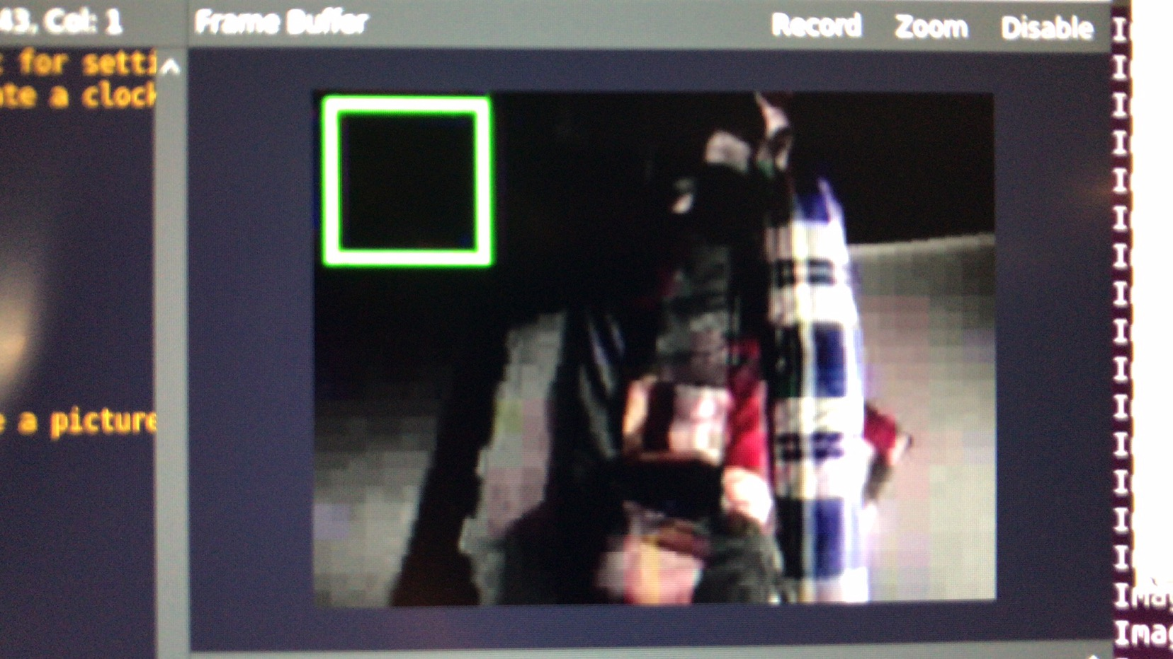
ROI Selection on Server Site
(Program)
Source Code on Maxnod (client/sender) to Display ROI:
.
.
.
.
if read_data:
read_str = read_data.decode('utf-8')
if read_str == 'H001 copied N10001':
print("Received: ",read_str)
write_str = 'N10001 copied, now sending image N10001-2020-02-20.jpg'
print("Sent: ",write_str)
uart_A.write(write_str)
uart_A.write(img.compressed())
if read_str == 'H001 copied N10001-2020-02-20.jpg':
print("Received: ",read_str)
print("read_str: ", read_str)
#print("X_1: ",read_str[0:3])
if(read_str[0:3]=='PX1'):
x_1=int(read_str[4:6])
y_1=int(read_str[7:9])
x_2=int(read_str[10:12])
y_2=int(read_str[13:15])
ROI_flag= True
if ROI_flag==True:
img.draw_rectangle(x_1,y_1, x_2-x_1, y_2-y_1,(0,255,0),5)
lcd.display(img)
Source Code on laptop (host/receiver) to select ROI:
.
.
.
.
def togetROI(event,x,y,flags,param):
# grab references to the global variables
global Points
# if the left mouse button was clicked, record the starting
# (x, y) coordinates and indicate that cropping is being
# performed
if event == cv2.EVENT_LBUTTONDOWN:
if len(Points)<2:
Points.append((x, y))
if len(Points) ==2:
print("sending point")
PointData='PX1' + str(format(Points[0][0],'03')) + str(format(Points[0][1],'03')) + str(format(Points[1][0],'03')) + str(format(Points[1][1],'03'))
print('Point Data:' + PointData)
ser.write(PointData.encode('utf-8'))
x_1 = Points[0][0]
y_1 = Points[0][1]
x_2 = Points[1][0]
y_2 = Points[1][1]
ROI_flag=True
Fig. image_received.jpg with ROI
Resolution: 320x240

Slide 35


Handshake message
1.CAMSVR2 at remote location. Send “hello, N10001 is here”
2.UART host: “H001 copied N10001”
3.Send ”N10001
copied, now sending image N10001-2020-02-20.jpg sending”
4. Sending Image via UART
5. UART host: “H001 copied N10001-2020-02-20.jpg
6. UART host select and sends ROI: “PX1XXXYYYXXXYYY”
7. UART client received ROI and process Illegal Intrusion algorithm inside the ROI, when the Intrusion is detected, send “N10001 IllegalIntrusion is detected, now sending image”
8. UART host send “H001 IllegalIntrusion copied, now asking image”
9. Sending Illegal Intrusion Image via UART

Slide 36
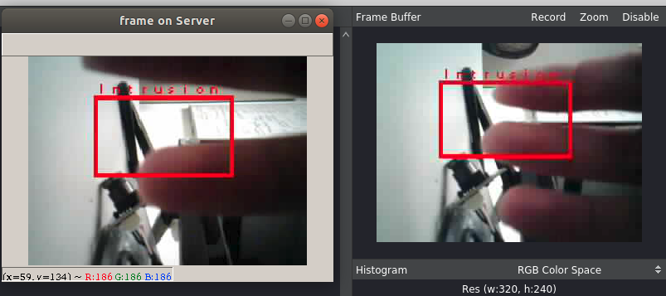
ROI Selection Step1 on Server Site
(Program)
Source Code on Maxnod (client/sender) to Detect Intrusion:
.
.
.
.
if ROI_flag==True:
img.draw_rectangle(x_1, y_1, x_2-x_1, y_2-y_1,(0,255,0),5)
roi = img.copy([x_1, y_1, x_2-x_1, y_2-y_1])
roi1=roi.copy()
if roi_Iflag ==False:
background = roi1.copy()
roi_Iflag=True
roi = roi.sub(background)
roi.binary([(0,40)], invert=True)
mean = roi.get_histogram().get_statistics().l_mean()
if mean >5:
intrusion_flag = True
intrusion_display_count = 0
background = roi1.copy()
print("Intrusion_flag ", intrusion_flag)
if intrusion_flag == True:
if (intrusion_display_count < 30):
img.draw_rectangle(x_1, y_1, x_2-x_1, y_2-y_1,(255,0,0),5)
img.draw_string(x_1, y_1-20, 'Intrusion', (255,0,0),2)
intrusion_display_count = intrusion_display_count+1
write_str = 'N10001 IllegalIntrusion is detected, now sending image'
uart_A.write(write_str)
print("Sent: ",write_str)
else:
intrusion_flag = False
Source Code on laptop (host/receiver) to sget Intrusion Image:
.
.
.
.
if received_data.decode('utf-8') == 'N10001 IllegalIntrusion is detected, now sending image':
print ("Received: " + received_data.decode('utf-8'))
send_data = "H001 IllegalIntrusion copied, now asking image"
ser.write(send_data.encode('utf-8'))
print ("Sent: " + send_data)
image_send_flag = True
image_transfered = False
f = open('image_received1.jpg','wb')#open file to write again
cap_once = False #reset to capture image
Fig. image_received.jpg Illegal Intrusion

Slide 37
Sending Data
Send Binary data:
https://stackoverflow.com/questions/17589942/using-pyserial-to-send-binary-data

