Slide 1

Template-2019-10-26
Company confidential
CTI One Corporation
Version: x0.1
Date: Dec.29, 2017, updated: Oct 18 2019
Project Lead: Harry Li, Ph.D.
Group Leaders: Team members:
https://github.com/hualili/robotics-open_abb/tree/master/2019S/ControlPrototype

Slide 2

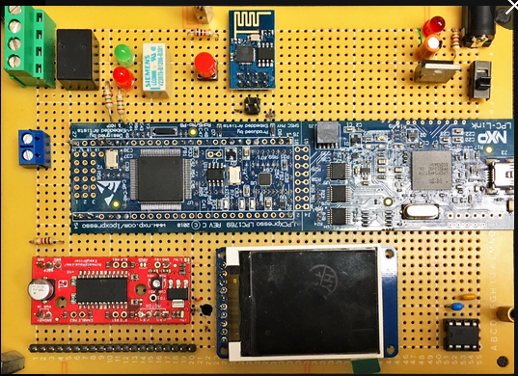
System Layout Design
Front Side
GPIO testing circuit with solid state relay
PWR circuit unit
J1: PWR Connector
LPC1769
SPI I/F Flash
Dimension: 16 x 11 mm or 6.25 x 4.50 inch
Harry Li, Ph.D. SJSU CMPE 127

Slide 3
First Thing First, Layout Design
FLASH
PWR
CKT
LPC1769
GPP testing
LCD
Wire wrapping board
Harry Li, Ph.D. SJSU CMPE 127

Slide 4
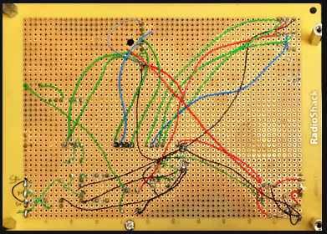
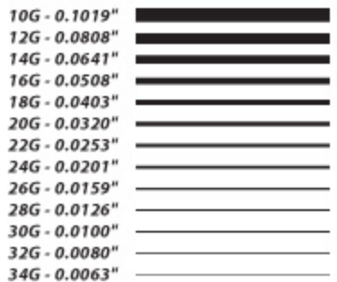
System Layout Design Back Side
Standoffs
Standoffs
Wire Wrapping: 18g to 24G
Wire soldered or wire wrapped
http://www.softflexcompany.com/WSWrapper.jsp?mypage=Tips_Wire_Temper.html
Harry Li, Ph.D. SJSU CMPE 127

Slide 5


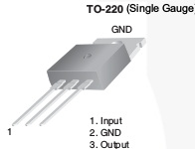
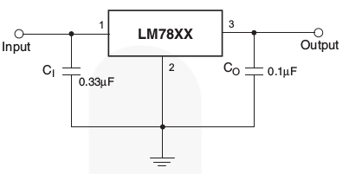
PWR Regulator LM7805
The LM78XX series of three-terminal positive regulators
is available in the TO-220 package and with several fixed
output voltages, making them useful in a wide range of
applications. Each type employs internal current limiting,
thermal shut-down, and safe operating area protection. If
adequate heat sinking is provided, they can deliver over
1 A output current. Although designed primarily as fixed-
voltage regulators, these devices can be used with exter-
nal components for adjustable voltages and currents.
Note: 1. Voltage drop 1.5 volt;
2. current output 1 A.
Harry Li, Ph.D. SJSU CMPE 127

