Slide 1

Aiv100-2019-5-21
CTI One Corporation
Version: x0.4
Date: Sep 7, 2018
Project Lead: Harry Li, Ph.D.
Team members:
Company confidential

Slide 2

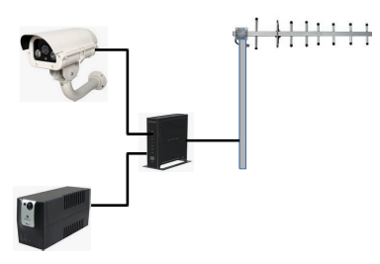


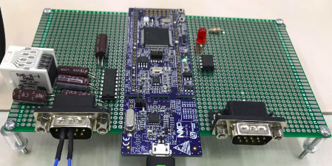
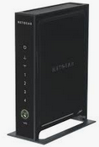


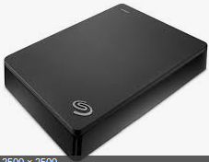

AIV-100 System Setup Illustration
Visit us on Youtube
https://www.youtube.com/watch?v=41BT45oxFTM
Camera 1
Office
Camera 4
smartphone
Checking

Slide 3
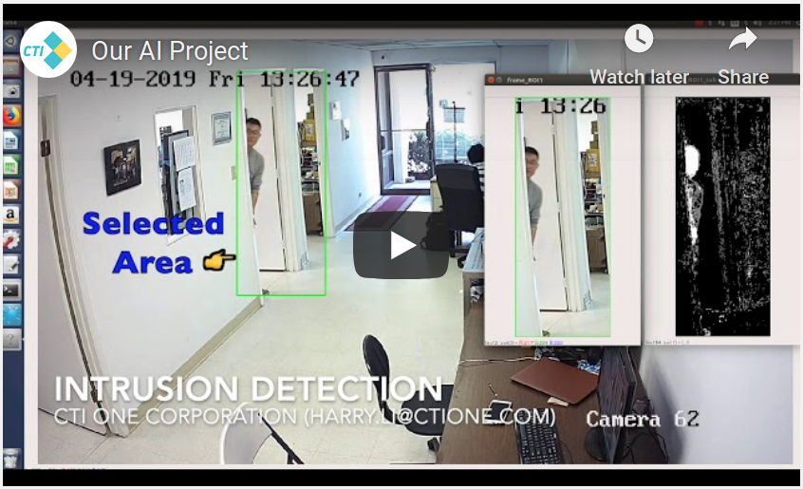
AIV-100 Intrusion Detection
Visit us on Youtube
https://www.youtube.com/watch?v=41BT45oxFTM

Slide 4
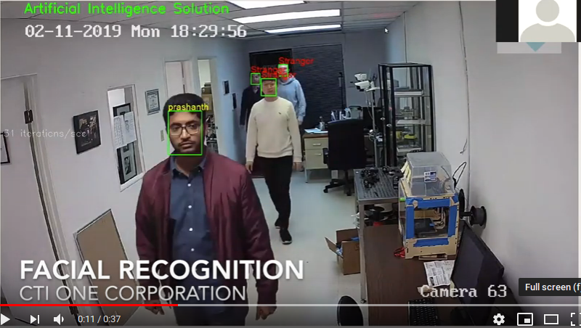
AIV-100 Facial Detection
Visit us on Youtube
https://www.youtube.com/watch?v=41BT45oxFTM
www.ctione.com

Slide 5
AIV-100 Facial Detection
Visit us on Youtube
https://www.youtube.com/watch?v=41BT45oxFTM
www.ctione.com

Slide 6
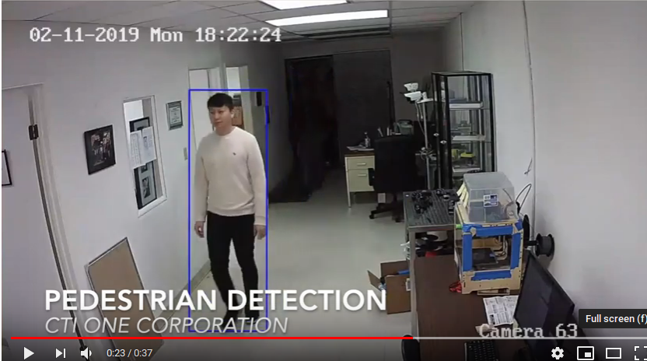
AIV-100 Behavior Analysis
Visit us on Youtube
https://www.youtube.com/watch?v=41BT45oxFTM

Slide 7
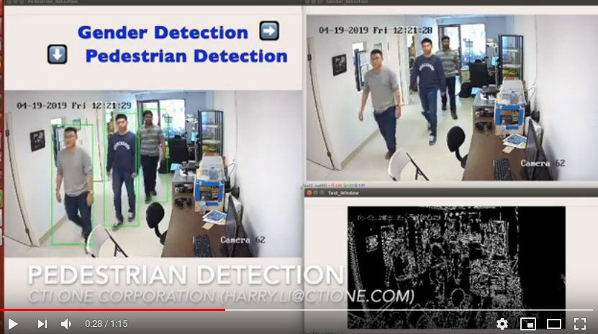
AIV-100 Behavior Analysis
Visit us on Youtube
https://www.youtube.com/watch?v=41BT45oxFTM

