Slide 1

mass-flow-controller-2019-10-26
Company confidential
CTI One Corporation
Version: x0.1
Date: Dec.29, 2017, updated: Oct 18 2019
Project Lead: Harry Li, Ph.D.
Group Leaders: Team members:

Slide 2



Oct 25 2019 Sierra Mass Flow Controller (MFC)
Reference: datasheets
101-compod-Sierra-gas-flow-meter-controller.pdf
102-sierra-smarttrak.pdf
provides precise control of
process gases such as
nitrogen, argon, carbon
dioxide, and methane
Every SmartTrak 100 is prepro-
grammed for up to 10 gases that are field selectable.
The SmartTrak 100 can also be integrated into the network via standard protocols such as Modbus, Profibus and Foundation Fieldbus. pp. 4
Harry Li, Ph.D.
1

Slide 3
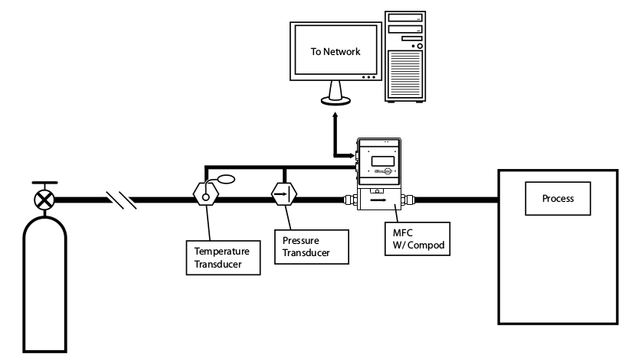
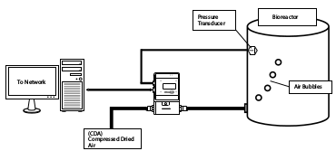
Oct 25 2019 Sierra MFC Typical Applications
101-compod-Sierra-gas-flow-meter-controller.pdf pp. 2

Slide 4
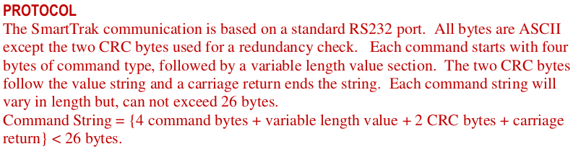
Oct 25 2019 Software Command Set
https://www.sierrainstruments.com/userfiles/file/manuals/SmartTrak-100-Series-Basic-Command-Set_v1d_21013.pdf?x=4268
The RS232 port does not depend on hardware handshaking and uses only three wires on the port: transmit, receive and ground. The port on the host needs to be configured to (9600,n,8,1) : 9600 baud, no parity, eight bit characters, one stop bit.
firmware version 2.044
102-2-SmartTrak-100-Series-Basic-Command-Set_v1d_21013.pdf pp. 1
The algorithm to generate CRC bytes
1
Harry Li, Ph.D.

Slide 5
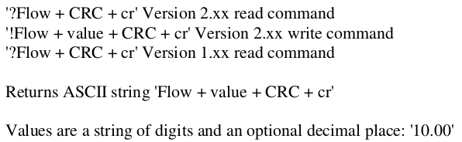
Oct 25 2019 Command Semtex
DESCRIPTION
FLOW makes the streaming mode data = flow only. If meter is in streaming mode, this data will stream until a FLOWwSETPOINT, FLOWwSETPOINTwDAC or TOTALwDIFFwDAC is sent to the meter. If not in streaming mode then one flow will be return with each FLOW command sent. ReadMeter, WriteMeter both will set flow as the streaming data.
Harry Li, Ph.D.

Slide 6
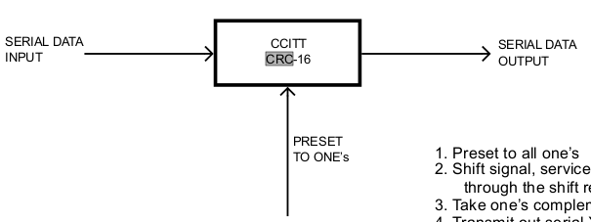

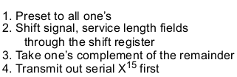


Oct 25 2019 CRC Algorithm
102-3-forCRC-from802.11b.pdf pp. 24
“The CCITT CRC-16 FCS shall be the one’s complement of the remainder generated by the
modulo 2 division of the protected PLCP fields by the polynomial”
Example: given the data to be coded as
The result with 1's complement, pp. 25
Harry Li, Ph.D.

Slide 7

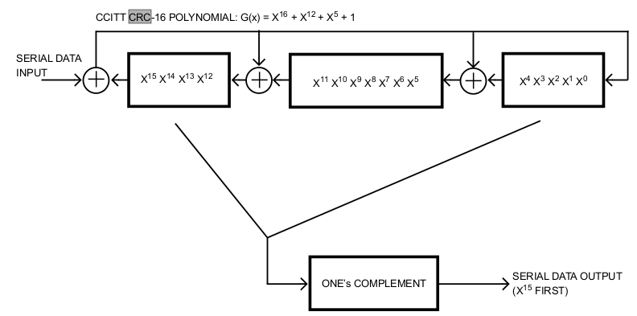
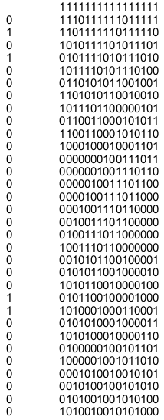
Oct 25 2019 CRC Implementation Example
Initialization, preset to 1's
102-3-forCRC-from802.11b.pdf pp. 27

