Slide 1

3-7-4-1-lpc-hardware-2019-3-18.odp
CTI One Corporation
Version: x0.4
Date: Sep 7, 2018
Project Lead: Harry Li, Ph.D.
Team members:
Company confidential

Slide 2
Mar-28-2019 MODBUS

Slide 3
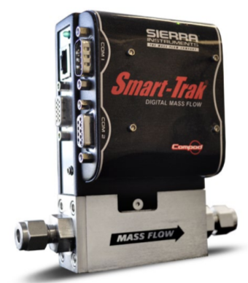
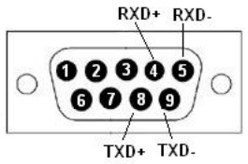


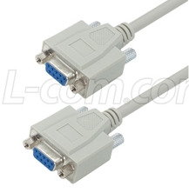
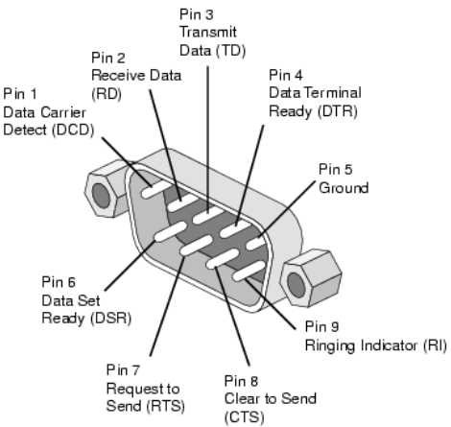

Mar-28-2019 Sierra Smart-Track-100 Compod
RS485
Male DB9
https://knowledge.ni.com/KnowledgeArticleDetails?id=kA00Z000000P9E8SAK&l=en-US
RS232
Note LPCNOD with DB9 Male connector for RS485 communication to Smart-track-100 compod DB9 Male connector, so we need DB9-DB9 female to female cable. See below:

Slide 4
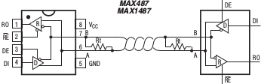
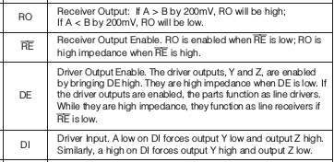
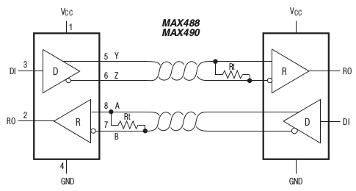
Mar-28-2019 RS485 Hardware
MAX485
Need to verify Sierra Smart-Track-100 485 pin configuration
From MAX485 datasheet, pp. 7

Slide 5
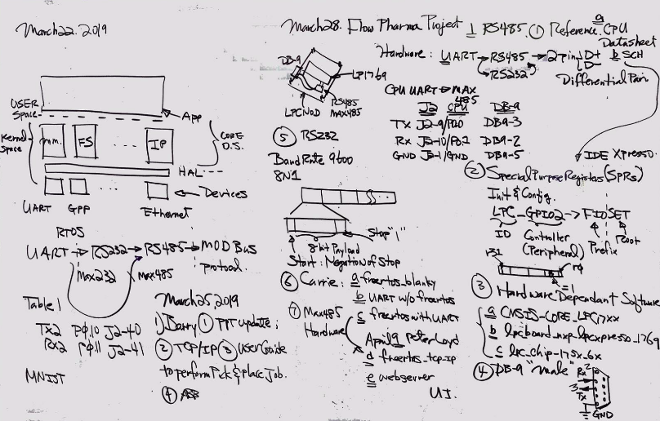
Mar-28-2019 RS232 Hardware

Slide 6
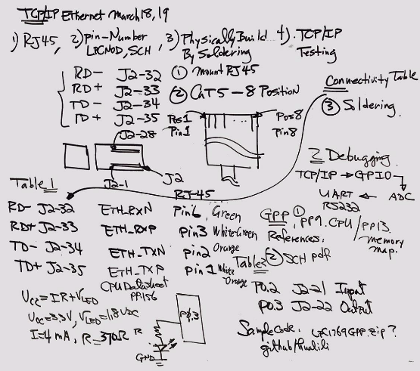
Mar-28-2019 Ethernet Hardware

Slide 7
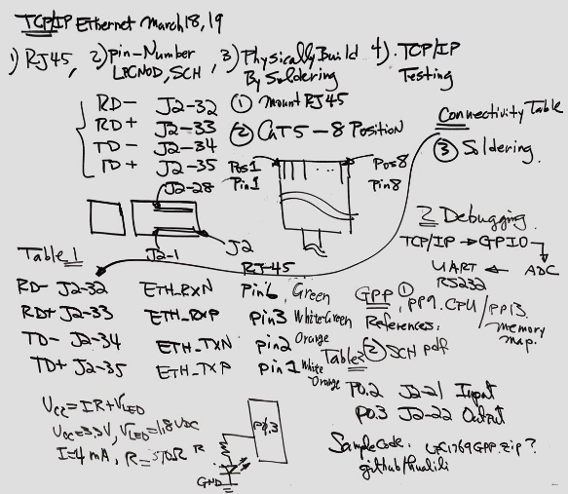
Mar-19-2019 TCP/IP Hardware

Slide 8
TX2SVR System Architecture
Tx2SVRGPU
USB
Ethernet
Router
Ethernet
LPCNOD
rs232
rs232
Flow Control
H1
Liq. Pump
H2
Spray Tech
H3
VIDCAM
TSI THERMAL MASS FLOWMETER
Cavro ® Centris Pump

Slide 9
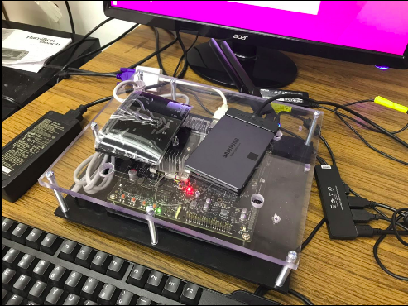
Mar-19-2019 Prototype Design

Slide 10
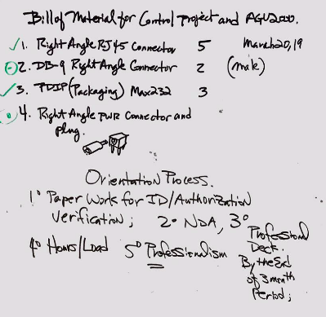
Mar-28-2019 Intern Orientation

