Slide 1

Debugging-Master-2019-10-26
Company confidential
CTI One Corporation
Version: x0.1
Date: Dec.29, 2017, updated: Oct 18 2019
Project Lead: Harry Li, Ph.D.
Group Leaders: Team members:
https://github.com/hualili/robotics-open_abb/tree/master/2019S/ControlPrototype

Slide 2
Oct 28 2019 TCP/IP Communications

Slide 3


Oct 28 2019 ADC For Thermal Couple Type K
Or jumper wire
Toggle s/w
Lpc1769 RS232
Potential meter ADC testing
RJ45 (F)
RJ45 (M)
Signal Amplifier
Thermal couple Type K
Reference: LPCXpresso1769_CD_revD(1).pdf

Slide 4
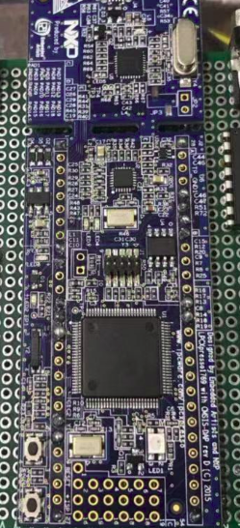
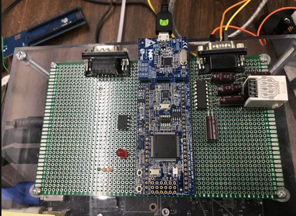

Oct 28 2019 ADC Pinout and PCB Layout
J2-1 GND

Slide 5
Oct 28 2019 ADC
100_CAVRO_centris manual.pdf
rs232
CAVRO centris
Pump
Tx2svr
Server
Lpc1769 RS232
rs232
Sierra MFC
IP router (Ethernet)
RJ45 (F)
RJ45 (M)
Signal Amplifier
Thermal couple Type K
Temperature sensor ds1620
Lpc1769 RS232
Temperature Non-contact sensor

Slide 6
Oct 28 2019 System Connectivity
100_CAVRO_centris manual.pdf
rs232
CAVRO centris
Pump
Tx2svr
Server
Lpc1769 RS232
rs232
Sierra MFC
IP router (Ethernet)
RJ45 (F)
RJ45 (M)
Signal Amplifier
Thermal couple Type K
Temperature sensor ds1620
Lpc1769 RS232
Temperature Non-contact sensor

Slide 7
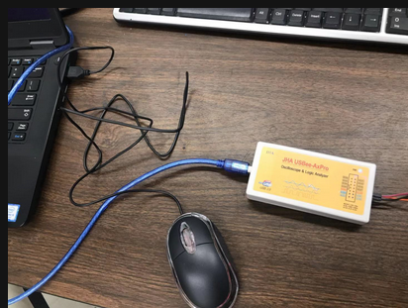
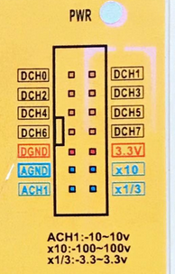
Oct 28 2019 Logic Analyzer for RS232 Tesing
8-digital channels;
1-analog oscilloscope with x10 and x1/3 gain

Slide 8

Oct 28 2019 Logic Analyzer for RS232 Tesing

Slide 9
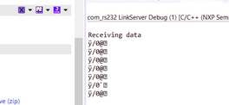
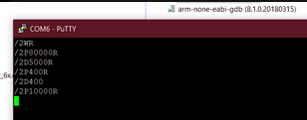
Oct 26 2019 LPC1769 UART Receiving Test
tx
rx
rx
Laptop usb-RS232
Pump RS232
Lpc1769 RS232
tx
Test commands rx received on LPC
Test commands tx sent by laptop
9600 bps, 8n1

Slide 10
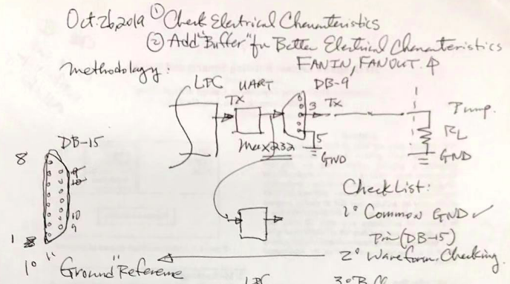
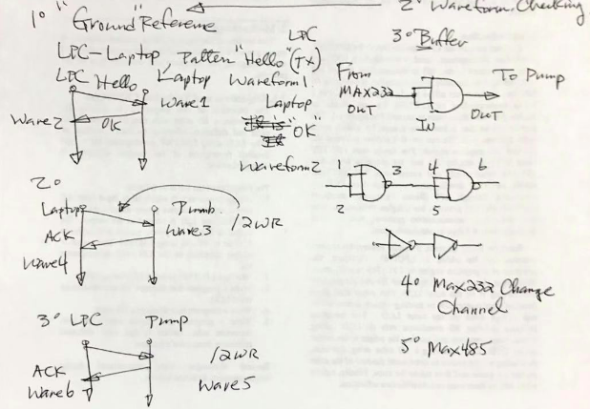
Oct 26 2019 RS232 Debugging
Note: hardware buffering does not seem to provide any effect as far as for removing the bug.

Slide 11
Oct 26 2019 LPC1769 UART Buffering
https://www.element14.com/community/blogs/dzxdesigns/2015/12/29/writing-a-buffered-uart-driver-for-the-nxp-lpc17xx
With reliability being a major requirement, it was chosen to use a buffer for holding received data to ensure that no data is dropped, even if it happens to be received without the application making a call to UART_Read(). The driver would make use of a circular buffer.

Slide 12

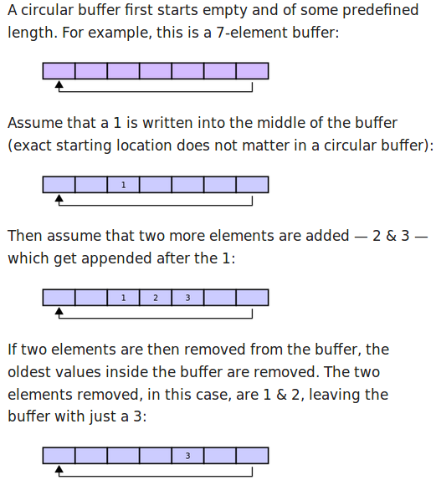


Oct 26 2019 Circular Buffer
https://en.wikipedia.org/wiki/Circular_buffer
The circular buffer is well-suited as a FIFO buffer, Example:
A consequence of the circular buffer is that when it is full and a subsequent write is performed, then it starts overwriting the oldest data. In this case, two more elements — A & B — are added and they overwrite the 3 & 4:
Finally, if two elements are now removed then what would be returned is not 3 & 4 but 5 & 6 because A & B overwrote the 3 & the 4 yielding the buffer with:

Slide 13
Oct 26 2019 UART FIFO Buffer
Cpu pp. 309
Table 279: UARTn FIFO Control Register (U0FCR - address 0x4000 C008, U2FCR - 0x4009 8008, U3FCR -
0x4007 C008) bit description
Cpu pp. 314
Table 281: UARTn Line Status Register (U0LSR - address 0x4000 C014, U2LSR - 0x4009 8014, U3LSR - 0x4009 C014)
bit description

Slide 14
Oct 26 2019 Pie4 UART
https://www.raspberrypi.org
pie4-rpi_DATA_2711_1p0_preliminary.pdf
GPIO pins can be switched (multiplexed) into various other modes backed by dedi-cated peripheral blocks such as I2C, UART and SPI.In addition to the standard peripheral options found on legacy Pis, extra I2C, UART and SPI peripheralshave been added to the BCM2711 chip and are available as further mux options on the Pi4.

Slide 15
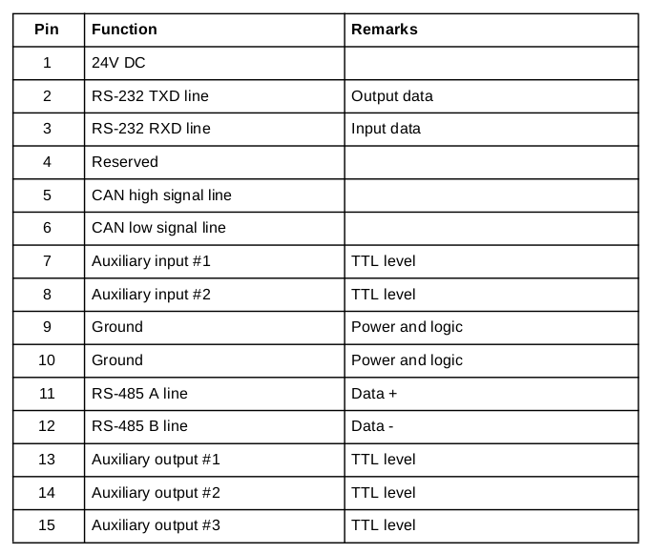
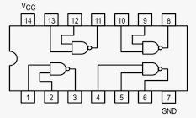

Oct 26 2019 RS Debugging
ls7400

Slide 16
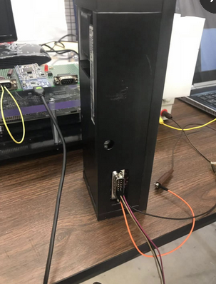
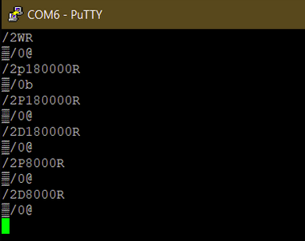
Oct 25 2019 CAVRO Centris 24V Pump
100_CAVRO_centris manual.pdf
1. address mapping s/w = 1;
2. check data sheet, pp. 57,
Command syntex: \ … R
1
Harry Li, Ph.D.

Slide 17
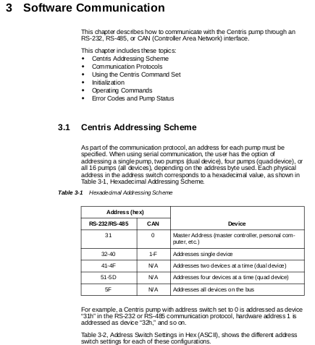
Oct 25 2019 C Code to Test CAVRO Centris Pump
100_CAVRO_centris manual.pdf
Write C/C++ or Python code to send and receive all the commands of CAVRO centris pump.
Document: 100_CAVRO_centris manual.pdf pp. 33 and on.

Slide 18
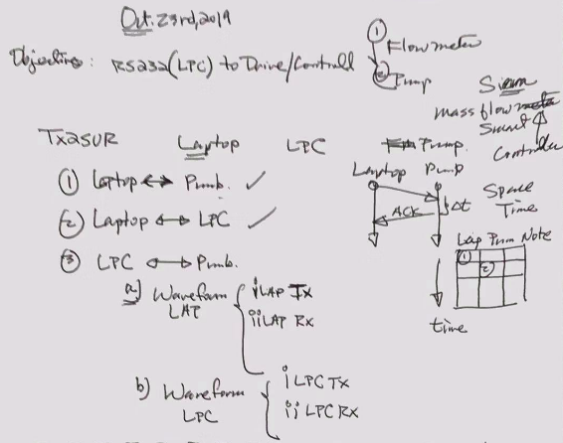
Oct 25 2019 RS Debugging
1
Harry Li, Ph.D.

Slide 19
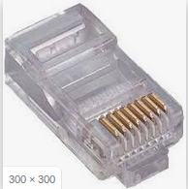
Oct 25 2019 Pump DB15 to DB9 Cabling
Build DB15 Female/DB9 Female cable
1
Harry Li, Ph.D.

Slide 20
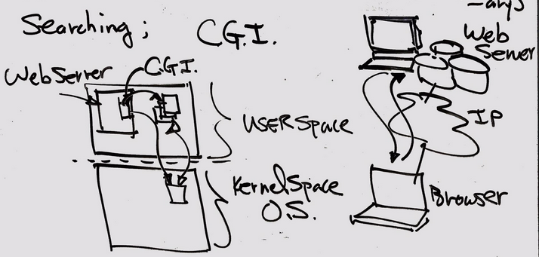

Basic Concept for CGI
1
Harry Li, Ph.D.

Slide 21
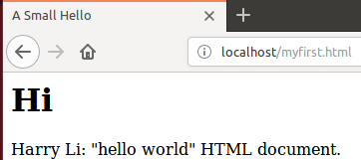
Write Your HTML Local Web Content at /var/www/html
Example: write HTML local web page
<!DOCTYPE html PUBLIC "-//IETF//DTD HTML 2.0//EN">
<HTML>
<HEAD>
<TITLE>
A Small Hello
</TITLE>
</HEAD>
<BODY>
<H1>Hi</H1>
<P>Harry Li: "hello world" HTML document.</P>
</BODY>
</HTML>
Note: Place this html web page “myfirst.html” at /var/www/html then use your browser http://localhost/myfirst.html
1
Harry Li, Ph.D.

Slide 22

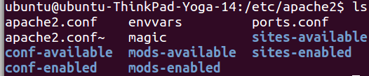
Apache2 And Its Document Root
https://www.digitalocean.com/community/tutorials/how-to-install-linux-apache-mysql-php-lamp-stack-on-ubuntu-14-04
1. Document root: /var/www/html where all the web content live. By default, Ubuntu does not allow access through the web browser to any file apart of those located in /var/www, public_html directories (when enabled) and /usr/share (for web applications). If your site is using a web document root located elsewhere (such as in /srv) you may need to whitelist your document root directory in /etc/apache2/apache2.conf.
Note: configuration files
2. Apache2, located at /etc/apache2, note
All of its configuration folders based on “available” and “enabled” categories. You will have to make sure they match up to your web configurations as shown later on this PPT.
3
CTI One Corporation, Santa Clara, CA 95051

Slide 23
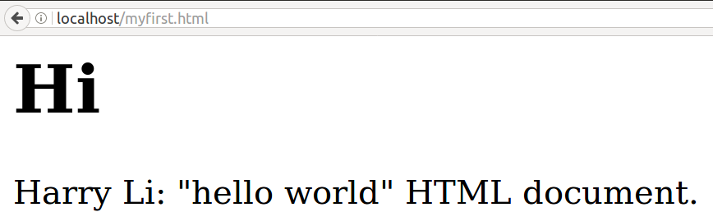
Browser Calling Your HTML Local Web Content
1. Use browser point to http:/localhost/myfirst.html or http://127.0.0.1/myfirst.html
Note: From time to time, you may want to change port address, if so, you need to edit the configuration file at /etc/apache2/ports.conf and change the Listen 80 to your desired port number. After edit you need to restart the apache2 server.
2
CTI One Corporation, Santa Clara, CA 95051

Slide 24
Writing a C CGI Program
Example: CGI program written in C
1. place this program at the default location:
/usr/lib/cgi-bin
You can check /etc/apache2/conf-available/serve-cgi-bin.conf
To find out the default location.
2. Compile and build this CGI program written in C.
/*---------------------------------------------------------------------*
* Program: mycgi.c; coded by: Harry Li; *
* Version: x01.0; Date: 2009 *
* Note: Port this from my original implementation on *
* embedded ARM platform with BOA websever to *
* x86 64 bit platform with Apatche2. *
* compilation and build: *
* sudo gcc -Wall mycgi.c -o main *
*----------------------------------------------------------------------*/
#include <stdio.h>
int main()
{
printf("Content-type: text/html\n\n");
printf("<html>\n");
printf("<body>\n");
printf("<h1>Harry Li: Hello there!</h1>\n");
printf("</body>\n");
printf("</html>\n");
return 0;
}
3
CTI One Corporation, Santa Clara, CA 95051

Slide 25
CGI Lives at /usr/lib/cgi-bin
So Place CGI Code there
Choose your cgi directory based on apatch2 default setting from etc/apache2/conf-available/serve-cgi-bin.conf as:
/
<IfDefine ENABLE_USR_LIB_CGI_BIN>
ScriptAlias /cgi-bin/ /usr/lib/cgi-bin/
<Directory "/usr/lib/cgi-bin">
AllowOverride None
Options +ExecCGI -MultiViews +SymLinksIfOwnerMatch
Require all granted
</Directory>
</IfDefine>
Cgi-bin conf file
Any request for a resource beginning with /cgi-bin/
should be served from this directory and should be treated as a CGI program.
Use $service apache2 restart to restart your apache2 server
CTI One Corporation, Santa Clara, CA 95051

Slide 26
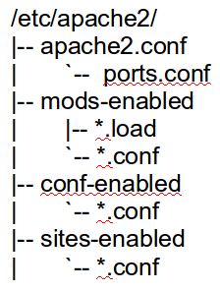
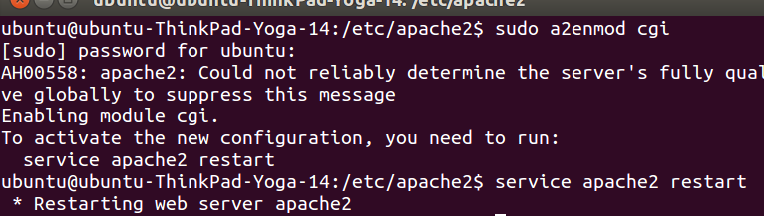
Enable CGI
https://www.linux.com/blog/configuring-apache2-run-python-scripts
1. Enable CGI in apache (enable cgid).
$sudo a2enmod cgi
This will automatically enable mod_cgid if your server is configured with a multi-threaded MPM.
2. Start new web service by
$service apache2 restart
Note 1:
If $service apache2 restart failed, then ???
Note 2: apache2.conf is the new version of httpd.conf
Note: when googling apache2 set up, you will see mentioning of httpd.conf, in this whole process you don have to do anything about it, apach2 conf is the latest.
CTI One Corporation, Santa Clara, CA 95051

Slide 27
CGI Configuration
https://code-maven.com/set-up-cgi-with-apache
1. /etc/apache2 directory is the standard place to find the Apache configuration files.
2. check if /etc/apache2/conf-available/serve-cgi-bin.conf file has a symbolic link from /etc/apache2/conf-enabled/serve-cgi-bin.conf. It has a section that maps the /cgi-bin path in the URLs to the /usr/lib/cgi-bin/ directory to enable CGI execution.
/etc/apache2/conf-available/serve-cgi-bin.conf
<IfModule mod_alias.c>
<IfModule mod_cgi.c>
Define ENABLE_USR_LIB_CGI_BIN
</IfModule>
<IfModule mod_cgid.c>
Define ENABLE_USR_LIB_CGI_BIN
</IfModule>
<IfDefine ENABLE_USR_LIB_CGI_BIN>
ScriptAlias /cgi-bin/ /usr/lib/cgi-bin/
<Directory "/usr/lib/cgi-bin">
AllowOverride None
Options +ExecCGI -MultiViews +SymLinksIfOwnerMatch
Require all granted
</Directory>
</IfDefine>
<Directory "/usr/lib/cgi-bin">
Options +ExecCGI
AddHandler cgi-script .py
</Directory>
</IfModule>
# vim: syntax=apache ts=4 sw=4 sts=4 sr noet
Note: configuration files
CTI One Corporation, Santa Clara, CA 95051

Slide 28
Check Symbolic Link Enabled
https://code-maven.com/set-up-cgi-with-apache
Check installed modules at /etc/apache2/mods-available directory. The cgi module is called cgi.load
The enabled modules have symbolic links in /etc/apache2/mods-enabled, check if the CGI module have a symbolic link enabled by default:
$ cd /etc/apache2/mods-enabled
$ sudo ln -s ../mods-available/cgi.load
Note if the symbolic link enabled when try to “ln -s”, it will show “File exists”, so the CGI configuration is done and is ready for you to test out your CGI program.
If check symbolic link if failed,
CTI One Corporation, Santa Clara, CA 95051

Slide 29
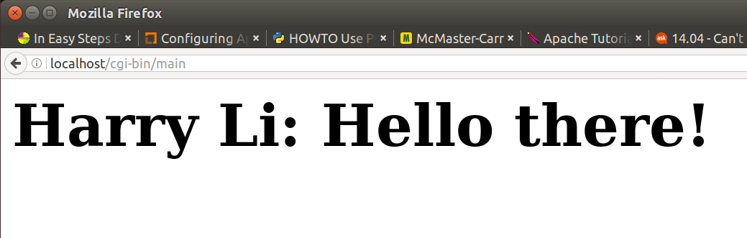
Browser Calling the CGI Program
Example, Calling CGI program “main” on a local Web server, type
http://localhost/cgi-bin/main
Note: The URL for your CGI program is a virtual path. The actual CGI script on the Web server in my case lives on /usr/lib/cgi-bin/. Check the conf to find/verify its actual location
/etc/apache2/conf-enabled/serve-cgi-bin.conf
CTI One Corporation, Santa Clara, CA 95051

Slide 30
Writing a Python CGI Program
Example: CGI program written in C
1. place this program at the default location:
/usr/lib/cgi-bin
2. before browser calling this program, change it to executable by chmod +x test.py
#!/usr/bin/env python
# -*- coding: UTF-8 -*-
# enable debugging
import cgitb
cgitb.enable()
print('Content-Type: text/html\r\n\r\n')
#print()
print('<!DOCTYPE html PUBLIC "-//IETF//DTD HTML 2.0//EN">')
print('<HTML>')
print('<HEAD>')
print('<TITLE>')
print('A Small Hello')
print('</TITLE>')
print('</HEAD>')
print('<BODY>')
print('<H1>Python CGI</H1>')
print('<P>Harry Li: "hello world" HTML document.</P>')
print('</BODY>')
print('</HTML>')
3
CTI One Corporation, Santa Clara, CA 95051

Slide 31
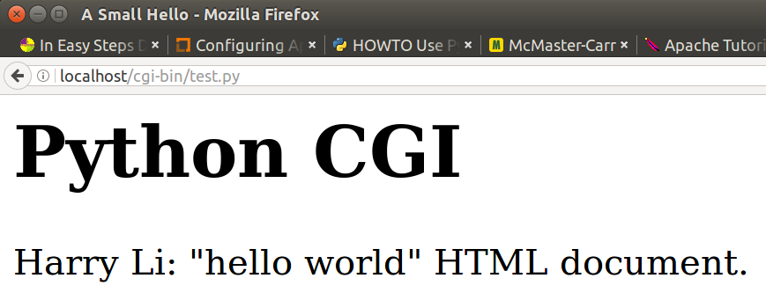
Browser Calling the Python CGI Program
Example, Calling CGI program “main” on a local Web server, type http://localhost/cgi-bin/test.py
CTI One Corporation, Santa Clara, CA 95051

Slide 32

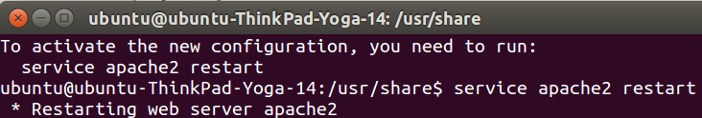
Find Apache2 Public IP Address
https://www.digitalocean.com/community/tutorials/how-to-install-linux-apache-mysql-php-lamp-stack-on-ubuntu-14-04
Your server's public IP address is usually the address to connect to your server through SSH. Use the iproute2 tools to get your address as:
ip addr show eth0 | grep inet | awk '{ print $2; }' | sed 's/\/.*$//'
This will give you one or two lines back. They are both correct addresses, but your computer may only be able to use one of them, try each one.
An alternative method is:
curl http://icanhazip.com
Use $service apache2 restart
to restart your apache2 server
3
CTI One Corporation, Santa Clara, CA 95051

Slide 33

Error Log For Debugging CGI
1. Find error log at: /var/log/apache2.
2. Inspect error log:
[Sun Dec 31 22:26:43.096093 2017] [cgi:error] [pid 1926] [client 127.0.0.1:52726] AH01215: (8)Exec format error: exec of '/usr/lib/cgi-bin/response.py' failed
[Sun Dec 31 22:26:43.096844 2017] [cgi:error] [pid 1926] [client 127.0.0.1:52726] End of script output before headers: response.py
CTI One Corporation, Santa Clara, CA 95051

Slide 34

Debugging By Checking “cgi.load”
1. Check to see if at /etc/apache2/mods-available directory, the cgi module cgi.load is there
2. Then check enabled modules of cgi at /etc/apache2/mods-enabled
It is there, but it is not, then add symbolic links
$ cd /etc/apache2/mods-enabled
$ sudo ln -s ../mods-available/cgi.load
If cgi.load is not there, then ???
CTI One Corporation, Santa Clara, CA 95051

