Slide 1

TX2 Vehicle Charging Intructions.ppt
AGV2000 Vehicle Charging Instruction.ppt
Reference: Owner’s Manual UBC41 4-in-1 Battery Charger – Tripp Lite.pdf
CTI One Corporation
Version: x0.1
Date: Mar 28, 2019
Project Lead: Harry Li, Ph.D.
Team members:
Minh Duc Ong
Company confidential

Slide 2
Vehicle Power Nodes
The vehicle has 2 power supply nodes: 36V node and 12V node.
- 36V includes three 12V batteries which are connected in series.
- 12V includes only one 12V batteries
+
24V power node connects to
- Motors
+
-
+
-
-
12V
12V
12V + 12V + 12V = 36V node
+
12V power node connects to
- Router,
- TX2 Server1, TX2 Server2.
- LPC node
-
+
-
12V
12V node

Slide 3
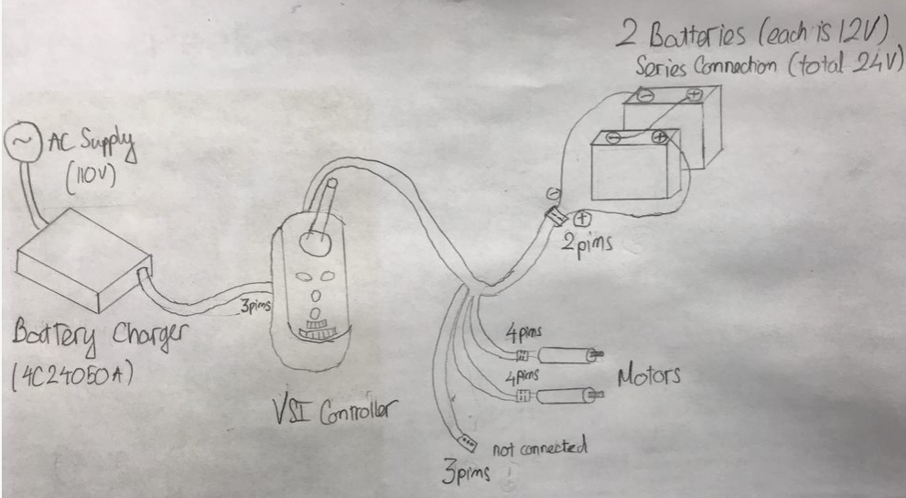
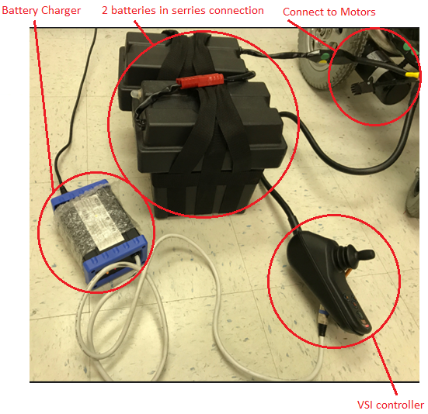
24V-Power Node Charging Instruction
2
5
4
3
1
Figure 1. Charging method:
The battery charger is used for charging 2 batteries.
Charger: Wheel charger 4C24050A
Charger Specification, retrieved from:
https://www.flexelmobility.com/wp-content/uploads/CTE-24V5A.pdf
Steps:
Step1: Connect the charger as the picture
Step2: Connect AC power supply(110V) to the charger
Step3: Check led indicator as instruction on the charger: Orange mean charging

Slide 4
12V-Power Node Charging Instruction
Charger: UBC41 4-in-1 Battery Charger – Tripp Lite
Charger Specification: https://www.tripplite.com/4-in-1-battery-charger~UBC41
Step 1: Turn the processors of the vehicle. (On/Off switch)
Step 2: Disconnect 12V power node from the motors and the processor.
Step 3: Select main AC power outlet. (110V)
Step 4: Set the Low Charge Rate Switch.
Step 5: Connect the power cord’s connector to into the charger’s power inlet. Then plug the other end of power cord into the AC power outlet.
Step 6: Press the Battery Voltage Selection button on the battery charger to be 12V.
Step 7: Connect the charger’s clamps to the battery terminals as following:
Step 7.1: Connect the positive clamp to the battery positive terminal.
Step 7.2: Then connect the negative clamp to the battery negative terminal.
Step 8: After the charging is finished, disconnect the charger from the 36V power node.
Step 9: Reconnect the battery to the motors and the processor.

