Slide 1

2019S-11-AGV2000-Batteries-charging-ZZ-2019-7-23.ppt
CTI One Corporation
Version: x0.1
Date: Sep 17, 2018
Project Lead: Harry Li, Ph.D.
Group Leaders: Zhixuan Zhou
Team members:
Release to Public

Slide 2
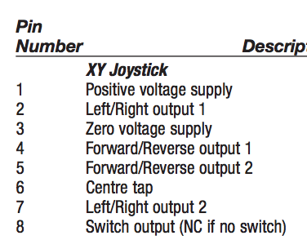
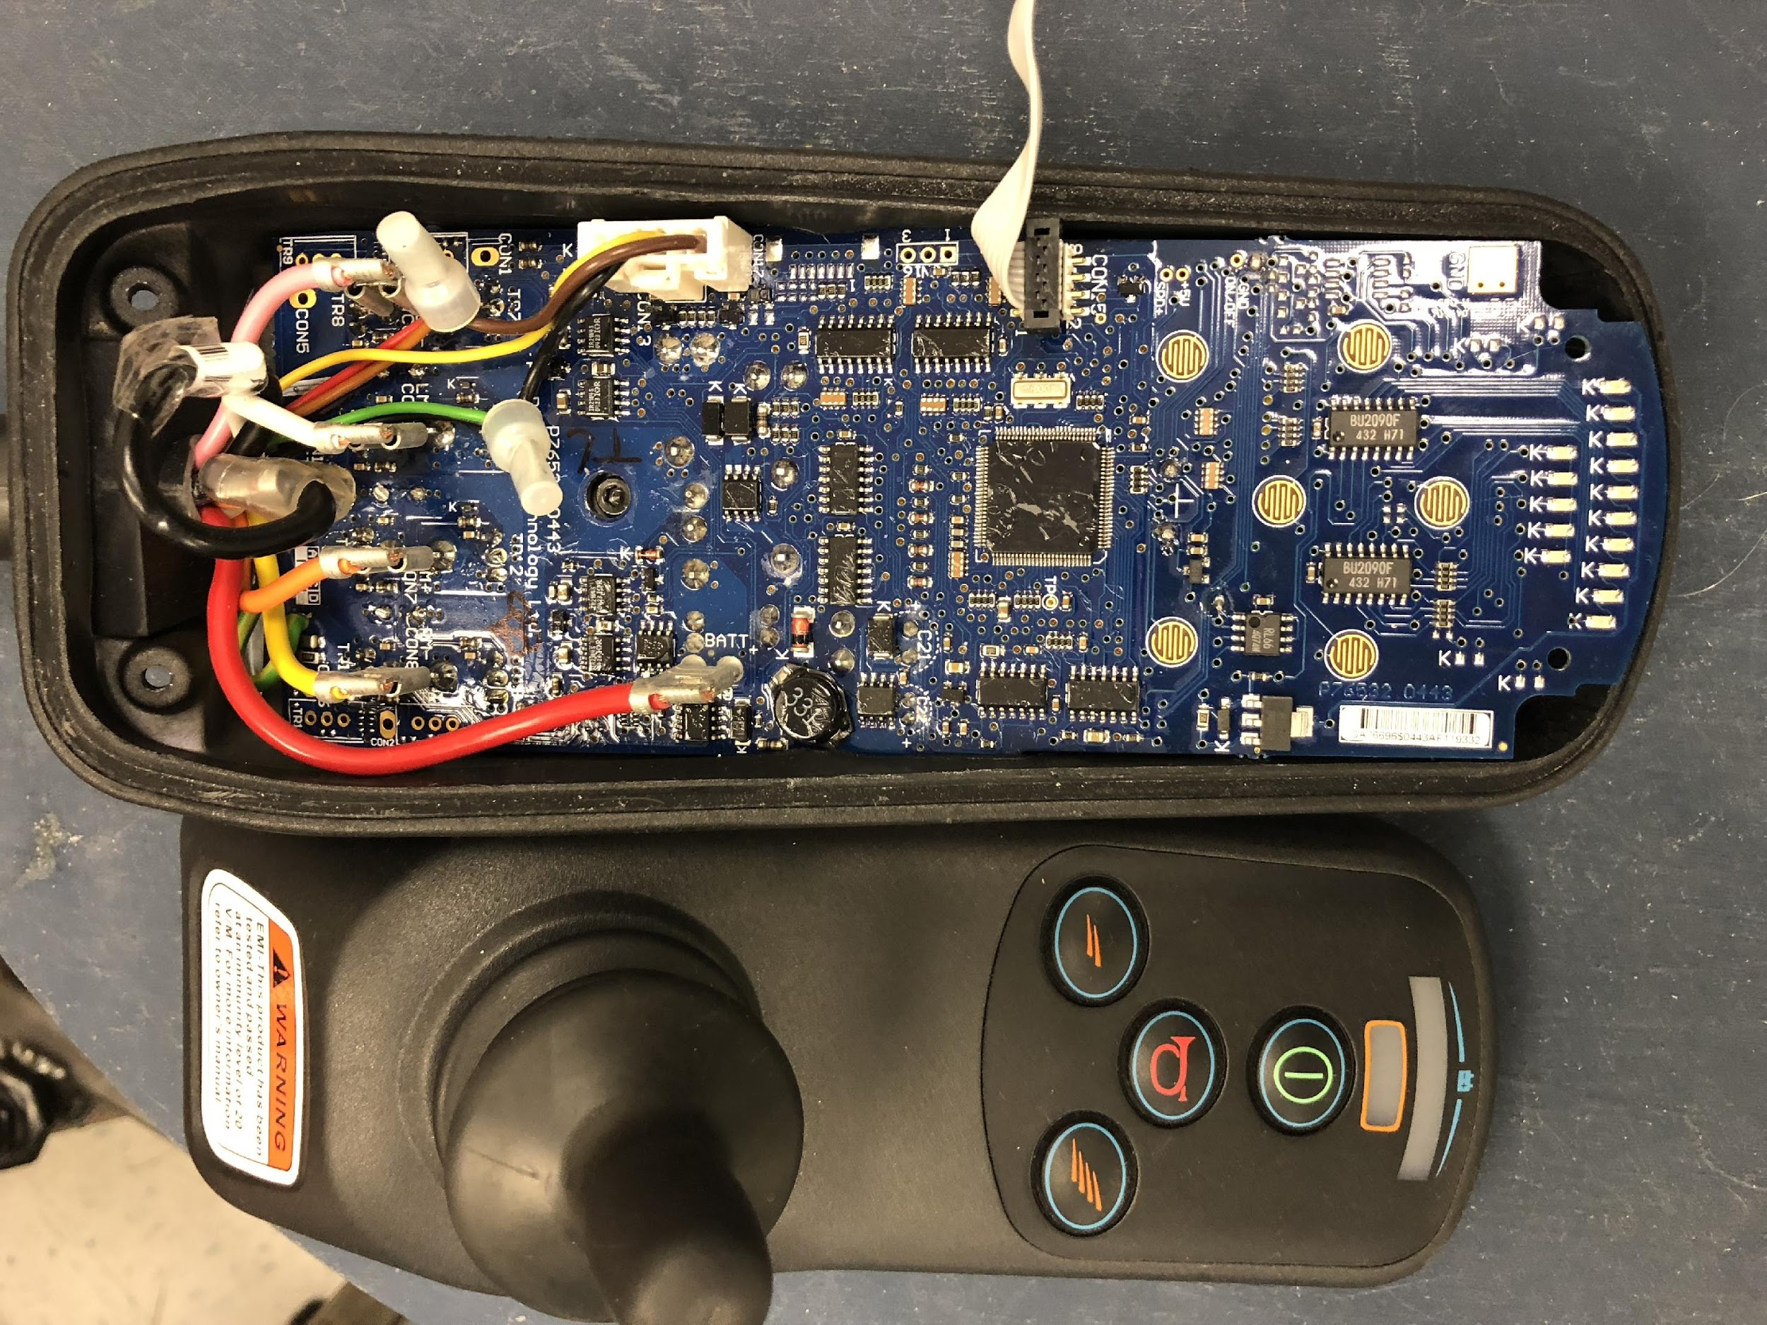
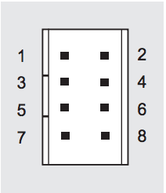
Pin Layout & Description
JC2000 Contactless Multi-axis Joystick
Release to Public

Slide 3
Testing Data Table
JC2000 Contactless Multi-axis Joystick
Release to Public
 | Description | Original | Forward | Reverse | Right | Left | Forward Right | Forward Left
#1 | Positive Voltage (Input) | 5 | 4.92 | 4.92 | 4.92 | 4.92 | 4.92 | 4.92
#2 | Left/Right 1 (output) | 2.45 | 2.47 | 2.5 | 1.08 | 3.75 | 1.61 | 3.35
#3 | Zero Voltage (output) | GND | GND | GND | GND | GND | GND | GND
#4 | Forward/Reverse 1 (output) | 2.45 | 3.78 | 1.06 | 2.32 | 2.05 | 3.40 | 3.28
#5 | Forward/Reverse 2 (output) | 2.45 | 3.77 | 1.03 | 2.45 | 2.00 | 3.09 | 3.15
#6 | Centre Tap (output) | 2.45 | 2.44 | 2.45 | 2.44 | 2.44 | 2.44 | 2.45
#7 | Left/Right 2 (output) | 2.44 | 2.40 | 2.44 | 1.05 | 3.67 | 1.30 | 3.42
#8 | Switch (output) | 0 | 0 | 0 | 0 | 0 | 0 | 0

Slide 4
Testing Data Analysis
JC2000 Contactless Multi-axis Joystick
Release to Public
 | Right Related | Left Related | Forward Related | Reverse Related
#1 | Input to Joystick, Always 5v
#3 | Always GND
#2 & #7 | Decreasing, minimum 1.08v | Increasing, maximum 3.75v | No change, stay 2.45v | No change, stay 2.45v
#4 & #5 | No change, stay 2.45v | No change, stay 2.45v | Increasing, maximum 3.78v | Decreasing, minimum 1.03v
#6 | Output from Joystick, Always 2.45v
#8 | Always 0v

Slide 5
PWM Output Control
Release to Public
NXP LPC1769 Processor
pwm1 pwm2 pwm3 GND
8kΩ
8kΩ
8kΩ
Pin#2, pin#7
Pin#4, pin#5
Pin#6
10μF
10μF
10μF

Slide 6
PWM Control Table
Release to Public
Frequency: 2kHz
Duty cycle range: 55% to 95%
Output voltage from processor to motor control board.
 | Straight Forward | Right Forward | Left Forward | Straight Reverse | Right Reverse | Left Reverse | Stop
Pin #2 & Pin #7 | 2.45V | 1.08V to 2.2V | 2.8V to 3.75V | 2.45V | 1.08V to 2.2V | 2.8V to 3.75V | 2.45V
Pin #4 & Pin #5 | 2.8V to 3.75V | 2.8V to 3.75V | 2.8V to 3.75V | 1.08V to 2.2V | 1.08V to 2.2V | 1.08V to 2.2V | 2.45V
Pin #6 | 2.45V | 2.45V | 2.45V | 2.45V | 2.45V | 2.45V | 2.45V
Pin #3 | GND | GND | GND | GND | GND | GND | GND

Slide 7
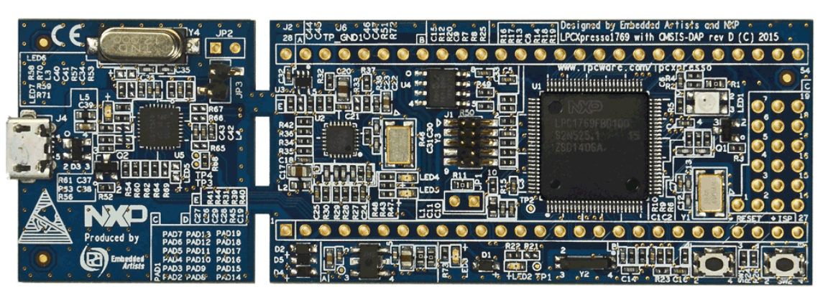
LPCNOD PWM Control
Release to Public
P2.0 (J2-42)
Controls Left/Right
P2.2 (J2-44)
Constant Output 2.44v for Centre Tap Pin
P2.1 (J2-43)
Controls Forward/Reverse

Slide 8

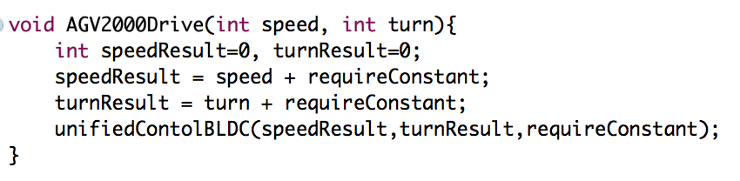
PWM Control Function
Release to Public
Speed Range: [-20, 20]
-20 to 0: Reverse drive
0 to 20: Forward drive
High speed reverse
Slow down
Stop
speedup
High speed forward
-20 0 20
Turn Range: [-20, 20]
-20 to 0: Right Turn
0 to 20: Left Turn
No Turn
Sharp right turn
Getting wider
Sharp left turn
-20 0 20

Slide 9
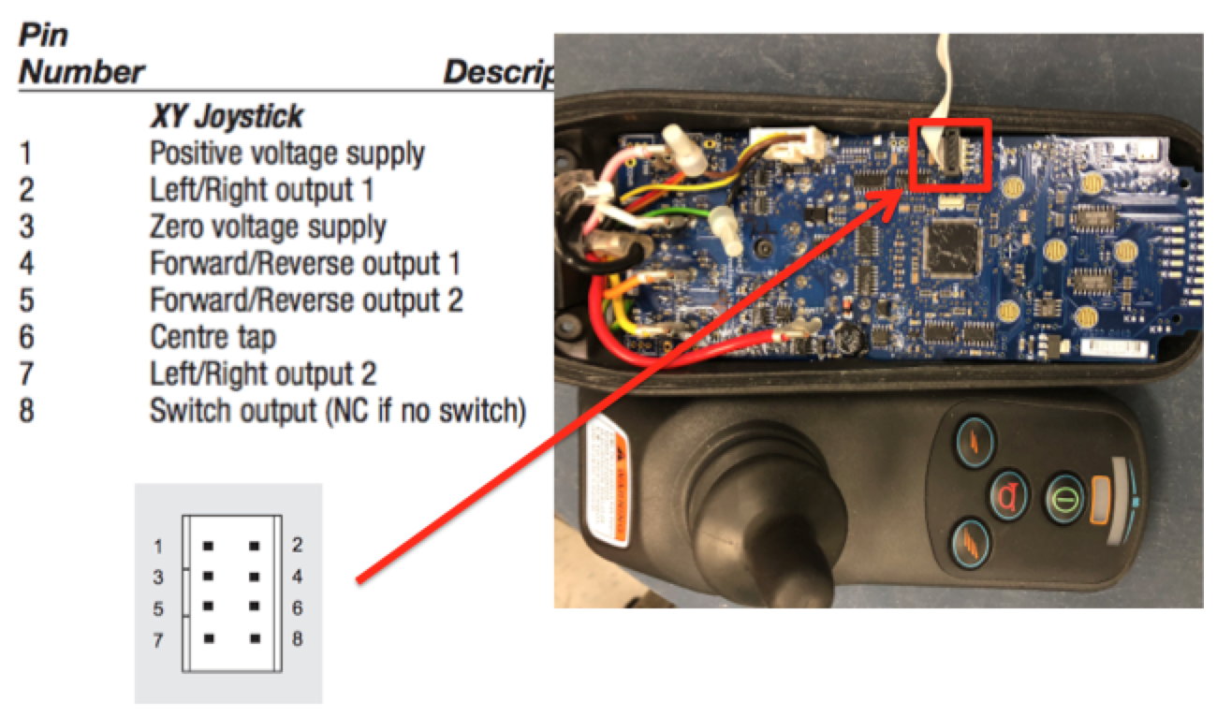
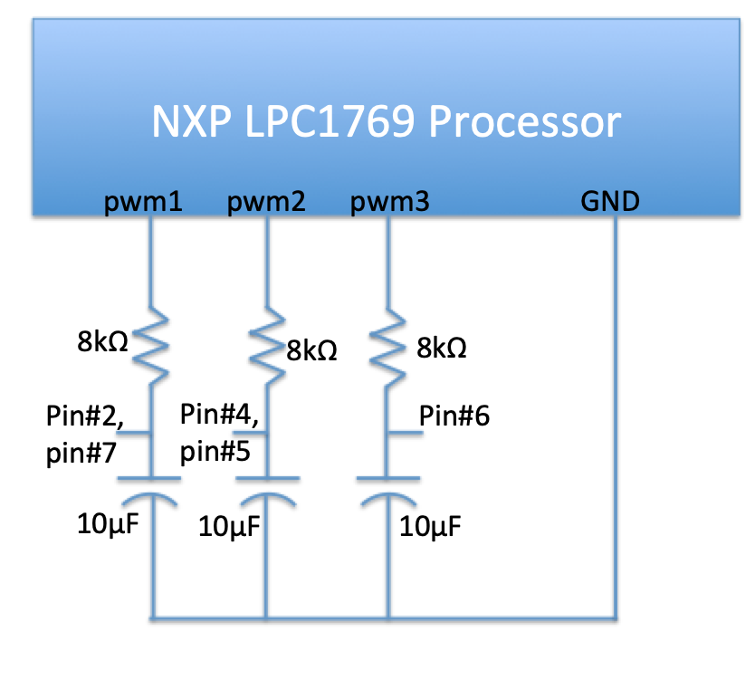
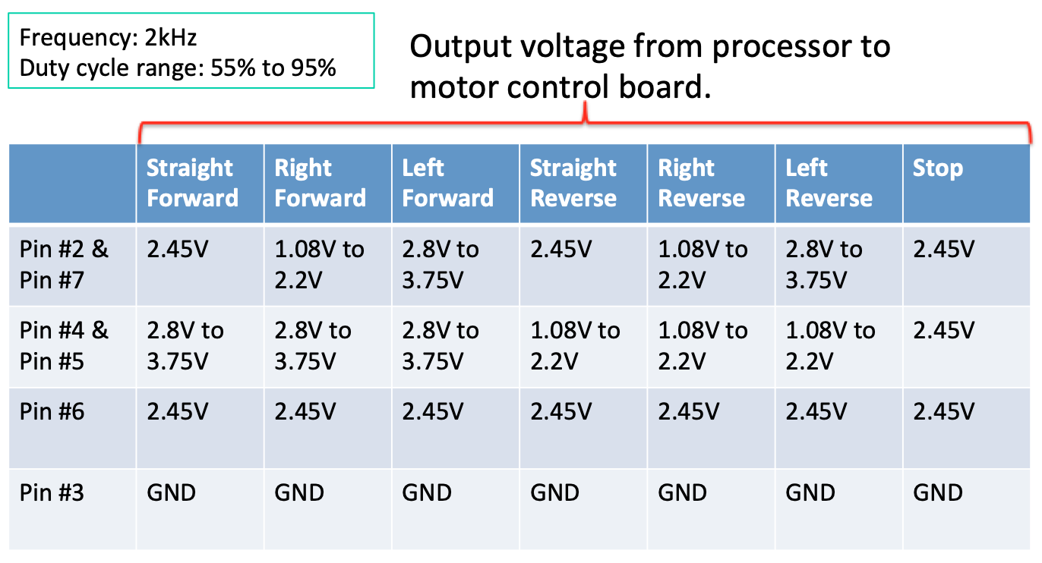
1-17-2019 AGV2000 Motor
Pin Assignment
Connectivity Table
Pin on LPC1769 | Pin on Motor Controller
P2.0(J2-42) | #2 & #7
P2.1(J2-43) | #4 & #5
P2.2(J2-44) | #6
GND(J2-1) | #3

Slide 10
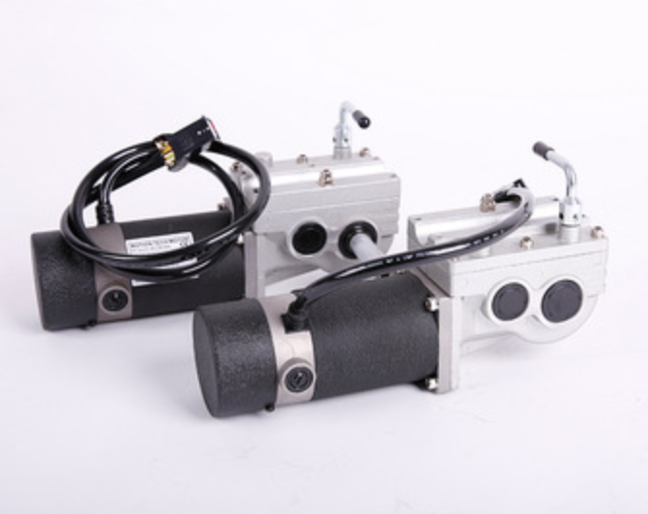
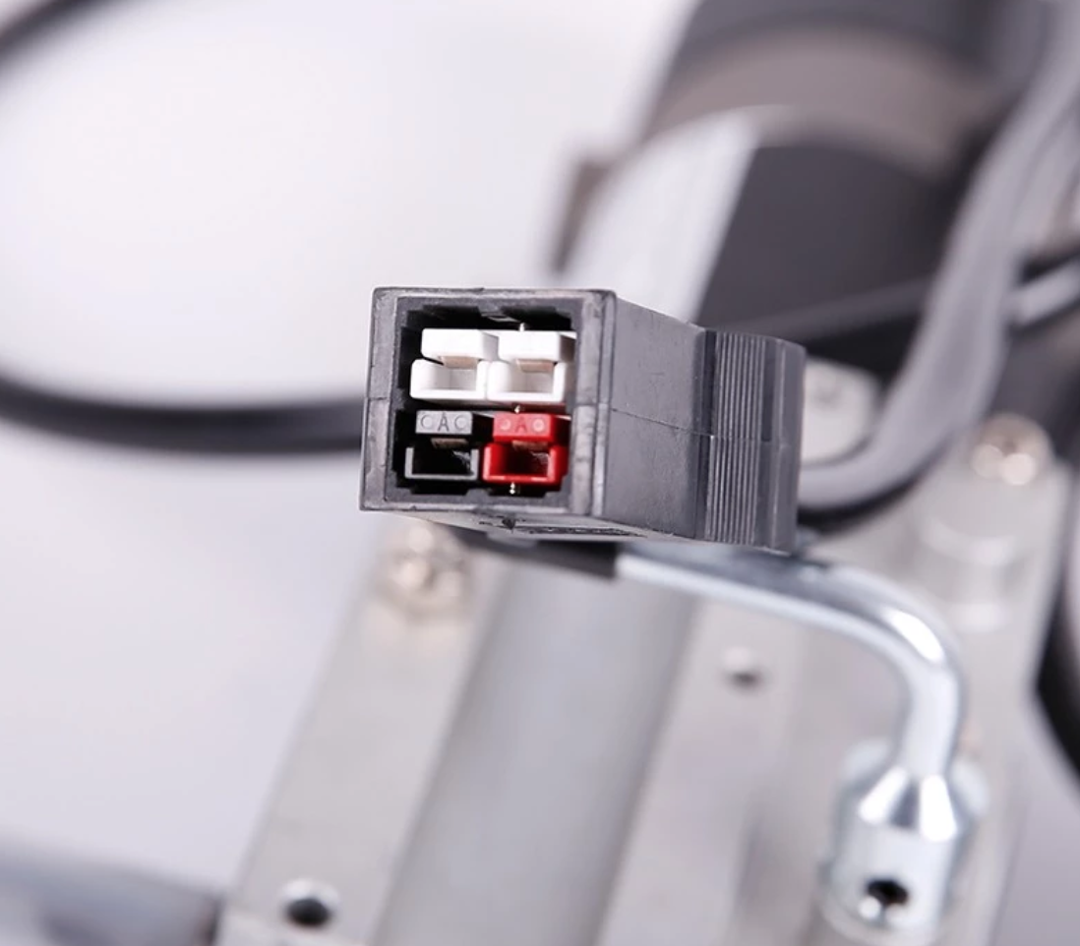
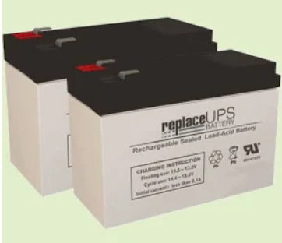
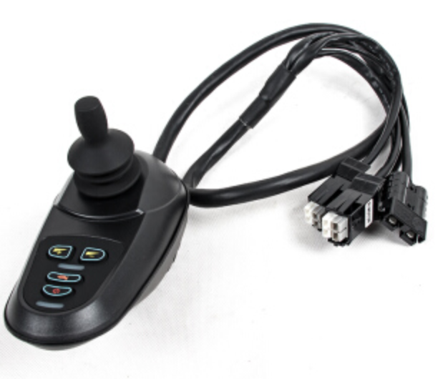
1-17-2019 AGV2000 Motor
Components Connection
DC Motor
DC Motor
Type: EC82M244632ELGB
24V, 3.0Amax, 4600 (32:1)
320W C.C.W F-Class
Pluggable connector Motor <-> Controller
Controller <-> Battery
Battery
Motor Controller

Slide 11
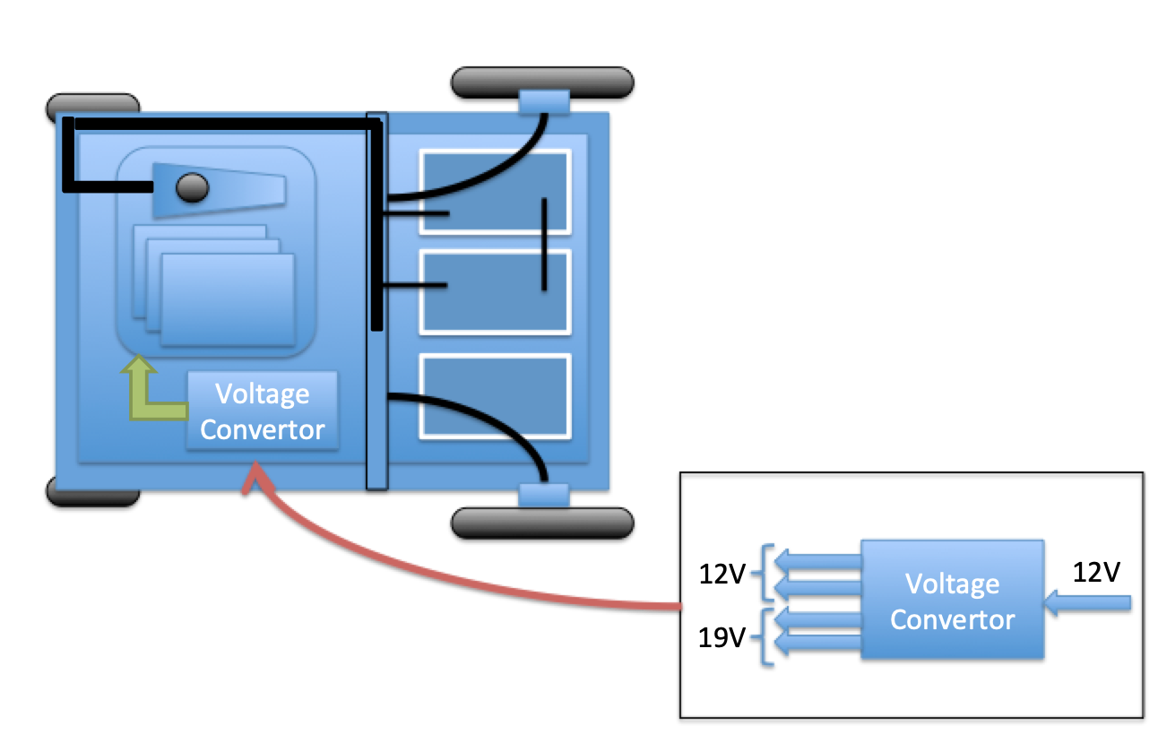
4-15-2019 AGV2000 Motor
Motor Drive Design
Motor Controller
Batteries
Processors

Slide 12
Driving Testing Data Table
Duty cycle (-10,0)
Confidential
Number of pulse | Exp Dist (in inch) | Exp Dist (in mm) | The change of pulse vs. previous test | Distance difference (10mil pulses difference) (in inch) | Distance difference (10mil pulses difference) (in mm)
10 million | 6 | 152.4
20 million | 11.5 | 292.1 | 10 mil | 5.5 inch | 139.7 mm
30 million | 16.75 | 425.45 | 10 mil | 5.25 inch | 133.35 mm
40 million | 21.75 | 552.45 | 10 mil | 5 inch | 127 mm
50million | 26.625 | 676.275 | 10 mil | 4.875 inch | 123.825 mm
Distance
Forward/Reverse
Duty Cycle: 85% (75+10)
AGV2000

Slide 13
Driving Testing Data Table
Duty cycle (-10,3)
Confidential
Number of pulse | Exp X (inch) | Exp X (mm) | Exp Y (inch) | Exp Y (mm) | The change of pulse | Distance difference X (10mil pulses difference) (in mm) | Distance difference Y (10mil pulses difference) (in mm)
10 million | 2.375 | 60.325 | 1.0 | 25.4
20 million | 7.25 | 184.15 | 7.125 | 180.975 | 10 mil | 123.825 mm | 155.575 mm
30 million | 8.675 | 220.345 | 13.875 | 352.425 | 10 mil | 36.195 mm | 171.45 mm
y
Forward/Reverse Duty Cycle: 65% (75-10)
Left/Right Duty Cycle: 85% (75+10)
x
AGV2000
Function for X: f= 0.079375p² + 13.17625p – 114.3
Function for Y: f= -0.43815p² – 25.527p – 151.13
P represents million of pulses

Slide 14
Driving Testing Data Table
Duty cycle (-10,3)
Confidential
Number of pulse | Exp X (inch) | Exp X (mm) | Exp Y (inch) | Exp Y (mm) | The change of pulse | Distance difference X (10mil pulses difference) (in mm) | Distance difference Y (10mil pulses difference) (in mm)
10 million | 1 | 25.3 | 0.35 | 8.89
20 million | 6.125 | 155.575 | 1.875 | 47.625 | 10 mil | 130.275 mm | 38.735 mm
30 million | 11.375 | 288.925 | 4.5 | 114.3 | 10 mil | 133.35 mm | 66.675 mm
40 million | 15.25 | 387.35 | 8.75 | 222.25 | 10 mil | 98.425 mm | 107.95 mm
y
Forward/Reverse Duty Cycle: 65% (75-10)
Left/Right Duty Cycle: 85% (75+3)
x
AGV2000
Function for X: f= -0.1746p² + 22.0662p – 215.9
Function for Y: f= 0.2064p² – 3.65125p + 38.1
P represents million of pulses

Slide 15
AGV2000 Hardware Design
Motor Controller
Motor Controller
Battery Bank
Motors
Processors
3 x PWM
1 x GND
Ethernet Cable
LPCNOD
RF System
SPI
Router
Battery Bank
Stereo Vision
TX2SVR
USB Cables
Ethernet Cable
Color Camera

Slide 16
AGV2000 Hardware Design_ZZ
Motor Controller
24V
Motor Controller
Battery Bank 1
Processors
Motors
3 x PWM
1 x GND
USB 5V
LASSEN
Ethernet Cable
LPCNOD
RF System
SPI
Pi3Nod
LASSEN
12V
LASSEN
Router
Battery Bank 2
USB 5V
12V
LASSEN
Stereo Vision
TX2SVR
LSMSEN
Monitor
USB Cables
Ethernet Cable
19V
19V
Color Camera

Slide 17
AGV2000 Power Design
Battery Bank
Voltage | Component | Power From
24V | Motors | 2 x 12V battery
19V | TX2SVR | 12V with voltage boost converter
 | Monitor
12V | Router
5V | LPCNOD | USB Power hub
 | Raspberry Pi

Slide 18
System Design Management on Board
AGV 2000
Platform 1
Platform 2
(26”x20”)
(20”x13”)
(20”x13”)
Battery Bank 1
(11”x11.3”)
Battery Bank 2
Battery Bank 3
12 V
19 V
Router
TX2SVR
Motor Controller
(8”x3.8”)
Connection hub
PI3 NOD
LPCNOD
RJ45 USB

Slide 19
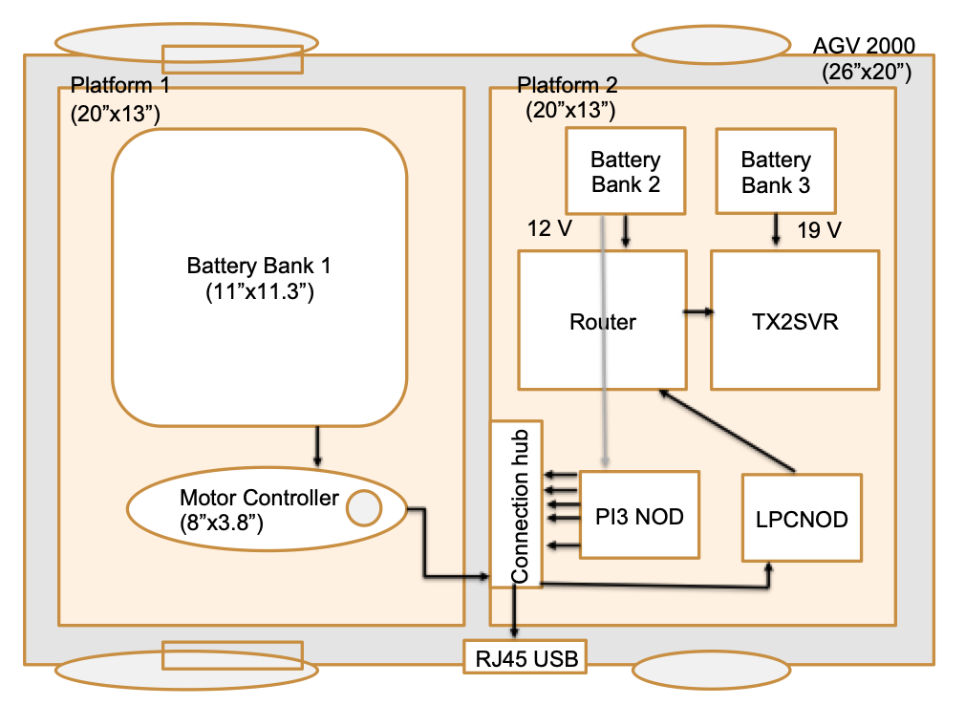
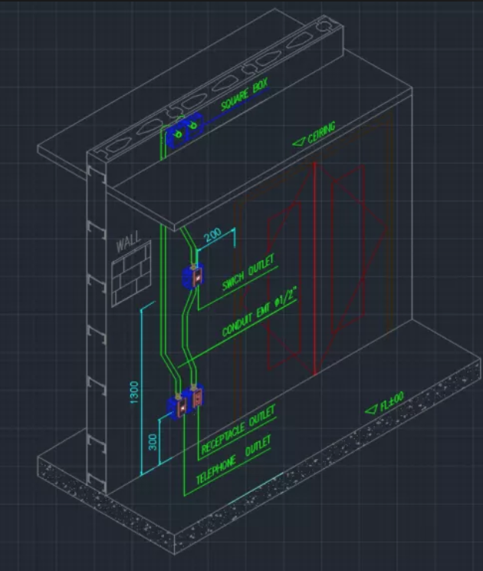
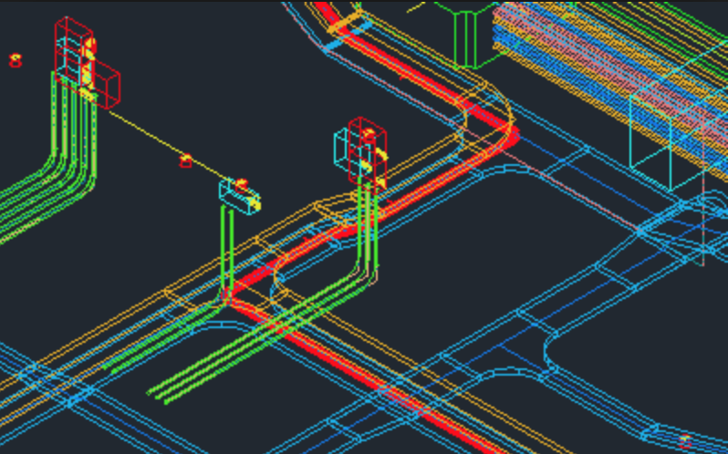
CAD Design For AGV2000

