Slide 1

190h-1-Jetson-Nano-WiFi-v1-YY-2022-3-1.odp
CTI One Corporation
Date: Mar. 1, 2022
Project Lead: Harry Li, Ph.D.
Team: Yusuke Yakuwa

Slide 2
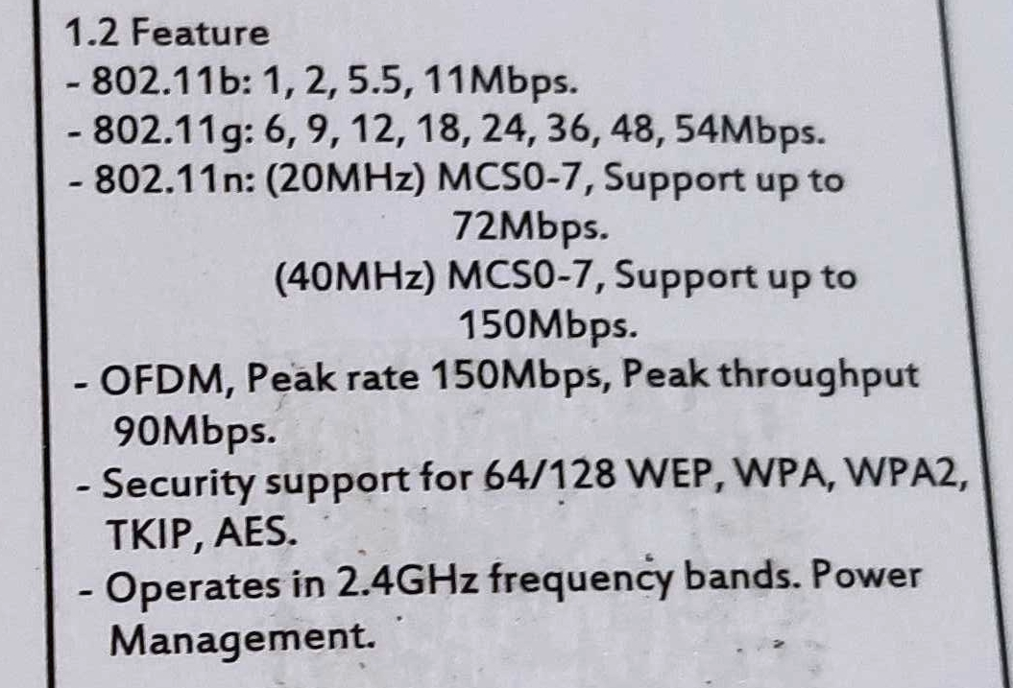
WiFi Module For Jetson Nano
Cytron Technologies
Jetson Nano USB USB Wireless G2B02
1. Product Information
Main Chipset: Ralink RT7601
Interface: USB 2.0/1.1 Type A
2. Feature
802.11b, 802.11g, 802.11n
Operation in 2.4 GHz frequency bands only
Note: 2.4GHz WiFi is interfered by other devices such as microwave ovens.
https://en.wikipedia.org/wiki/2.4_GHz_radio_use

Slide 3
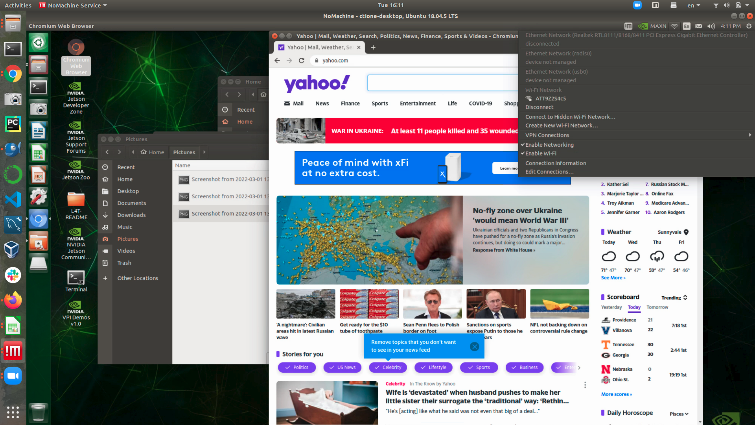
Test
OS: Nvidia L4T 32.5.1 / Jetpack 4.5.1
Jetson Nano 4GB Model: P3450
Network Type: 802.11b

Slide 4
END

