Slide 1

lec9-2-2-IP-2019-2-1.ppt
CTI One Corporation
Version: x0.2
Date: June 28, 2018
Project Lead: Harry Li, Ph.D.
Updated Feb 1, 2019
Team members: Meng-Huan Lee
Rahul Devaragudde Gopala
Company confidential

Slide 2
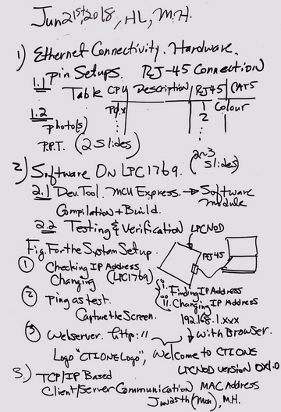
6-21-18 Ethernet Connection And Webserver

Slide 3
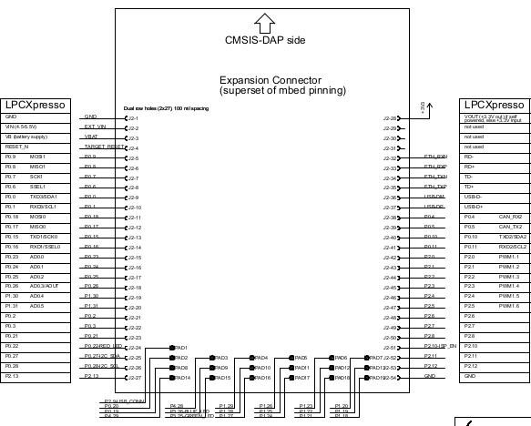
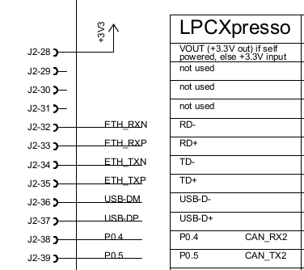
2019-2-1 LPC1769 Rev D Ethernet Pins

Slide 4
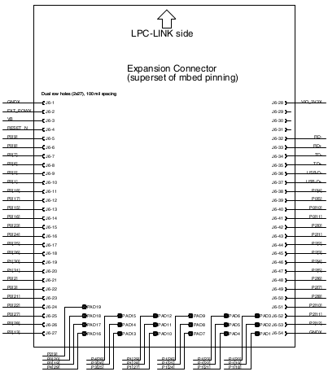
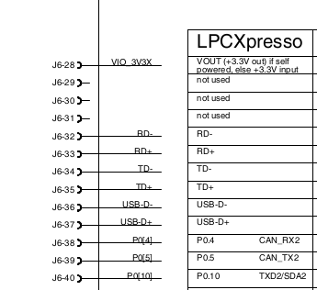
2019-2-1 LPC1769 Rev B Ethernet Pins
Same pin numbers except the connector name is J6, later in Rev D, the connector name is changed from J6 J2

Slide 5
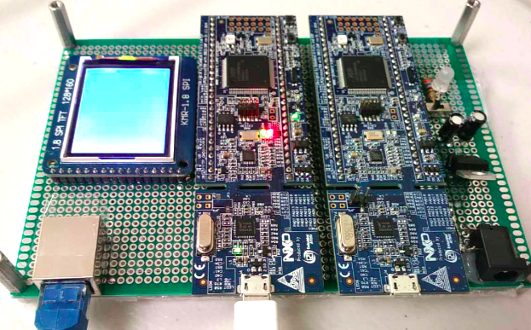
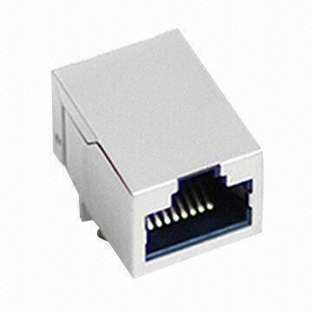
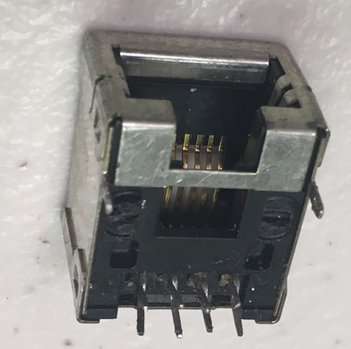
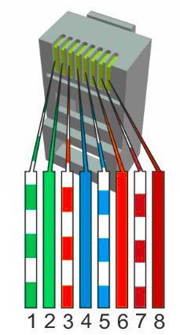
Ethernet Hardware Connection
LPC1769
RJ-45 Header
8 7 6 5 4 3 2 1
RJ-45
1
View from beneath
LPC1769 Module | RJ-45 Jack
Pin | Definition | Pin | Definition
J2_32 | ETH_RXN | 6 | RX-
J2_33 | ETH_RXP | 3 | RX+
J2_34 | ETH_TXN | 2 | TX-
J2_35 | ETH_TXP | 1 | TX+
CAT5 Cable

Slide 6
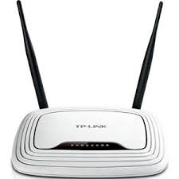

System Connection Diagram
Router
LPC1769
Ethernet
Ethernet
Laptop
RJ-45
USB Connection

Slide 7
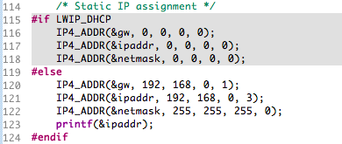
Software Setup
Environment: MCUExpresso IDE v10.1.1 [Build 606]
Test code: LPCOpen “webserver” example
Varialbe “LWIP_DHCP” in “lwipopts.h” decide to use DHCP or manual setup IP Address
LPC1769 IP setting: IP 192.168.0.3, GW 192.168.0.1, Mask 255.255.255.0
PC IP setting: IP 192.168.0.1, Mask 255.255.255.0

Slide 8
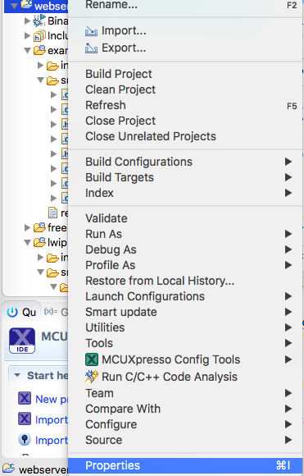
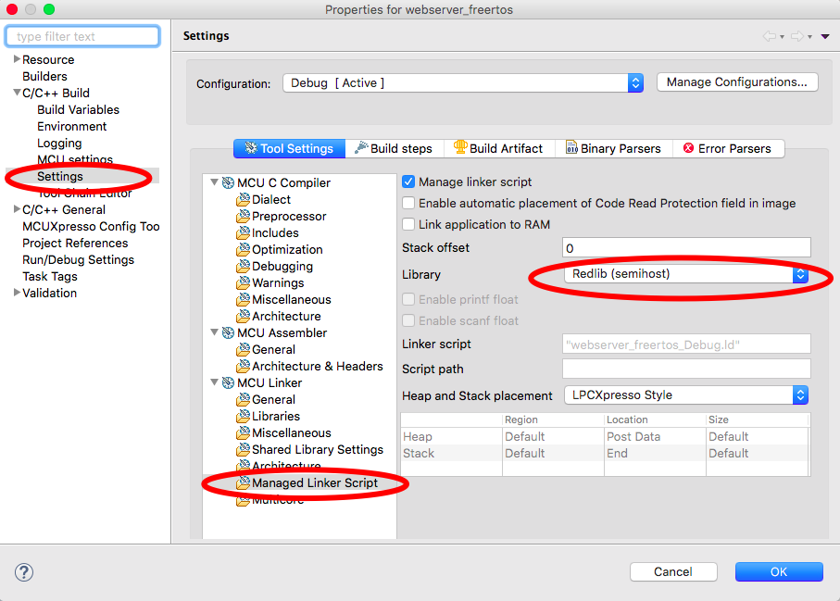
Software Setup (Optional for Debug)
If like to print debug information on MCUExpresso console:
Right click on project name -> properties
Changed to Redlib (semihost)
Otherwise, keep as Redlib (nohost)

Slide 9
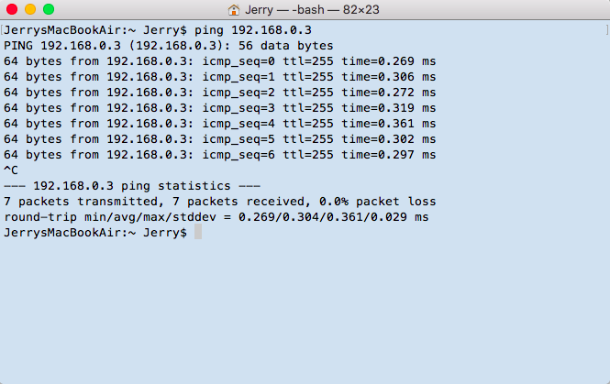
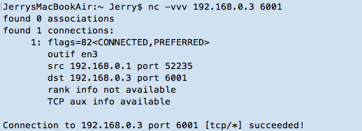
Testing and Verification
PC: ping 192.168.0.3 successfully
Use Netcat (NC) to test the IP and port:

Slide 10
Testing and Verification
Message loop-back test using Netcat:
Type message and enter, and LPC will send back
Transmit Round trip time (1kB and 2kB)
NC Console Output
LPC Console Output

Slide 11
About Netcat
https://en.wikipedia.org/wiki/Netcat
netcat (often abbreviated to nc) is a computer networking utility for reading from and writing to network connections using TCP or UDP. The command is designed to be a dependable back-end that can be used directly or easily driven by other programs and scripts.
to install and use netcat in ubuntu. You can choose to install netcat with the ‘apt-get install netat’
https://www.unixmen.com/play-with-netcat-in-ubuntu/
Chatting With Netcat
Creating the server with netcat
HTTP banner grabbing

Slide 12
Program Overview
Server Thread
Create new connection
Main()
vSetupIFTask()
Create task:
xTaskCreate()
Bind (IP,Port)
Start server program
Listen
Conn in
Start the task
vTaskStartScheduler()
Detect connection status
Accept
Receive data
Read buffer
Send Data (Echo)
Clear buffer

