Slide 1

3-7-4-5-1-pressureSensor-2019-9-13.odp
CTI One Corporation
Version: x0.4
Date: Sep 7, 2018
Project Lead: Harry Li, Ph.D.
Team members:
Company confidential

Slide 2

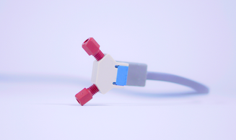
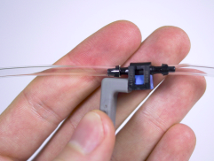
Microfluidic Pressure Sensor
https://www.elveflow.com/microfluidic-flow-control-products/microfluidic-flow-control-module/microfluidic-liquid-flow-through-pressure-sensor/

Slide 3
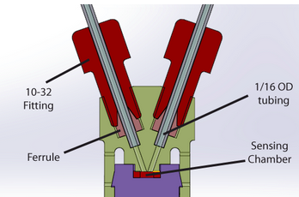
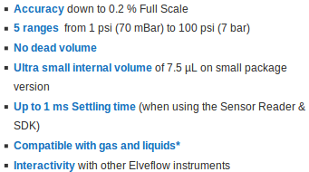
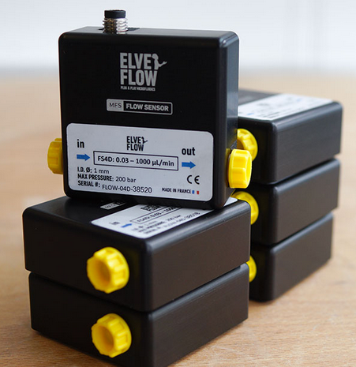
Microfluidic Pressure Sensor
http://www.elveflow.com/microfluidic-flow-control-products/microfluidic-flow-control-module/microfluidic-liquid-flow-through-pressure-sensor/?gclid=EAIaIQobChMIuM3OycnO5AIVxRd9Ch3L6wjoEAMYAyAAEgK7gvD_BwE
Microfluidic pressure sensor – small cut
ELVESYS – Innovation Center
83 avenue Philippe Auguste
75011 Paris, FRANCE

