Slide 1

LPCNOD-IP-motor-v3-MHL
2018-9-7
CTI One Corporation
Version: v3
Date: Sep 7, 2018
Project Lead: Harry Li, Ph.D.
Team members: Meng-Huan Lee
Company confidential

Slide 2
Project Introduction
Objectives
  Integrate LPC1769 with 100Mbps Ethernet to replace Modbus, achieved better scalability, lower round trip time
  Implement FreeRTOS in the system to achieve multitasking, inter-task communication and better CPU utilization
Progress
  Implemented communication between TX2SVR1 and LPCNOD through TCP/IP
  Completed testing on the vehicle integrated with TX2SVR1
  Enhanced safety system: LPC will stop the vehicle if the TX2SVR1 disconnected
confidential

Slide 3
7-??-2018 System Architecture
Meeting notes (need to find picture)
confidential

Slide 4
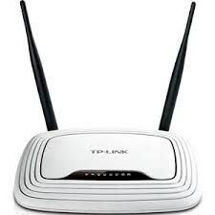
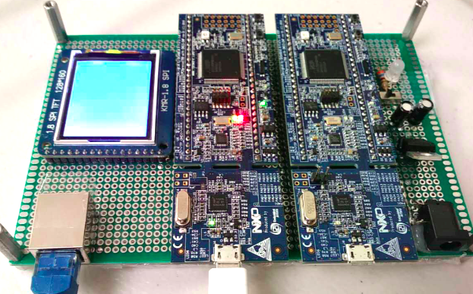
AGV4000 System Connection Diagram
Router
IP 192.168.0.1
LPCNOD
Ethernet
TX2SV1
RJ-45
IP 192.168.0.2
TX2SV2
IP 192.168.0.4
PWM
Motor Driver
IP 192.168.0.3
confidential

Slide 5
LPCNOD Program Overview
main()
m2
vSetupNetwork()
m3
prvSetupHardware()
m1
tcp_client_thread()
motorHandler()
Create new connection
v1
processReceivedFrame()
mh1
Create task 1
vSetupNetwork()
m2
Waiting for command
mh2
Connect to TX2SV1
v2
Create task 2
motorHandler()
m3
Handle command
mh3
Receive command
v3
Start the task
vTaskStartScheduler()
Send Command to Motor Handler
v4
Control motor
mh4
m4
xQueue
confidential

Slide 6
Communication Flow
main( )
m2
vSetupNetwork( )
m3
motorHandler( )
m1
preSetup
Hardware()
m2
CreateTask1
CreateTask2
StartTask
m3
Create connection
m4
v1
Connect to TX2SVR1
v2
Receive command
v3
v4
Send
command
Decode command
mh3
xQueue
Control
motor
mh4
confidential

Slide 7
Program Flow Chart
Create New
Connection
Task2
Task1
Main()
Delete
Connection
Initialize
motor
Task1
Connect to
TX2SVR1
Fail
Waiting to receive
Success
Task2
Fail
Received
Data
Process
command
Success
Send to
xQueue
Control
motor
Clear
Buffer
confidential

Slide 8
LPCNOD Main Program
int main(void)
prvSetupHardware();
/* xQueue is for transferring data between threads. */
xQueue = xQueueCreate( 1, 10 * sizeof( char ) +1);
/* Thread for Ethernet interface and TCP connection. */
xTaskCreate( );
/* Add motor control thread to handle the data received */
xTaskCreate( );
/* Start the scheduler */
vTaskStartScheduler();
m1
m2
m3
m4
confidential

Slide 9
LPCNOD Motor Handler
xTaskCreate(motorHandler, (signed char *) "Motor_Handler",
configMINIMAL_STACK_SIZE, &xQueue, (tskIDLE_PRIORITY + 1UL), (xTaskHandle *) NULL);
void motorHandler(void *pvParameters) {
xQueue = *(xQueueHandle *) pvParameters;
for( ;; ) {
processReceivedframe();
vTaskDelay(1);//sleep for 1ms
}
}
void motor_data_frame_init() {
memset(&data_frame, 0, sizeof(data_frame));
…
char temp[10] = "";
if(xQueueReceive(xQueue, &temp, portMAX_DELAY)){
…
}
mh1
mh2
confidential

Slide 10
LPCNOD Motor Handler
void processReceivedframe() {
// initialize the motor_data_frame
motor_data_frame_init();
…
//get the control byte
control_byte = data_frame.sign_action;
switch (control_byte) {
…
}
mh3
mh4
confidential

Slide 11
LPCNOD vSetupNetwork
static void vSetupNetwork(void *pvParameters) {
…
//Setup IP Address and
netif_set_default(&lpc_netif);
netif_set_up(&lpc_netif);
//Start TCP client thread
tcp_client_init();
…
}
tcp_client_thread(void *arg){
struct netconn *conn;…
while(1){
/* Create a new connection identifier. */
conn = netconn_new(NETCONN_TCP);
err = netconn_connect ( conn, &servIpaddr, TX2SVR1_PORT)
while ((err = netconn_recv(conn, &buf)) == ERR_OK) {
…
xQueueOverwrite( xQueue, stopVehicle);
}
…
}
m3
v1
v2
v3
v4
confidential

Slide 12
Test Result
  Tested items:
  LPCNOD and TX2SVR1 connection test
  2. LPCNOD command receiving test
LPCNOD IP Address
TX2SVR1 IP Address
confidential

Slide 13
Test Result
  Test items:
  3. TX2SVR1 disconnect with LPCNOD
  4. Round trip time test
  Result: 0.6ms
Stop vehicle and auto reconnect
confidential

Slide 14
Issues
Issue: TX2SV1 program VIDPATFSM is always terminated unexpectedly (Solved)
Issue: VIDPATFSM has not yet handled network disconnection properly:
  After disconnection, the program need to restart
  The program does not handle “cannot bind port” and “Disconnect” exception
confidential

