Slide 1

nnn-n-Pyinstaller-Deployment-YY-2022-6-14.odp
CTI One Corporation
This document is created by: Harry Li, Ph.D.
Yusuke Yakuwa
June 14, 2022

Slide 2
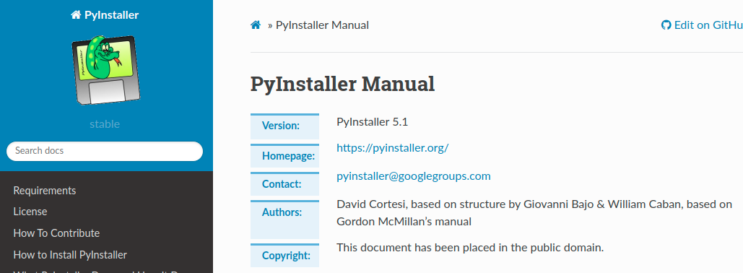
Pyinstaller for CV100 Release
https://pyinstaller.org/en/stable/index.html
Pyinstall
1. Generate a executable program and its requirements, dependecies in a folder
2. Read the Python code and collect dependecies
3. Support many major Python packages such as matplotlib, Tensorflow, PyQT, and so on

Slide 3
Requirements On macOS
https://pyinstaller.org/en/stable/requirements.html#pyinstaller-requirements
PyInstaller runs on macOS 10.15 (Catalina) or newer. It can build graphical windowed apps (apps that do not use a terminal window). PyInstaller builds apps that are compatible with the macOS release in which you run it, and following releases. It can build x86_64, arm64 or hybrid universal2 binaries on macOS machines of either architecture. See macOS multi-arch support for details.
macOS multi-arch support
https://pyinstaller.org/en/stable/feature-notes.html#macos-multi-arch-support

Slide 4
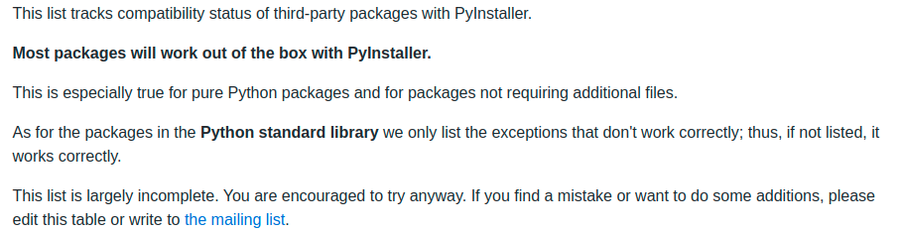
Supported Packages
https://github.com/pyinstaller/pyinstaller/wiki/Supported-Packages

Slide 5
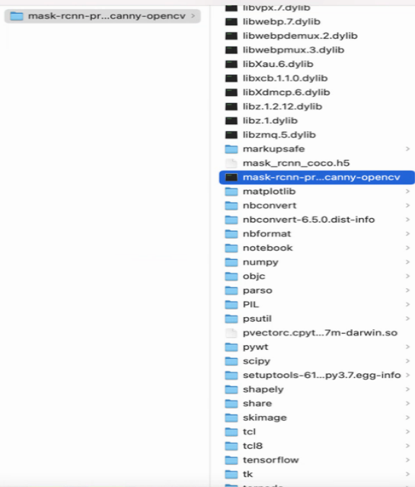
The Folder Structure Of Pyinstaller Result On macOS
mask-rcnn-prediction-canny-opencv (hilighted) is the executable program in a folder

