Slide 1
Path Pattern 1 for Unity Simulation
1
2
3
4
5
6
7
8
9
10
11
A
Stop 1
B
C
Stop 2
D
E
Stop 5
F
Stop 3
G
H
Stop 4
I
Stage I. Build this for Karting
Harry Li, Ph.D.

Slide 2
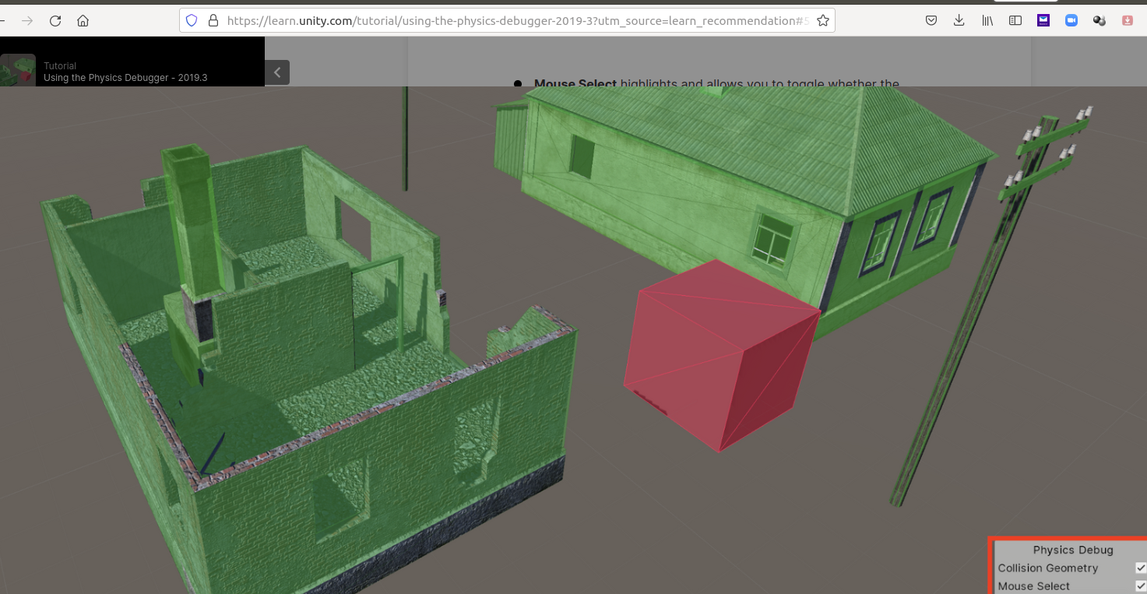
https://learn.unity.com/tutorial/using-the-physics-debugger-2019-3?utm_source=learn_recommendation#5e0e13ffedbc2a1490bd4822
Stage II. Build this in Unity
Harry Li, Ph.D.

Slide 3
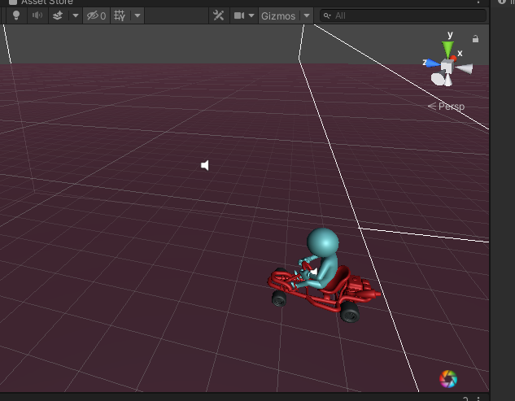
https://learn.unity.com/tutorial/using-the-physics-debugger-2019-3?utm_source=learn_recommendation#5e0e13ffedbc2a1490bd4822
Stage III. Integrate this with Karting
Harry Li, Ph.D.

Slide 4
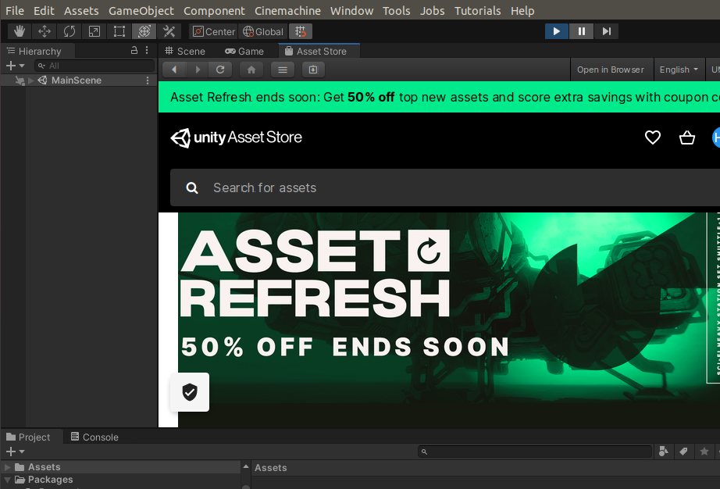
Use Assets Store
1
Harry Li, Ph.D.

Slide 5

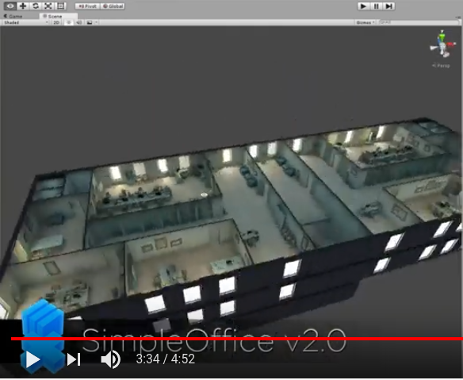
Office Building
https://docs.unity3d.com/Manual/
https://www.youtube.com/watch?v=kjnH7Vnpyp0&t=188s
https://assetstore.unity.com/packages/3d/props/interior/simple-office-28730
Room 1
Harry Li, Ph.D.

