Slide 1

flashing-bug-fix-master-Integration-2020-3-8
Company confidential
CTI One Corporation
Version: x0.1
Date: Dec.29, 2017, updated: Oct 18 2019
Project Lead: Harry Li, Ph.D.
Group Leaders: Team members: Yusuke Yakuma
https://github.com/hualili/robotics-open_abb/upload/master/aiv100
harry@harry-Latitude-E5470:~/Documents/3-project/3-2-0-1-utility/3-2-0-1-1-8-histo$

Slide 2

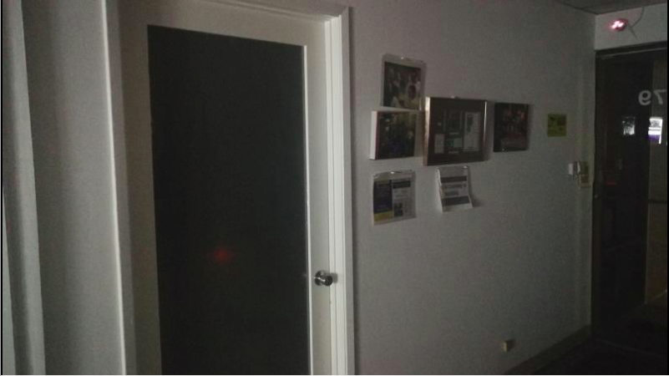
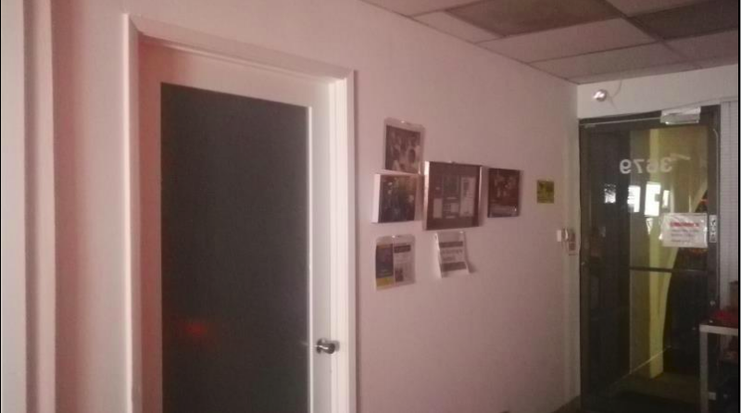
March-4-20 Intrusion Detection Bug
Intrusion detection has sent a lot of false alarms, and it was discovered the cause of the problem was due to the red light in the imaging environment was flashing periodically, and this leads to the image difference increased and lead to the false alarm, see the image below.
Image 2 normal image
Image 1 with red light flashing

Slide 3
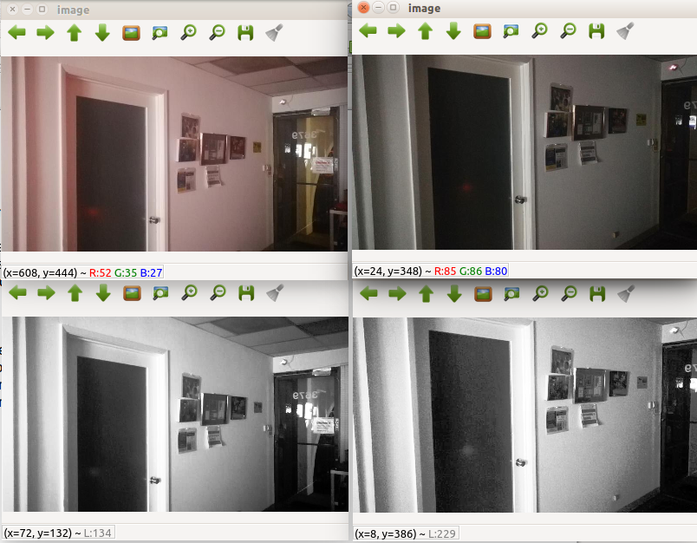
March-8-20 Bug Fix
Option 1. White Balancing Technique should fix the bug based on the root cause of the problem, e.g., DC energy of the image elevated by the flashing light, plus red light superimposed on the normal image.
Option 2. Just use histogram equalization, since intrusion detection does not require color image, so gray scale histogram equalization can be utilized. The test is conducted on the color images and shows very promising result.
The bottom 2 images look similar for the intrusion detection input
romisin
does
ing re

Slide 4
Thank you!

