Slide 1
3-1-14-AGV2000-Total-Solution-2019-5-15
CTI One Corporation
Version: x0.4
Date: Sep 7, 2018
Project Lead: Harry Li, Ph.D.
Team members: Zhixuan Zhou, Shuwen Zheng
Company confidential

Slide 2
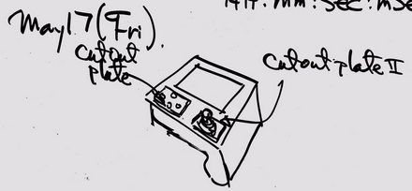
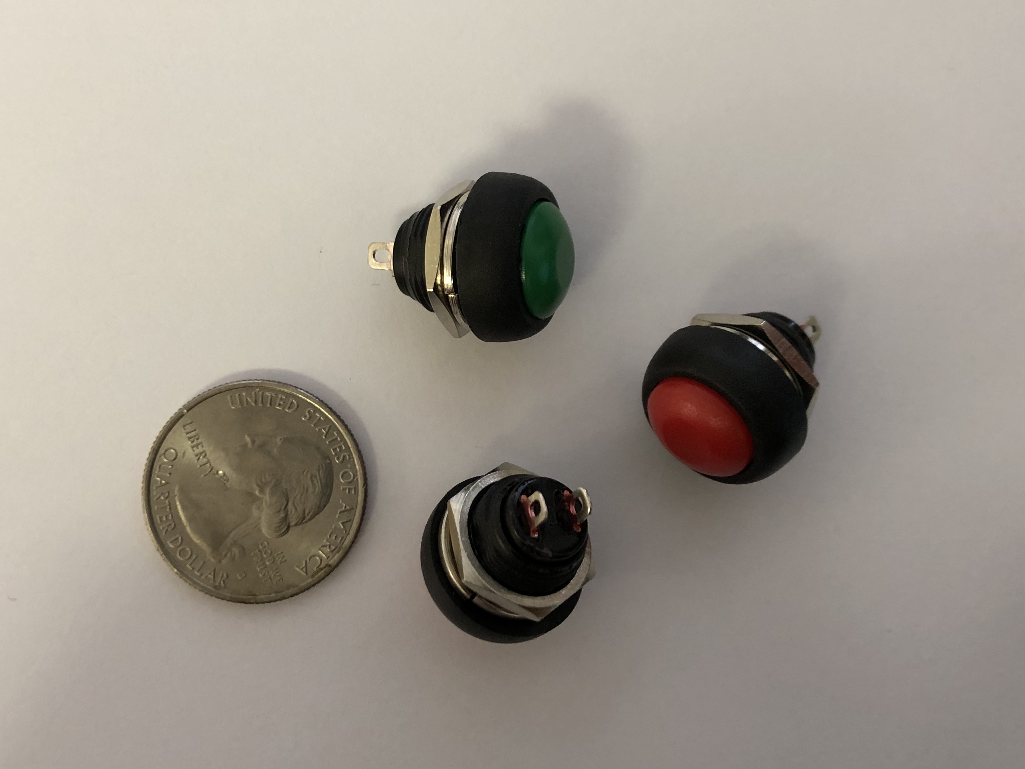
May-17-2019 AGV2000 Handheld Controller
Add 2 mounting plates
button parameters:
total height: 21.3mm
max hat diameter:17.4mm
hat height: 7.5
screw diameter: 1.6mm
screw height: 8mm

Slide 3
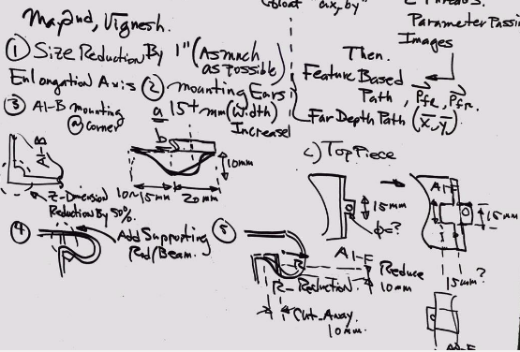
May-15-2019 AGV2000 Handheld Controller
May 15, 2019
1. Design requirement: battery
2. loading and unloading batteries – openings
And internal mechanism to secure the battery
3. Mounting ears enlargement upto 20-30 mm with bump ups to 10 mm and add reenforcement beams on both sides
4. corresponds to modification 3 in the hand-writing requirements, add mounting screw mechanism to hold mounting caps
5. boards inside:
(1) PIENOD
(2) all RF modules (4 boards)
Reduction should not cause battery holding and loading problem
Shuwen (2019-5-15) : add battery charging design with external connector on the device, need to identify the connector for charging.

Slide 4
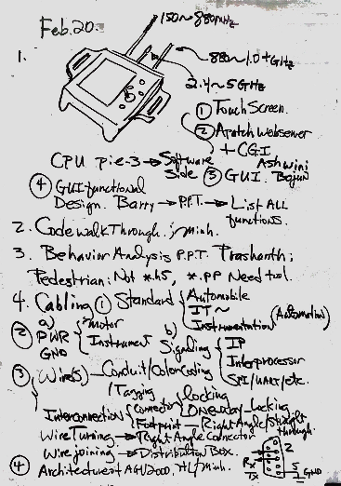
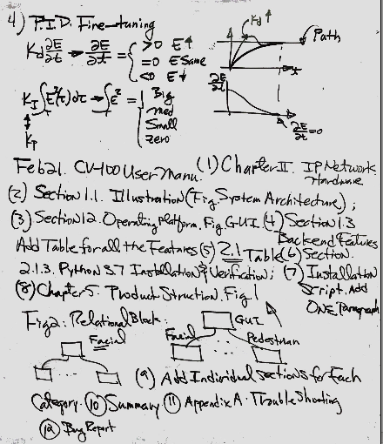
Feb-21-2019 AGV2000 Handheld Controller

Slide 5
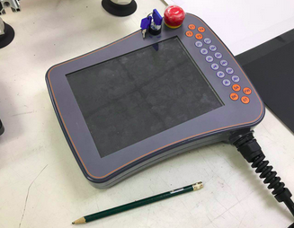
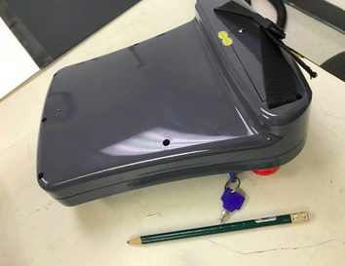
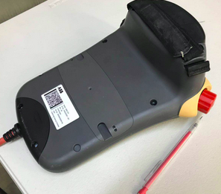
April 2019 Handheld Sample System 1

Slide 6
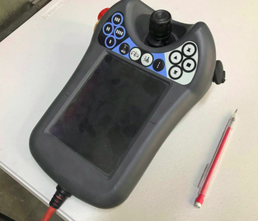
April 2019 Handheld Sample System 2

Slide 7
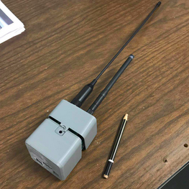
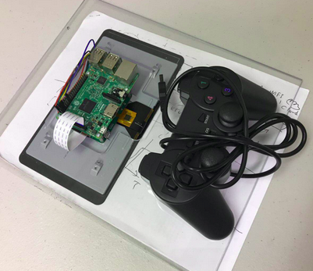
Feb-21-2019 Subsystem To Be Integrated

Slide 8
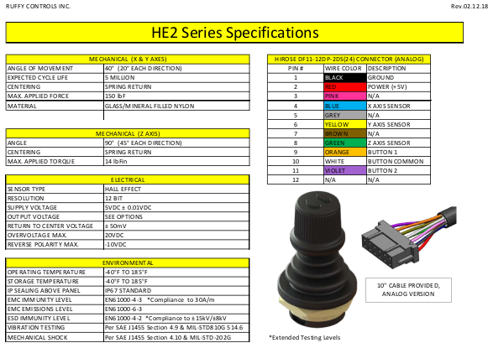
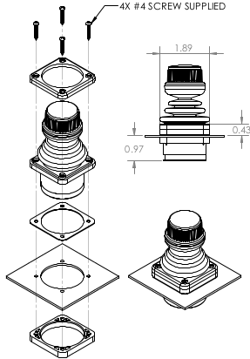
Feb-21-2019 Industrial Grade Joystick
DROP-IN STANDARD SQUARE BEZE

Slide 9
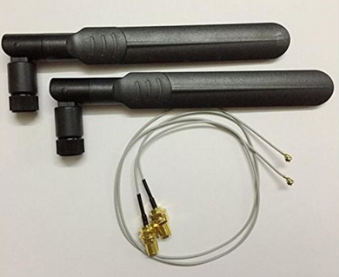
Feb-21-2019 Wifi SMA Connector

Slide 10
Feb-21-2019 System Block Diagram

