Slide 1

CAMSVR2 Assembly Steps
Company confidential
CTI One Corporation
Version: 4.0
Date: March 17, 2020
Project Lead: Harry Li, Ph.D.
Creator: Shengping Jiang
Last modified by: Shalvin Prasad
Approved for Release: Feb. 15, 2020, Director Signature: Harry-Li-digital-signature-2020-2-16
http://ctione.com/
https://github.com/hualili/robotics-open_abb/tree/master/ai-embedded
/media/harry/easystore/backup-2020-2-15/CTI0/3proejcts/3-8-smart-tech/3-8-4-huaYuan/3-8-4-6-products/CAMSVR-3-8-4-6-1/manufacturing-camsvr3-8-4-6-1/camsvr-pack/104-Assembly/final$

Slide 2

Step 1. Preparation
Table 1 Assembly Tools
Name | Model | Supplier
Screwdriver kit | 6PCS Mini Screwdriver Set | amazon.com
Soldering Iron Kit | SI03 Soldering Iron Kit | amazon.com
Multimeter | MSR-R500 Digital Multi-meter | Etekcity
1 Order parts according to the CAMSVR2
Bill of Materials
2 Use 3D printer to print four parts
(CTI-CAMSVR2-020, CTI-CAMSVR2-021, and
CTI-CAMSVR2-022) designed by CTI One
3 Visual check the quality and count quantity
for each kind of parts
4 Check Table 1 Assembly Tools and workplace

Slide 3
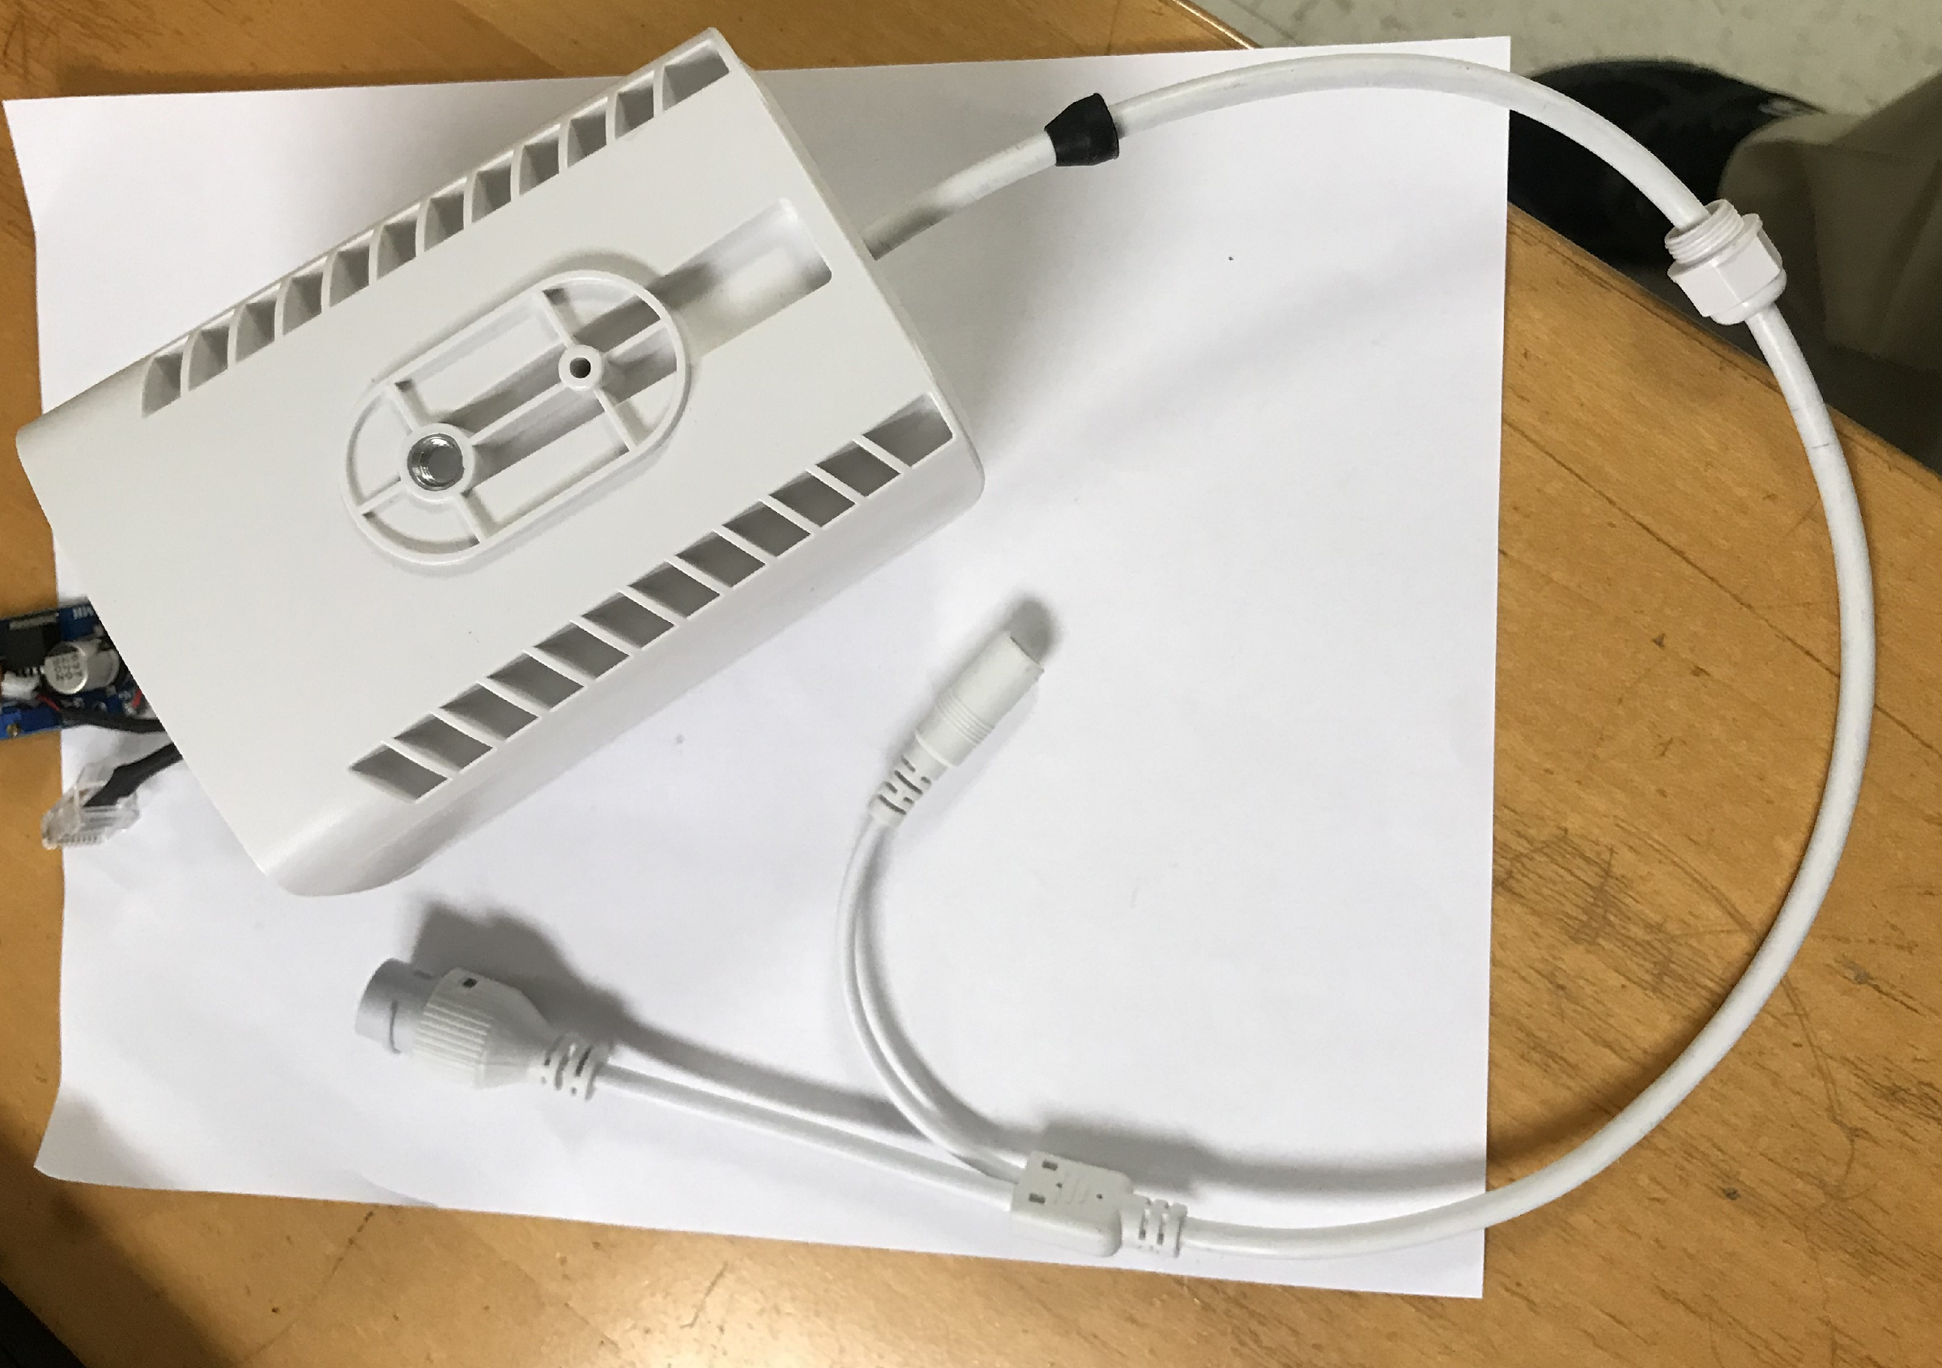
Step 2. Assembly the Main Cable (1/2)
CTI-CAMSVR2-018
CTI-CAMSVR2-015
1 Check the main cable (CTI-CAMSVR2-017) has the nut seal (CTI-CAMSVR2-016), and the back rubber seal (CTI-CAMSVR2-015)
2 Insert the cable from the back of the case (CTI-CAMSVR2-018) into the case
CTI-CAMSVR2-016
CTI-CAMSVR2-017

Slide 4
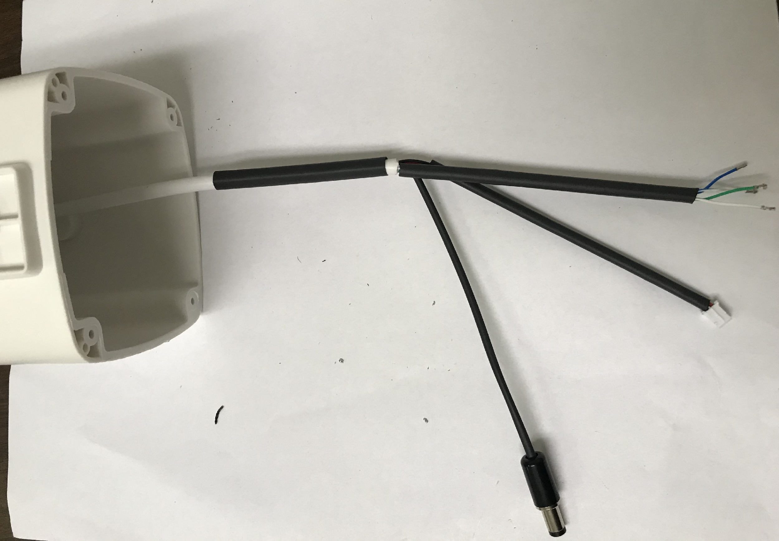
Step 2. Assembly the Main Cable (2/2)
1 With the main cable inserted in the case, put wire wrapper (CTI-CAMSVR2-028) on the main cable
2 Put wire wrapper (CTI-CAMSVR2-029) on one of power wire sets (red and black wire) and the four lines cable
3 Put wire wrapper (CTI-CAMSVR2-030) on another power wire set (red and black wire)
4 Install a two pins male connector (CTI-CAMSVR2-031) on one of power wire sets.
5 Install another power wire set with the Barrel jack (CTI-CAMSVR2-023)
CTI-CAMSVR2-031
CTI-CAMSVR2-028
CTI-CAMSVR2-029
CTI-CAMSVR2-023
CTI-CAMSVR2-030

Slide 5
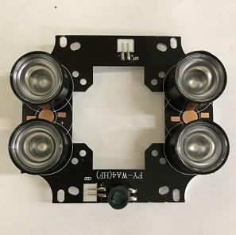
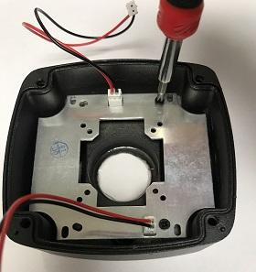
Step 3. Assembly the LED Board
1 Put the LED light lens (CTI-CAMSVR2-005) on the LED night-vision board (CTI-CAMSVR2-006) (Call the new part as LED board).
2 Put the LED board into the camera head unit (CTI-CAMSVR2-002). Use two screws (CTI-CAMSVR2-008) to hold the LED board on the camera head unit (put two screws on the right side of the head unit).
CTI-CAMSVR2-005
CTI-CAMSVR2-008
CTI-CAMSVR2-006
CTI-CAMSVR2-002

Slide 6
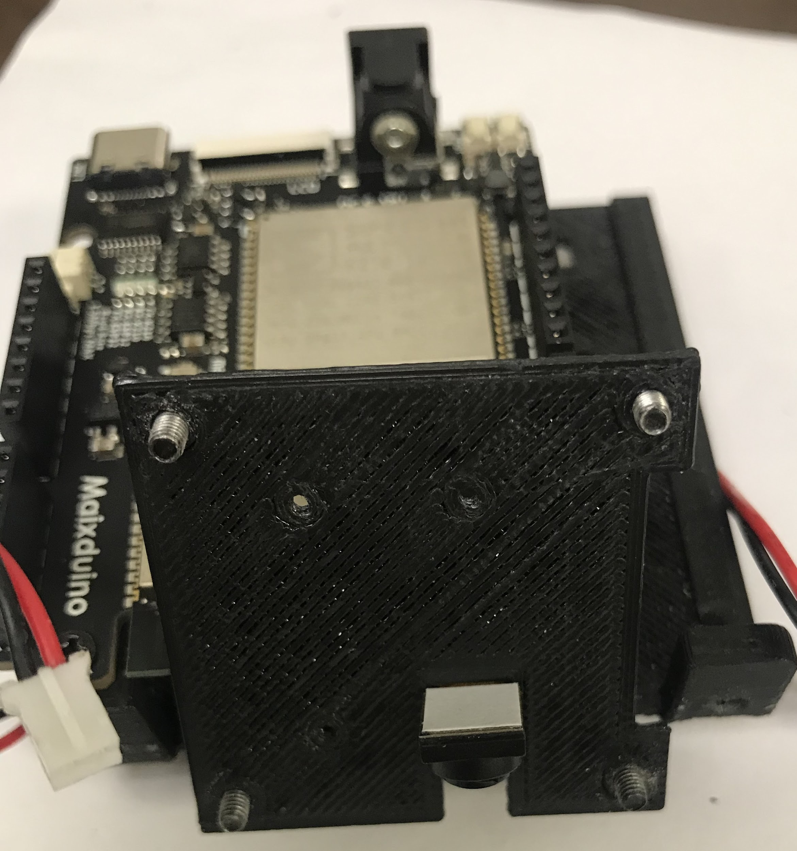
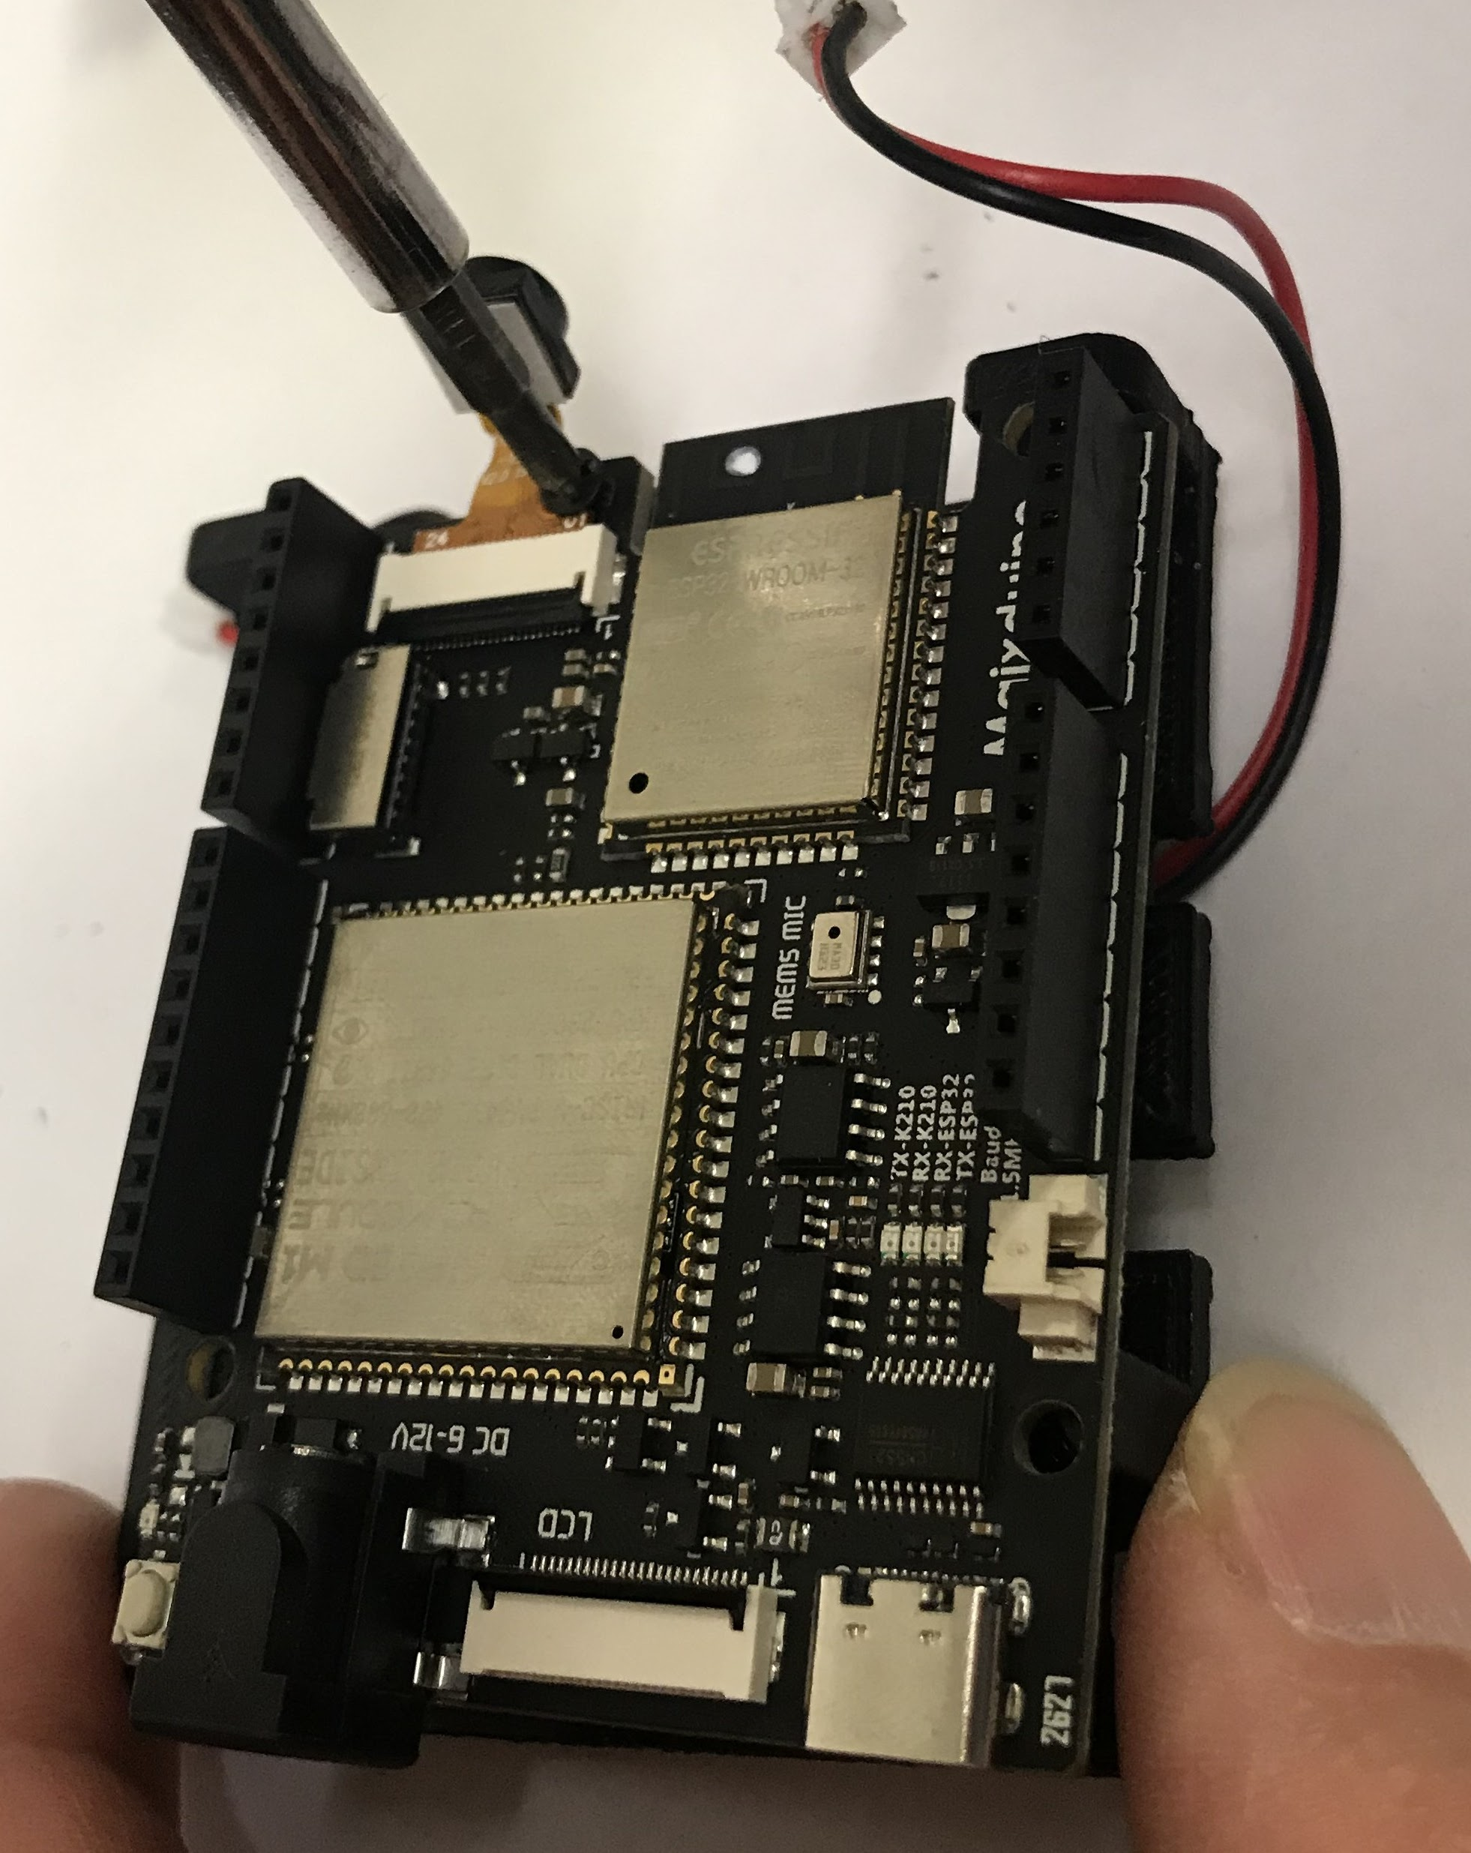
Step 4. Assembly the Main Board (1/5)
Last modified: March 16, 20 by SP
1 Use four screws (CTI-CAMSVR2-008) to hold the MAXNOD main board (CTI-CAMSVR2-024) on the face of the main board holder (CTI-CAMSVR2-022) (Left figure)
2 Insert the MicroSD card (CTI-CAMSVR2-026) into the SD slot of the MAXNOD main board (CTI-CAMSVR2-024)
3 Put the camera board holder (CTI-CAMSVR2-020) between the camera and the MAXNOD main board. Put four screws (CTI-CAMSVR2-008) in the holes of the camera board holder (CTI-CAMSVR2-020) (Right figure)
CTI-CAMSVR2-008
CTI-CAMSVR2-024
CTI-CAMSVR2-020
CTI-CAMSVR2-022

Slide 7
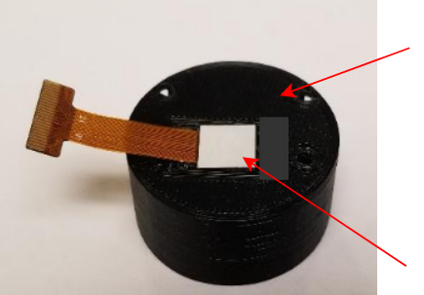
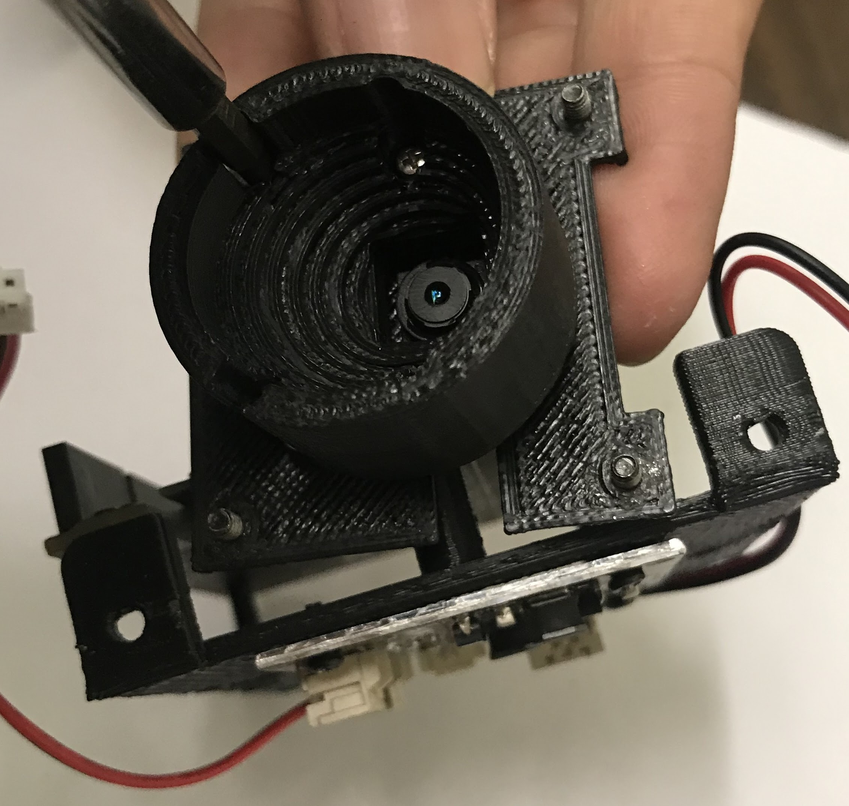
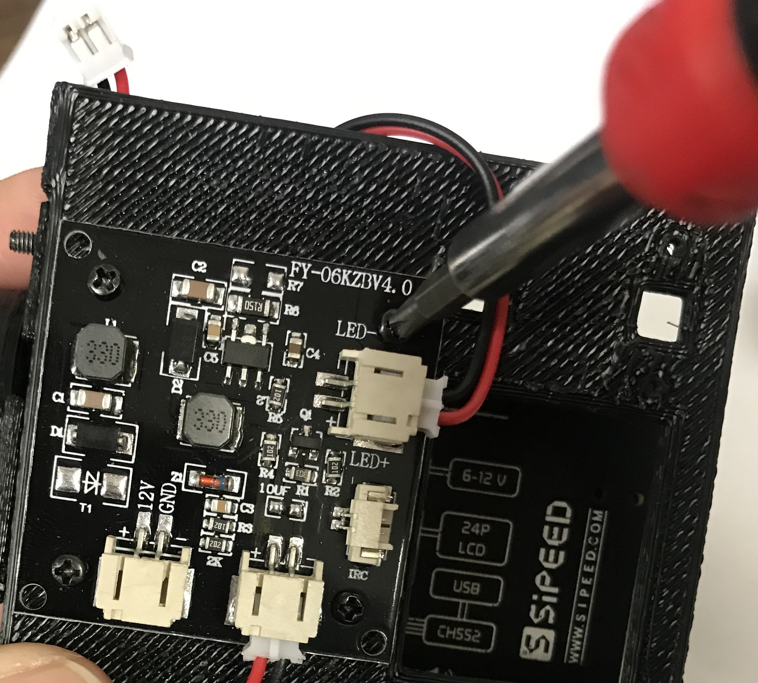
Step 4. Assembly the Main Board (2/5)
Last modified: March 16, 20 by SP
Figure 4.3
4 Firmly place the camera module on 3D printed camera cover(CTI-CAMSVR2-021) as shown in Figure 4.3.
5 Use the camera front holder (CTI-CAMSVR2-021) to hold the camera. Use four screws (CTI-CAMSVR2-011) to hold the camera front holder on the camera board holder (CTI-CAMSVR2-020) (Left figure).
6 Use four screws (CTI-CAMSVR2-010) to hold the LED controller (CTI-CAMSVR2-019) on the back of the main board holder (CTI-CAMSVR2-022) (Right figure).
CTI-CAMSVR2-021
Last modified: March 16, 20 by SP
Camera
Last modified: March 16, 20 by SP
CTI-CAMSVR2-021
CTI-CAMSVR2-022
CTI-CAMSVR2-020
CTI-CAMSVR2-011
CTI-CAMSVR2-010
CTI-CAMSVR2-019

Slide 8
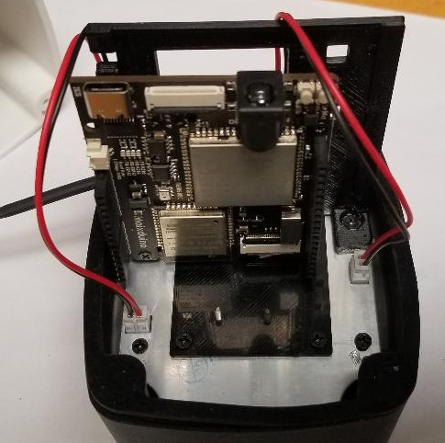
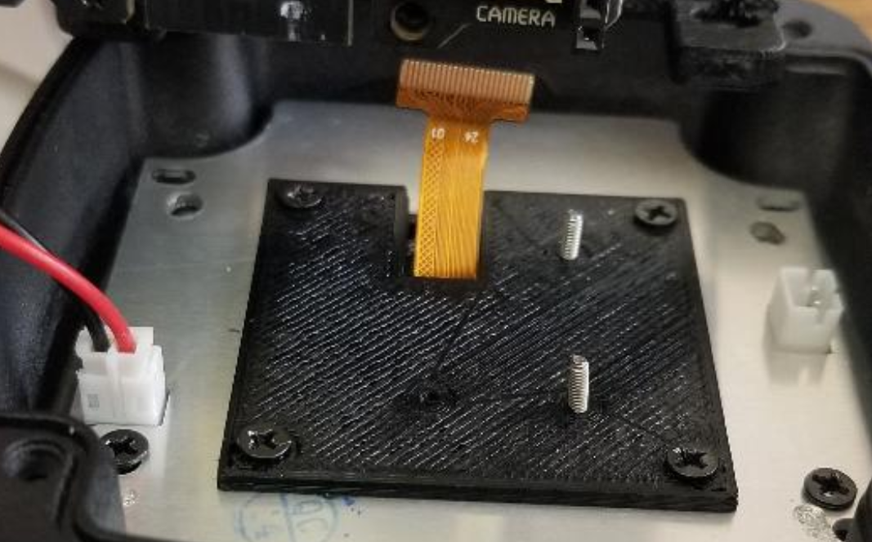
Step 4 Assembly the Main Board (3/5)
Last modified: March 16, 20 by SP
7 Mount the MAXNODE to the camera head unit (CTI-CAMSVR2-002) as shown in Figure 4.7a & 4.7b. Use 2 screws (CTI-CAMSVR2-009) to mount the MAXNODE.
9 Figure is captured after step 7 is been completed
Figure 4.7b
Figure 4.7a
CTI-CAMSVR2-002
CTI-CAMSVR2-009
Notes:
Updated SP-20_11_3

Slide 9
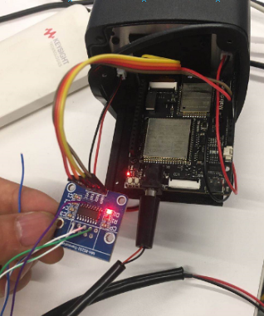
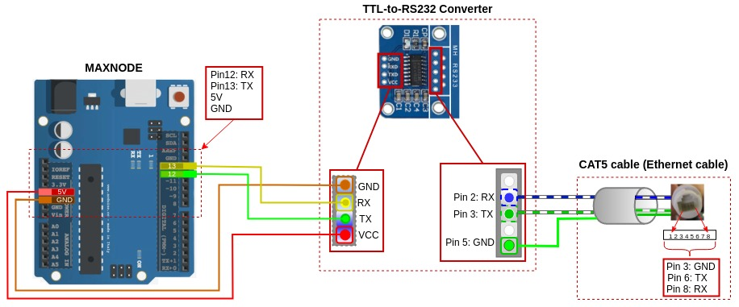
Step 4 Assembly the Main Board (4/5)
Last modified: March 16, 20 by SP
Figure 4.10b
10 Solder cables from CAT5 (Ethernet cable) to TTL-to-RS232 converter and then from the converter to MAXNODE using Figure 4.10a and 4.10b as illustration.
Figure 4.10a
CTI-CAMSVR2-033
CTI-CAMSVR2-024
CTI-CAMSVR2-017
Notes:
Updated SP-20_11_3

Slide 10
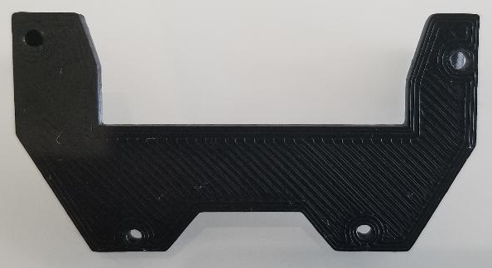
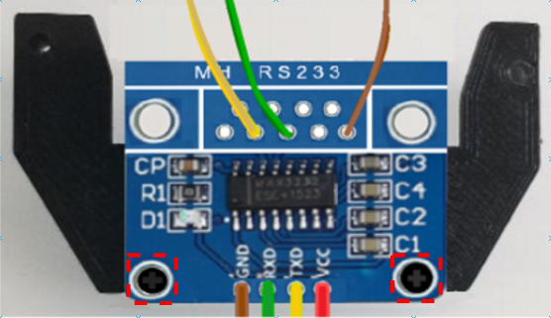
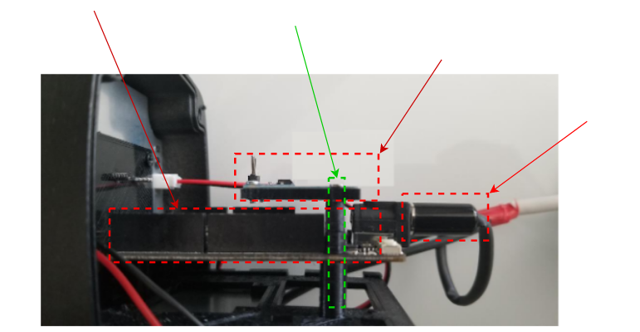
Step 4. Assembly the Main Board (5/5)
Last modified: March 15, 20 by SP
Figure 4.11a
Figure 4.11b
11 Attach TTL-to-RS232 converter to the 3D printed mount (Figure 4.11a) using two screws as shown in Figure 4.10b.
12 Next, attach the 3D printed mount board from Figure 4.11b on the MAXNOD and connect the Barrel jack (CTI-CAMSVR2-023) to the MAXNOD main board as shown in Figure 4.12
CTI-CAMSVR2-033
CTI-CAMSVR2-032
Figure 4.12
CTI-CAMSVR2-024
CTI-CAMSVR2-034
CTI-CAMSVR2-033
CTI-CAMSVR2-023
Notes:
Updated SP-20_11_3

Slide 11
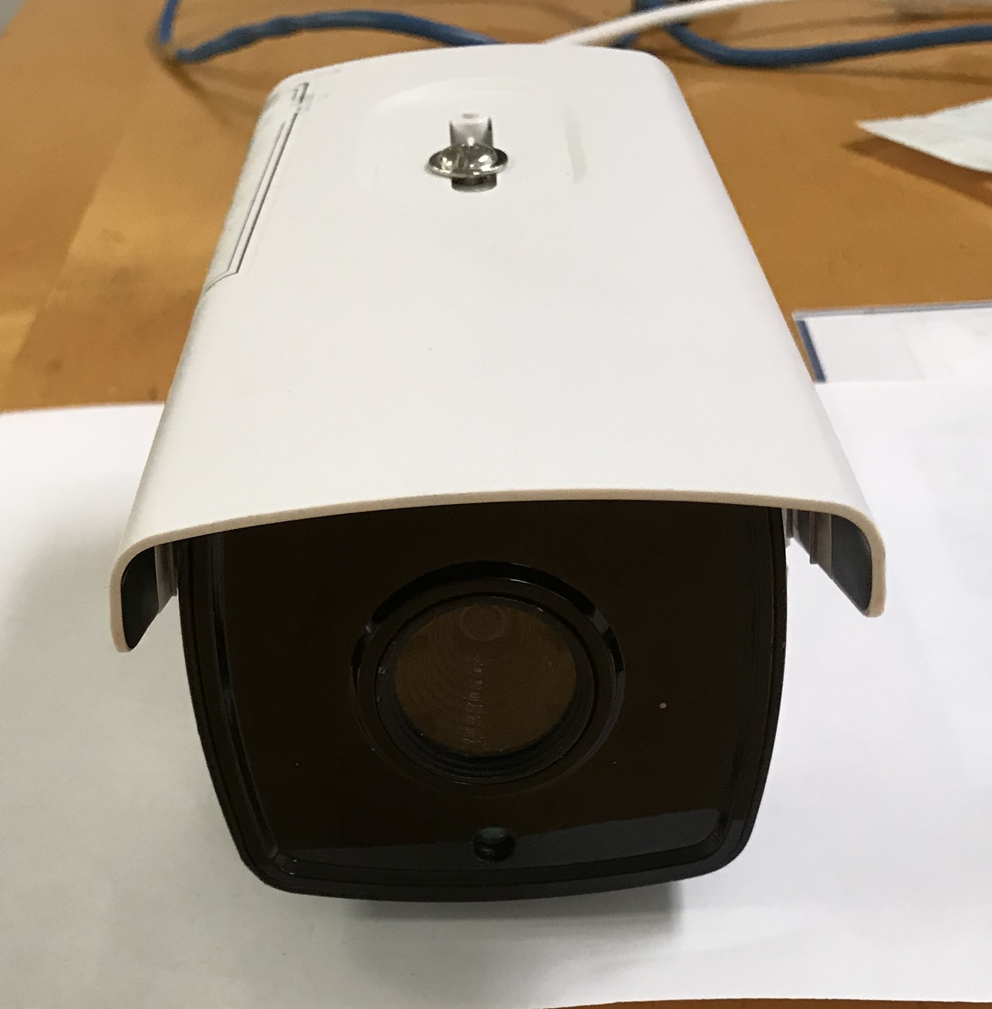
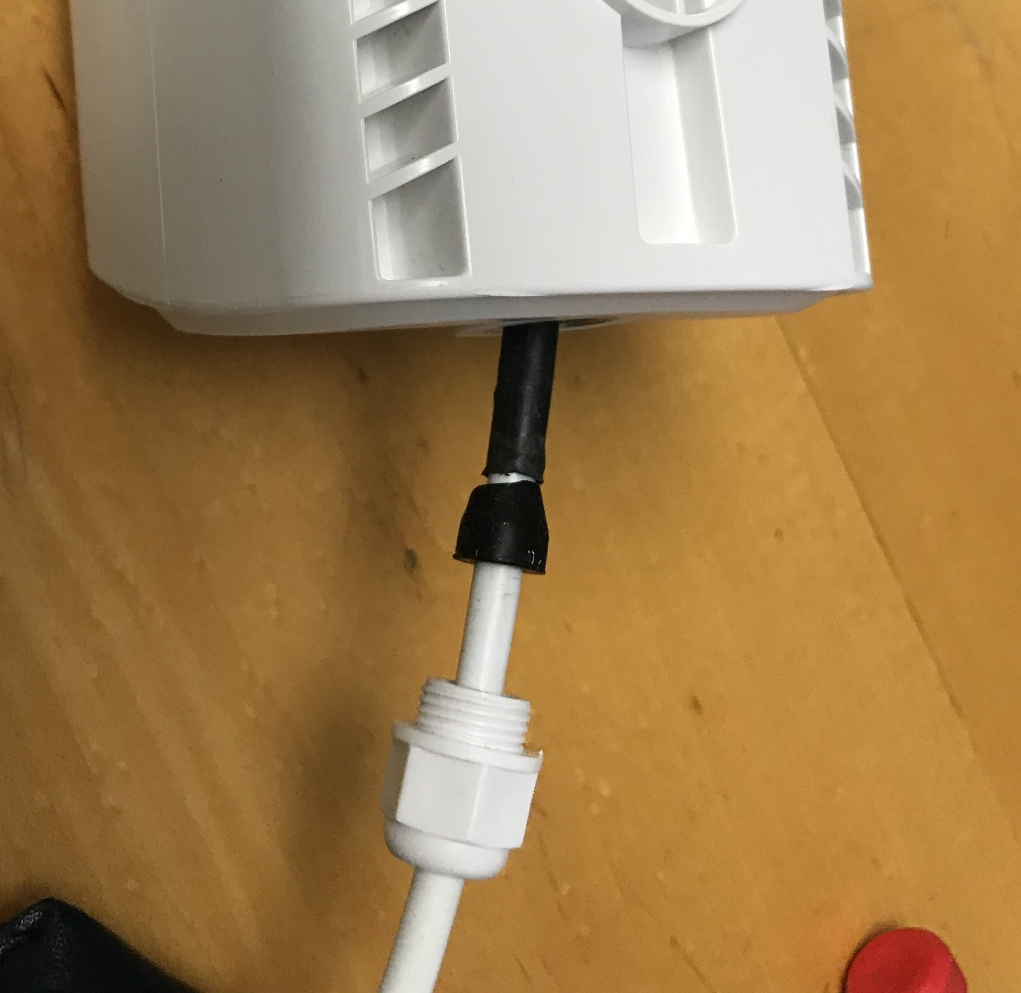
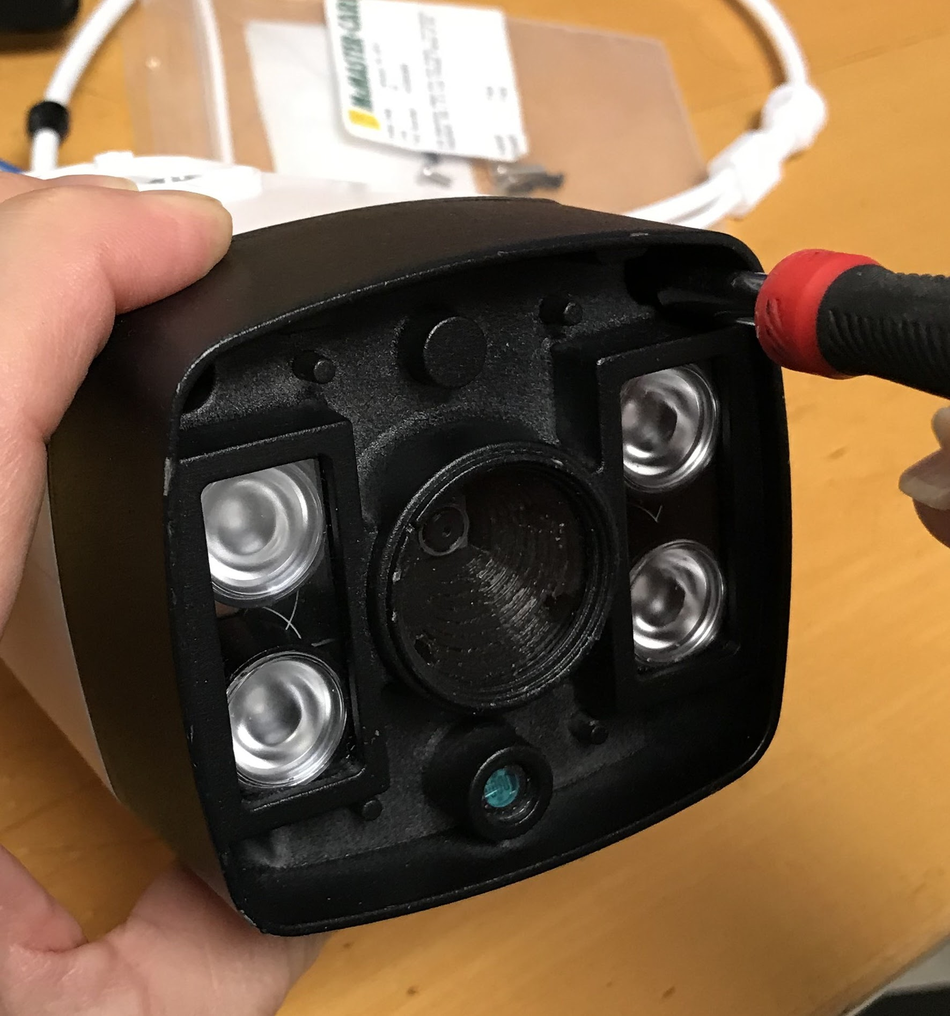
Step 5. Complete Assembly
CTI-CAMSVR2-018
CTI-CAMSVR2-012
CTI-CAMSVR2-015
CTI-CAMSVR2-013
CTI-CAMSVR2-003
CTI-CAMSVR2-004
CTI-CAMSVR2-014
CTI-CAMSVR2-001
CTI-CAMSVR2-016
1 Put the camera front rubber seal (CTI-CAMSVR2-003) on the back of the camera head unit (CTI-CAMSVR2-002).
2 Use four screws (CTI-CAMSVR2-004) to close the camera head unit (CTI-CAMSVR2-002) with the case (CTI-CAMSVR2-018) (Left figure).
3 Use the Back Rubber Seal (CTI-CAMSVR2-015) and the seal nut (CTI-CAMSVR2-016) to seal the main cable (CTI-CAMSVR2-017) with the case (CTI-CAMSVR2-018) (Right figure).
4 Put the camera front cover (CTI-CAMSVR2-001) on the front of the camera head unit (CTI-CAMSVR2-002).
5 Put the sticker (CTI-CAMSVR2-014) on the front back of the case cover (CTI-CAMSVR2-012).
6 Use the screw (CTI-CAMSVR2-013) to hold the case cover (CTI-CAMSVR2-012) on the top of the case (CTI-CAMSVR2-018) (Right figure)(Middle figure).

Slide 12
(END)

