Slide 1

102-object-tracker-HL-2020-07-08
Version: x0.1 (alpha)
Date: July 8, 2020
Project Lead: Harry Li, Ph.D.
Team Members:
Minh Duc Ong
Rachana Bumb

Slide 2

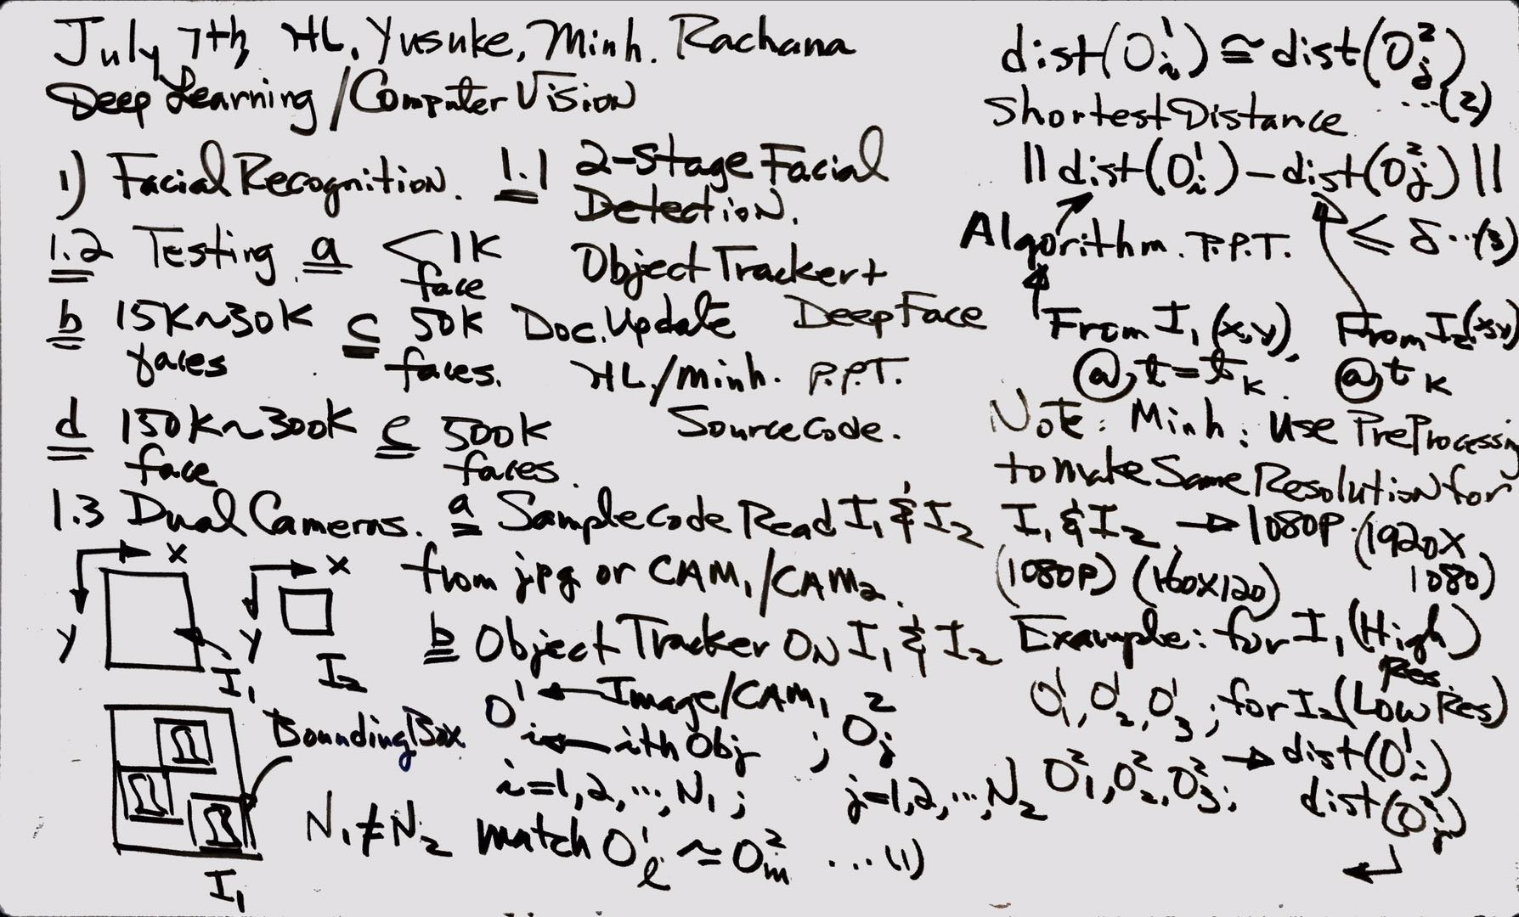
Dual Cameras Design

Slide 3
Dual Cameras Design Block Diagram
Load 2 Camera Resolutions
A4-1
Load ith Object from Image 1
A1
Matching 2 Resolutions
Load jth Object from Image 2
A2
A4-2
A4-5
Load 2 Images from 2 Cameras
Find Euclidean Distance
j+=1
A3
A4-3
A4-8
No
i+=1
Matching Object ID from 2 Images
jth is last Object of Image 2
A4
A4-4
Yes
Stop
A4-6
Match ith with Object on Image 2 based on Shortest Distance
A5
ith is last Object of Image 2
No
A4-9
A4-7
Yes
Stop

Slide 4

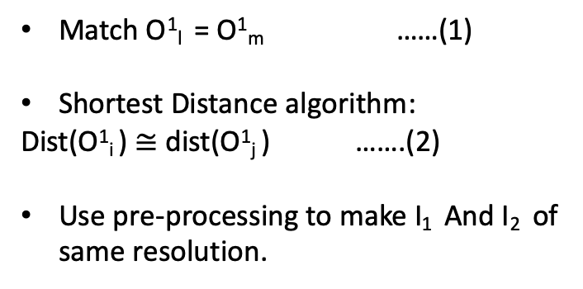
Algorithm
Read I₁ and I₂ from JPEG or CAM1/CAM2
Object tracker on I₁ and I₂
O¹_{i}
Bounding box
x
Image/CAM1
y
i=1,2,3……….N₁
i^{th} object
O²_{j}
Image/CAM2
j=1,2,3……….N₂
j^{th} object
~I₂
I₁

Slide 5
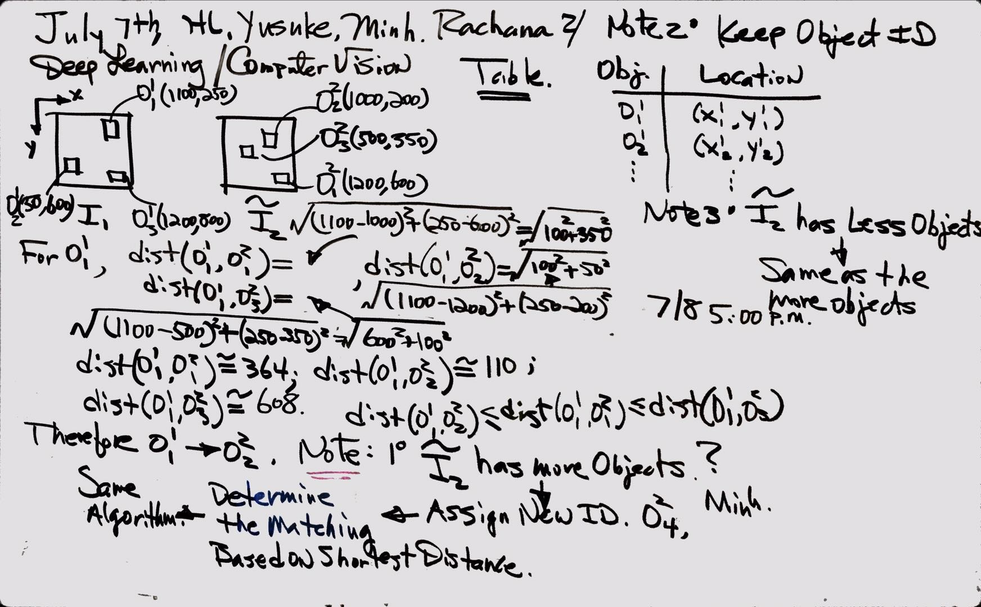
Dual Cameras Example

Slide 6
Dual Cameras Example
O¹₁ (1100,250)
O²₂ (1000,200)
O²₃ (500,350)
O²₁ (1200,600)
O¹₂ (50,600)
O¹₃ (1200,800)
I₁
~I₂

Slide 7
Dual Cameras Example
Note:
I₂ has more objects than I₁ ? -> Assign new ID O²₄ -> Determine the matching based on shortest distance algorithm
Keep object IDs in table
Obj | Location
O¹₁ | X¹₁, y¹₁
O¹₂ | X¹₂ , y¹₂
I₂ has less objects than I₁ ? -> Same as the more objects

