Slide 1

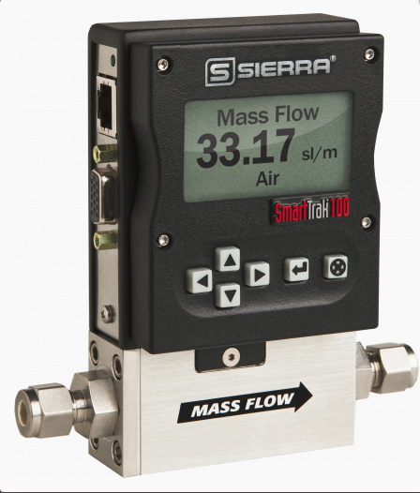
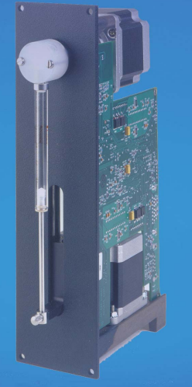
VG100: Technical Specification and Testing with NVDIA TX2
SmartTrak 100 MFC and Cavro Pump(XP 3000)
CTI One Corporation
Date: July 26th, 2019
Notes:
<number>

Slide 2
SmartTrak 100
Features:
Mass flow rates up to 1000 slpm (standard litre/min); higher upon request.
50 slpm (nlpm) version in a small footprint 3 inches long, 1 inch wide, 7 inches tall (76.2 mm, 177.8 mm, 25.4 mm); does not include fitting length.
10 pre-programmed gases come standard; substitute up to 9 more
Precision digital PID valve control; no valve tuning or adjustment
Control functions also available from PC via RS-232; Source code for RS-232 communication provided.
Wide range of digital communication protocol options: Modbus, ProfibusDP, Foundation Fieldbus.
Enhanced networking capability, including two digital relays, totalization, inputs, and display.
All clean gases including toxics and corrosives.
Pressure up to 5000 psig (333 barg).
Software Available: Compod Programmable Control Module Product Software 2.1.1 07/28/2017

Slide 3
SmartTrak 100
Performance Specifications:
Accuracy Standard: ± 1.0 % of full scale including linearity under calibration conditions (± 2.0 of full scale for 100M from 201-200 slpm).
Repeatability: ± 0.2% of full scale
Temperature Coefficient: ± 0.025% of full scale per °F (± 0.05% of full scale per °C), or better
Precision digital PID valve control; no valve tuning or adjustment
Pressure Coefficient: ± 0.01% of full scale per psi (± 0.15% of full scale per bar), or better
Response Time: 2 seconds (typical) to within ± 2% of final value (includes settling
time), faster or slower available upon request (controllers only)
Gas and Ambient Temperature: 32 to 122°F (0 to 50°C)
Standard Gas Pressure: 500 psig (34.5 barg) maximum, burst tested to 750 psig
(51.7 barg); High Pressure: 5000 psig (333 barg) maximum, burst tested to 7500 psig (500 barg) Pressure up to 5000 psig (333 barg).

Slide 4
SmartTrak 100
Operational Specifications:
Mass Flow Rates:
100L Low Flow: 0 -10 sccm to 0 -50 slpm
C100L High Pressure: 100 sccm to 20 slpm
100M Medium Flow: 0-20 to 0-200 slpm
100H High Flow: 0-100 to 0-1000 slpm (higher flows available).
Power Requirements: (ripple should not exceed 100 mV peak-to-peak)
For Mass Flow Meters: 15-24 VDC ±10%, (230 mA, regulated)
For Mass Flow Controllers:
C100L: 24 VDC ±10% (500 mA, regulated)
C100L High Pressure: 24 VDC ±10% (500 mA, regulated)
C100M: 24 VDC ±10%, (800 mA, regulated)
C100H: 24 VDC ±10%, (1260 mA, regulated)
Control Range For Controllers: 2–100% of full scale flow; automatic shut-off at 1.9%.
Output Signal
Analog:
Linear 4–20 mA, 500 ohms maximum loop resistance and one of the
following (user selectable):
Linear 0–5 VDC, 1000 ohms minimum load resistance
Linear 0-10 VDC, 1000 ohms minimum load resistance
Linear 1-5 VDC, 1000 ohms minimum load resistance
Command Signal:
Analog (choice of one):
Linear 4–20 mA, 0–5 VDC, 0-10 VDC, 1-5 VDC

Slide 5
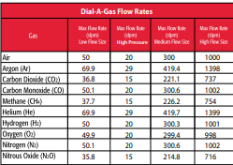
SmartTrak 100
Digital Specifications:
RS-232 standard, RS-485 optional
Profibus DP
Modbus
Foundation Fieldbus
RS-485 communication with Modbus RTU protocol allows digital multidrop networks
Available with optional LCD display
Internal gas flow totalizer with adjustable pulse output
Two digital output relays and one analog input can be configured by user
with MODBUS or included software for a wide variety of process controls
Gases: The following ten gases make up the Dial-A-Gas® feature of every SmartTrak instrument; up to nine alternate gases may be substituted.

Slide 6
Cavro Pump (XP 3000)
Features:
The XP 3000 is a compact syringe pump that is designed for OEM precision liquid handling applications. It has the following standard features and functions:
• Small and lightweight
• Syringe sizes from 50 µL to 5 mL
• Accuracy < 1.0% at full stroke
• Precision ≤ 0.05% at full stroke
• Standard dispense/aspirate resolution of 3,000 steps
• Microstep dispense/aspirate resolution of 24,000 steps
• 3-port-, 3-port distribution-, and T- valves, or Y-block
• Borosilicate glass, Kel-F and Teflon fluid contact
• Optional RS-232/RS-485 or CAN/RS-485 interface
• Programmable plunger speeds from 1.2 sec/stroke to 20 min/stroke, with ramps
and on-the-fly speed changes
• Valve leak detection
• Rack and pinion drive with lost-step detection
• Manually movable syringe drive (power off)
• Pump diagnostics, self-test, and error reporting
• 5K programmable EEPROM
• Auxiliary inputs and outputs
• Operates using a single 24VDC power supply

Slide 7
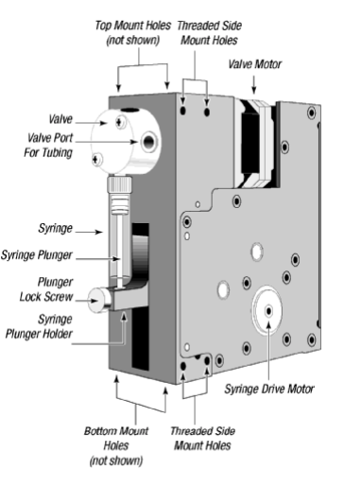
Cavro Pump (XP 3000)
Fuctional Diagram:

Slide 8
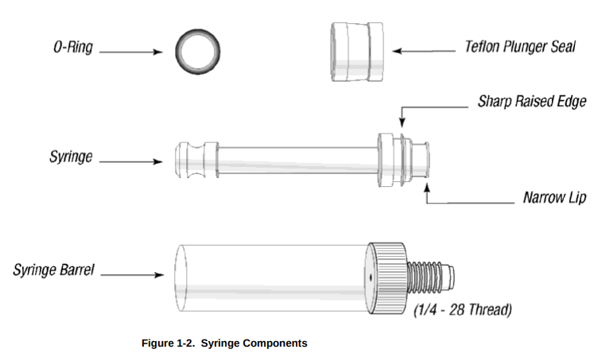
Cavro Pump (XP 3000)
Syringe and Syringe Drive:

Slide 9
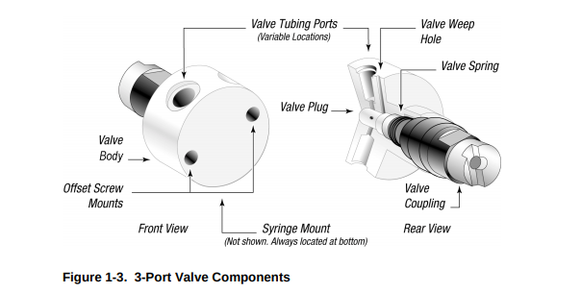
Cavro Pump (XP 3000)
Valve and Valve Drive:

Slide 10
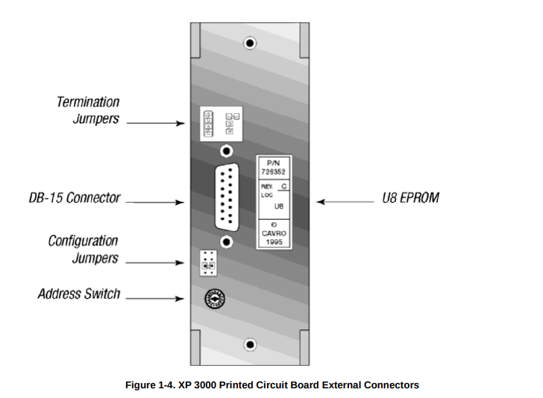
Cavro Pump (XP 3000)

Slide 11
SmartTrak100 testing with NVDIA TX2
Power up the MFC using the given adapter equipped with the
DB-15 connector. It will display some readings.
Connect the RJ45 to serial to USB adapter and the connect USB to
any of the available ports on NVIDIA TX2.
Open terminal in TX2 and run the script read.py. Mass flow readings
will then be displayed on the terminal.
Now to display the readings on the webpage run the script serial.html.
The MFC readings are now displayed on the webpage.

Slide 12
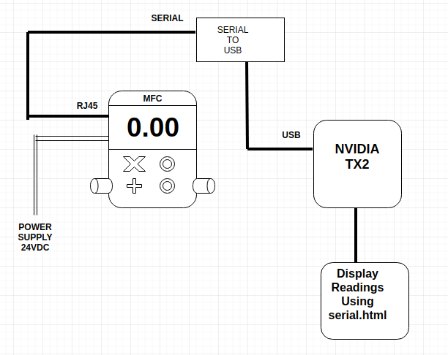
Block Diagram

Slide 13
Cavro Pump Testing with NVIDIA TX2
Pump needs the power supply of 24V DC.
Can be controlled using the ASCII commands sent from the
data terminal serially.
Each pump linked to the NVIDIA TX2 will have its own separate
Address.
The pump requires a female DB-15 connector to USB adapter for
for communication.

