Slide 1
Collision Detection

Slide 2
Separating Axis Theorem?
What is SAT?[1][2][3]
Fast generic algorithm to generate penetration vector between shapes
Eliminate the need to have collision detection code for every shape
The complexity of SAT is how much sides both objects have combined ( e.g between triangle and square 3 sides+ 4 sides = 7 checks)

Slide 3
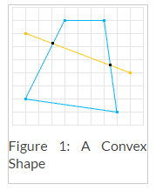
Separating Axis Theorem
Limitation
Only Works well with convex shape[2]

Slide 4
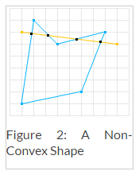

Separating Axis Theorem
Limitation
If concave shape is introduce, the algorithm could give false positive[3]
Figure copied from [2][3]

Slide 5
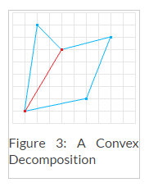
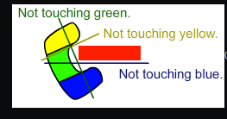
Separating Axis Theorem
Limitation
To calculate concave shapes, the code have to be adapted to represent concave shapes as a combination of convex shapes.[2]
Figure copied from [2][3]

Slide 6
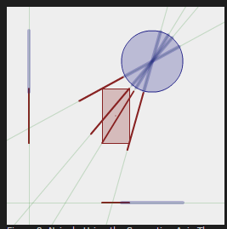
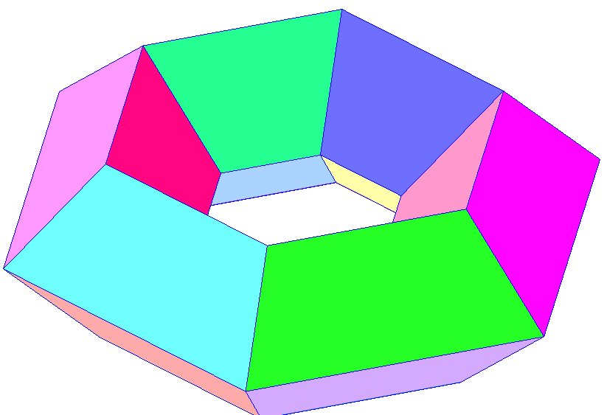
Separating Axis Theorem
Limitation[1]
Usually not used for shaped with curved edges. Because it has infinite number of separating axes.
But it can by used by decomposed into a finite number of straight edges.
Or naïvely use this with a circle
Figure copied from [1]

Slide 7
References
[1]Metanet Software Inc, Collision Detection and Response,2011 http://www.metanetsoftware.com/technique/tutorialA.html
[2]William Bittle. SAT (Separating Axis Theorem). January 1, 2010. http://www.dyn4j.org/2010/01/sat/#sat-notes.
[3]Rocketman Development. Separation of Axis Theorem (SAT) for Collision Detection. May 19 2010. http://rocketmandevelopment.com/blog/separation-of-axis-theorem-for-collision-detection/

