Slide 1
2D Game
Physics Engine
Michael Tanaya
Hua Ming Chen

Slide 2
Physics Engine of Current System
The Basis
Implementing Symplectic Euler Intergration into Rigid bodies
Simulating collision similar to the real world
The Main Structure
Collision Detection
Gather Collision Info
Collision Resolve/Resolution

Slide 3
Collision Detection
Three cases of collision
Rectangle body with Rectangle body
Circle body with Circle body
Rectangle body with Circle body
The first two cases of collision is pretty trivial. Since rectangle bodies are axis align, we only need to account for all four axis on both rectangle. While, circle bodies collision are only determined using their radius.
The complicated calculation is in the collision between rectangle body and Circle body.

Slide 4
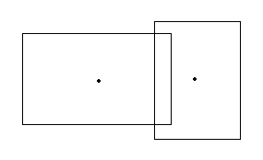
Rectangle / Rectangle Collision
The collision condition of two rectangle can be determined by X and Y bounds check.

Slide 5
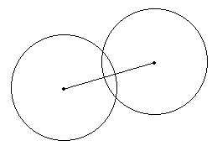
Circle /Circle Collision
The collision condition is true when the distance between the two circle center is less than the sum of their radius

Slide 6
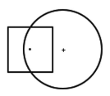
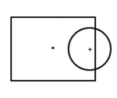
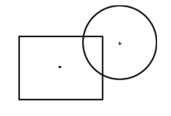
Rectangle /Circle Collision
Three types of collision
Rectangle position inside Circle
handled by an if statement that
determined if rectangle center position in inside the circle
Circle Position inside Rectangle
also handled by an if statement that
determined if circle center
position in inside the rectangle
General Collision
Handled by Vector calculation

Slide 7
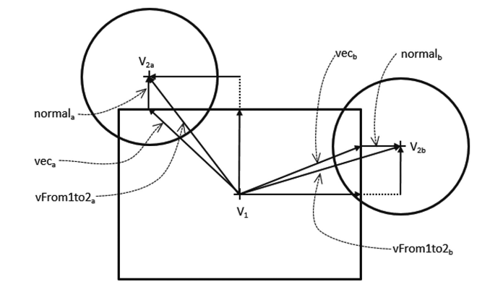
General Collision Rectangle Circle
Handled by calculating
Vector from both centers of objects (Vfrom1to2)
Clamp the Vector to bound of rectangle
Find normal from Vfrom1to2 to the clamped vector
Compare distance of normal with circle radius
If normal is smaller, then collision is true

Slide 8
Gather Collision Info
For the engine to be able to resolve the collision smoothly it will need to gather info of the collision.
The collision info contain depth and normal of the collision
Depth and normal will be used for positional correction when resolving collision

Slide 9
Collision Resolve/Resolution
Position Correction
s1Pos-=Normal*Rate*s1.mass/(s1.mass+s2.mass)
s2Pos+=Normal*Rate*s1.mass/(s1.mass+s2.mass)
If mass=0, it’s cannot move.
It will invoked multiple times.

Slide 10
Collision Resolve/Resolution
Compute Friction
Simulated by applying a deceleration in the tangent direction
It’s also account for multiple times.
V-=f*m

Slide 11
Collision Resolve/Resolution
Compute and Apply Impulse
relativeV=V2-V1
VinNor=Dot(relativeV,Normal)
V1-=-(1+Restitution)*VinNor*Normal*
s1.mass/(s1.mass+s2.mass)
V2+=-(1+Restitution)*VinNor*Normal*
s2. mass/(s1.mass+s2.mass)
Loop will end when there is no collision or Relaxation time=0

Slide 12
Rotational Physics
Attribute of a Rectangle [2]
Theta : Rotate Angle
Omega : Angular Velocity
J : Moment of Inertia
M : Mass
F : Friction
V : Velocity
4 Corners of Object
Center Point

Slide 13
Rotational Physics
Two parts of Rotational Physics[1]
Movement : Resolve the changing of velocity of an object.
Rotation: Resolve the changing of angular velocity of an object.

Slide 14
Movement
Support Points
The support point of a polygon is the vertex that is the farthest along a given direction. If two vertices have equal distances along the given direction, either one is acceptable.

Slide 15
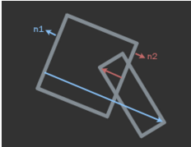
Movement
Finding Axis of Separation[3]
Retrieve a face normal from A
Retrieve support point from B along -n
Compute penetration distance (in B's model space)
Store greatest distance
if the greatest distance is positive, means there is no collision

Slide 16
Movement
Collision Resolve/Resolution
After gathering collision information (Depth & Normal Vector），
The collision resolution of movement part is same.
Position Correction
Compute Friction
Compute and Apply Impulse

Slide 17
Rotation
Rotate Function[2]
V.prototype.rotate = function(angle, vector) {
var x = this.x - vector.x;
var y = this.y - vector.y;
var x_prime = vector.x + ((x * Math.cos(angle)) - (y * Math.sin(angle)));
var y_prime = vector.y + ((x * Math.sin(angle)) + (y * Math.cos(angle)));
return new V(x_prime, y_prime);
};

Slide 18
Rotation
AngularVelocity Resolve[3]
Use the following equation to understand the relationship between a point on a body and the velocity of that point:
ω=r×v
contactVector = supportPoint-center
angularVelocity += 1.0f / inertia * Cross( contactVector, impulse );

Slide 19
Reference
[1]Johnny Huynh,Separating Axis Theorem for Oriented Bounding Boxes. http://www.jkh.me/files/tutorials/Separating%20Axis%20Theorem%20for%20Oriented%20Bounding%20Boxes.pdf
[2]Burak Kanber,How Physics Engines Work http://buildnewgames.com/gamephysics/
[3]Randy Gaul,How to Create a Custom 2D Physics Engine: Oriented Rigid Bodies
http://gamedevelopment.tutsplus.com/tutorials/how-to-create-a-custom-2d-physics-engine-oriented-rigid-bodies--gamedev-8032

