Slide 1
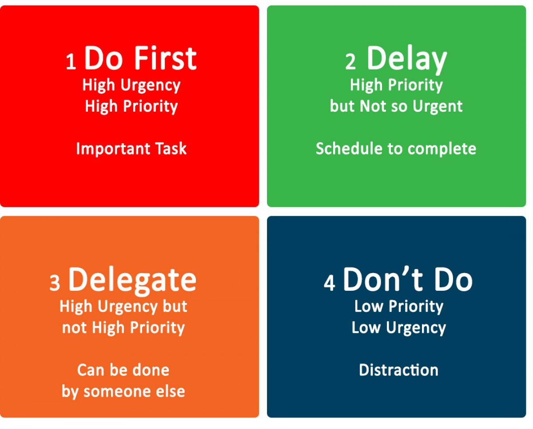
Do Next
(Decide)
Compunders
Delete

