Slide 1
Transductive Regression Piloted by Inter-Manifold Relations

Slide 2

Regression Algorithms. Reviews
Tikhonov Regularization on the Reproducing Kernel Hilbert Space (RKHS)
Classification problem can be regarded as a special version of regression
Regression Values are constrained at 0 and 1 (binary)
samples belonging to the corresponding class =>1
o.w. => 0
Belkin et.al, Regularization and semi-supervised learning on large graphs
Fei Wang et.al, Label Propagation Through Linear Neighborhoods
Exploit the manifold structures to guide the regression
An iterative procedure is deduced to propagate the class labels within local neighborhood and has been proved convergent
Cortes et.al, On transductive regression.
transduces the function values from the labeled data to the unlabeled ones utilizing local neighborhood relations,
The convergence point can be deduced from the regularization framework
Global optimization for a robust prediction.

Slide 3
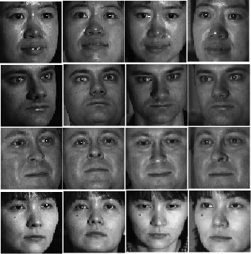
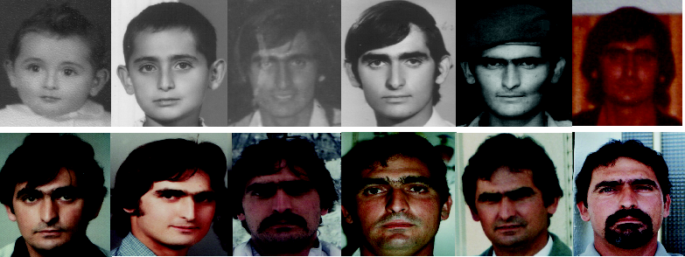
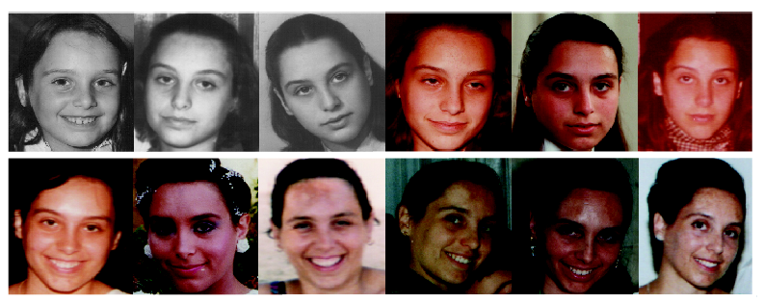
The Problem We are Facing
Age estimation
Pose Estimation
w.r.t. different genders
w.r.t. different persons
CMU-PIE Dataset
w.r.t. different
Genders
Persons
Illuminations
FG-NET Aging Database
Expressions

Slide 4
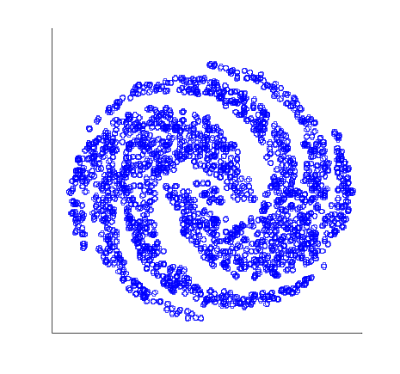
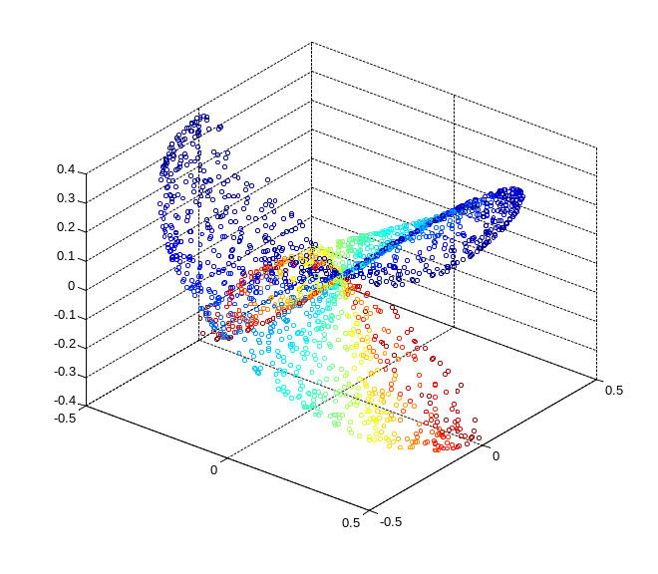
The Problem We are Facing
Traditional Algorithms
Regression on Multi-Class Samples.
All samples are considered as in the same class
The class information is easy to obtain for the training data
For the incoming sample, no class information is given.
Samples close in the data space X are assumed to have similar function values (smoothness along the manifold)
Utilize class information in the training process to boost the performance
The problem

Slide 5
The Problem.Difference with Multiview Algorithms
Multi-View Regression
Multi-Class Regression
No explicit correspondence.
The data of different classes may be obtained from different instances in our configuration, thus it is much more challenging.
One object can have multiple views or employ multiple learners for the same object.
Disagreement of different learners is penalized
The class information is utilized in two ways: Intra-Class Regularization & Inter-Class Regularization
There exists a clear correspondence among multiple learners.
The problem

Slide 6
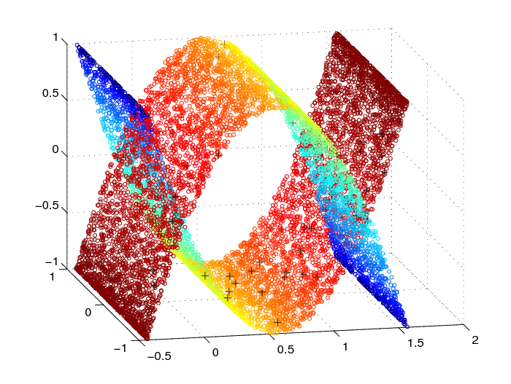
TRIM. Assumption & Notation
Samples from different classes lie within different sub-manifolds
Samples from different classes share similar distribution along respective sub-manifolds
Labels: Function values for regression.
Intra-Manfiold Intra-Class, Inter-Manifold Inter-Class.
The algorithm

Slide 7
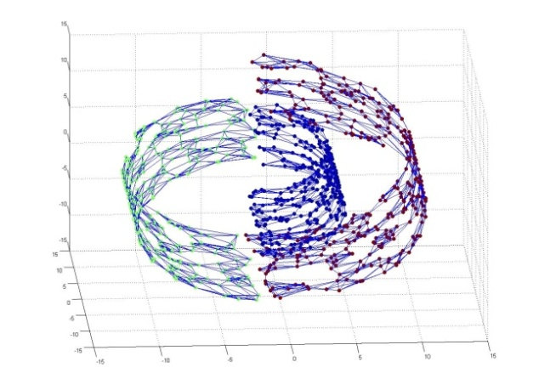
TRIM. Intra-Manifold Regularization
It may not be proper to preserve smoothness between samples from different classes.
Correspondingly, intra-manifold regularization item for different classes are calculated separately
The Regularization
when p=1
Respective intrinsic graphs are built for different sample classes
when p=2
intrinsic graph

Slide 8
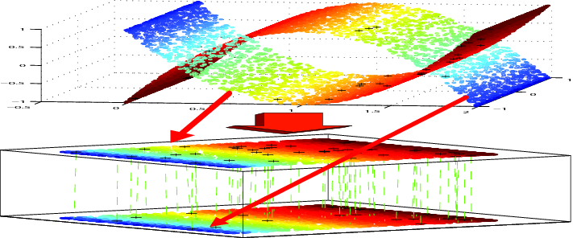
TRIM. Inter-Manifold Regularization
Assumptions
Samples with similar labels lie generally in similar relative positions on the corresponding sub-manifolds.
Motivation
1.Align the sub-manifolds of different class samples according to the labeled points and graph structures.
2. Derive the correspondence in the aligned space using nearest neighbor technique.
The algorithm

Slide 9
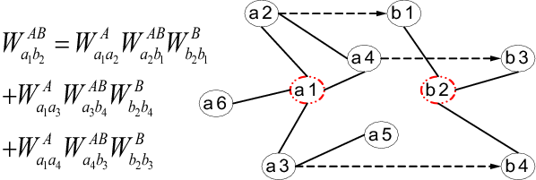
TRIM. Reinforced Landmark Correspondence
Initialize the inter-manifold graph using the - ball distance criterion on the sample labels
Reinforce the inter-manifold connections by iteratively implementing
Only sample pairs with top 20% largest similarity scores are selected as landmark correspondences.
The algorithm

Slide 10
TRIM. Manifold Alignment
Minimize the correspondence error on the landmark points
Hold the intra-manifold structures
where
The item is a global compactness regularization, and is the Laplacian Matrix of
1 If and are of different classes
0 o.w.
The algorithm

Slide 11
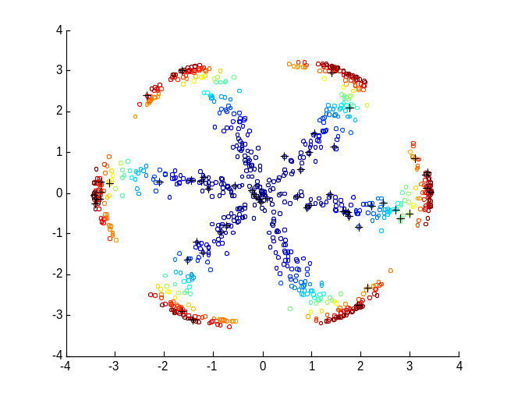
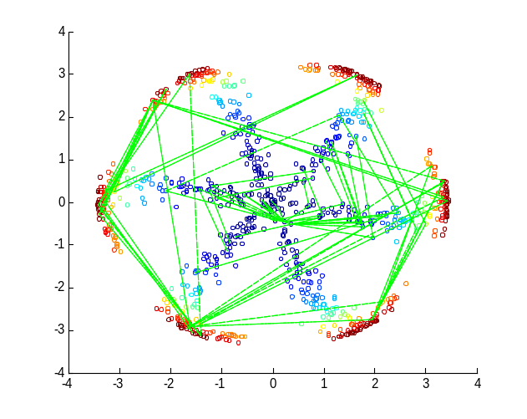
TRIM. Inter-Manifold Regularization
Concatenate the derived inter-manifold graphs to form
Laplacian Regularization

Slide 12
TRIM. Objective
Fitness Item
RKHS Norm
Intra-Manifold Regularization
Inter-Manifold Regularization
Objective Deduction

Slide 13
TRIM. Solution
The solution to the minimization of the objective admits an expansion (Generalized Representer theorem)
Thus the minimization over Hilbert space boils down to minimizing the coefficient vector
over
The minimizer is given by
where
and K is the N × N Gram matrix of labeled and unlabeled points over all the sample classes.
Solution

Slide 14
TRIM.Generalization
For the out-of-sample data, the labels can be estimated using
Note here in this framework the class information for the incoming sample is not
required in the prediction stage.
Original Version without kernel
Solution

Slide 15
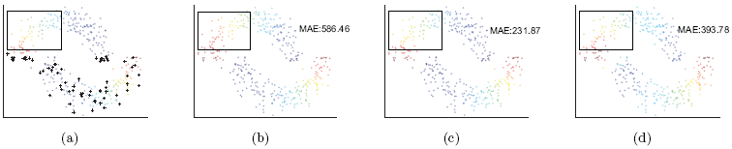
Experiments. Nonlinear Two Moons
(a) Original Function Value Distribution. (b) Traditional Graph Laplacian Regularized Regression (separate regressors for different classes). (c) Two Class TRIM. (d) Two Class TRIM on RKHS. Note the difference in the area indicated by the rectangle.
The relation between function values and angles in the polar coordinates is quartic.
Two Moons

Slide 16
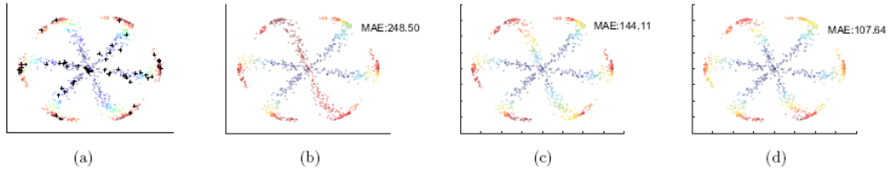
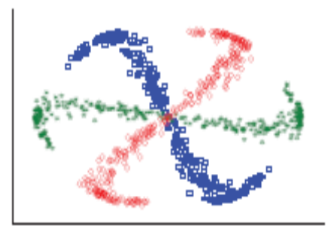
Experiments.Cyclone Dataset
Regression on Cyclone Dataset: (a) Original Function Values. (b) Traditional Graph Laplacian Regularized Regression (separate regressors for different classes). (c) Three Class TRIM. (d) Three Class TRIM on RKHS.
The cross manifold guidance that could be utilized grows rapidly as the class number increases.
Regression on one class failed for the traditional algorithm because the lack of labeled samples.
Class Distribution of the Cyclone Dataset
Cyclone

Slide 17
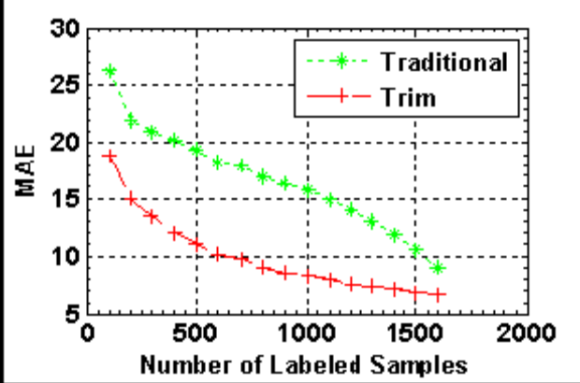
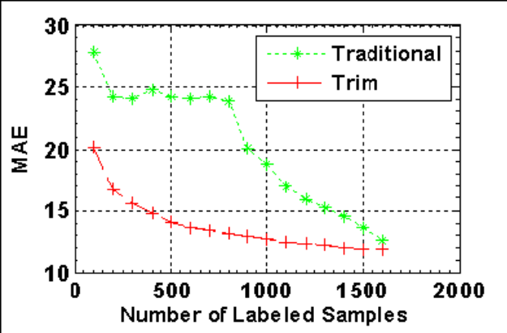
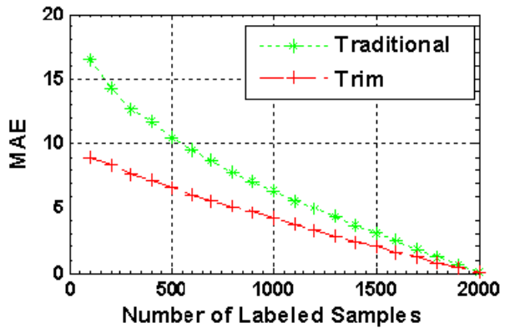
Experiments.Age Dataset
Open set evaluation for the kernelized regression on the YAMAHA database. (left) Regression on the training set. (right) Regression on out-of-sample data
TRIM vs traditional graph Laplacian regularized regression for the training set evaluation on YAMAHA database.
YAMAHA Dataset

Slide 18
Summary
A new topic that is often met in applications but receive little attention.
Sub-manifolds of different sample classes are aligned and labels are propagated among samples from different classes.
Intra-Class and Inter-Class graphs are constructed and corresponding regularizations are introduced.
Class information is utilized in the training stage to boost the performance and the system does not require class information in the testing stage.
Summary
Notes:
Summary……

Slide 19
Thank You!

