Slide 1
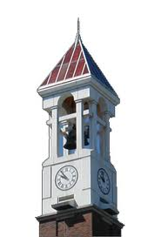


Introduction
Welcome to CNIT Summer Course
Huyunting Huang
Master Student of CIT
© July 9, 2018 by INSTRUCTOR FULL NAME. All rights reserved. This presentation may not be duplicated or transmitted, in part or in whole, without the express written permission of the author.

Slide 2

Course Instructor
Course Instructor&Teaching Assistant(TA)
Huyunting Huang (Arthur)
huan1182@purdue.edu
SteamID: arthurht94
Office hour: Tuesday 3:55 PM-4:45 PM, phys 022

Slide 3
Course webpage
https://github.com/huan1182/STEMABC-CIT

Slide 4
Todays topic
Course overview
Environment Set up

Slide 5
Course Topics
Basic knowledge about Programming
Data type, operator & expression
Math Fundamentals(Boolean/Binary Algebra)
Conditional Statements
Array,vector & Loop
Function
Some Algorithms
Sort
Hash Table
Binary Tree
……

Slide 6
Course Overview
Lecture(50min)
Lab(50min)
Homework (assigned on Tuesday/Thursday each week and the due date is on Thursday and next Monday.)
Midterm/Final exam

Slide 7
Grade Breakdown
Course Lab 25%
Assignment 25%
Midterm Exam 25%
Final Exam 25%
Delayed Submmissions of assignment will not be accepted
Evaluation Standard
A:90%+
B:80%+
C:70%+
D:60%+
Fail:0~59.99999999999%

Slide 8
Assignment requirement
For programming assignment, you must make sure that your code can be runned successfully for at least once in your lap/desktop, I will not debug your code.(But you're welcome to ask me questions about your assignment before due date.)
Delayed submmission is unacceptable.

Slide 9
Recommended Textbook(Not mandatory to buy)
Programming Principles and Practice Using C++
—by Bjarne Stroustrup

Slide 10
Some Useful Resources
1, Coursera
2, CodeCademy
3, Leetcode
4, Stackoverflow
……

Slide 11
The most important skill you should master in your undergraduat life is self-learning!

Slide 12
Course Introduction—Our World
Can you figure out how many computers will be used for your daily life?

Slide 13
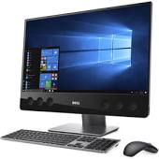
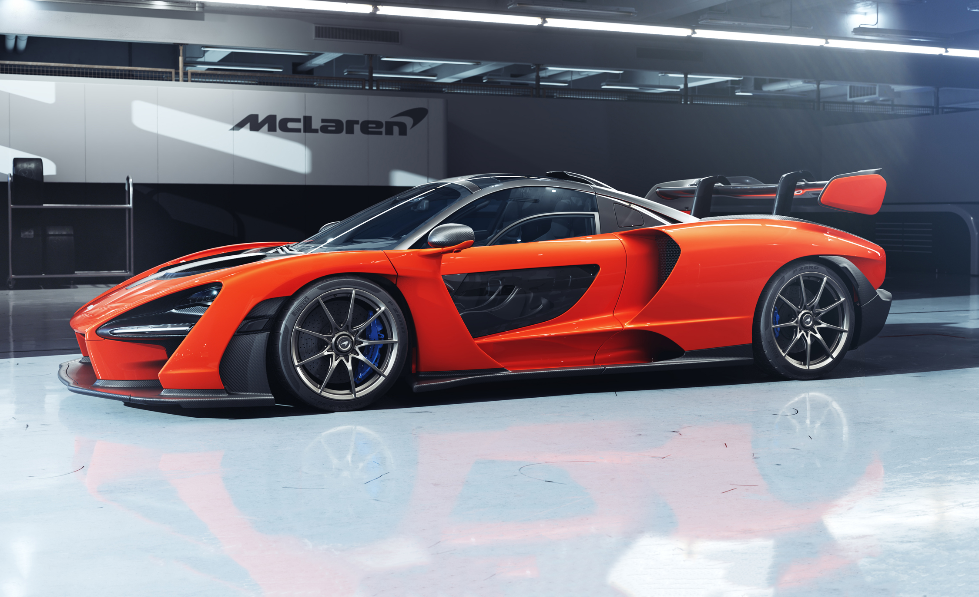
Course Introduction—Our World
Can you figure out how many computers will be used for your daily life?
A glimpse about it:
There're more than 30 computers in one car, 1 computer in MP3 player, 1 in Mobile, 1 for your laptop,etc.
??????

Slide 14
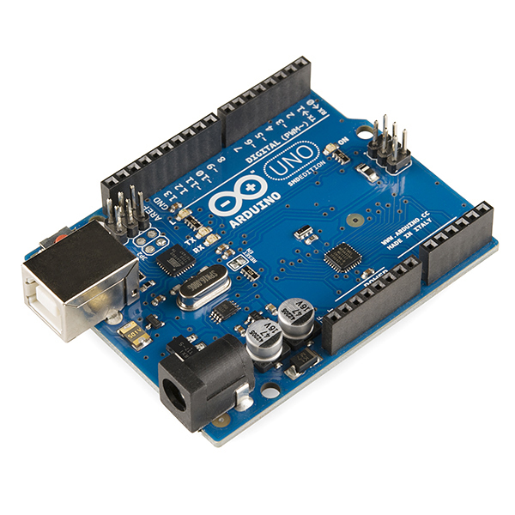
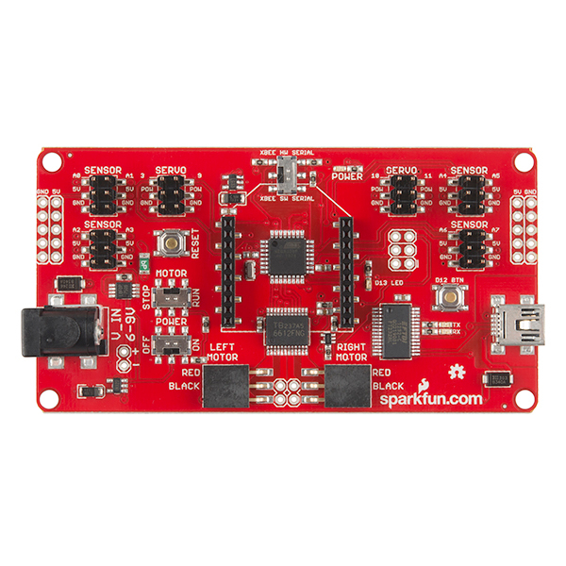
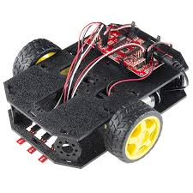
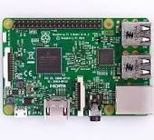
Many computers look like these.

Slide 15
Computer is everywhere
Communication time:
Discuss with your partner and list 5 things that are completely unrelated (neither directly or undirectly related) to computer.

Slide 16
Computer is everywhere
Communication time:
Discuss with your partner and list 5 things that are completely unrelated (neither directly or undirectly related) to computer.
It's harder than you might expect.

Slide 17
But computer is just computer……
It will never work until we give it some command (of course you also need to make sure it's powered by some kind of energy).
And how to edit and send those commands to computer, is what we will learn in this course.

Slide 18
What can you do after taking this course
1, Practically, you'll be able to take other courses(even some graduate courses ) without many coding issues (but still with mathematical and other issues.).
2, You'll be able to solve many problems more efficiently (especially when you need to process some data, believe me you don't want to do them by hand.)
3, You're able to step into the areas you're interested in(AI,game development, Computer Graphic Technology, Robotic etc.).

Slide 19
Today's Lab
1, Open and log on the computer with your purdue account
2, Open Visual Studio 2017(search it in start menu)
3, Create a new C++ project (you can follow me)
4, Copy the code from course webpage
5, Compile it
6, Run it and see what's happened in your desktop.
7, You're good to go!

Slide 20
/*
First program using C++
*/
#include<iostream>
using namespace std;
void keep_window_open()// to keep window open
{
char ch;
cin >> ch;
}
int main()
{
cout << "hello world"<<endl;
keep_window_open();
}

