Slide 1
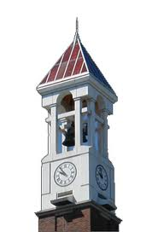


CIT Summer Course
BOOLEAN Algebra and Conditional Statement
Huyunting Huang
Master Student of CIT
© July 12, 2018 by Huyunting Huang. All rights reserved. This presentation may not be duplicated or transmitted, in part or in whole, without the express written permission of the author.

Slide 2
Today' topic
1, Binary System
2, Boolean Algebra(Proposition, and, or, not)
3, conditional statement (if/else, switch……case)
4, Lab time

Slide 3
Binary System
Instead of decimal system, computer use binary system as its math fundamentals.
The Binary system use only 2 numbers: 0 & 1, which can represent 2 states of a system eg: Open/close, true/false, up/down, etc.

Slide 4
counting binary number
A carry of binary number will appear every two steps
0,1,10,11,100,101,110,111,1000……
Compare with decimal number (carry appears every 10 steps)
0,1,2,3,4,5,6,7,8,9,10,11……

Slide 5
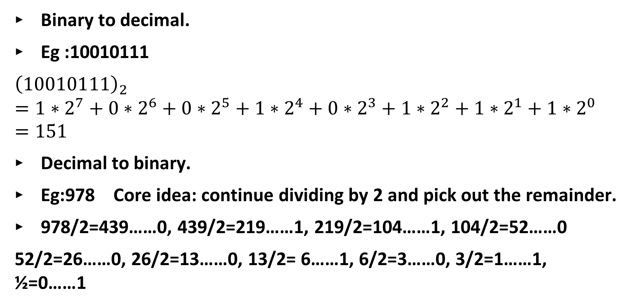
Convert binary to decimal and vice versa
Binary to decimal.
Eg :10010111
$${\left(10010111\right)}_{2}=1∗2^{7}+0∗2^{6}+0∗2^{5}+1∗2^{4}+0∗2^{3}+1∗2^{2}+1∗2^{1}+1∗2^{0}=151$$
Decimal to binary.
Eg:978 Core idea: continue dividing by 2 and pick out the remainder.
978/2=439……0, 439/2=219……1, 219/2=104……1, 104/2=52……0
52/2=26……0, 26/2=13……0, 13/2= 6……1, 6/2=3……0, 3/2=1……1, ½=0……1

Slide 6
978/2=439……0, 439/2=219……1, 219/2=104……1, 104/2=52……0
52/2=26……0, 26/2=13……0, 13/2= 6……1, 6/2=3……0, 3/2=1……1, ½=0……1
Result :1101000110

Slide 7
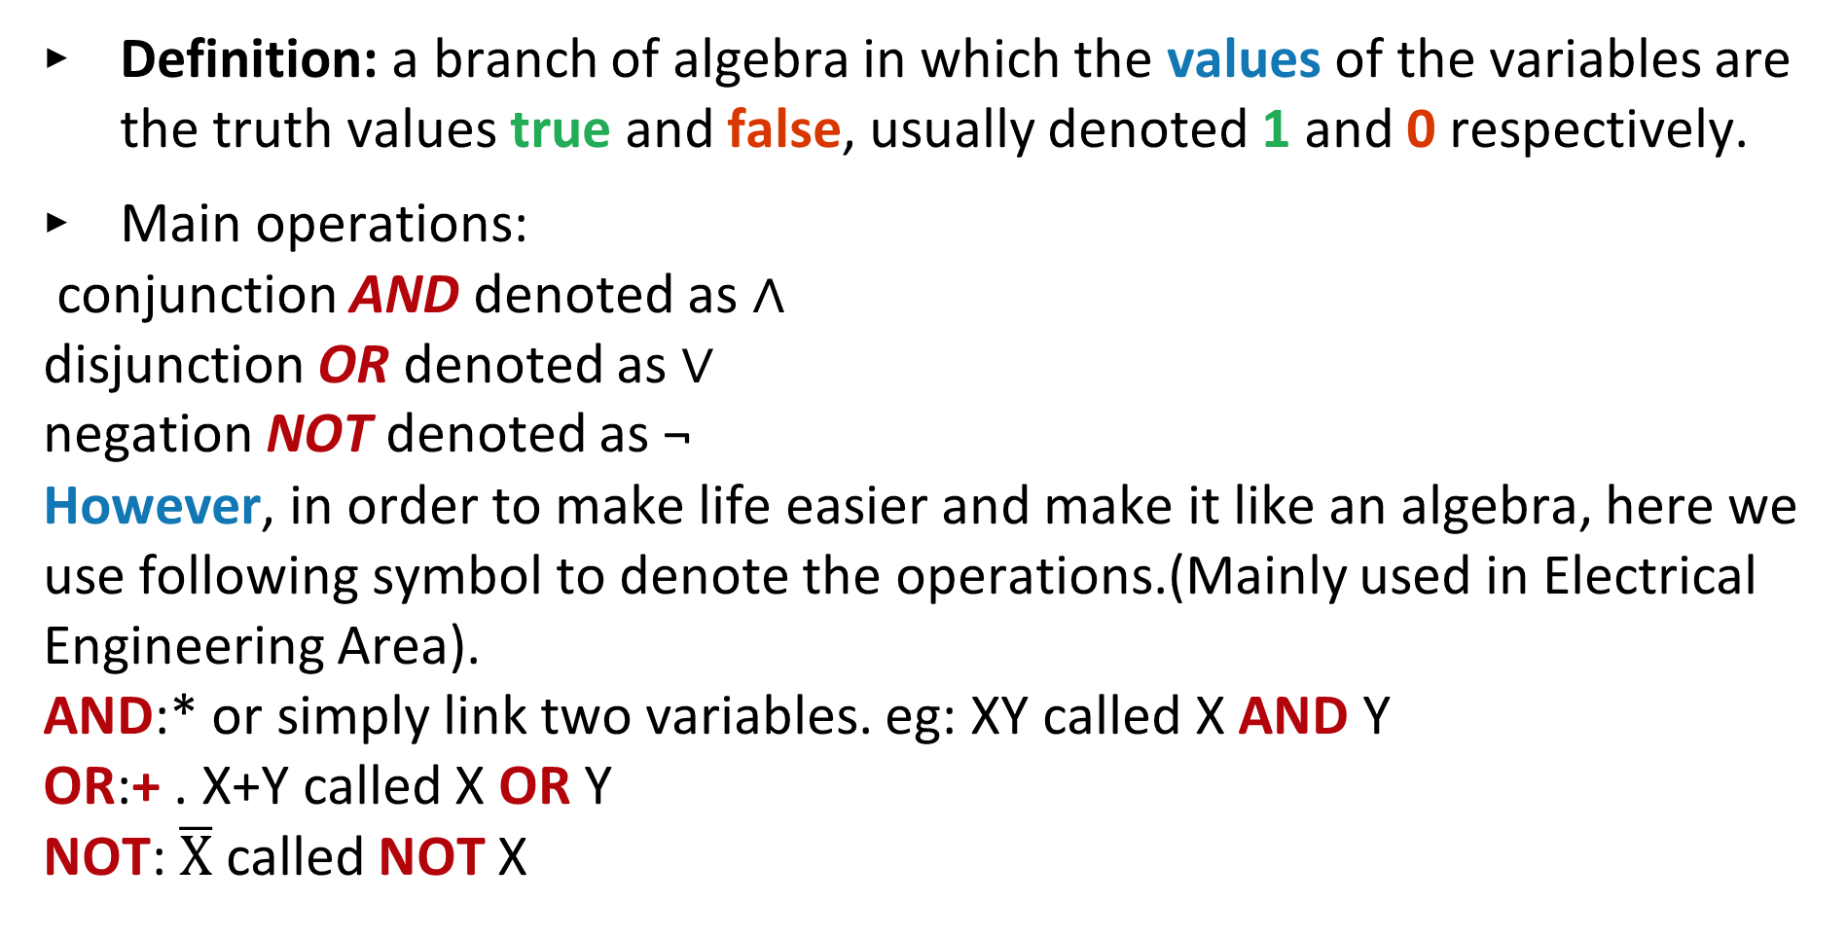
Boolean Algebra
Definition: a branch of algebra in which the values of the variables are the truth values true and false, usually denoted 1 and 0 respectively.
Main operations:
conjunction AND denoted as ∧
disjunction OR denoted as ∨
negation NOT denoted as ¬
However, in order to make life easier and make it like an algebra, here we use following symbol to denote the operations.(Mainly used in Electrical Engineering Area).
AND:* or simply link two variables. eg: XY called X AND Y
OR:+ . X+Y called X OR Y
NOT: $\overline{X}$ called NOT X

Slide 8
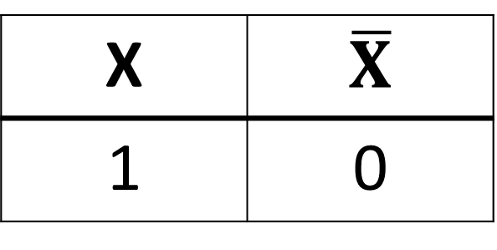
Truth table for main operation
X | Y | X+Y | XY
1 | 1 | 1 | 1
1 | 0 | 1 | 0
0 | 1 | 1 | 0
0 | 0 | 0 | 0
X | $$\overline{X}$$
1 | 0
0
1

Slide 9
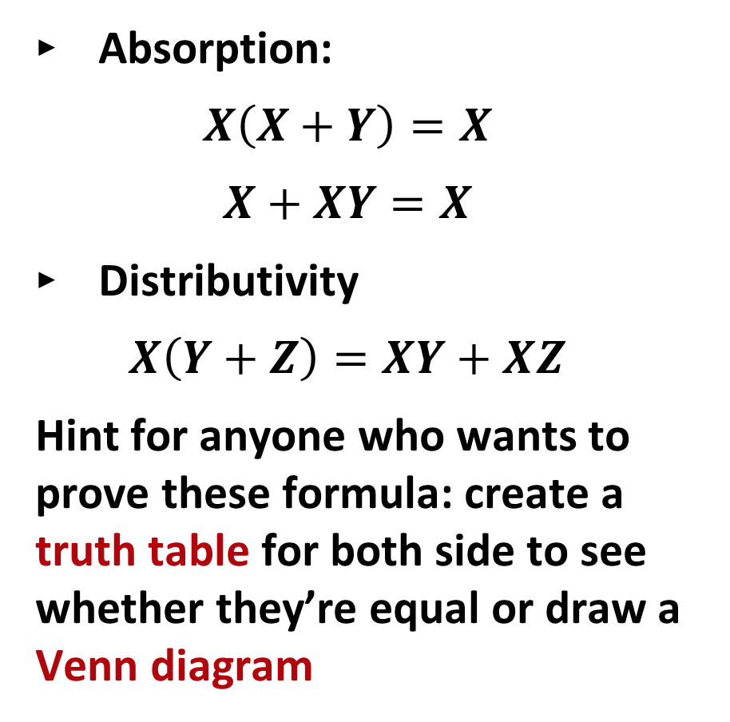
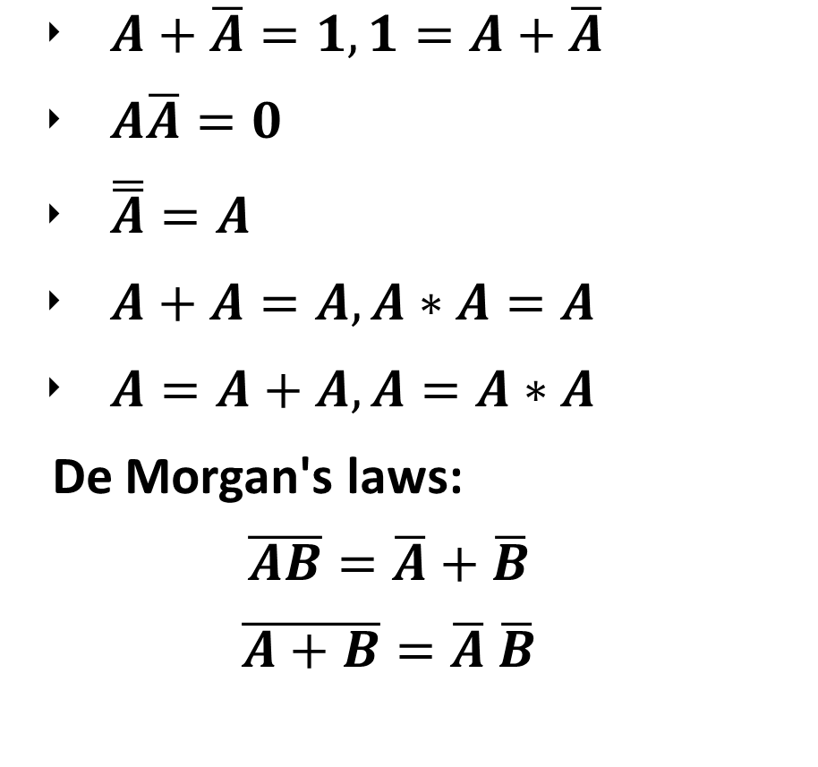
Some useful formulas
$A+\overline{A}=1,1=A+\overline{A}$
$A\overline{A}=0$
$\overline{\overline{A}}=A$
$A+A=A, A∗A=A$
$A=A+A, A=A∗A$
De Morgan's laws:
$$\overline{AB}=\overline{A}+\overline{B}$$
$$\overline{A+B}=\overline{A} \overline{B}$$
Absorption:
$$X\left(X+Y\right)=X$$
$$X+XY=X$$
Distributivity
$$X\left(Y+Z\right)=XY+XZ$$
Hint for anyone who wants to prove these formula: create a truth table for both side to see whether they’re equal or draw a Venn diagram

Slide 10
Logical operator in C++
AND: && , eg: X&&Y
OR: ||, eg: X||Y
NOT: !, eg: !X

Slide 11
Relational and comparison operators ( ==, !=, >, <, >=, <= )
operator | description
==(it’s different from =) | Equal to(don’t confuse it with assignment!!!)
!= | Not equal to
< | Less than
> | Greater than
<= | Less than or equal to
>= | Greater than or equal to

Slide 12
Selection statements: if and else
The if keyword is used to execute a statement or block, if, and only if, a condition is fulfilled. Its syntax is:
if (condition) statement

Slide 13
int a =1;
if (a==1)
cout << a+1;
if (a!=2)
{
a++;
cout<< a+2;
}
condition(no semicolon here)
statement(s)

Slide 14
else statement
Selection statements with if can also specify what happens when the condition is not fulfilled, by using the else keyword to introduce an alternative statement. Its syntax is:
if (condition) statement1 else statement2

Slide 15
if (x == 100)
cout << "x is 100";
else
cout << "x is not 100";

Slide 16
else if(condition) statement
if (x > 0)
cout << "x is positive";
else if (x < 0)
cout << "x is negative";
else if……
else
cout << "x is 0";

Slide 17
switch statement
The syntax of the switch statement is a bit peculiar.
Its purpose is to check for a value among a number of possible constant expressions.
It is something similar to concatenating if-else statements, but limited to constant expressions. Its most typical syntax is:
switch(expression)
{
case 1:
{ ……}
case 2:
{ …… }
case 3:
{……}
default:
………//default statement
}

Slide 18
example
int a;
switch (a%2)
{ case 0:
cout<<“a is an even number”;
break;// break is to jump out of this block, or it might go through all the cases, eg a=2 will
gothrough case 0 and default case.
case 1:
cout<< “a is an odd number”;
break;
default: // if expression doesn’t fulfill any of the constant above, it will run default case.
cout<<“a is not an integer”;
break;
}

Slide 19
Lab time!!!!

