Slide 1
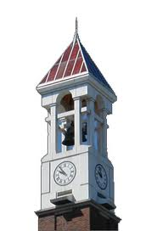


CIT Summer Course
BOOLEAN Algebra
Huyunting Huang
Master Student of CIT
© by INSTRUCTOR FULL NAME. All rights reserved. This presentation may not be duplicated or transmitted, in part or in whole, without the express written permission of the author.

Slide 2
Today' topic
1, Binary System
2, Boolean Algebra(Proposition, and, or, not)
3, conditional statement (if/else, switch/case)
4, Lab time

Slide 3
Binary System
Instead of decimal system, computer use binary system as its math fundamentals.
The Binary system use only 2 numbers: 0 & 1, which can represent 2 states of a system eg: Open/close, true/false, up/down, etc.

Slide 4
counting binary number
The binary number will carry every two steps

