Slide 1



CIT Summer Course
Midterm Review
Huyunting Huang
Master Student of CIT
© July 26, 2018 by INSTRUCTOR FULL NAME. All rights reserved. This presentation may not be duplicated or transmitted, in part or in whole, without the express written permission of the author.

Slide 2
Today' topic
1, Review of midterm
2, Lab time

Slide 3
Comment about C# and C++
1, For C#, the only difference for a beginner is the structure of a program: C# begins directly from the class & object which is the key concept of object-oriented programming, while for C++ it start from the function and gradually move into the area of object-oriented programming after you can figure out those basic knowledge(which is what C++ created for.).
2, The basic knowledge in programming like data type(int, float….), operator(+=,&&,++,||), namespace, variable(int a, float b,etc.), expression(a=3/2,a++,etc.), programming structure(if, switch, for, while), pointer,etc are almost the same. And they’ve already been put in the previous lecture.

Slide 4
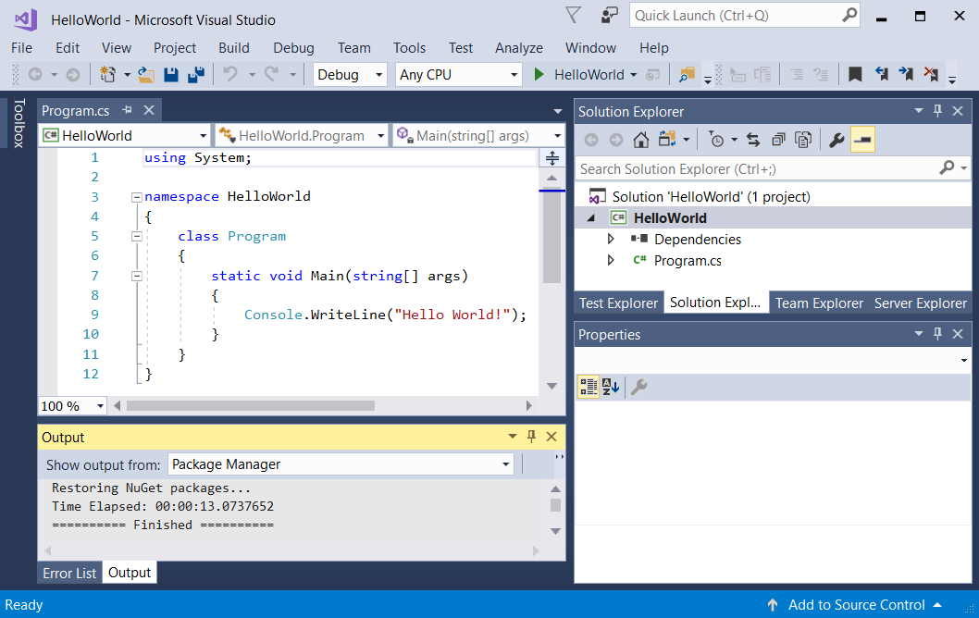

Slide 5
Midterm Review
Average :30.6
Highest Score:79
Lowest score:0
PS: If you think there’s something wrong in your grade, come and ask me to recheck.

Slide 6
Comment about your exam
1, Some problems (problem 2 (b), problem 4) are exactly the same problems in the assignment/lab. And if you didn’t individually finish those lab/homework, the solutions are already posted in webpage. I can see no reason why some of your grades are lower than 30.
2, If you spent 1~2 hours reading the materials carefully (read and ask for help if don’t understand.) per week and finished the assignment by yourself instead of simply copying others, your score is expected to be at least 60.

Slide 7
Part of the solution
Problem 1:
(1)
4
4
1
1
1
(2)(be careful about the boundary condition and how to count an array)
1
4
9
16
the value of a[i] is larger than 9
(3)
4
7
1
-2
1
7
4
(4)
dog
cow
cat

Slide 8
Problem 2: Read lecture 4 and lecture 8.
Problem 4: Read solution for lab6(in the code file). It’s just the function arraysort with different name.
And in order to force you to do some reading:
Problem 5 will be your today’s lab as a practice of for loop( in lecture 5), switch(or if) structure(in lecture 4) and the operation of vector(in lecture 7).
PS: reading the requirement and code from others are also the required skills for programmers.

Slide 9
Lab time!

