Slide 1
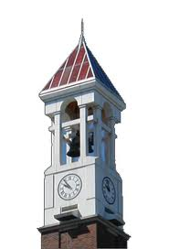


CIT Summer Course
Review
Huyunting Huang
Master Student of CIT
© July 18, 2018 by INSTRUCTOR FULL NAME. All rights reserved. This presentation may not be duplicated or transmitted, in part or in whole, without the express written permission of the author.

Slide 2
Today' topic
1, Review of assignment
2, Lab time

Slide 3
Honesty Policy
Please don’t plagiarize your partner’s work.
In your next assignment, the plagiarization will result in zero point of both of your homework.
If you don’t know how to do your homework, email me(reply within 24 hours) or ask me at office hour for hint.

Slide 4
How I grade your assignment
problem 1: 0.6 point in each part.
(1) (2) (4) : the value is correct will get full grade(0.6), wrong value will result in zero.
(3): lack of decimal point: zero
(5): The value of final step is correct: half value(0.3), all the value is correct (0.6)
problem 2: 1.5 for (1), 1.5 for (2),
(1), 0.375 each part, the process is correct (0.25), the answer is correct (0.125) PS: for decimal to binary, wrong order will result in 0.
(2), 0.5 each, the process is right(0.5)

Slide 5
Data type and operator
The written style:
int a = 2;
double b=a;
cout<< b //the result is 2.0, the decimal point matters!
cut off:
double a= 2.3;
int b=a;
cout << b; //the result is 2.0, the fraction part will be ignored
/ and %:
int a=3/2;
int b=5%3;
cout <<a<<b;// the result will be 1 and 2.

Slide 6
About assignment operator =
1, The value of left variable will be updated immediately by the expression of its right side.
2, It’s different from equivalent comparing operator ==
3, Read the lecture 2 if you forget the meaning of +=, -=, etc.

Slide 7

Binary and decimal number
convert binary to decimal:
${(1001001)}_{2}=1∗2^{6}+1∗2^{3}+1∗2^{0}=73$
convert decimal to binary

Slide 8
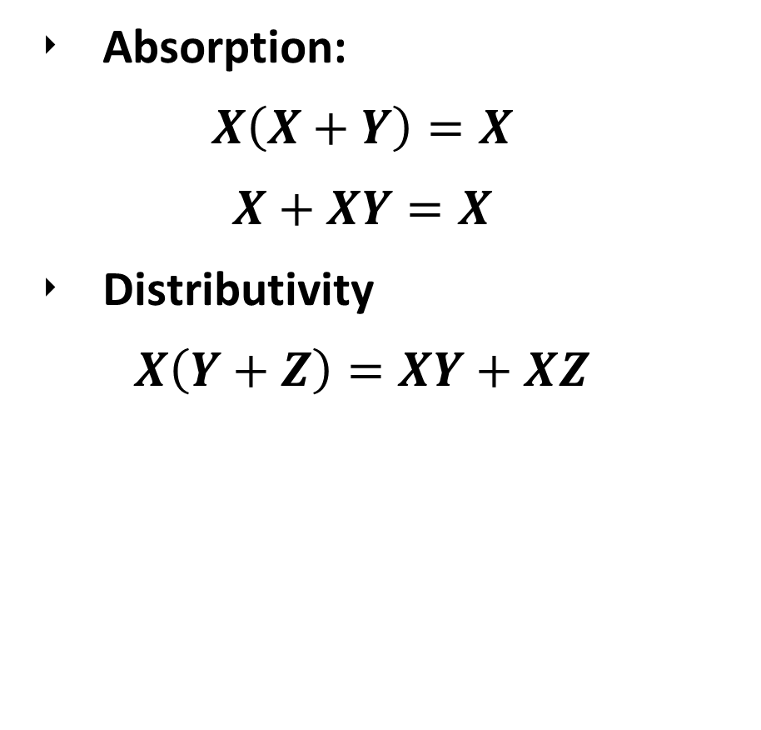
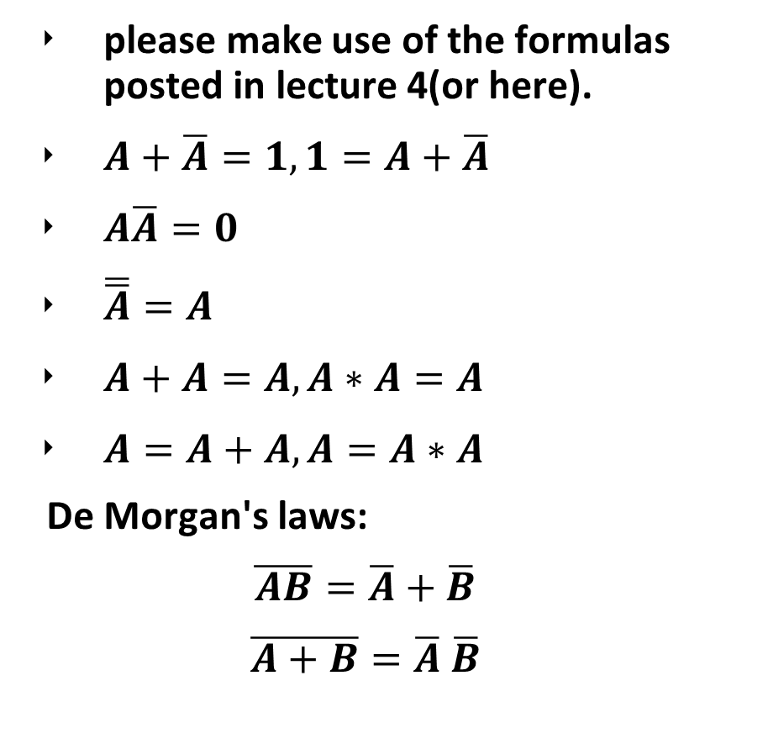
Boolean Algebra:
please make use of the formulas posted in lecture 4(or here).
$A+\overline{A}=1,1=A+\overline{A}$
$A\overline{A}=0$
$\overline{\overline{A}}=A$
$A+A=A, A∗A=A$
$A=A+A, A=A∗A$
De Morgan's laws:
$$\overline{AB}=\overline{A}+\overline{B}$$
$$\overline{A+B}=\overline{A} \overline{B}$$
Absorption:
$$X\left(X+Y\right)=X$$
$$X+XY=X$$
Distributivity
$$X\left(Y+Z\right)=XY+XZ$$

Slide 9
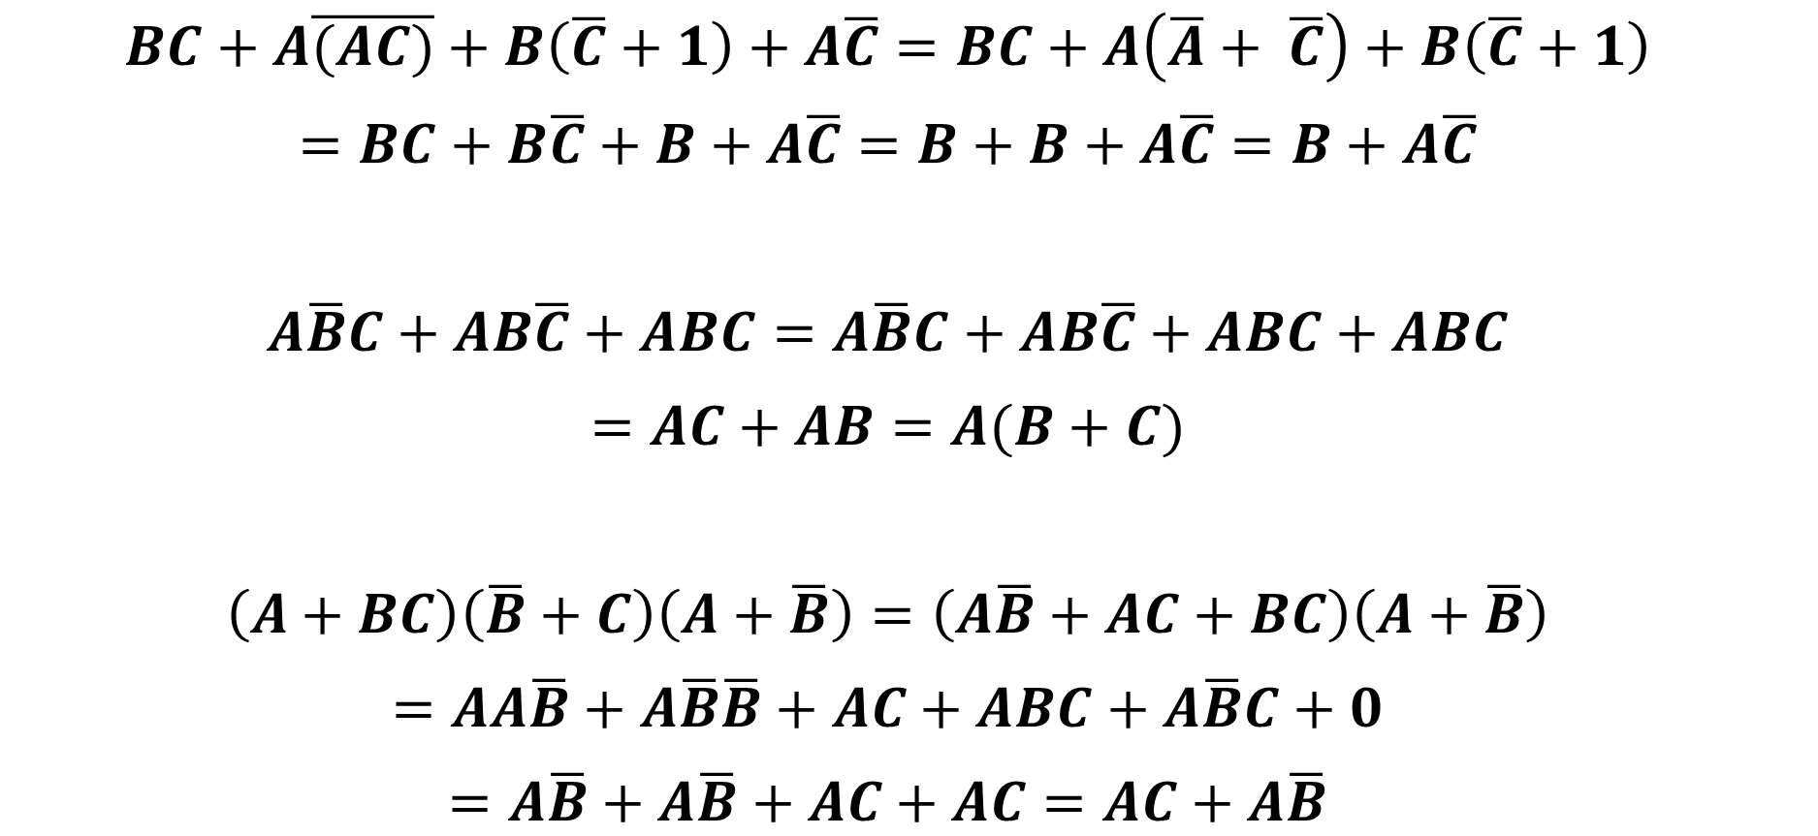
How to do the part II of problem 2
$$BC+A\overline{(AC)}+B\left(\overline{C}+1\right)+A\overline{C}=BC+A\left(\overline{A}+ \overline{C}\right)+B\left(\overline{C}+1\right)$$
$$=BC+B\overline{C}+B+A\overline{C}=B+B+A\overline{C}=B+A\overline{C}$$
$$A\overline{B}C+AB\overline{C}+ABC=A\overline{B}C+AB\overline{C}+ABC+ABC$$
$$=AC+AB=A(B+C)$$
$$\left(A+BC\right)\left(\overline{B}+C\right)\left(A+\overline{B}\right)=\left(A\overline{B}+AC+BC\right)\left(A+\overline{B}\right)$$
$$=AA\overline{B}+A\overline{B}\overline{B}+AC+ABC+A\overline{B}C+0$$
$$=A\overline{B}+A\overline{B}+AC+AC=AC+A\overline{B}$$

Slide 10
How to read and write code?
C++ is a high level programing language and is highly readable.
1, So it’s similar to writing book. You need to know what do you mean and what’s you purpose in each line of your code.
2, Using the way of analogy will be very helpful:
You can first think how you can solve the problem, what’s the process of your solution, then try to translate those process to code.

Slide 11
An example: sort an array by hand
To sort an array make it in small to big order, if we want to do it by hand, the most obvious way is:
1, go through all the array and find the smallest number, put it in the first position. (so in your program, you need to compare the values of 1st element and other one by one and change their value if 1st is larger)
2, go through the rest of the array, find the 2nd smallest number, put it in the 2nd position.
……
final step: put the last number(which is also the largest) in the last position.

Slide 12
Lab time

