Slide 1
Height
3D distance
2D distance
XY distance
Start point
End point

Slide 2
STEP 1
Historical crime incidence
Street-level crime risk
STEP 3
Optimised location of drone base stations
(under differing distance metrics)
Finalised drone base stations
Settings (number of drones, base stations, potential sites)
STEP 2

Slide 3
Historical crime incidence
Street-level crime risk

Slide 4
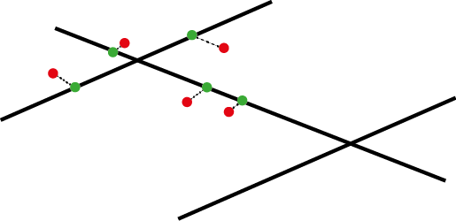
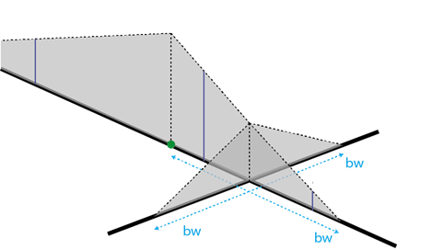
(a)
(b)

